Slide 1
MEDTRACK_DV | EXECUTIVE BRIEF
Hospital Performance Intelligence System
Enterprise Operational & Clinical Care Analytics
1,000
4
52
6,552
Inpatient admissions
Core clinical services
Operational weeks
Staff shifts
Python ETL (Star Schema) + Tableau Interactive Storyboard
Notes:
Good morning. Today we present MedTrack, a complete performance intelligence system designed to tackle hospital overcrowding, resource saturation, and patient throughput bottlenecks. Objective: unify fragmented clinical, bed capacity, and human capital data into real-time executive intelligence. Scale: 1,000 admissions, 4 services, 52 weeks, 6,552 staff shifts.

Slide 2
Healthcare Bottlenecks: Capacity, Acuity, and Burnout
BED CRISIS
STAFF FATIGUE
THROUGHPUT LATENCY
90–93%
88.98%
3 silos
bed utilization vs. 85% safety threshold
clinical workforce stress index
rosters, movement logs, bed census
Utilization runs at 90.14%–92.70%, leaving no surge buffer.
Nurse saturation of 89.21% risks retention and care quality.
Isolated data blocked proactive capacity forecasting.
Takeaway: Above 85% occupancy there is no surge buffer; one flu spike means immediate Emergency gridlock.
Notes:
Operating above 85% bed occupancy leaves zero surge buffer. When clinical demand spikes during external events like flu season, emergency units face immediate gridlock. Scheduling rosters, patient movement logs, and bed censuses were isolated, preventing proactive capacity forecasting.

Slide 3
Foundational Engineering: Star Schema & Grain Isolation
patients.csv
1,000 admissions
Python ETL
Clean, validate, engineer features: 52 weeks, day-of-week, stay hours and days
Normalized Star Schema
Anti-Cartesian grain isolation: weekly logs and patient-level records never multiply metrics
➜
➜
services_weekly.csv
208 weekly service logs
staff_schedule.csv
6,552 shifts, 110 staff
0
99.8%+
100%
duplicate records
data completeness
referential integrity (ADM-, PAT-, MOV-, RES-)
Takeaway: Solving grain mismatch up front guarantees 100% aggregation integrity in every Tableau view.
Notes:
Before building visuals, we solved a fundamental data engineering trap: grain mismatch. In Milestone 1, we engineered dedicated analytical tables in Python to guarantee 100% aggregation integrity in Tableau. Source files: patients, services_weekly, staff_schedule, plus the 208-row hospital_insights_summary.

Slide 4
Storyboard Architecture: Seamless Arrow Navigation
TIER 1
TIER 2
TIER 3
Hospital Overview
Patient Flow & Quality
Resource & Utilization
Macro throughput, weekly demand, department intake
>
Movements, age mix, ALOS, event triggers
>
Bed saturation, workforce strain heatmaps
Next ( > ) opens Patient Flow
Back ( < ) to Overview; Next ( > ) to Resources
Back ( < ) to Patient Flow
Interactive action filtering: department selections cross-filter linked views while preserving narrative context.
Takeaway: One click moves leaders from volume to patient experience to frontline strain.
Notes:
Notice the black circular navigation buttons in the top headers. They allow hospital administrators to transition seamlessly between macro-level volume, patient experience, and frontline staff strain.

Slide 5
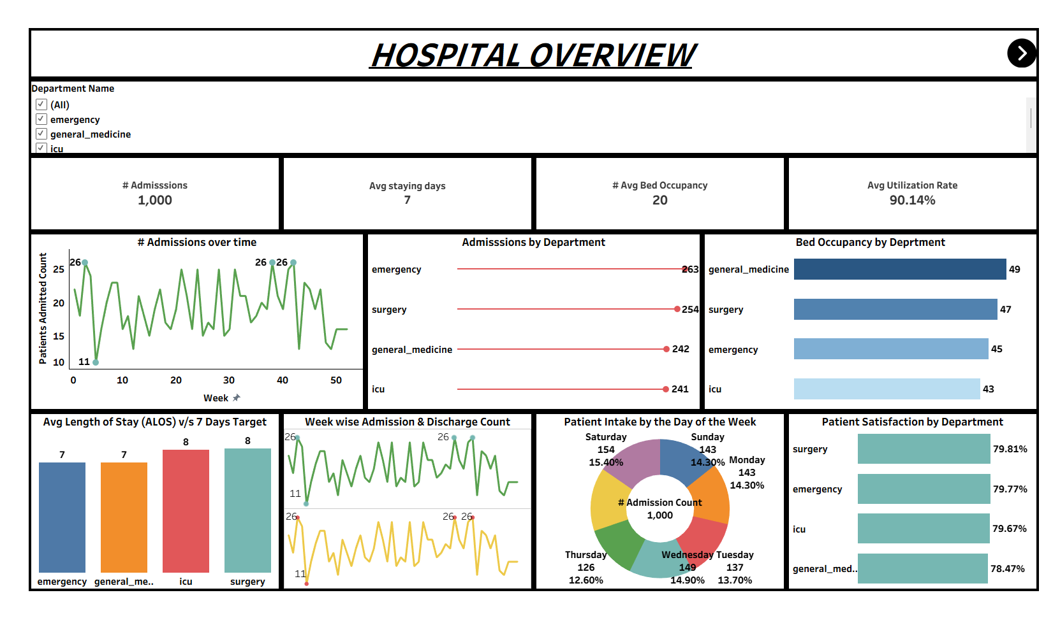
Executive Snapshot: High Demand Across Departments
1,000
7 days
Admissions
Average stay
20
90.14%
Avg bed occupancy
Utilization
Emergency (263) + Surgery (254) drive 51.7% of admissions
Saturday peaks at 15.4%; Sunday 14.3%
ICU and Surgery average 8 days vs. 7-day target
Satisfaction steady at 78.5%–79.8%
Takeaway: Satisfaction is stable, but occupancy is high and weekends are an operational spike.
Notes:
Dashboard 1 gives leadership an immediate operational pulse. Even though satisfaction remains stable at about 79%, occupancy is high, and weekend admissions represent an operational spike. Emergency 263, Surgery 254, General Medicine 242, ICU 241.

Slide 6
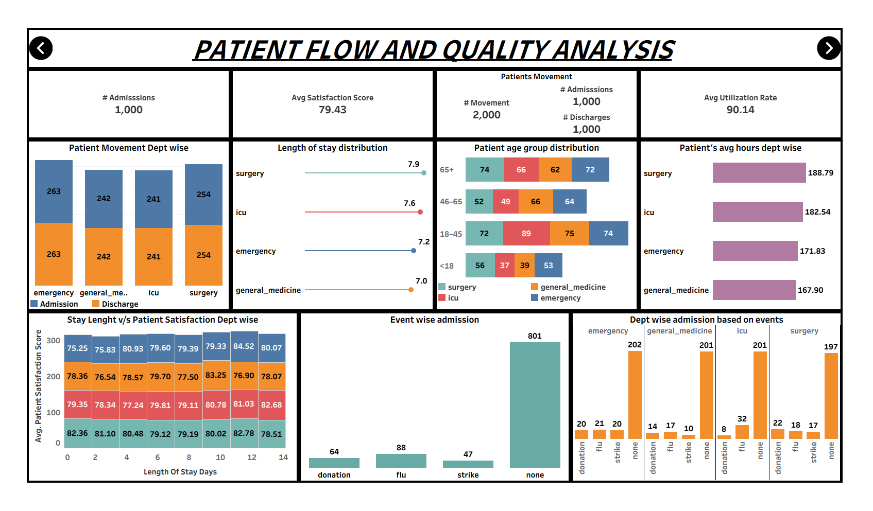
Inpatient Journey: Acuity, Demographics & Events
2,000
79.43
Total movements
Avg satisfaction
1,000 in, 1,000 out: admissions match discharges
Surgery stays 188.79 hrs (7.9 d); ICU 182.54 hrs (7.6 d)
Ages 18–45 (310) and 65+ (274) dominate volume
Flu: 88 admissions, incl. ICU (32) and Emergency (21)
Donation drives: 64; strikes: 47; baseline: 801
Takeaway: Surgery and ICU consume the most clinical hours; flu events concentrate pressure on critical care.
Notes:
Dashboard 2 shifts focus to clinical operations. Surgery and ICU demand the highest clinical hours per patient. Admissions and discharges balance 1:1 in every department. The event breakdown shows how external shocks like flu outbreaks concentrate pressure on emergency and intensive care.

Slide 7
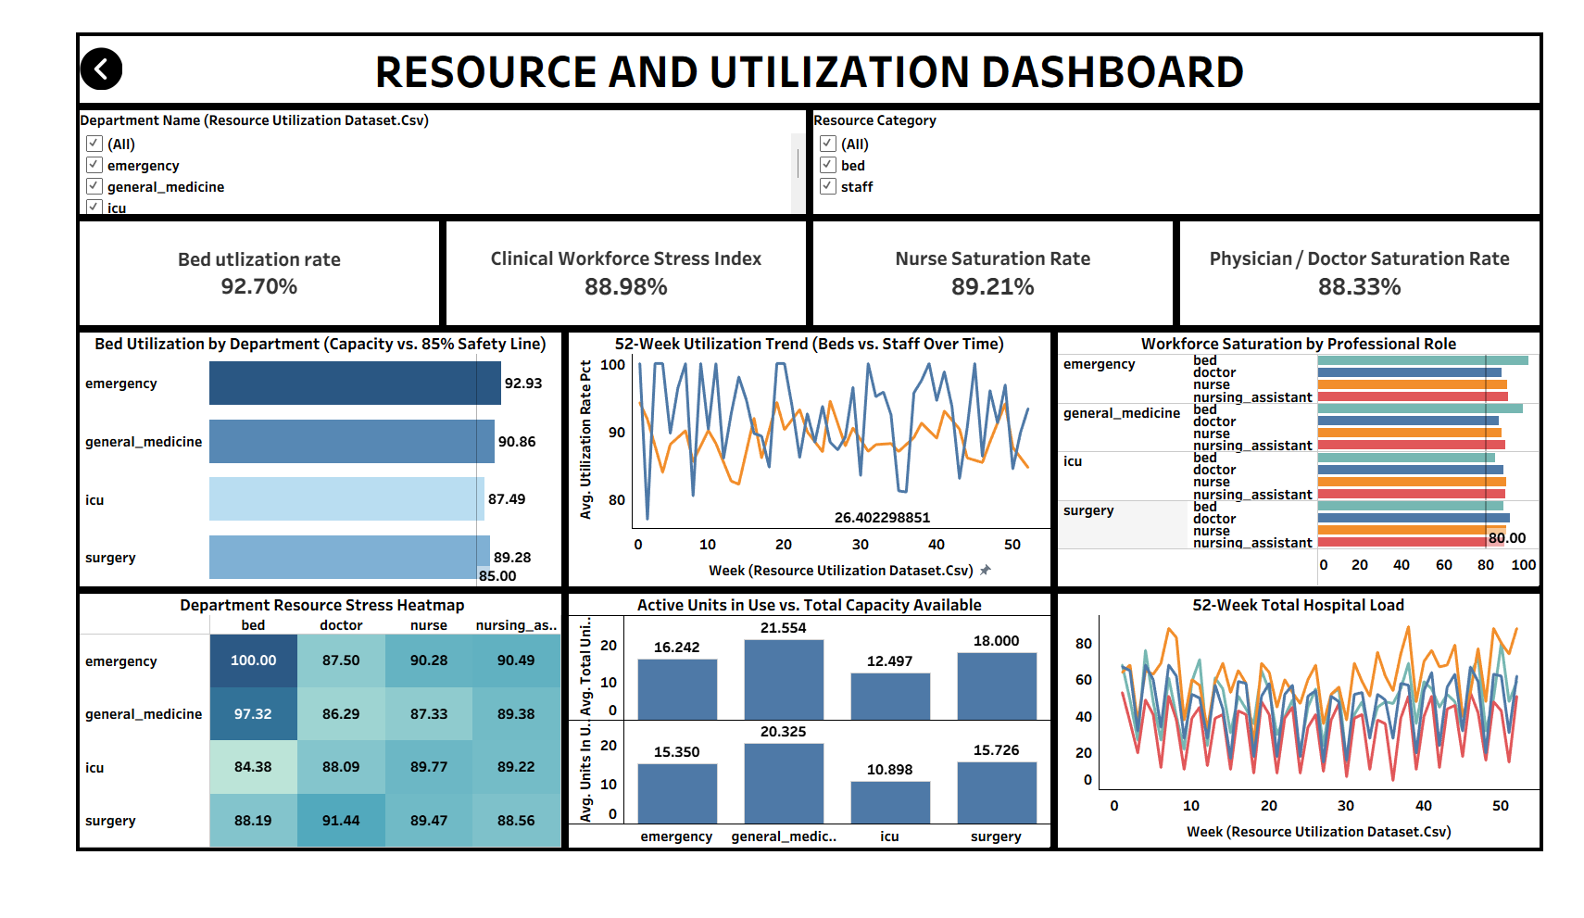
Capacity Constraints: Bed Saturation & Staffing Strain
92.70%
88.98%
Bed utilization
Workforce stress
89.21%
88.33%
Nurse saturation
Physician saturation
Emergency beds hit 100%; Emergency nurses 90.28%
Bed use by dept: Emergency 92.93%, Gen Med 90.86%, Surgery 89.28%, ICU 87.49%
Takeaway: Every department runs above the 85% safety line, with no decompression cycles across 52 weeks.
Notes:
This is our most critical operational finding. Every single department is operating above the 85% safety line. Emergency is running at full capacity, and nursing staff are under sustained stress year-round. Beds and staff utilization move in tandem across the 52-week trend.

Slide 8
Cross-Departmental Comparison: Throughput vs. Strain
Department | Admissions | ALOS (days) | Bed util. | Nurse stress | Satisfaction | Status
Emergency | 263 | 7.2 | 92.93% | 90.28% | 79.77% | Critical Overflow
General Medicine | 242 | 7.0 | 90.86% | 87.33% | 78.47% | High Saturation
Surgery | 254 | 7.9 | 89.28% | 89.47% | 79.81% | Capacity Bound
ICU | 241 | 7.6 | 87.49% | 89.77% | 79.67% | Acuity Constrained
Emergency is the primary bottleneck: high intake and maximum resource saturation
Surgery and ICU hold beds longest (ALOS near 8 days), restricting upstream discharges
Takeaway: Long Surgery/ICU stays block Emergency transfers, driving boarding and diversions.
Notes:
When ICU and Surgery beds are occupied longer than benchmarked, Emergency cannot transfer patients, creating ambulance diversions and hallway boarding.

Slide 9
Data-Driven Interventions for Executive Leadership
1
IMMEDIATE | Days 1–30
2
MID-TERM | Days 31–90
3
STRATEGIC | Q3–Q4
Dynamic Nurse Float Pool
Rapid Discharge Rounds
Predictive Surge Scheduling
Deploy flexible nurses to Emergency and ICU Friday–Sunday to absorb weekend surges (Saturday intake 15.4%).
Structured morning discharge rounds in Surgery and General Medicine to cut ALOS from 7.9 toward the 7.0-day target and free beds before afternoon intake.
Feed flu and event surveillance into the automated roster to scale beds and physicians before surges hit.
Takeaway: Cutting ALOS by 0.5–0.9 days in Surgery and ICU can bring occupancy back under 85% without new construction.
Notes:
By addressing the weekend intake surge and reducing ALOS by just 0.5 to 0.9 days in Surgery and ICU, hospital bed occupancy should drop back toward the 85% safety line without requiring new construction.

Slide 10
Summary: Driving Value Through Healthcare Analytics
Reproducible Python ETL
Validated KPI Framework
Interactive 3-Tier Storyboard
Milestone 1: automated star schema generation
Milestone 2: 9 standard and novel metrics
Synchronized navigation and role-based operational insights
MedTrack transforms static healthcare reporting into proactive, actionable operational intelligence.
Live workbook: https://public.tableau.com/app/profile/vikram.simha.m.k/viz/Infosys_17914708025670/
Notes:
Thank you. The pipeline is fully validated and documented across both Milestone 1 and Milestone 2. We welcome any questions.

