Slide 1

SMART ENERGY CONSUMPTION ANALYSIS AND PREDICTION USING MACHINE LEARNING
Presenting by
Harshani Talari

Slide 2
Project Overview
This project focuses on analyzing and forecasting device-level energy consumption using Machine Learning and Deep Learning models. The system monitors historical power usage data, identifies patterns, predicts future energy consumption, and provides an interactive web-based dashboard.
The solution integrates:
· Data preprocessing pipeline
· Linear Regression baseline model
· LSTM deep learning model
· Flask-based web application
· HTML/CSS/JavaScript frontend

Slide 3
Technology Stack
· Python
· Pandas, NumPy
· Scikit-learn
· TensorFlow / Keras
· Flask
· HTML, CSS, JavaScript
· Matplotlib
System Workflow
1. Data Collection
2. Data Cleaning & Preprocessing
3. Feature Engineering
4. Baseline Model (Linear Regression)
5. LSTM Model Development
6. Model Evaluation
7. Model Saving & Integration
8. Web Application Deployment

Slide 4
Backend Implementation (Flask)
File: app.py
Key Functionalities:
· Loads dataset (final_data.csv)
· Recreates MinMaxScaler
· Recreates LSTM architecture
· Loads trained weights
· Accepts 24 hourly values
· Returns predicted energy consumption
API Endpoints:
· / → Home page
· /predict → Accepts JSON input and returns prediction

Slide 5
Frontend Implementation
base.html
home.html
dashboard.html
prediction.html
device.html
Features:
· Clean responsive UI
· Input validation (exactly 24 values)
· AJAX fetch call to Flask API
· Displays:
1. Prediction result
2. Error messages

Slide 6
Final Output of System
✔ Energy consumption analysis
✔ Time-based aggregation
✔ Graph visualization
✔ Energy prediction
✔ Clean dashboard interface

Slide 7
Final Project Architecture
User
↓
Upload CSV
↓
Flask Server
↓
Pandas Processing
↓
Resampling & Aggregation
↓
Prediction Calculation
↓
Send Data to HTML
↓
Display Dashboard + Graph

Slide 8
Results & Achievements
  Developed smart energy dashboard
  Implemented time-based energy analysis
  Integrated prediction module
  Enabled CSV upload & visualization
  Built complete Flask-based web application

Slide 9
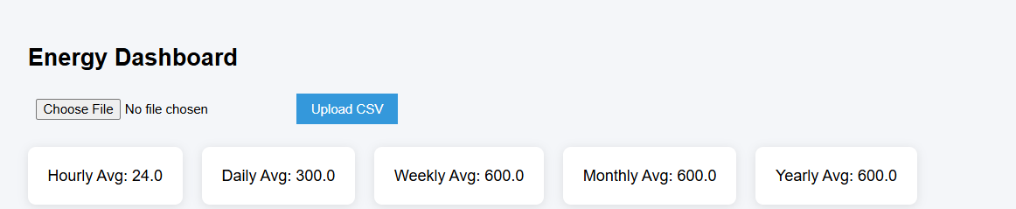
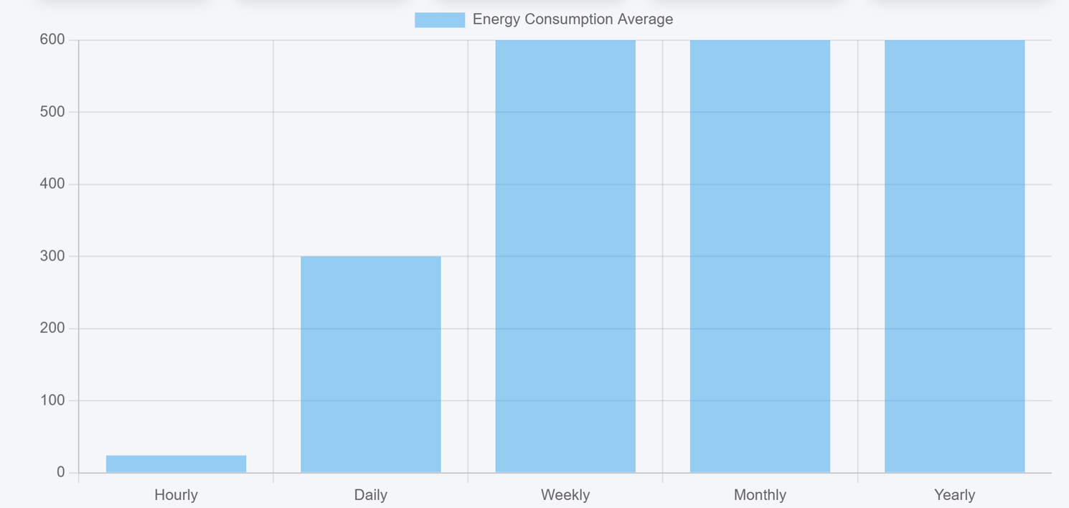
User Interface

Slide 10
Q & A

Slide 11
THANK YOU

