Slide 1
TEAM
SOCIALPILOT
Vaishnavi Yerramilli
Social Media Scheduler & Campaign Management Platform
Team Lead • Core Integration • Dashboard • Deployment • Testing
GROUP PROJECT PRESENTATION
Lakshmi Supriya
Authentication • User Management • Notifications
A centralized workspace for content, scheduling, campaigns, analytics and reporting.
Jaya Durga
Campaign Management • Content Scheduling • Scheduler
Sowjanya
Social Accounts • Mock OAuth • UI/UX
Susmitha
Analytics • Reports • Visualization
1

Slide 2
Project Overview & Proposed Solution
Problem → centralized solution
Problem
Managing multiple social channels, campaigns, schedules and performance data can become fragmented and time-consuming.
Solution
SocialPilot brings social accounts, content, scheduling, campaigns, analytics, reports and notifications into one user-scoped workspace.
Login
→
Dashboard
→
Accounts
→
Content
→
Schedule
→
Campaigns
→
Analytics
→
Reports
SocialPilot | Group Project
2

Slide 3
Technology Stack — Why & How
Only the technologies used by SocialPilot
Technology
Why
How
React.js
Reusable component architecture
Pages, dashboard and reusable UI components
Vite
Fast frontend development
Development server and production build
Tailwind CSS
Responsive styling
Consistent application UI
FastAPI
Lightweight Python API framework
REST endpoints and backend logic
SQLAlchemy
ORM abstraction
Models and database queries
JWT
Stateless authentication
Protected API requests
Axios
Frontend/API communication
Calls FastAPI endpoints
PostgreSQL / Supabase
Production persistence
Application data storage
Vercel / Render
Cloud deployment
Frontend / backend hosting
Git / GitHub
Version control
Branches, commits and collaboration
SocialPilot | Group Project
3

Slide 4
System Architecture & Database
How the application layers work together
→
→
FastAPI
JWT + Logic
SQLAlchemy
PostgreSQL
User
React + Vite
Axios / REST
→
→
→
→
Architecture
Core Database Entities
Frontend handles pages and UI state. Axios communicates with FastAPI. FastAPI validates requests, authenticates users and runs business logic. SQLAlchemy persists data in the relational database.
User → SocialAccount User → Campaign → Post Post → Analytics User → Notifications All user-owned records are filtered using authenticated user_id.
Local development: SQLite • Production: PostgreSQL / Supabase
SocialPilot | Group Project
4

Slide 5
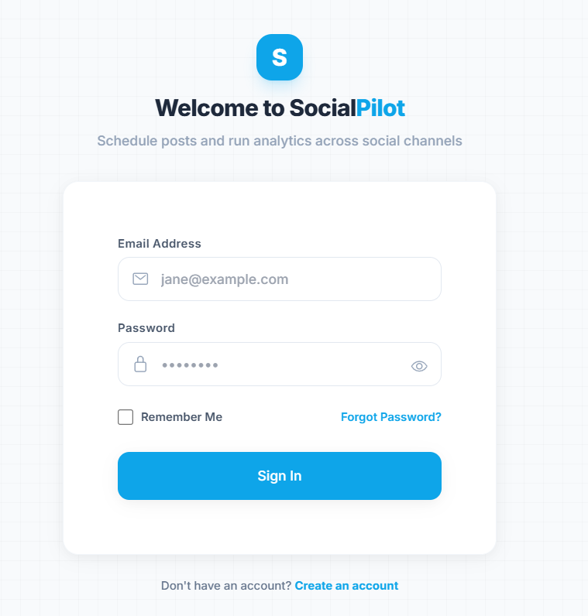
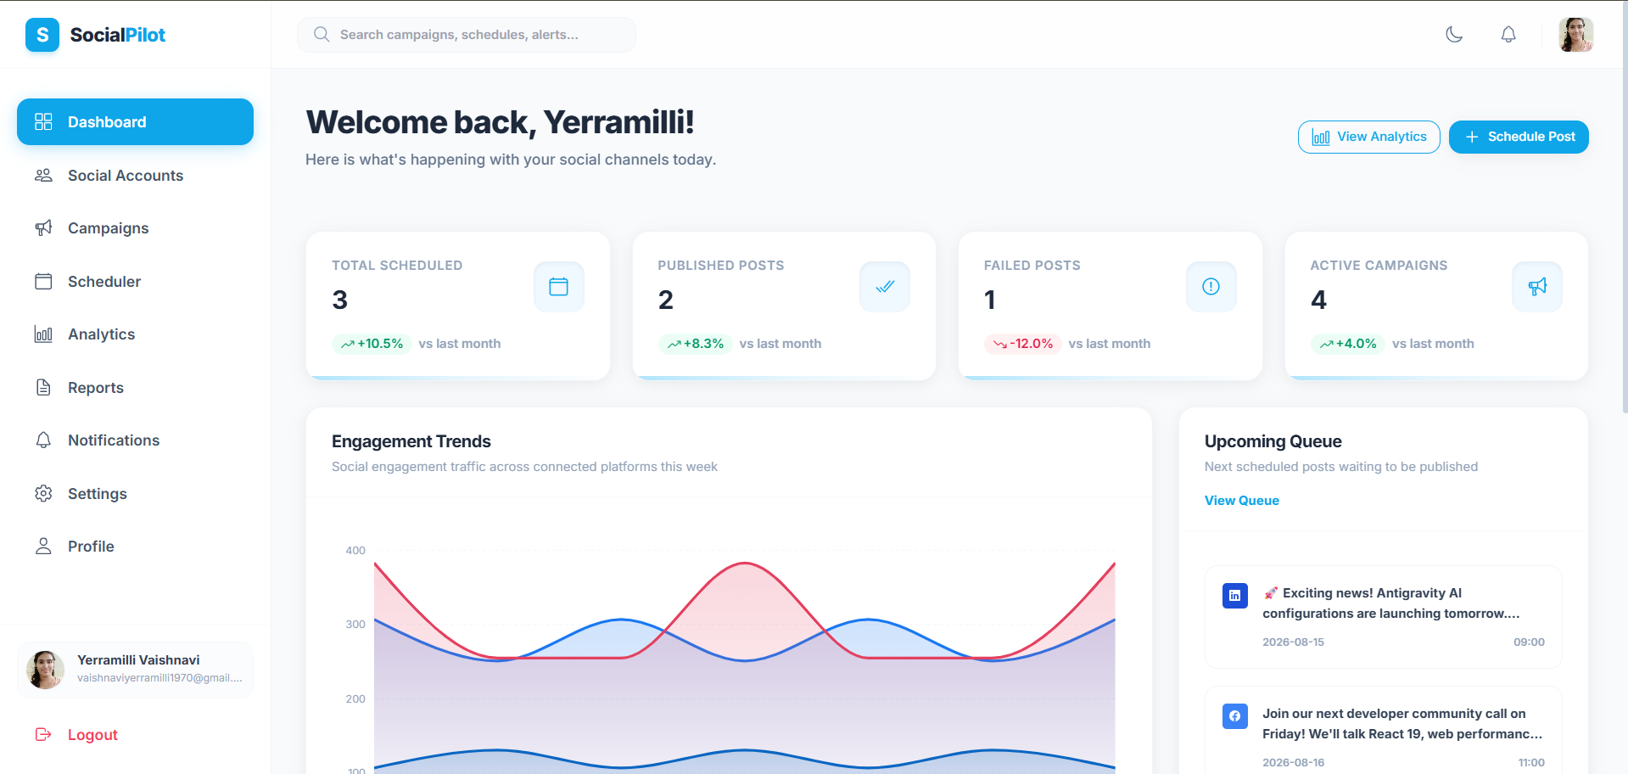
Authentication & Dashboard
Two core entry-point modules
What it does
What it does
Registration, login, profile management and protected access identify the current user.
Central overview of accounts, campaigns, posts and scheduled activity.
How it is implemented
How it is implemented
React forms → FastAPI auth → bcrypt password hashing → JWT → protected endpoints.
Dashboard components request aggregated data through Axios; FastAPI returns user-scoped statistics.
Original registration UI
Original dashboard UI
SocialPilot | Group Project
5
5

Slide 6
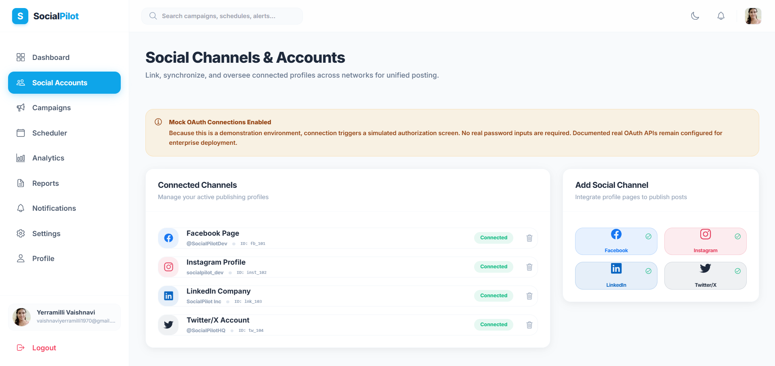
Social Accounts & Content Management
Connect channels and manage content
What it does
What it does
View, connect and disconnect social accounts in one place.
Create and manage content that can be linked to campaigns and scheduled.
How it is implemented
How it is implemented
SocialAccounts UI → FastAPI social-account endpoints → social_accounts table. Current connection is Mock OAuth / demo flow.
React form → Axios → FastAPI → SQLAlchemy → posts table.
Original social accounts UI
SocialPilot | Group Project
6
6

Slide 7
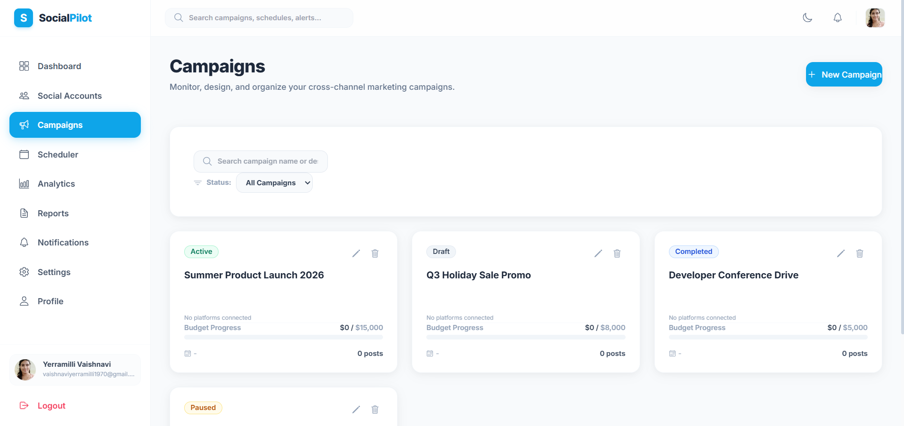
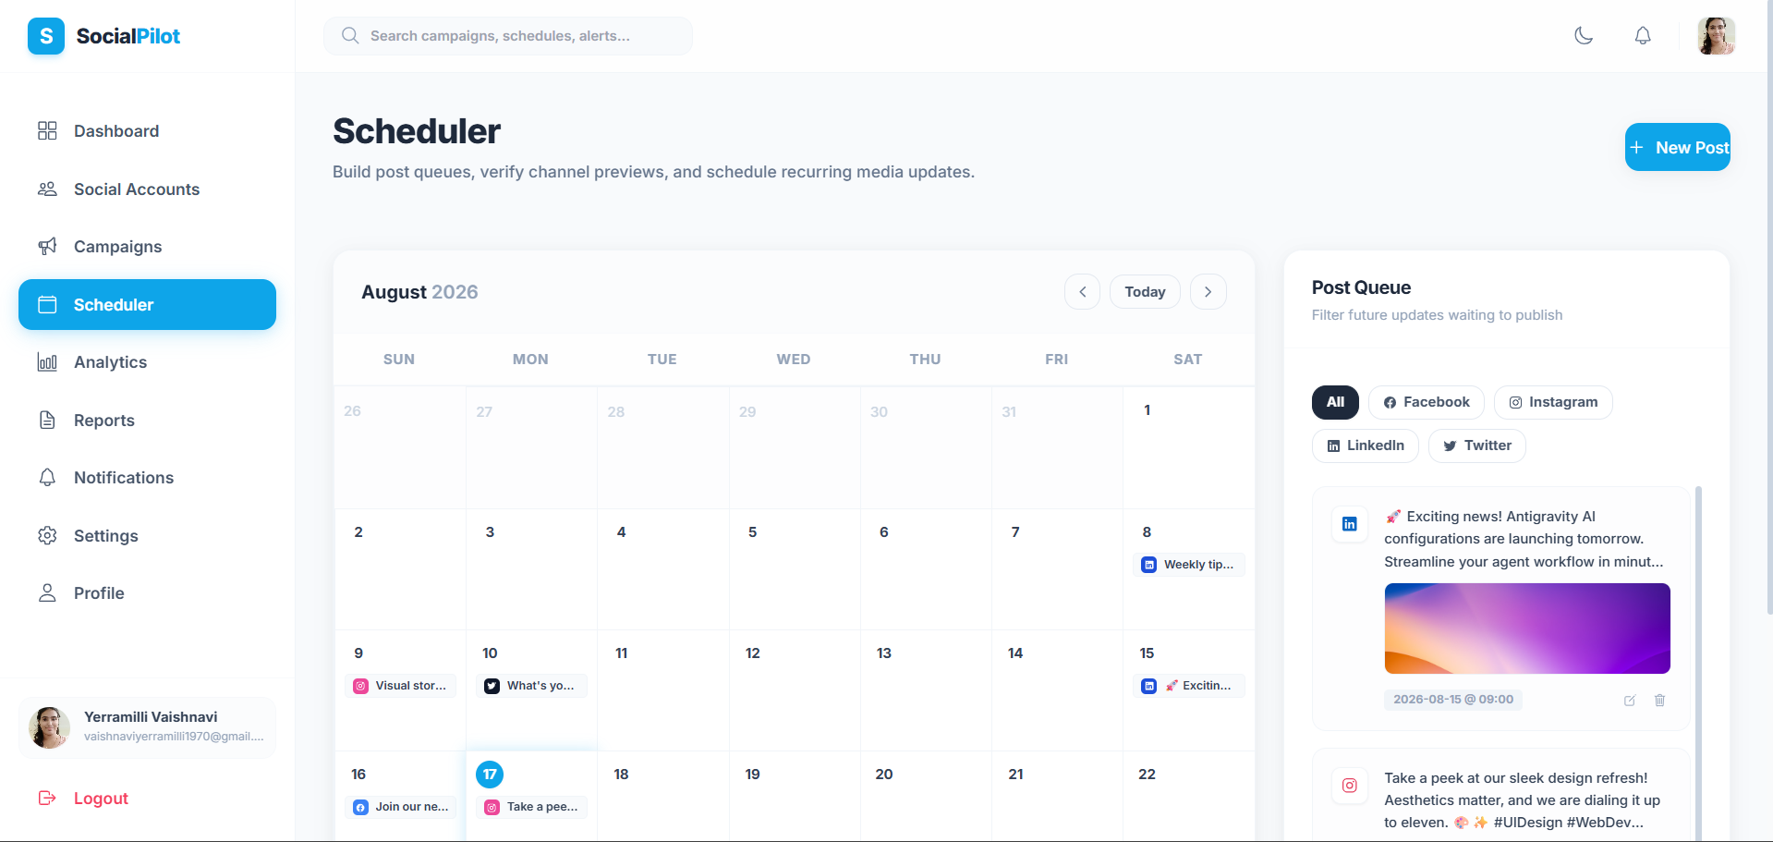
Scheduler & Campaign Management
Plan content and organize campaigns
What it does
What it does
Choose date/time, view scheduled posts and manage scheduling status.
Create, view, update and delete campaigns and associate related content.
How it is implemented
How it is implemented
Scheduler + Calendar UI → scheduler API → normalized dates → posts table. Publishing is simulated; no live social API call.
Campaign UI → campaign service → FastAPI → SQLAlchemy → campaigns table.
SocialPilot | Group Project
7
7

Slide 8
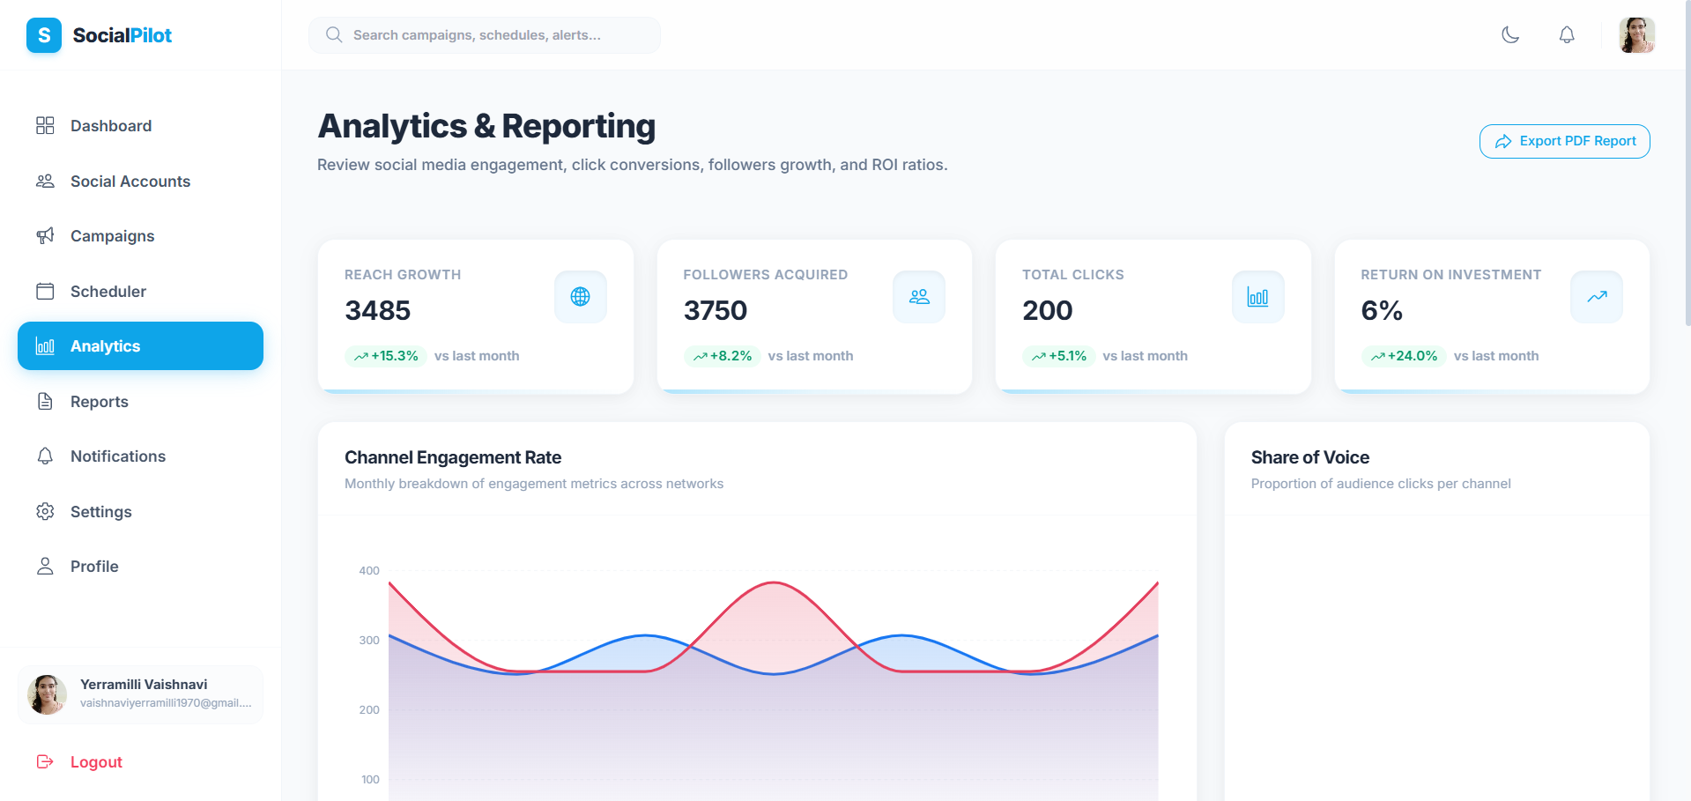
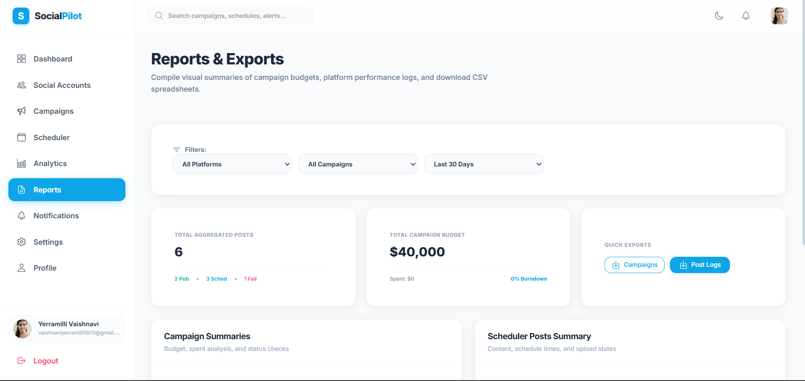
Analytics & Reports
Turn stored data into performance views
What it does
What it does
Visualizes engagement, reach, impressions, clicks and campaign performance where implemented.
Provides filtered performance/post data and downloadable CSV reports where implemented.
How it is implemented
How it is implemented
Database metrics → FastAPI analytics endpoints → Axios → React charts/summary cards.
Reports UI → fetch data → client-side filtering → CSV formatting → download.
SocialPilot | Group Project
8
8

Slide 9
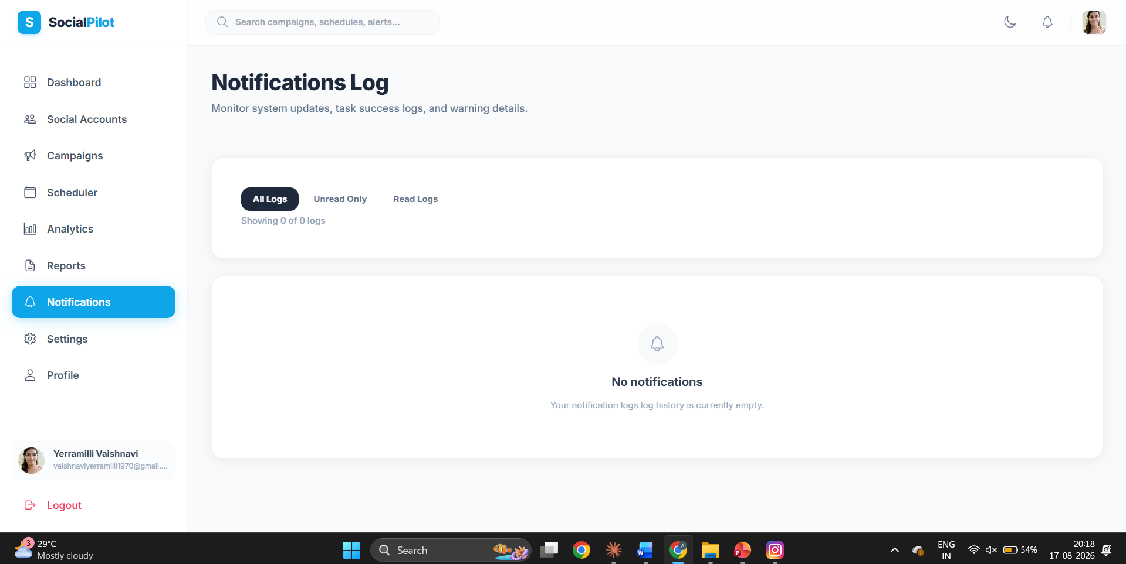
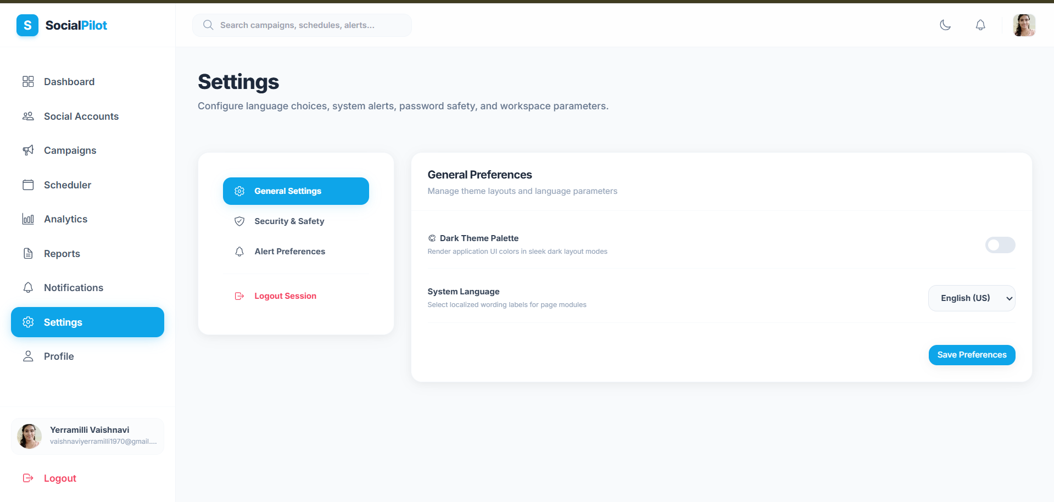
Notifications, Settings & Search
Supporting modules that complete the workspace
What it does
What it does
Displays activity, campaign and scheduling alerts with read/unread actions where implemented.
Settings supports theme/profile-related controls; global search finds user-owned campaigns, posts and notifications.
How it is implemented
How it is implemented
Notification UI/context → FastAPI notifications endpoints → notifications table → UI refresh.
Theme state uses localStorage; search sends query + authenticated user_id to the search endpoint.
SocialPilot | Group Project
9
9

Slide 10
Frontend & Backend Implementation
How the codebase is organized
Frontend
Backend
• React + Vite • React Router for page navigation • Tailwind CSS for styling • Reusable components and layouts • Context/hooks for shared state • Axios service modules for API calls • Pages for dashboard, accounts, campaigns, scheduler, analytics, reports and notifications
• FastAPI REST endpoints • Routers for auth, users, social accounts, campaigns, scheduler, analytics, notifications and search • Pydantic validation • JWT authentication dependencies • SQLAlchemy models/queries • User-scoped CRUD operations • SQLite locally; PostgreSQL/Supabase in production
React
→
Axios
→
FastAPI
→
JWT
→
SQLAlchemy
→
Database
SocialPilot | Group Project
10

Slide 11
Frontend ↔ Backend Data Flow
Example: scheduling a post
User Action
→
React
→
Axios
→
FastAPI
→
JWT Verify
→
SQLAlchemy
→
Database
→
JSON Response
Step-by-step
Why this architecture
1. User enters content and date/time. 2. React sends the request through Axios. 3. FastAPI validates the request and JWT. 4. Backend applies user_id filtering and business rules. 5. SQLAlchemy stores/updates the record. 6. JSON response updates the React UI.
Separation of UI, API, business logic and persistence makes the project modular, easier to test and easier to extend with real social APIs later.
SocialPilot | Group Project
11

Slide 12
Testing & Validation
Verified project-level checks
Authentication
CRUD Workflows
Registration, login, JWT protection and user-scoped operations.
Campaign, post, social-account and notification workflows.
Multi-user Isolation
Frontend Build
Seeded users were used to verify one user's operations do not affect another user's records.
Vite production build was validated.
API / Integration
Deployment
Core endpoint workflows and backend health were checked.
Frontend, backend and production database configuration were validated.
SocialPilot | Group Project
12

Slide 13
Deployment & Milestone Progress
From local development to production
Frontend
Backend
Database
React/Vite → Vercel Verified frontend: social-path.vercel.app
FastAPI/Uvicorn → Render Production API deployment
PostgreSQL / Supabase Production persistent storage
M1
M2
M3
M4
A functional project foundation was established with the frontend, backend, database layer, authentication system, and initial dashboard successfully integrated.
A functional content management and scheduling workflow was developed, allowing users to create content, associate it with campaigns, select scheduling dates/times, and manage scheduled posts through the dashboard.
Campaign management and analytics capabilities were integrated, enabling users to create and manage campaigns, track campaign-related content, and visualize performance metrics through the analytics dashboard and reports.
The completed application was validated through functional and integration testing, multi-user data isolation checks, production build validation, deployment, and project documentation.
SocialPilot | Group Project
13

Slide 14
Outcomes, Limitations & Future Scope
What is delivered and what comes next
Outcomes
Current Limitations
Future Scope
• Centralized social workflow • User-scoped data • Scheduling and campaign management • Analytics and reports • Notifications and search • Modular frontend/backend architecture
• Social connections use Mock OAuth / demo flow • Real platform OAuth needs official developer accounts/API credentials • Live social-media publishing is not implemented • Some preference controls are currently client-side
• Real Instagram/Facebook/LinkedIn/X OAuth • Real social API publishing • Background workers for scheduling • AI-assisted content • Advanced analytics • More exports and collaboration features
SocialPilot | Group Project
14

Slide 15
Team Contributions & Q&A
Five-member delivery split
Vaishnavi Yerramilli
Lakshmi Supriya
Team Lead • Core Integration • Dashboard • Deployment • Testing
Authentication • User Management • Notifications
Jaya Durga
Sowjanya
Campaign Management • Content Scheduling • Scheduler
Social Accounts • Mock OAuth • UI/UX
Susmitha
Analytics • Reports • Visualization
Q n A
THANK YOU • TEAM – 1 SOCIALPILOT
SocialPilot | Group Project
15

