Slide 1


SOCIALPILOT
SOCIAL MEDIA SCHEDULER & CAMPAIGN MANAGEMENT PLATFORM
INTERNSHIP PROJECT • TEAM PRESENTATION

Slide 2

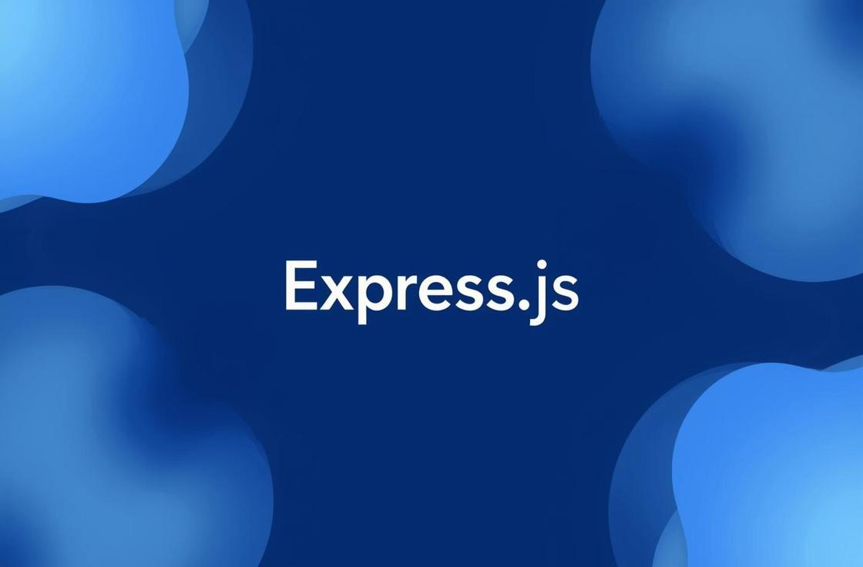

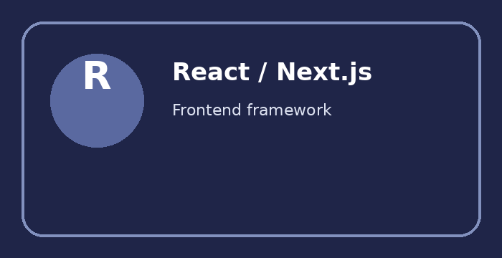
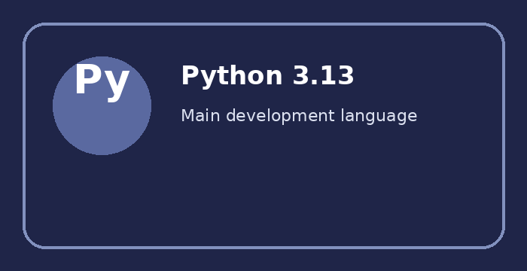
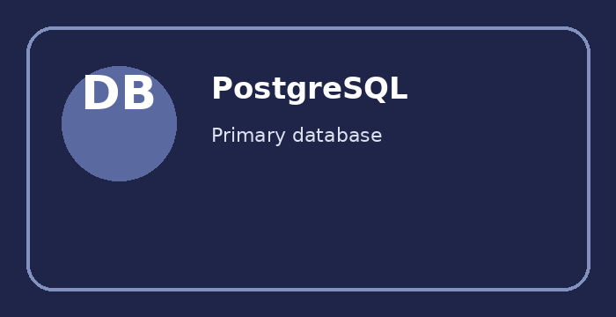
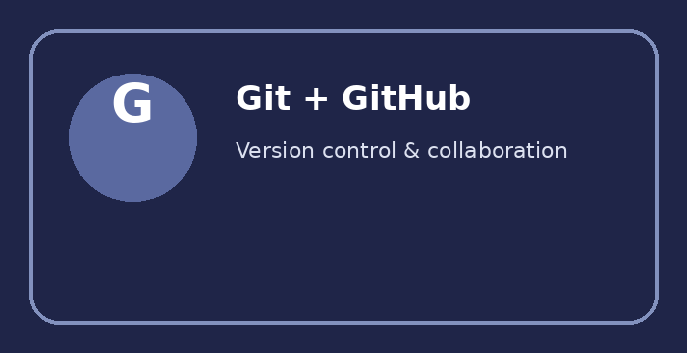
Technology Stack
GitHub
Database: PostgreSQL
Backend: Python + FastAPI
Frontend: React / Next.js
Tools & Security
SQLAlchemy ORM, pgAdmin and Alembic migrations.
REST APIs, authentication and business logic.
Dashboard, pages and reusable UI components.
JWT • Pydantic • Swagger • Git + GitHub

Slide 3
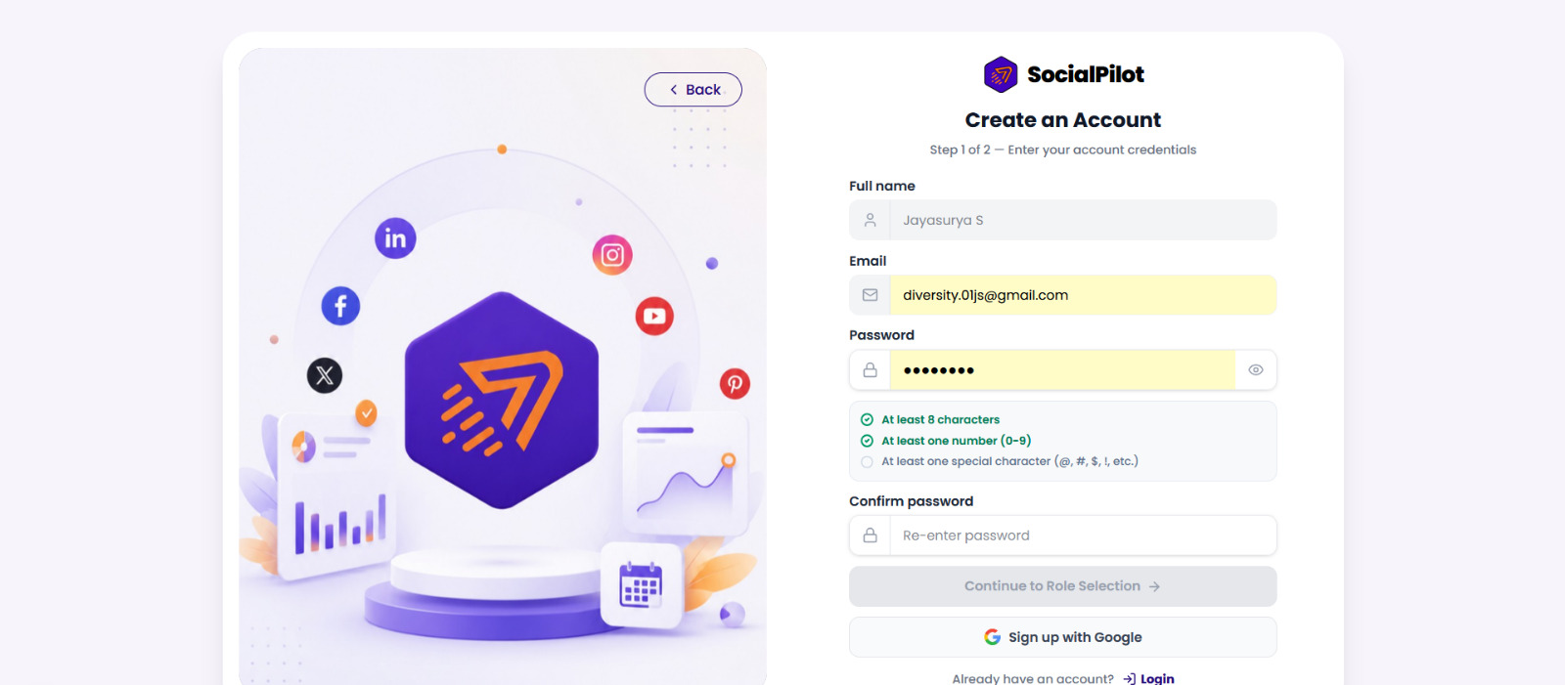
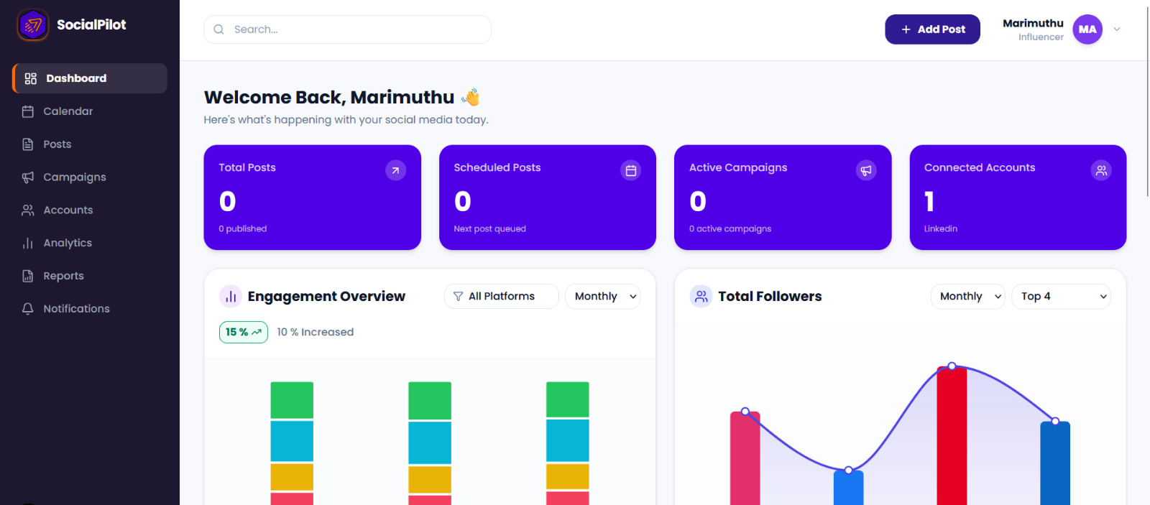
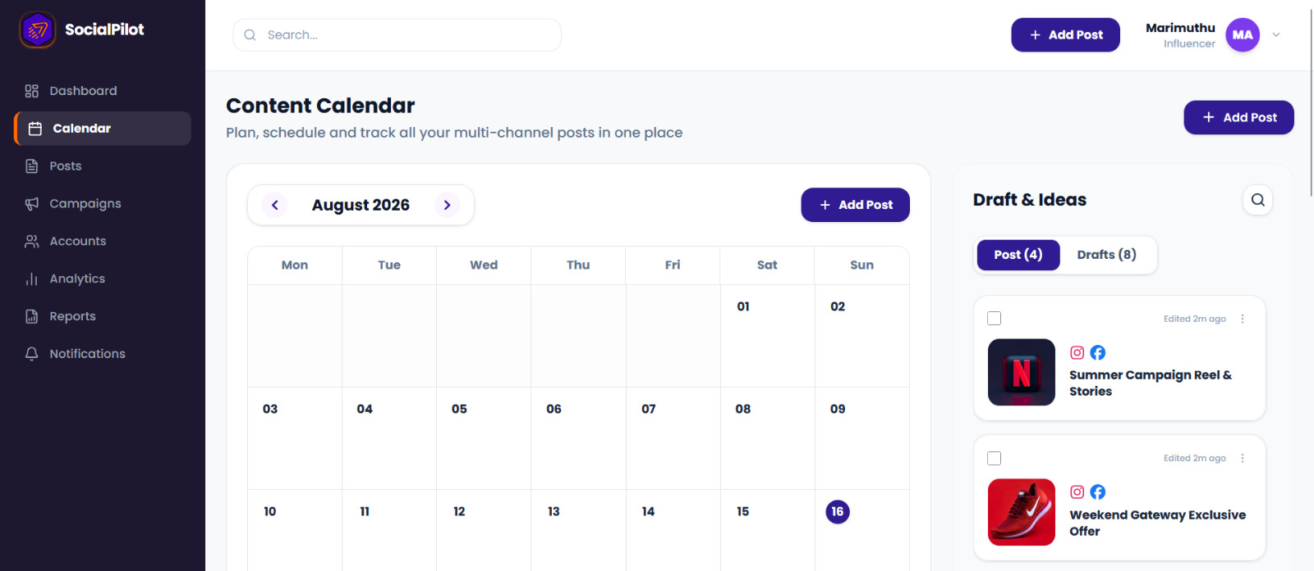

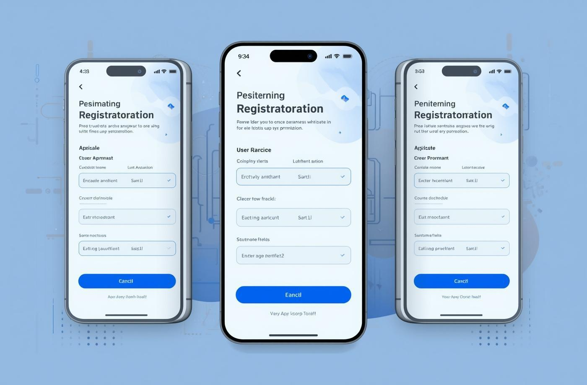

Core Features of SocialPilot
Accounts & Security
Campaigns & Analytics
Content & Scheduling
Register, log in and manage secure access with JWT authentication.
Manage campaigns, track performance, calculate ROI and compare results.
Create posts, set publishing times and automate recurring posts.

Slide 4
Challenges in Social Media Management
1
2
Manual Posting
Multiple Platforms
Repeated manual posting takes time and makes consistent publishing difficult.
Managing content across separate platforms creates extra work and complexity.
3
4
Campaign Tracking
Scattered Monitoring
Campaign data, performance and ROI are difficult to monitor in one place.
Publishing status, logs and analytics are spread across different tools.

Slide 5
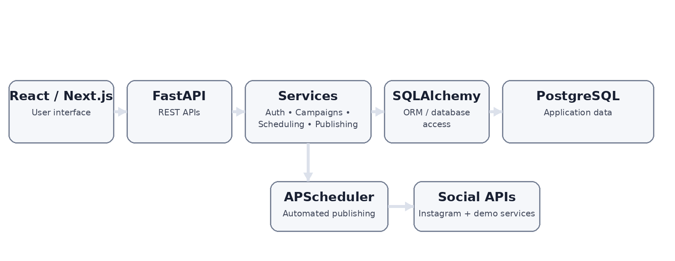
System Architecture Overview
SocialPilot follows a layered architecture: • React / Next.js – user interface • FastAPI – REST API layer • Services – authentication, campaigns, scheduling and publishing • SQLAlchemy + PostgreSQL – data layer • APScheduler + Social APIs – automated publishing

Slide 6
Challenges & Solutions
1
2
Centralized Management
Automated Scheduling
One dashboard brings accounts, posts, campaigns and analytics together.
APScheduler checks scheduled posts and triggers the publishing workflow.
3
4
Secure Integration
Reliable Monitoring
JWT authentication and REST APIs provide controlled access and communication.
Publishing logs and notifications record the result of each publishing action.

Slide 7
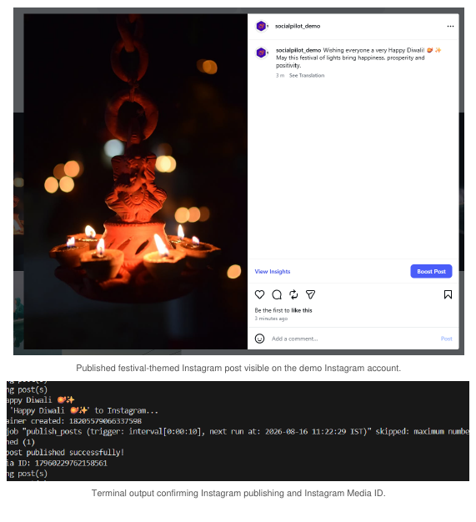
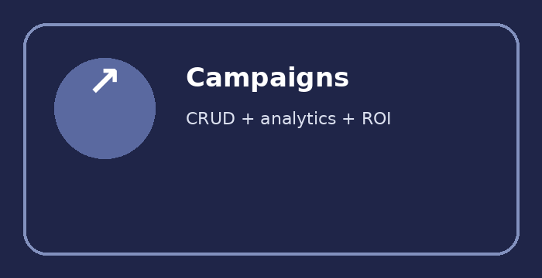

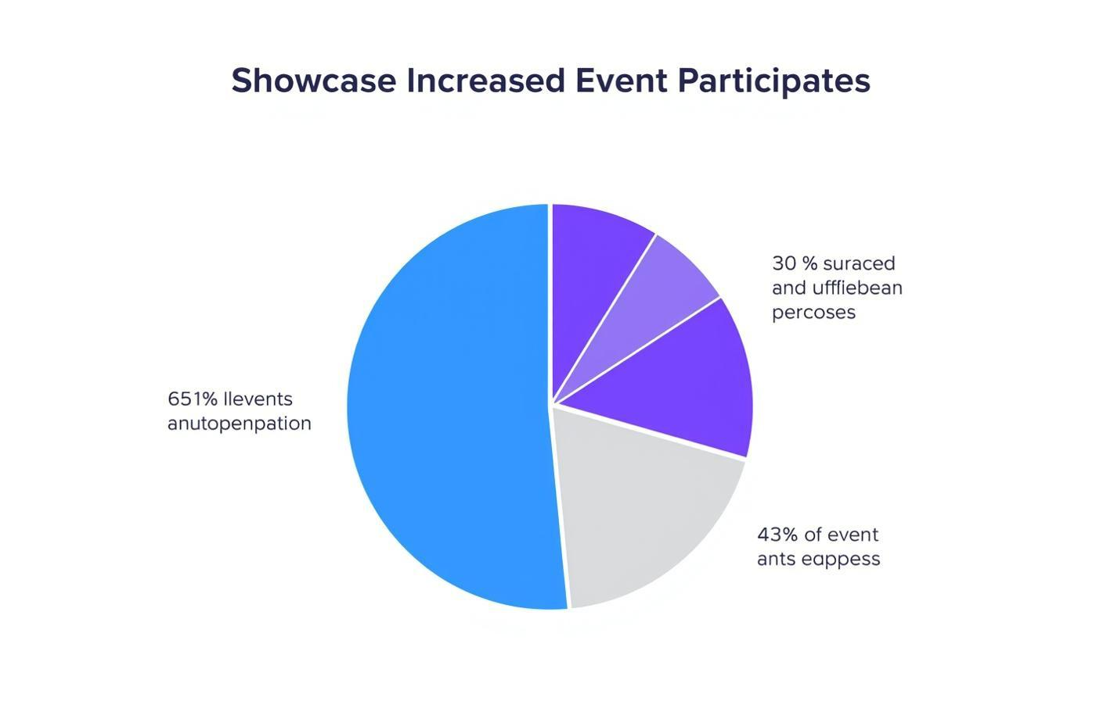


Project Outcomes & Achievements
Automated Publishing
Campaign & Analytics
Real Social Publishing
Scheduled and recurring posts with Pending → Publishing → Published / Failed status handling.
Campaign CRUD, tracking, reports, engagement analytics, ROI and comparison endpoints.
Instagram real API publishing with publishing logs, notifications and Media ID handling.

Slide 8

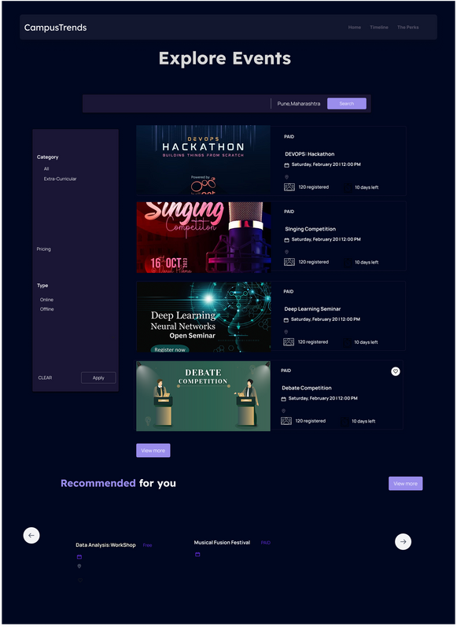
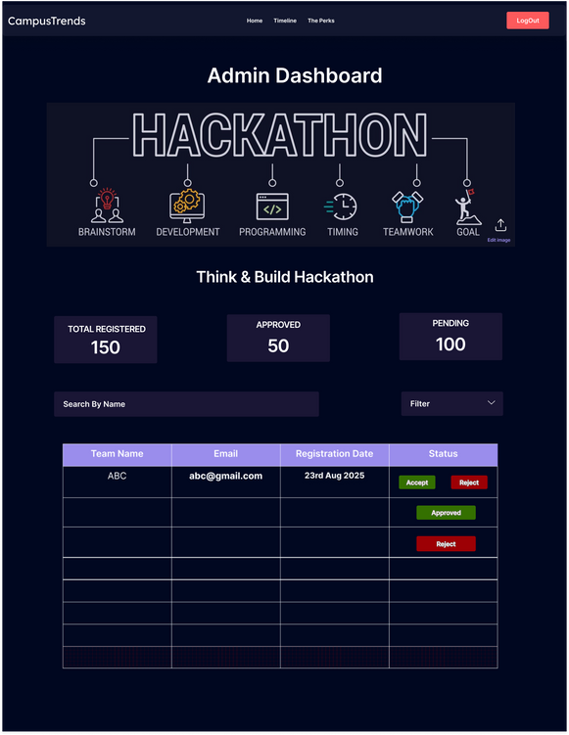
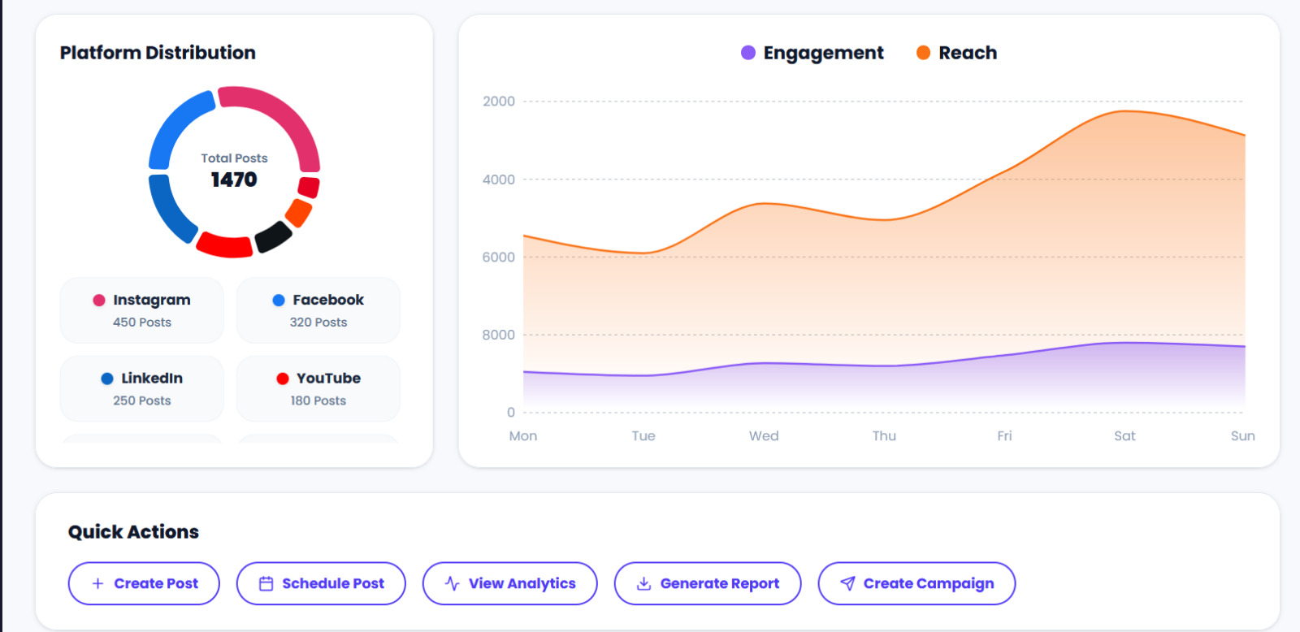
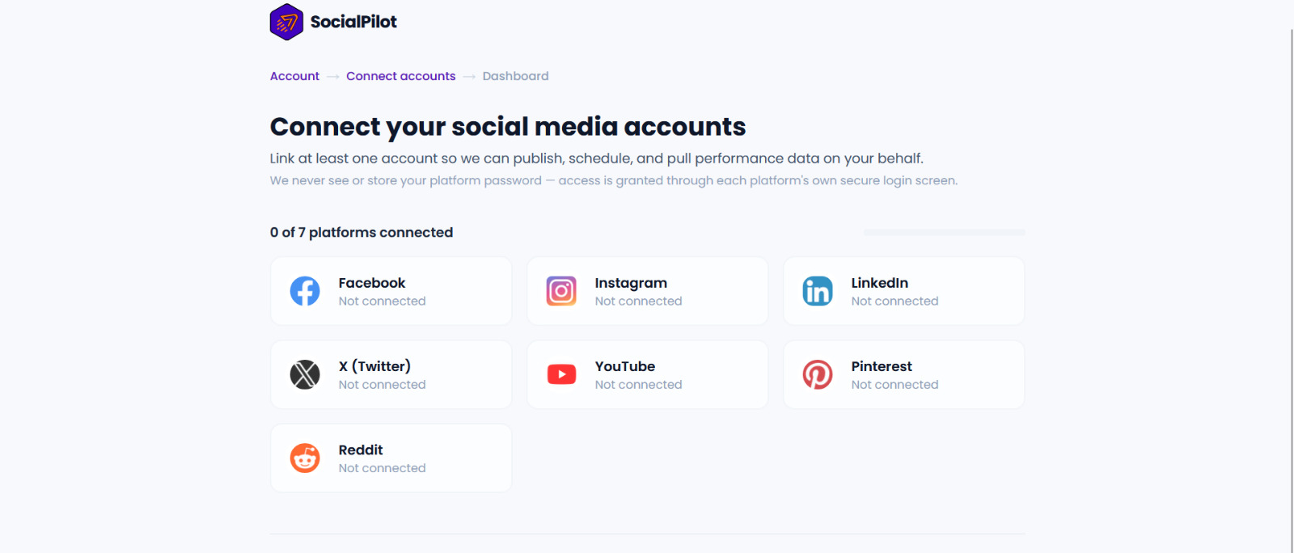

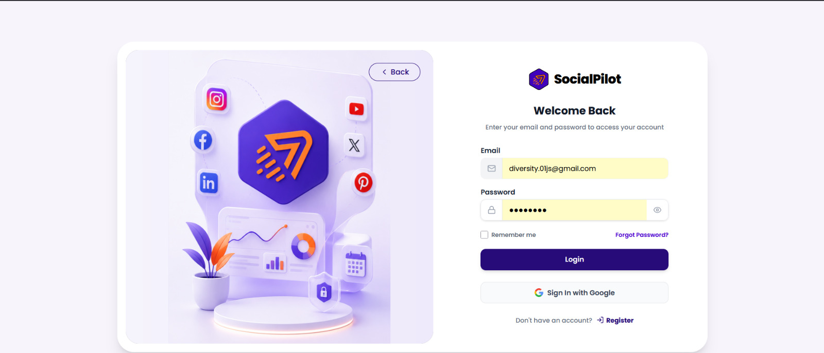
These screens showcase SocialPilot's user experience for account management, dashboard analytics and content scheduling.

Slide 9

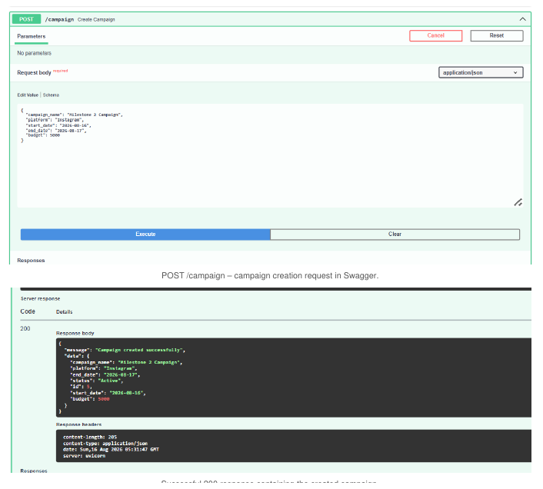
API-to-Database Flow
1. Request
Frontend sends a JSON request to a FastAPI endpoint.
2. Processing
Pydantic validates data and SQLAlchemy stores it in PostgreSQL.
3. Response
FastAPI returns the result to the frontend for display and monitoring.

Slide 10

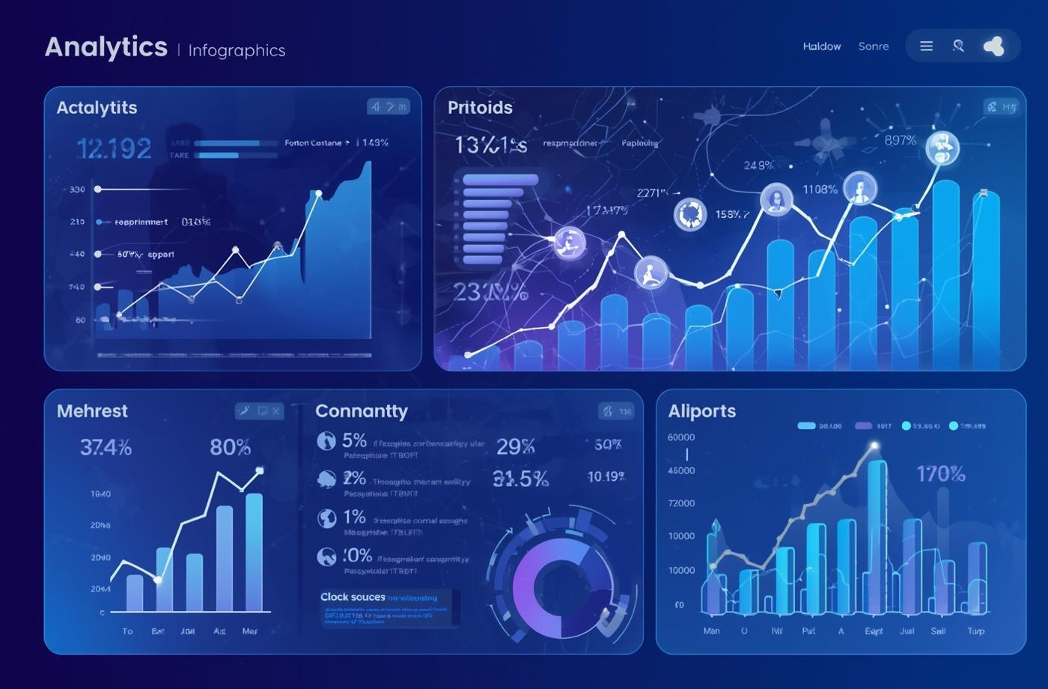

Future Enhancements for SocialPilot
Deployment & Automation
Advanced Analytics
More Real Integrations
Cloud deployment, CI/CD, smarter scheduling and advanced automation features.
Richer dashboards, audience insights, campaign comparison and improved ROI reporting.
Complete production APIs for Facebook, LinkedIn and X/Twitter and add more platforms.

Slide 11
TEAM SOCIALPILOT
Prathiba — Leadership / Integration / GitHub
Jayaram — Database Development
Jayasurya — Frontend / API Integration
Swetha — Frontend / UI-UX
Laxmi — Backend / Authentication
Samhita — Backend / Scheduling & Campaigns
Anuja — Testing / Deployment / Documentation
Notes:
Prathiba — Leadership / Integration / GitHub
Swetha — Frontend / UI-UX

Slide 12
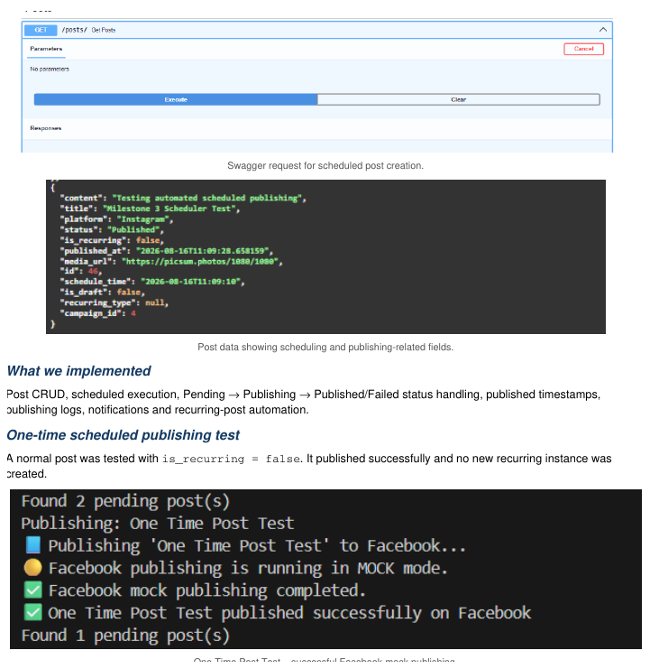
Project Demonstration
Backend/API evidence Campaign management • Scheduled publishing • Instagram publishing • Publishing logs

Slide 13
Q & A

Slide 14
THANK YOU

