Slide 1



Presentation on TrustShare | 08/09/2026
TRUSTSHARE
Encrypted File Management & Audited Sharing
NAME OF PROJECT:
PRESENTED BY:
TrustShare
Team 1

Slide 2





TABLE OF CONTENTS
03 | Overview
04 | Goals and company vision
05 | Target Audience
06 | Timeline
07 | System & Technical Architecture
08 | Core Security & Encryption Engine
09 | Real-Time Audit Logging
10 | Competitive Advantage
11 | Our Team
12 | Future Roadmap & conclusion

Slide 3

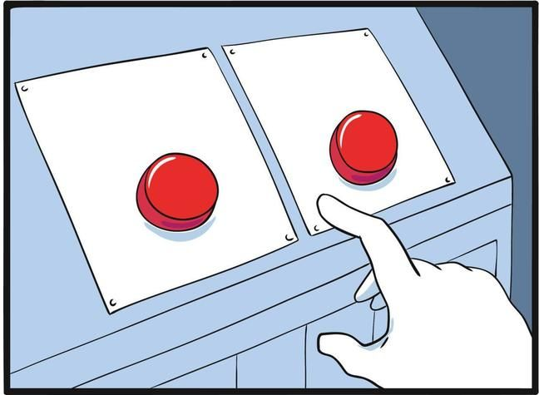
03/13
Overview
TrustShare is a zero-trust file platform combining Python encryption, FastAPI, and React to deliver secure storage, instant link revocation, and full audit logging.
The platform is designed to improve digital file security by protecting sensitive documents and enabling secure collaboration between users.
Leaked link = Game Over
Share links live forever until forgotten
www.sushilvatane07.github.io/tm/

Slide 4



04/13
Objectives and Goals
Objective
Objective
Build a zero-trust platform delivering end-to-end Python encryption to protect files at rest and in transit.
Provide instant link revocation and expiration controls so users maintain full authority over shared data.
Goal # 1
Goal # 2
Goal # 3
Eliminate cloud
data leaks
total transparency
full authority over
shared data.

Slide 5


05/13
Target Audience
Human Resources & Payroll:
Finance, Accounting & Tax Services:
Healthcare & Patient Records (HIPAA):
Legal & Contract Management:
Corporate IP & R&D Protection:

Slide 6




Timeline
06/13
8 sept 2026
1st Milestone
2nd Milestone
3rd Milestone
4th Milestone
Setup database schema, user authentication, file storage, and audit logs.
Integrate Python cryptography engine for file encryption and decryption pipeline.
Build revocable sharing links, expiration dates, and real-time security alerts.
Deploy 3D vault UI, user analytics dashboard, and Docker containers.

Slide 7
System &Technical Architecture
07/13
FRONTEND :
REACT (VITE) , CSS , JS
BACKEND API :
FASTAPI (PYTHON) FOR HIGH-PERFORMANCE ASYNCHRONOUS REQUEST HANDLING.
DATABASE LAYER :
POSTGRESQL & SUPABASE CLOUD FOR RELATIONAL USER, FILE, AND LOG METADATA.
DEPLOYMENT :
DOCKER & DOCKER COMPOSE FOR ISOLATED CONTAINERIZED ENVIRONMENTS.

Slide 8




08/13
Core security & Encryption Engine
AES Encryption
Isolated Storage
Password Hashing
Files encrypted at rest using Python’s cryptography library
Raw uploaded files and encrypted payloads stored in separate server directories
User Credentials hashed using industry-standard bcrypt algorithms

Slide 9


Append-Only Event Logs | Every login , file upload , link creation and download recorded
Timestamp & User Tracking | Captures User Id , Action Type and exact Timestamp
Transparency Dashboard | only Goggle verified Gmail can create account
09/13
Audit Logging &
Activity Monitoring

Slide 10

10/13
TrustShare vs Traditional Cloud
TrustShare Vault
Traditional Cloud
AES encryption
stored unencrypted
link revocation
Links live forever
audit logs
No download tracking
User Friendly
Silent leaks.

Slide 11

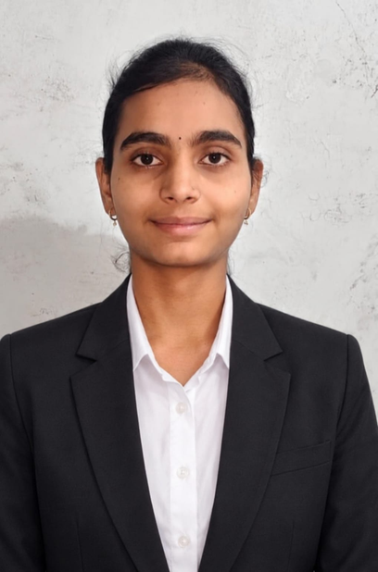
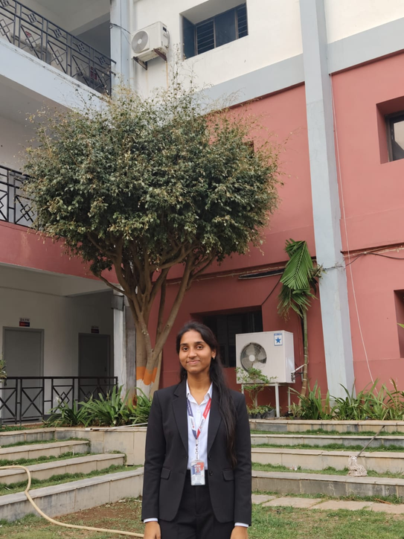

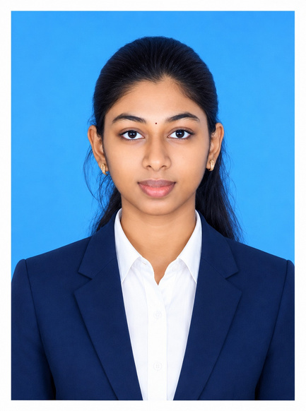

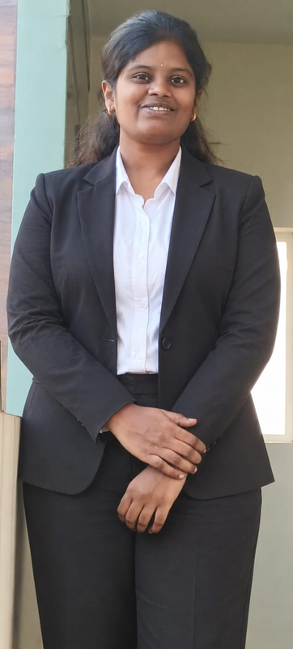
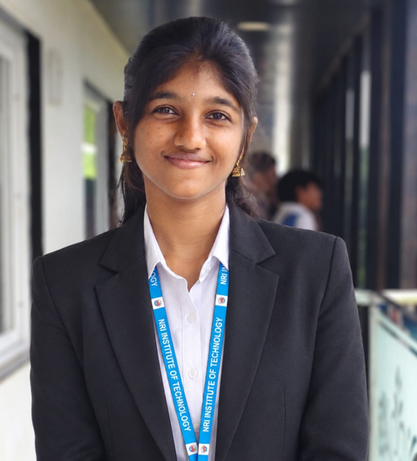
Our team
11/13
Sushil Vatane
Samiksha
Siri
arpita
Team Lead & Database Administrator
Authentication and
API
File Pipeline and
Storage
Cryptography and Security
Srilaja
Yogitha
Varshini
yogitha 2nd
Notification & Security Alert
Frontend UI/UX
Database Schema Architect
UI /UX

Slide 12
Future Roadmap and Conclusion
12/13
🤖 AI-Powered Anomaly Detection:
🔐 Client-Side Browser Encryption (Zero-Knowledge):
☁️ Multi-Cloud Storage Adapters:
🏢 Enterprise Role-Based Access Control (RBAC):
🎯 Core Conclusion
TrustShare successfully solves the critical security vulnerabilities of traditional cloud file sharing by proving that high security does not require sacrificing user experience. By combining Python-based zero-trust encryption, FastAPI backend performance, PostgreSQL database reliability, and a modern React dashboard, the project delivers a complete, production-ready security vault.

Slide 13


13/13
Thank You

