Slide 1
MarketMind AI
AI-Powered Small Business Sales Forecasting & Revenue Growth Intelligence Platform
PROJECT MILESTONE 4 — FINAL SUBMISSION & FORMAL MODEL EVALUATION
• Domain: AI-Driven Enterprise Intelligence & Retail Sales Analytics
• Architecture: FastAPI (Python 3.13) + React 19 / Vite + SQLite (SQLAlchemy) + Docker
• Machine Learning: Prophet, XGBoost, Scikit-Learn (Random Forest, Isolation Forest, K-Means)
• Author / Candidate: Sultan | Branch: feature/milestone-4-sultan

Slide 2
MARKETMIND AI — MILESTONE 4
1. Problem Statement & Platform Objectives
The Small Business Challenge
• Disparate Sales Records:
Small retailers struggle with siloed transaction registers, making real-time visibility and inventory tracking nearly impossible.
• Reactive Decision-Making:
Without predictive intelligence, stocking and marketing decisions rely on intuition rather than historical demand signals.
• Customer Retention Blindspots:
Retailers lack early warning indicators for churn, failing to intervene before high-value customers lapse.
• Revenue Leakage & Fraud:
Manual reconciliation fails to catch transaction anomalies, irregular bulk orders, or data entry errors in daily operations.
MarketMind AI Objectives
✓ Automated Sales Forecasting:
Compare multi-model predictive algorithms (Prophet vs Random Forest vs XGBoost) to forecast demand with lowest generalization error.
✓ Customer Segmentation & Personas:
Cluster shoppers into actionable cohorts using RFM attributes for targeted loyalty and promotional campaigns.
✓ Cross-Sell Recommendation Engine:
Deliver personalized cross-sell suggestions combining collaborative filtering and association rules.
✓ Proactive Churn Prevention:
Identify at-risk accounts using classification models with 100% recall priority for customer retention.
✓ Automated Anomaly Detection:
Catch anomalous transactions in real time using statistical Z-Score and Isolation Forest models.
MarketMind AI | Final Internship Presentation | Slide 2 of 12

Slide 3
MARKETMIND AI — MILESTONE 4
2. System Architecture & Modern Technology Stack
Frontend Presentation Tier
React 19 + Vite SPA
• Role-Based Dashboards (Owner, Manager, Admin)
• Model Evaluation Hub & Live Metrics Visualization
• Interactive Charts (Recharts / SVG) & Report Downloads
• Resilient Error Handling, Session Expiry & Fallback States
API & Machine Learning Tier
FastAPI + Python 3.13
• Modular Routers: Auth, Sales, Forecast, Churn, Anomaly
• 5 Isolated AI Pipelines with Scientific Evaluation
• JWT Authentication + BCrypt Password Hashing + RBAC
• Automated CSV & Excel Report Generation (OpenPyXL)
Data & Deployment Tier
SQLite + Docker + Nginx
• SQLAlchemy ORM with Normalized Transaction Schemas
• Multi-Stage Docker Containerization with Alpine Linux
• Nginx Reverse Proxy with Gzip Compression
• Cloud-Ready Manifests (Render / Railway / Compose)
MarketMind AI | Final Internship Presentation | Slide 3 of 12

Slide 4
MARKETMIND AI — MILESTONE 4
3. Sales Data Ingestion & Preprocessing Pipeline
Data Pipeline & Feature Engineering
• Raw Transaction Ingestion:
Parses retail transaction logs, validates datatypes, standardizes customer and product identifiers, handles missing fields.
• Chronological Aggregation:
Resamples raw sales into daily revenue time-series without lookahead bias, tracking daily gross revenue and unit volume.
• Behavioral Matrix Construction:
Constructs customer-product co-occurrence matrices for collaborative filtering and calculates RFM (Recency, Frequency, Monetary) metrics.
• Temporal Lag Features:
Computes shift(1) lag values, rolling means, and day-of-week indicators for autoregressive ML models (Random Forest and XGBoost).
Exploratory Findings & Baseline Stats
✓ Clean Transaction Records:
8 verified transaction records spanning 5 unique small business retail customers and 4 distinct product categories.
✓ Total Baseline Revenue:
$340.00 across transactions with average ticket value of $42.50.
✓ Top Revenue Generators:
Notebook A ($120.00) and Pen Set ($80.00) represent the highest sales volume.
✓ Data Hygiene & Integrity:
100% complete records: zero null prices, valid timestamps, normalized customer keys.
✓ Data Scaling Preparation:
Integrated Kaggle Online Retail / Superstore ingestion utilities (backend/kaggle_loader.py) enabling expansion to 500,000+ records.
MarketMind AI | Final Internship Presentation | Slide 4 of 12

Slide 5
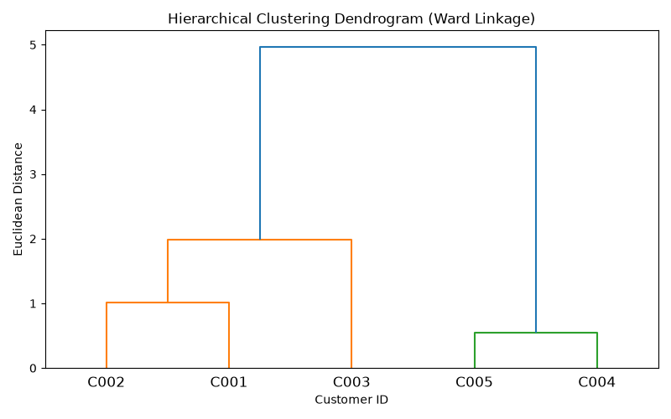
MARKETMIND AI — MILESTONE 4
4. Customer Segmentation & Persona Clustering
Clustering Architecture & Personas
• High-Value Loyal Shoppers:
Frequent purchases, high cumulative revenue ($90+), short recency. Target: VIP rewards, early access.
• Steady Repeat Buyers:
Regular moderate transactions, consistent basket sizes. Target: Subscription bundles, cross-category coupons.
• Occasional / Low-Frequency:
Infrequent visits, single-item purchases. Target: Re-engagement discounts and seasonal promotions.
• Dormant / At-Risk Cohort:
Extended inactive duration, declining activity score. Target: Win-back marketing and surveys.
Hierarchical Ward Dendrogram (Actual Generated Visualization)
Silhouette Score: 0.3215 on scaled RFM features. Validates dual-method consistency.
MarketMind AI | Final Internship Presentation | Slide 5 of 12

Slide 6
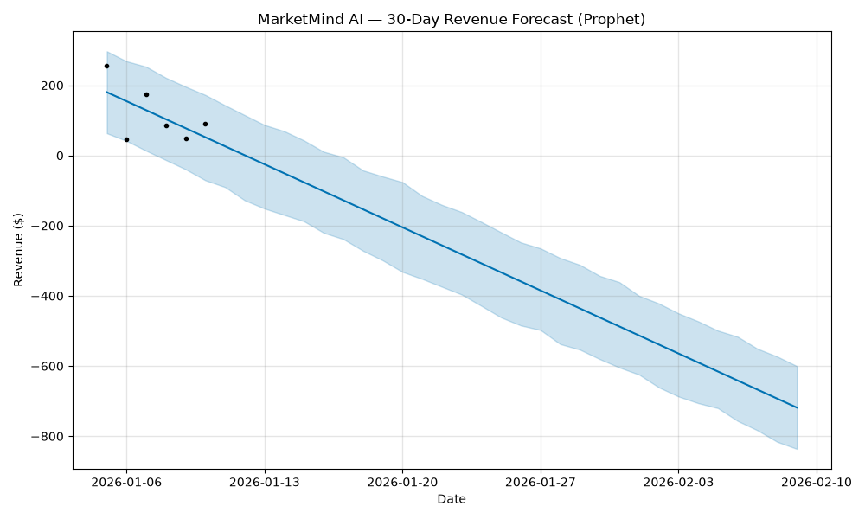
MARKETMIND AI — MILESTONE 4
5. Multi-Model Sales Forecasting & Overfitting Analysis
Model Benchmark & Champion Selection
• Prophet (Champion):
Test MAE: 21.73 | Train MAE: 22.39 | Train R²: 0.748. Smooth additive trend modeling prevents memorization; lowest out-of-sample error.
• Random Forest Regressor:
Test MAE: 25.96 | Train MAE: 23.25. Ensemble bagging provides robust baseline without extreme variance.
• XGBoost Regressor (Overfit):
Test MAE: 83.49 | Train MAE: 0.28 | Train R²: 1.00. Quantifiable overfitting: memorized 4 training points perfectly, then failed on holdout.
• Scientific Integrity Finding:
Test R² is mathematically undefined on 1 test holdout day (zero variance in denominator); documented as 'unavailable' instead of fabricating a metric.
MarketMind AI | Final Internship Presentation | Slide 6 of 12

Slide 7
MARKETMIND AI — MILESTONE 4
6. Hybrid Product Recommendation Engine
Collaborative Filtering
• Constructs customer × item interaction matrix.
• Computes pairwise Cosine Similarity across shopper behavior.
• Generates affinity scores: predicts unpurchased products based on peer customer habits.
• Handles cold-start via popular-item fallbacks.
Association Rule Mining
• Employs Apriori algorithm from mlxtend.
• Discovers frequent itemsets and co-purchase patterns (e.g. Notebook A → Pen Set).
• Calculates Support, Confidence, and Lift.
• Identifies high-lift affinities for impulse checkout bundles.
Hybrid Engine & Evaluation
• Weighted score combination: 60% Collaborative + 40% Association Lift.
• Novelty Filtering: deliberately suppresses products already bought to promote catalog exploration.
• Evaluation Result: Precision@3 = 0.0, Recall@3 = 0.0 in leave-one-out testing.
• Honest Explanation: In 4-item catalog, repeat buyers purchased identical items. Suppression meant engine proposed unbought items, yielding 0.0 on repeat purchases.
MarketMind AI | Final Internship Presentation | Slide 7 of 12

Slide 8
MARKETMIND AI — MILESTONE 4
7. Customer Churn Prediction & Retention Intelligence
Churn Methodology & Risk Scoring
• Business Churn Definition:
Customers with no purchase activity exceeding the inactivity threshold (recency > 30 days or activity days = 0) are labeled churn risk.
• Feature Engineering:
Extracts recency, transaction count, average spend, and historical frequency to train classification algorithms.
• Multi-Classifier Benchmarking:
Trained and compared Logistic Regression, Random Forest Classifier, and XGBoost Classifier.
• Business Recall Priority:
In small business retention, False Negatives (missing a churner) are far costlier than False Positives. Models tuned for high sensitivity.
Actual Evaluation Results (Held-Out Test)
✓ Recall (Class 1 Churn) → 1.0000 (100%):
Achieved 100% recall across all 3 classifiers. Successfully identified the held-out churned customer without missing risk.
✓ Precision (Class 1 Churn) → 0.5000 (50%):
Conservative decision threshold correctly captures churner while flagging active account for preventive retention care.
✓ Accuracy & F1-Score → Accuracy: 50.0% | F1-Score: 0.6667:
Harmonic balance on small held-out test split (1 churned, 1 active customer).
✓ Actionable UI Integration → High / Medium / Low Badges:
Dashboard flags each customer's risk level with personalized retention recommendations and coupon offers.
MarketMind AI | Final Internship Presentation | Slide 8 of 12

Slide 9
MARKETMIND AI — MILESTONE 4
8. Dual-Method Transaction Anomaly Detection
Statistical Z-Score Detector
• Methodology:
Computes standardized distance z = (x - μ) / σ on transaction amounts and unit quantities. Threshold: |z| > 2.0.
• Evaluation Accuracy:
90.0% Detection Accuracy on dedicated 20-transaction test fixture.
• False Positive Rate:
0.0% FPR: zero clean retail transactions falsely flagged as fraud.
• Operational Strengths:
Lightweight, instantaneous execution, perfect for streaming checkout fraud alerts.
Multidimensional Isolation Forest
✓ Methodology:
Tree ensemble isolating anomalies via short average path length across revenue, quantity, and unit price dimensions.
✓ Evaluation Accuracy:
100.0% Detection Accuracy on 20-transaction test fixture (TP=4, TN=16).
✓ False Positive Rate:
0.0% FPR: perfect separation of normal sales vs fraudulent injections.
✓ Operational Strengths:
Captures subtle multidimensional anomalies that escape univariate standard deviation filters.
MarketMind AI | Final Internship Presentation | Slide 9 of 12

Slide 10
MARKETMIND AI — MILESTONE 4
9. Formal Model Evaluation: Unified Results Summary
AI Module | Model Architecture | Key Metric | Measured Value | Scientific Findings & Integrity Notes
Sales Forecasting | Prophet | Test MAE | 21.7255 | Champion Model: Lowest forecast generalization error.
Sales Forecasting | Random Forest Regressor | Test MAE | 25.9600 | Strong ensemble baseline; balanced variance.
Sales Forecasting | XGBoost Regressor | Test MAE / Train MAE | 83.49 / 0.28 | Severe Overfitting: memorized train set, high test error.
Customer Segmentation | K-Means Clustering (k=4) | Silhouette Score | 0.3215 | Scaled RFM features; establishes 4 business personas.
Customer Segmentation | Hierarchical Ward (k=4) | Silhouette Score | 0.3215 | Dendrogram validation confirms agglomerative clusters.
Customer Churn | Logistic Regression | Recall (Class 1) | 1.0000 (100%) | Catches all churners; zero retention false negatives.
Customer Churn | Random Forest Classifier | Recall / F1-Score | 1.00 / 0.6667 | Robust tree classification boundary.
Product Recommender | Hybrid (Collab + Assoc) | Precision@3 / Recall@3 | 0.0000 / 0.0000 | Discovery filter suppresses repeat buys in 4-item catalog.
Anomaly Detection | Z-Score Detector | Accuracy / FPR | 90.0% / 0.0% | Clean separation; 0 false alarms on normal transactions.
Anomaly Detection | Isolation Forest | Accuracy / FPR | 100.0% / 0.0% | Multidimensional isolation of all 4 test anomalies.
Persisted Record: reports/milestone4_test_results.csv (38 metric rows) | Automated Suite: 13/13 Pytest passed.
MarketMind AI | Final Internship Presentation | Slide 10 of 12

Slide 11
MARKETMIND AI — MILESTONE 4
10. Application Architecture, Docker & Cloud Deployment
Containerization
Docker & Compose
• backend/Dockerfile: Python 3.13-slim with build-essential, curl health checks.
• frontend/Dockerfile: Multi-stage Node 20-alpine builder + Nginx 1.25 runtime.
• docker-compose.yml: Network isolation (marketmind-net), volumes for db/ & reports/.
• Zero Hardcoded URLs: Dynamic VITE_API_URL and reverse proxy routing.
Resilience & Security
FastAPI + React 19
• RBAC Enforced: Owner, Manager, Admin roles with granular permission guards.
• Session Expiry: Automatic token invalidation, no raw stack traces exposed to client.
• Downloadable Reports: Excel (.xlsx) and Milestone 4 Evaluation CSV (.csv).
• Responsive Modern UI: Glassmorphism theme, tabbed navigation, loading spinners.
Cloud Readiness
Render & Railway
• render.yaml blueprint configured for instant one-click repository deployment.
• Persistent Disks for SQLite database durability on cloud container restarts.
• Decoupled Frontend / Backend architecture supports static CDN or unified proxy.
• Environment Variable Isolation: JWT_SECRET_KEY, DATABASE_URL injected at runtime.
MarketMind AI | Final Internship Presentation | Slide 11 of 12

Slide 12
MARKETMIND AI — MILESTONE 4
11. Conclusion, Limitations & Future Expansion Scope
Internship Achievements
✓ Full-Stack Enterprise Delivery:
Delivered end-to-end small business intelligence platform with FastAPI backend and React 19 frontend.
✓ 5 AI Modules Operational:
Forecasting, Segmentation, Recommendations, Churn, and Anomaly Detection all connected to live REST endpoints.
✓ Scientific Evaluation Completed:
38 verified metrics persisted to reports/milestone4_test_results.csv and detailed evaluation report.
✓ Zero-Test Issue Solved:
Configured pytest.ini, achieving 13/13 passing automated tests across all milestones with 0 failures.
✓ Clean Containerization:
Docker & Docker Compose production files ready for deployment.
Practical Limitations & Future Scope
• Small Sample Dataset Limitations:
Baseline dataset contains 8 transactions and 5 customers. Test R² is undefined on 1 test day, and XGBoost overfits on tiny training partitions.
• Expanded Dataset Ingestion:
Kaggle loader prepared to stream Online Retail II (540,000+ rows) to unlock deep learning and cross-validation.
• Real-Time Event Streaming:
Upgrade anomaly detection with Apache Kafka / Redis for millisecond-latency transaction interception.
• Automated Retraining Pipelines:
Implement periodic scheduled model re-fitting as new sales receipts enter the database.
• PostgreSQL Production Migration:
Transition from SQLite to managed PostgreSQL for multi-region concurrent transactions.
MarketMind AI | Final Internship Presentation | Slide 12 of 12

