Slide 1
PROJECT PRESENTATION ON
HireHelper
HH
A Full-Stack Task Assistance Platform
Connecting people who need help with people willing to perform and manage task-related services.
Infosys Springboard Virtual Internship
Team: HireHelper_Team1

Slide 2
02
Project Overview & Problem Statement
Why a centralized task-assistance platform is needed
People who need help and people willing to provide help benefit from a simple, organized platform to discover, connect, and manage task-related activities.
Need Help
Want to Help
Coordination Gap
Finding suitable assistance and keeping task activity organized.
Potential helpers need visibility into available tasks.
Requests, task information, and interactions benefit from one system.
HireHelper | Infosys Springboard Virtual Internship | HireHelper_Team1

Slide 3
03
Proposed Solution
HireHelper bridges task creators and people willing to help
●
●
●
↔
↔
People Who Need Help
HireHelper Platform
Helpers / Users
Create and manage task-related activities
Centralized discovery, interaction and management
Discover tasks and interact with opportunities
HireHelper | Infosys Springboard Virtual Internship | HireHelper_Team1

Slide 4
04
Project Objectives
Core goals of the complete HireHelper application
Simplify Task Posting
Connect Users & Helpers
Centralize Management
Provide a structured way to add and manage tasks.
Support interaction around tasks and requests.
Organize task-related pages in one platform.
Provide Secure Access
User-Friendly Navigation
Full-Stack Integration
Use authentication, JWT, bcrypt and protected routes.
Enable access to dashboard, tasks, feed and settings.
Connect React interfaces with backend APIs and database.
HireHelper | Infosys Springboard Virtual Internship | HireHelper_Team1

Slide 5
05
Complete System Architecture
Frontend, backend, database, email services, and protected access
React Frontend
Node.js + Express.js
→
MongoDB
Axios / REST API →
Pages • Components • Router
REST APIs • Logic • Auth
Users • Tasks • Application Data
↓
Nodemailer
→
User Email
OTP & Reset Emails
Verification / Recovery
Authentication → JWT → Protected API Routes
HireHelper | Infosys Springboard Virtual Internship | HireHelper_Team1

Slide 6
06
Major Modules of HireHelper
The complete application module structure
HireHelper
Guest / Home
Authentication
Dashboard & Navigation
Platform introduction and navigation
Register, OTP, Login, Recovery
Dashboard, notifications, settings
Task Management
Requests / Applicants
Feed / Discovery
Add Task, My Tasks, details/actions
Poster and helper interaction
Explore available information/tasks
HireHelper | Infosys Springboard Virtual Internship | HireHelper_Team1

Slide 7
07
User Journey & Application Workflow
High-level journey through HireHelper
Guest User
→
Explore
→
Register / Login
→
Verify Account
→
Access App
→
Create / Discover
→
Interact / Manage
→
Task Workflow
After authentication, users can navigate between dashboard, task, request, feed, settings, notification and related features.
HireHelper | Infosys Springboard Virtual Internship | HireHelper_Team1

Slide 8
08
Authentication & Security
A dedicated module supporting secure application access
Register
→
OTP Generated
→
Email Verification
→
Login
→
JWT
→
Protected Features
Forgot Password → Registered Email → Secure Reset Link → New Password → Login Again
bcrypt password hashing • JWT authentication • OTP verification • Protected routes
HireHelper | Infosys Springboard Virtual Internship | HireHelper_Team1

Slide 9
09
Task Management Workflow
Core flow for task creation, availability, interaction, and management
1
2
3
4
5
6
→
→
→
→
→
Create Task
Backend
Database
Availability
Interaction
Management
Provide task information
Process API request
Store task data
Display in application
Requests / applicants
Manage task-related activity
Exact statuses and completion actions can follow the implemented project and PRD scope.
HireHelper | Infosys Springboard Virtual Internship | HireHelper_Team1

Slide 10
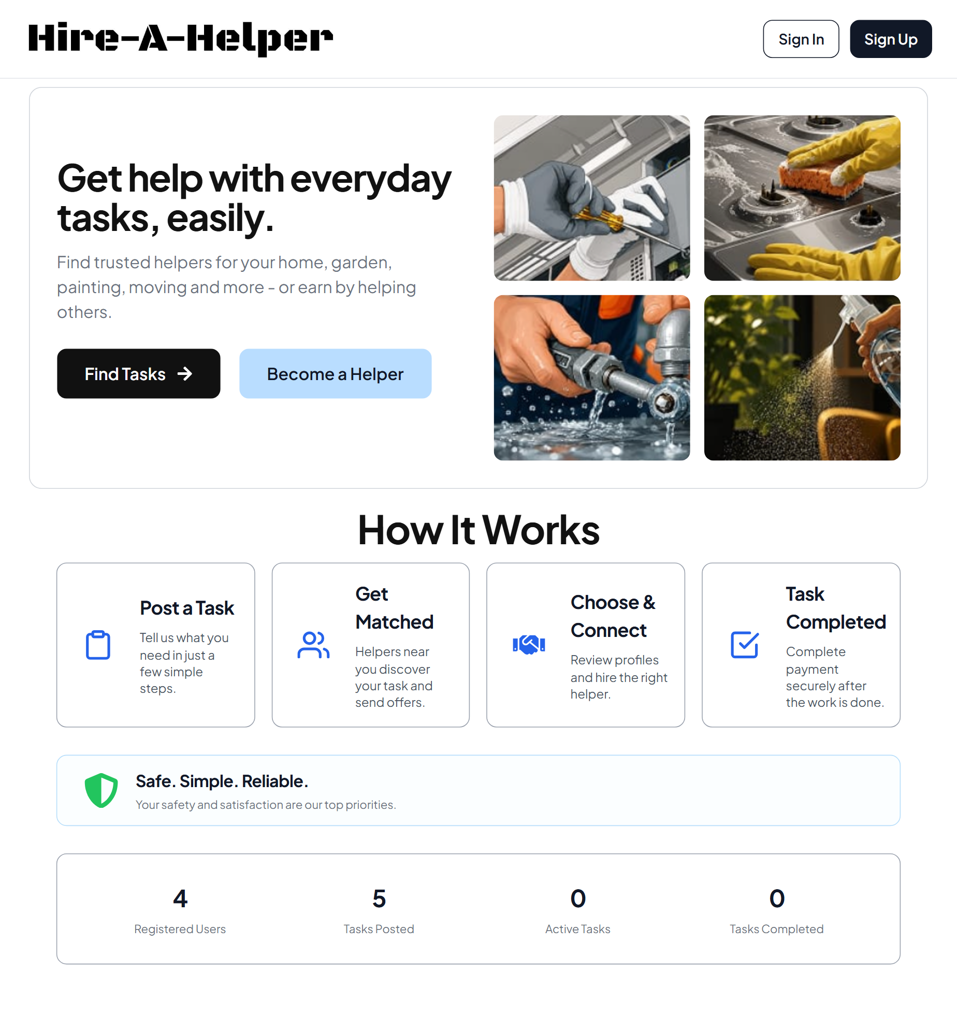
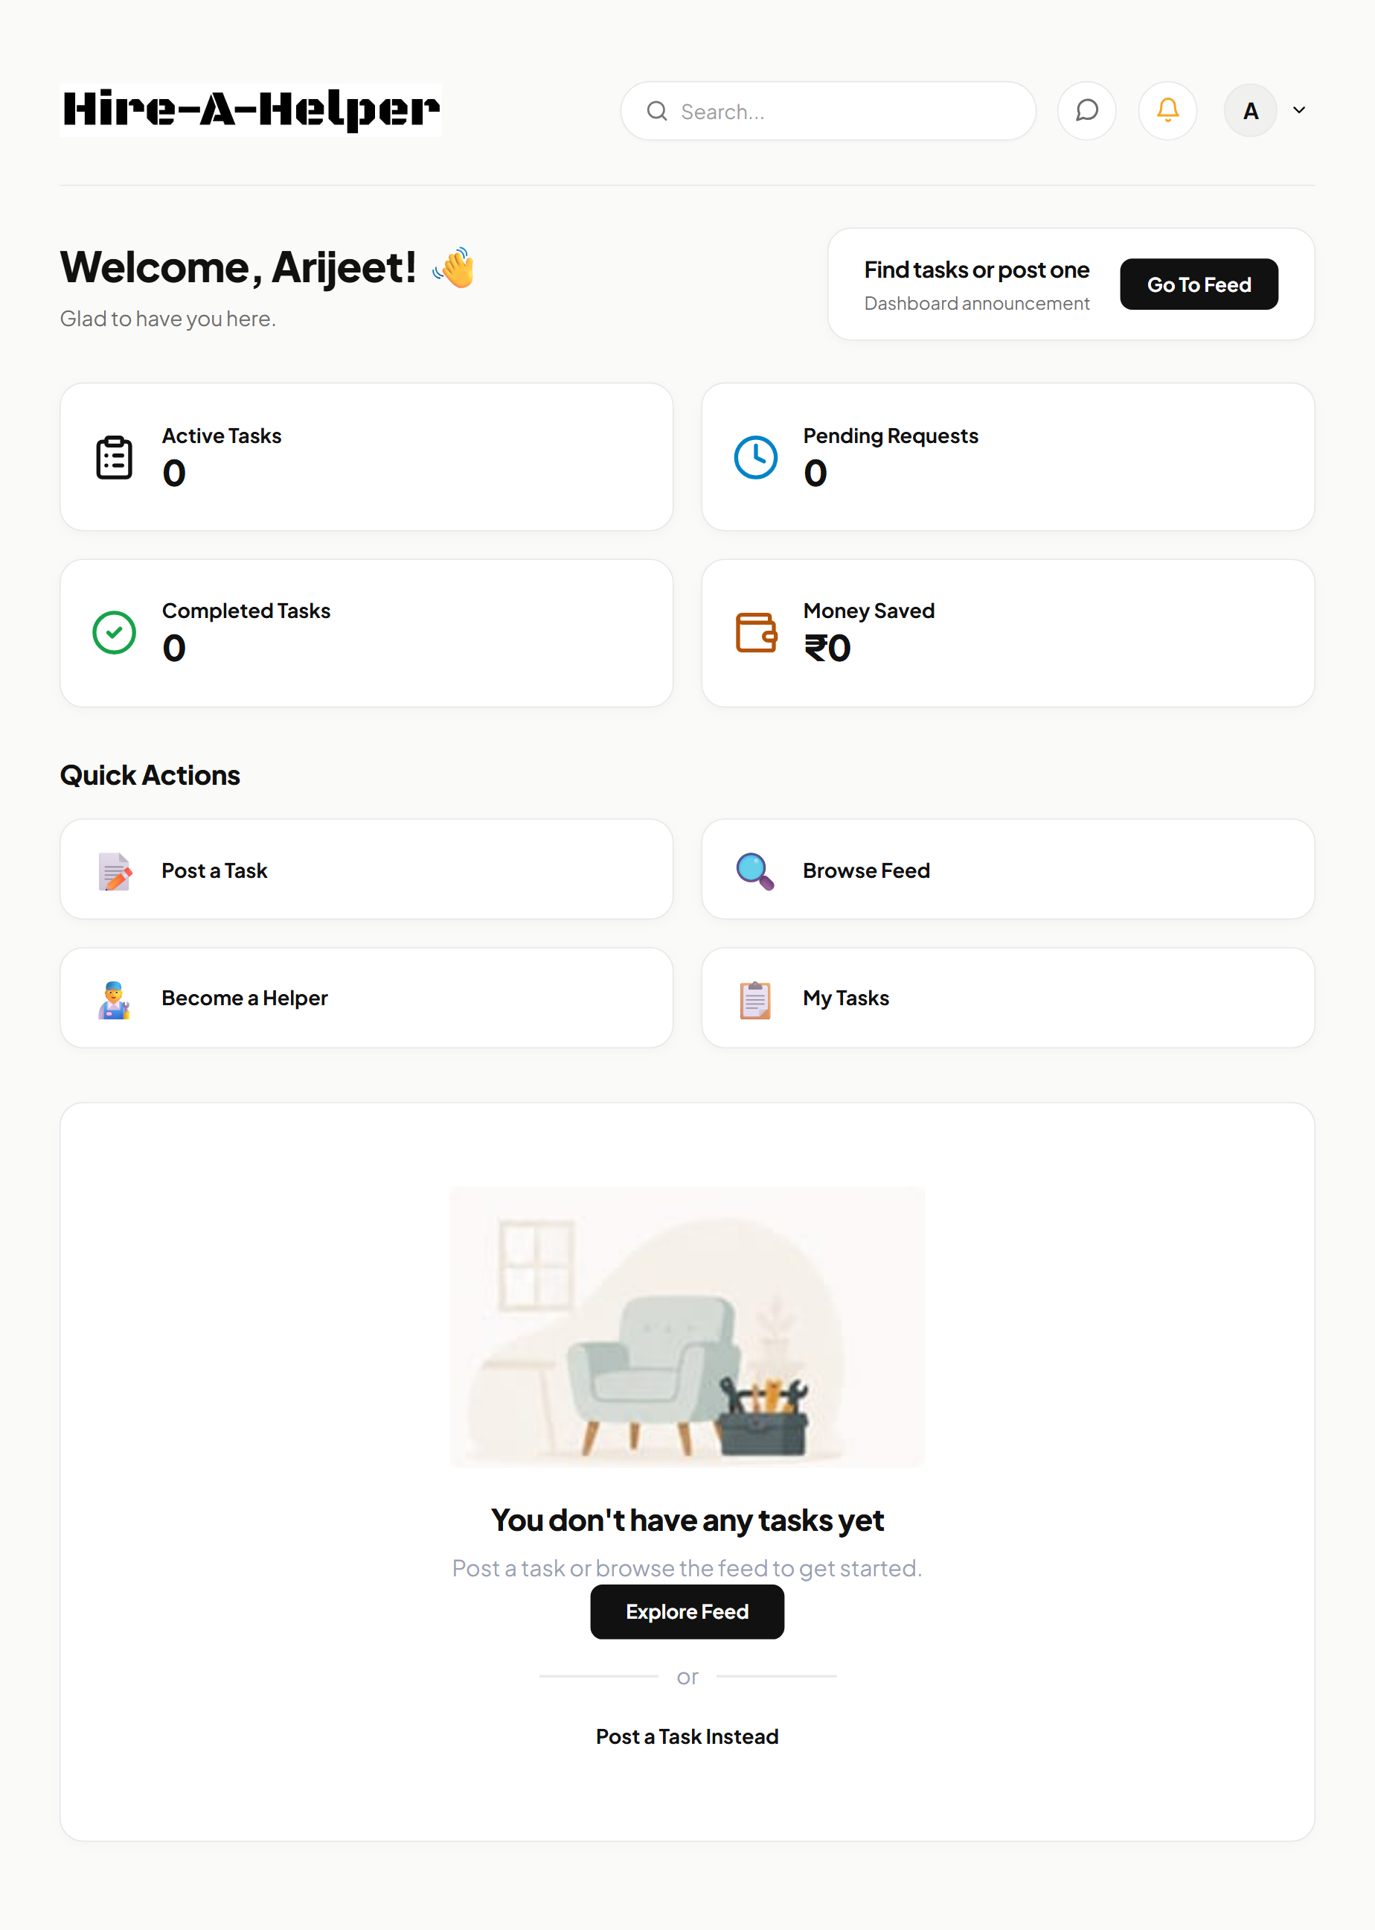
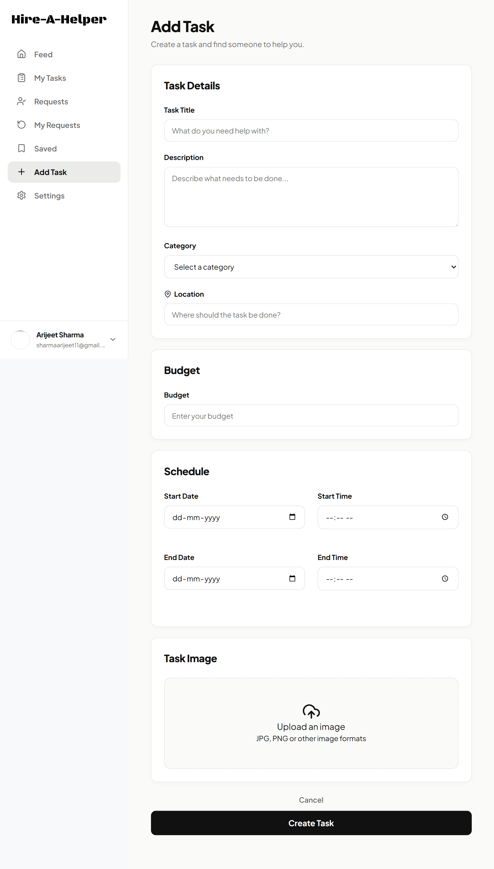
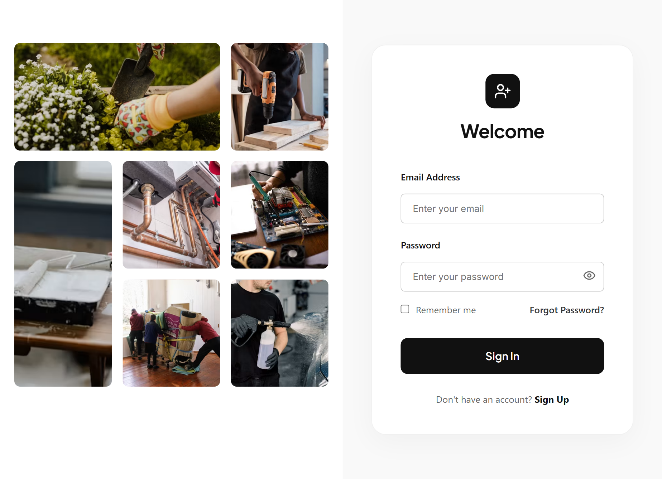
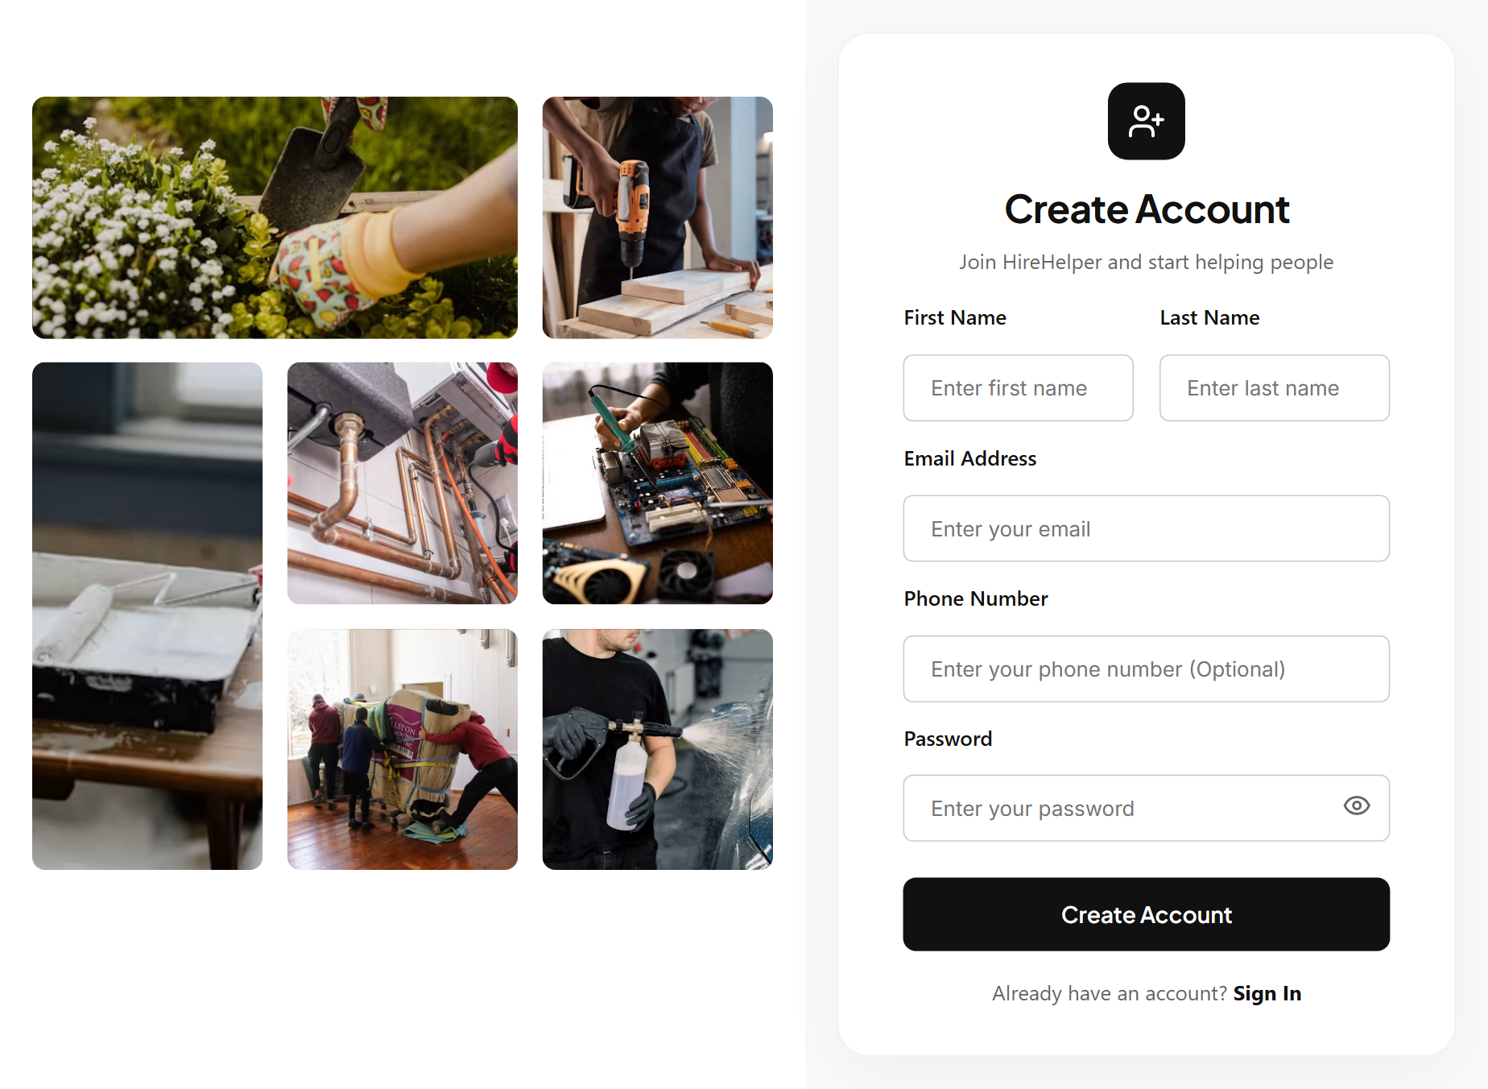
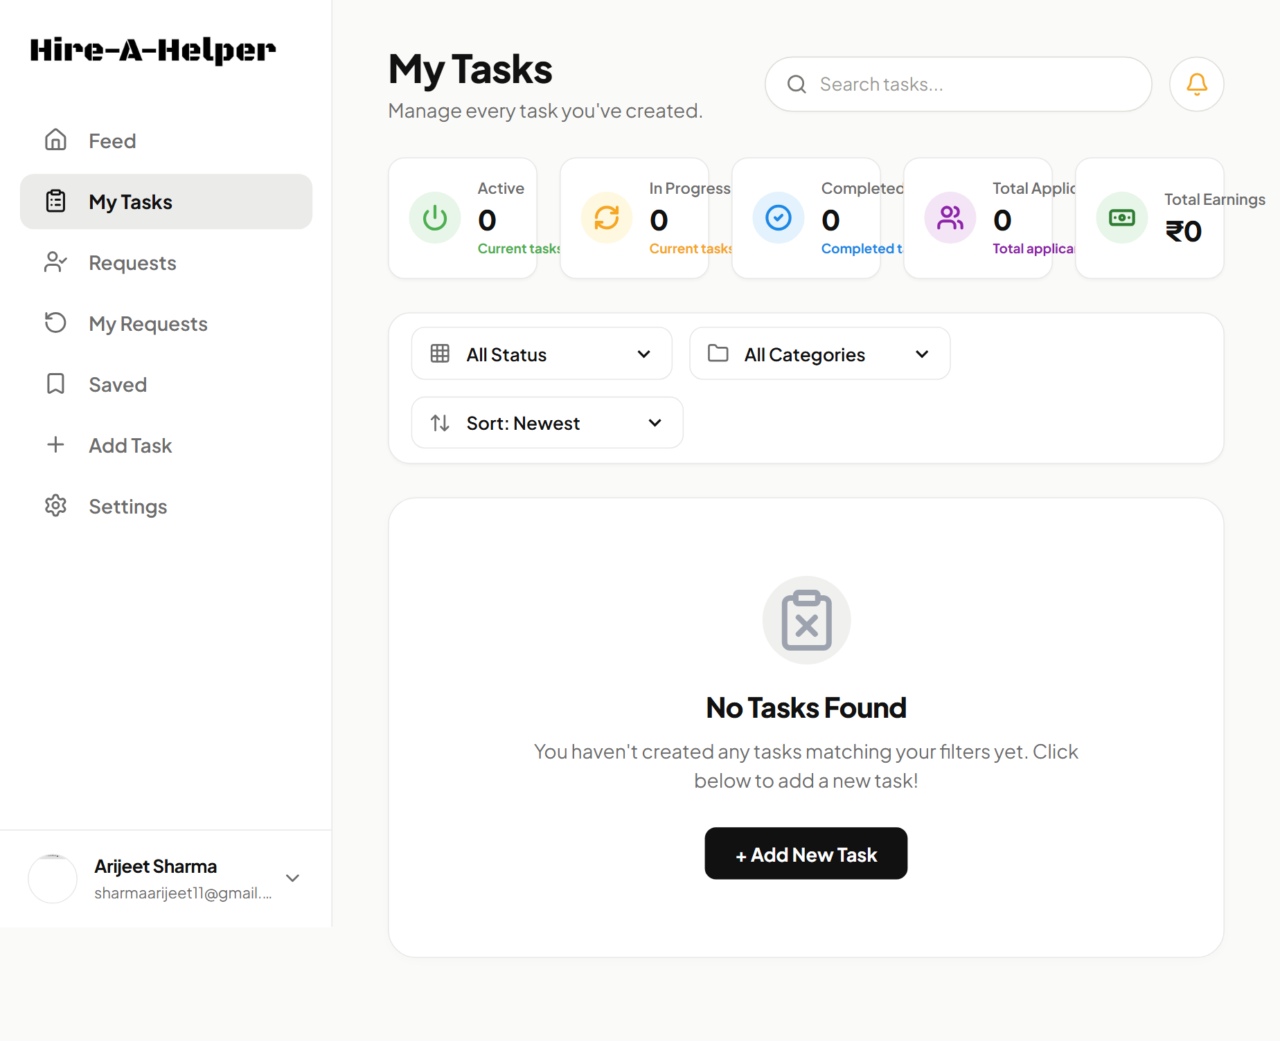
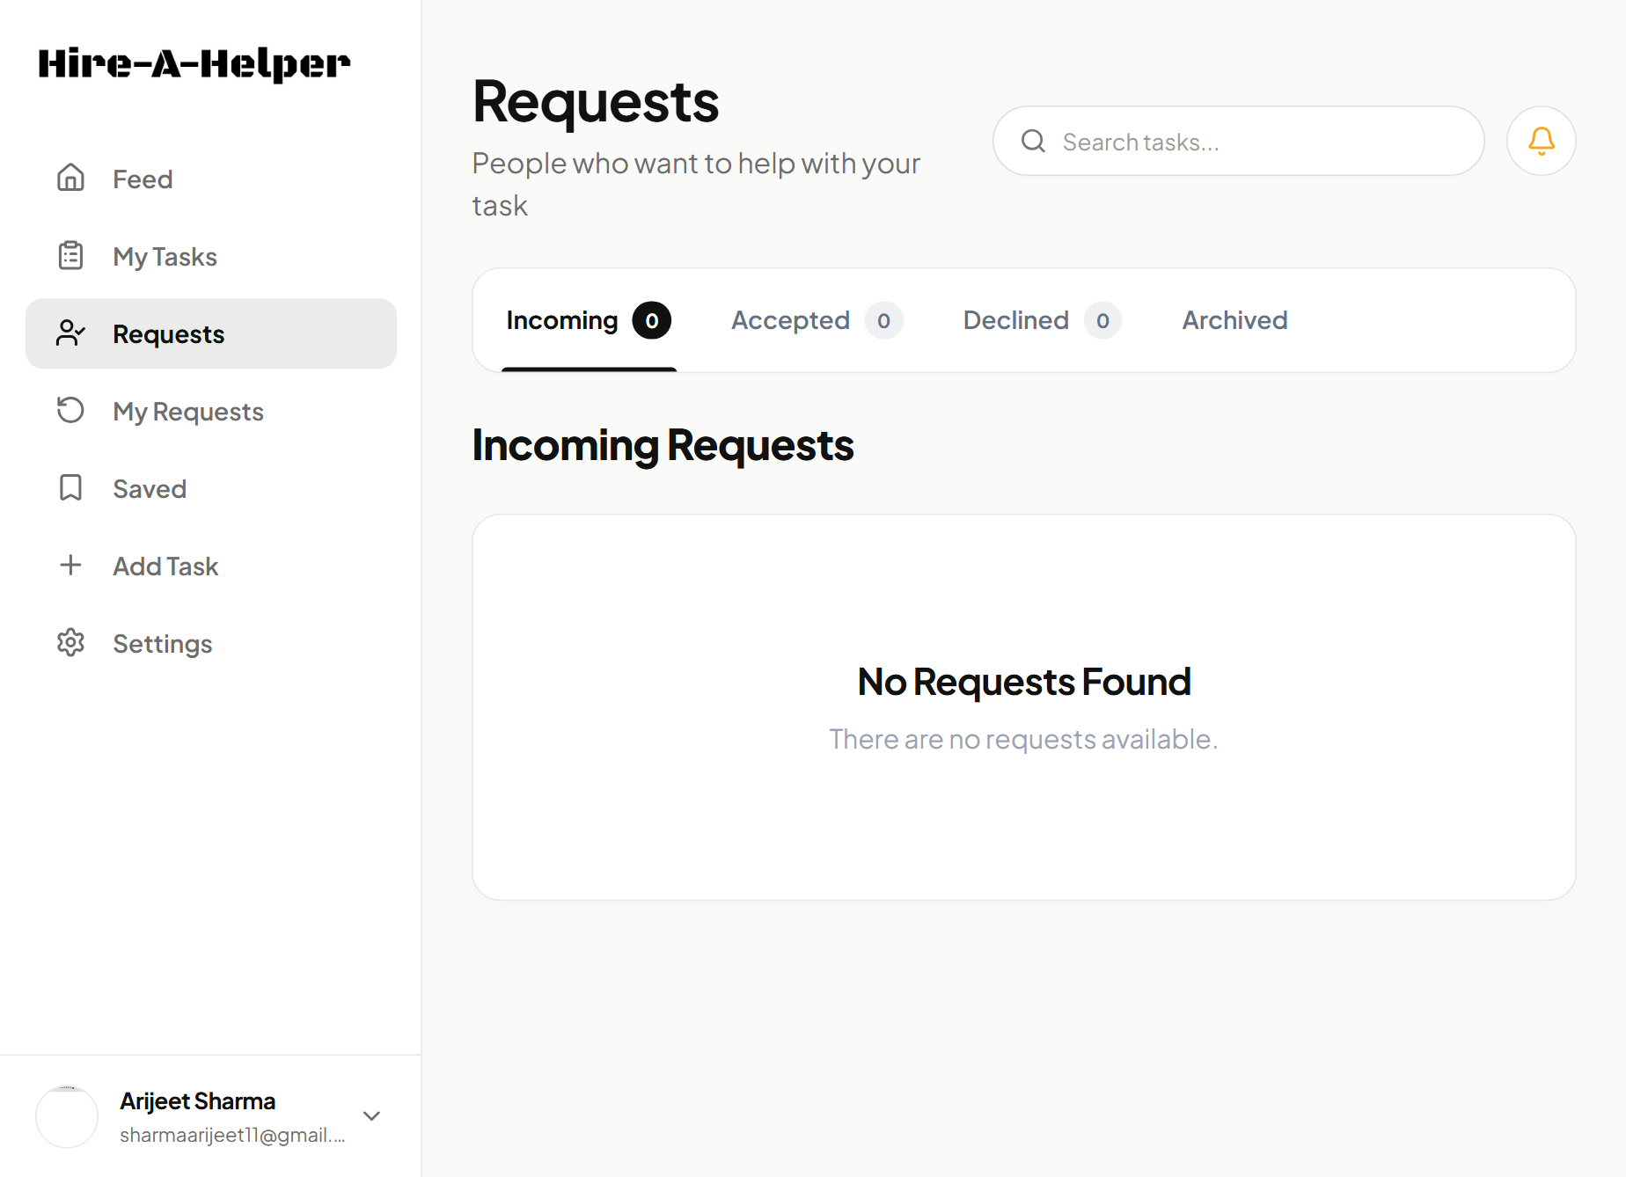
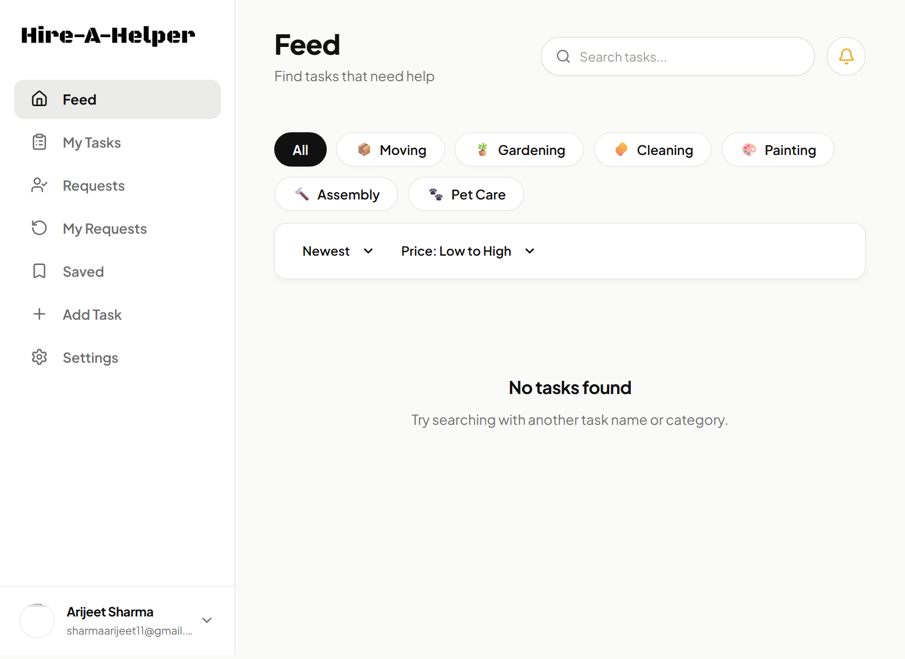
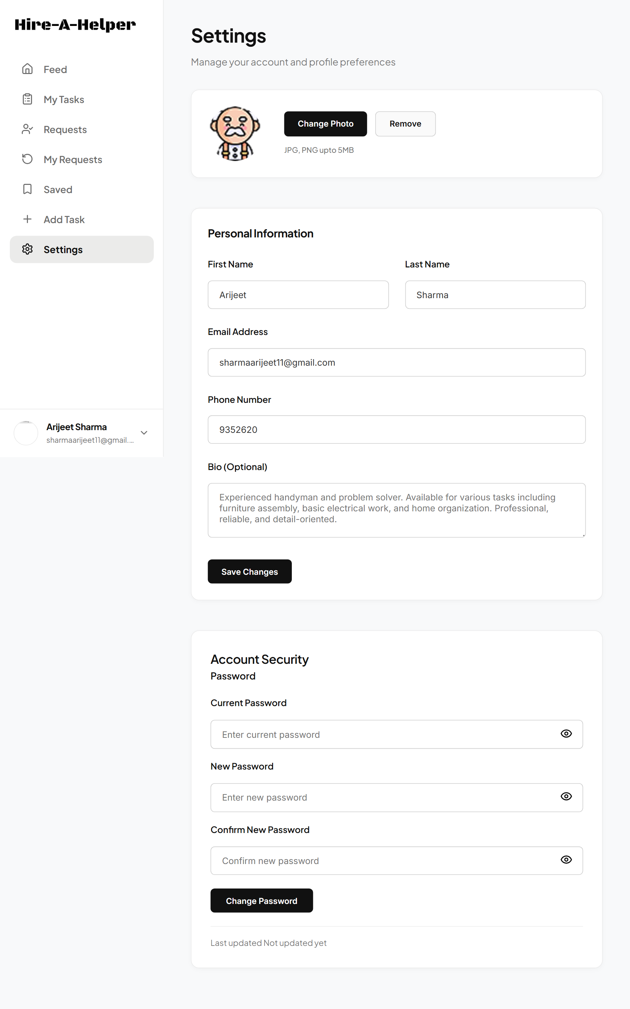
10
Key Application Screens & Features
Professional editable placeholders for your real project screenshots
HireHelper | Infosys Springboard Virtual Internship | HireHelper_Team1

Slide 11
11
Frontend–Backend API Integration
How data moves through the full-stack application
User Action
→
React Page /
Component
→
API Service
Layer
→
Axios
Request
→
Express
Route
→
Controller /
Logic
→
MongoDB
→
Response &
UI Update
React interfaces communicate with Express APIs; backend logic performs application operations and database communication before returning dynamic data to the UI.
HireHelper | Infosys Springboard Virtual Internship | HireHelper_Team1

Slide 12
12
Team Development & Collaboration
HireHelper was developed collaboratively through shared modules, integration, testing, and version control.
HireHelper Team
Frontend Development
Backend Development
Database & Integration
User interfaces, pages, navigation, and application experience.
APIs, business logic, authentication, and data processing.
Data management, API integration, testing, and module connectivity.
Planning → Module Development → Testing → Integration → Pull Requests → Review & Merge
HireHelper | Infosys Springboard Virtual Internship | HireHelper_Team1

Slide 13
13
Development Workflow & Tools
Implementation, testing, version control, and integration
Feature Branch
→
Development
→
Testing
→
Commit
→
Push
→
Pull Request
→
Review / Merge
→
Develop Branch
Git
GitHub
Postman
MongoDB Atlas
VS Code
Version control
Collaboration & PRs
API testing
Cloud database
Development
HireHelper | Infosys Springboard Virtual Internship | HireHelper_Team1

Slide 14
14
Challenges & Learning Outcomes
Key lessons from building and integrating the complete project
Frontend–Backend Integration
→
Connected interfaces, APIs, backend logic, and database responses.
Static to Dynamic Data
→
Integrated backend-driven functionality to reduce reliance on isolated mock flows.
Authentication & Security
→
Integrated OTP, JWT, password hashing, protected routes, and recovery workflows.
Email & API Configuration
→
Configured email integration and tested API request/response flows.
Collaborative Integration
→
Used branching and pull requests while integrating independently developed modules.
HireHelper | Infosys Springboard Virtual Internship | HireHelper_Team1

Slide 15
HireHelper
A complete full-stack task assistance platform integrating user access, task workflows, navigation, APIs, backend logic, database communication, and collaborative development.
Future Scope
Enhanced integrations • Real-time updates • Notifications • Ratings / reviews • Better matching • Analytics • Scalability
Thank You
Questions & Discussion

