Slide 1

EcoTrack
Group 2
Track Your Impact.
Build a Greener Future.
PROJECT PRESENTATION
01

Slide 2
Introduction
A digital platform to support everyday sustainable choices
What is EcoTrack?
EcoTrack is a sustainability-focused web application that helps users record everyday activities and understand their environmental impact.
Project objectives
Track transportation, electricity use and waste activity.
Monitor personal goals and community challenge progress.
Measure • Improve • Sustain
Support administrators with managing user and create challenge and generating reports.
Designed for users and admins
ECOTRACK • GROUP 2
02

Slide 3
Technology Stack
Technologies identified in the supplied project source
FRONTEND
UI & VISUALS
API INTEGRATION
React.js
Tailwind CSS / CSS
Axios
JavaScript • React Router • Vite
Responsive layouts and component styling
HTTP requests to backend endpoints
BACKEND
DATABASE
SUPPORTING TOOLS
Node.js • Express
MongoDB • Mongoose
Nodemailer • node-cron
Routes, controllers, middleware and scheduled jobs
Models, schemas and aggregation
Email OTP verification and scheduled reminders
ECOTRACK • GROUP 2
03

Slide 4
Key Features
User-facing functionality and administration tools
ACTIVITY TRACKING
SUSTAINABILITY
ACCOUNT & ADMIN
↗
✓
⚙
Transportation
Goals and progress
Email verification and profiles
Electricity consumption
Community challenges
Admin dashboard and user management
Waste management
Notifications and reminders
Challenge management and reports
ECOTRACK • GROUP 2
04

Slide 5
System Architecture
High-level request and data flow based on the supplied codebase
USER / ADMIN
REACT FRONTEND
EXPRESS API
MONGODB
Browser
Pages • Layouts • Routes
Routes • Controllers
Mongoose models
Supporting services
Email OTP (Nodemailer) • Scheduled jobs (node-cron) • Aggregation-based summaries • PDF reports
ECOTRACK • GROUP 2
05

Slide 6
Key Challenges
Summary of implementation challenges.
Carbon Footprint Tracking
Developing a reliable activity tracking system to record transportation, electricity consumption, and waste production and calculate the associated carbon footprint.
Goal and Challenge Progress Calculation
Implementing accurate progress tracking and automatically updating goal and challenge statuses based on user activities, targets, and defined time periods.
Automated Goal and Challenge Suggestions
Developing an automated system to suggest personalized goals and challenges and send timely reminders and notifications to encourage users to adopt sustainable habits.
Developing a reporting feature to retrieve and organize user statistics, challenge participation, and completion data.
Ensuring that report information is presented in a clear and structured format for effective administrative monitoring and analysis.
Admin Report Generation
ECOTRACK • GROUP 2
06

Slide 7
Summary of implementation challenge's solution
Carbon Footprint Tracking
Used MongoDB Mongoose Aggregation to process and summarize user activities.
Grouped activity data by day, week, and month to calculate carbon emissions and display tracking statistics
Goal and Challenge Progress Calculation
Developed backend logic to calculate progress based on user activities, predefined targets, and time periods.
Automatically updated goal and challenge statuses according to the user's progress and completion criteria.
Used MongoDB Mongoose Aggregation to process and summarize user activities.
Grouped activity data by day, week, and month to calculate carbon emissions and display tracking statistics.
Automated Goal and Challenge Suggestions
Used the node-cron package to schedule automated tasks at predefined times and intervals.
Implemented backend logic to generate goal and challenge suggestions and send scheduled reminders and notifications to users.
Implemented backend API integration to retrieve report data for the admin panel.
Organized the retrieved information into structured report sections for easier interpretation.
Connected the reporting functionality with the admin interface to support monitoring of user statistics and challenge progress.
Admin Report Generation
ECOTRACK • GROUP 2
07

Slide 8
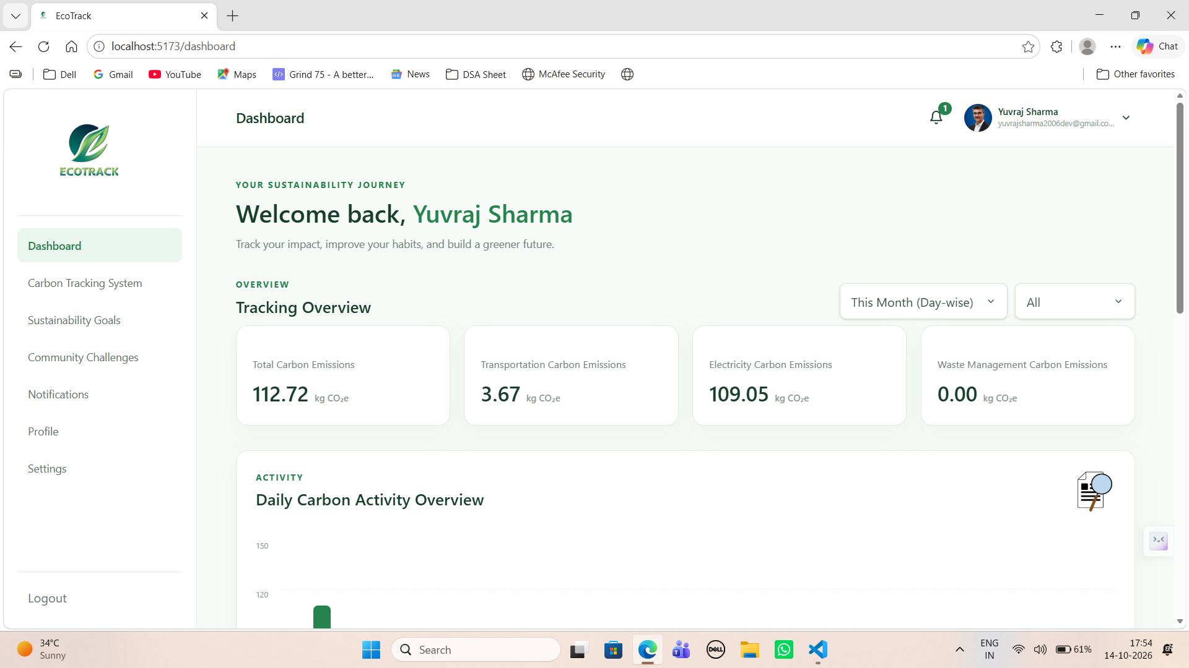
Key Pages — User Experience
User Dashboard
ECOTRACK • GROUP 2
08

Slide 9
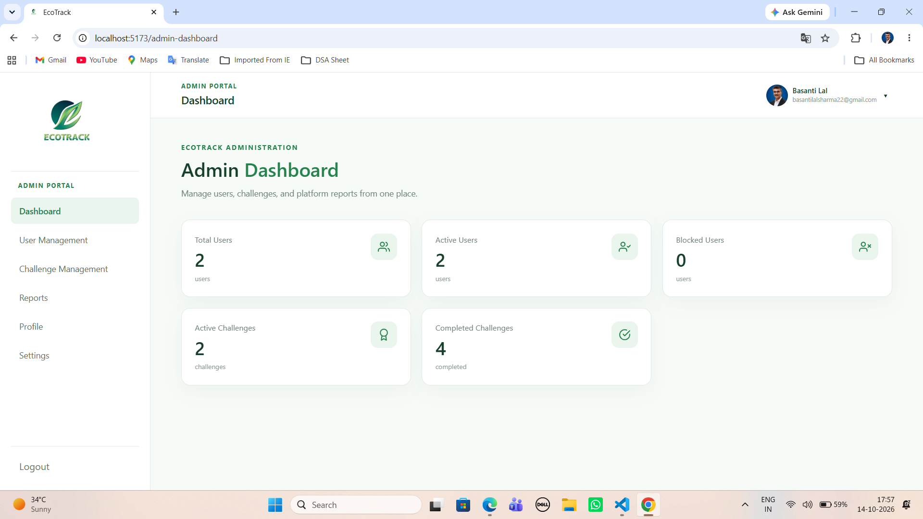
Key Pages — Admin Portal
Admin Dashboard
ECOTRACK • GROUP 2
09

Slide 10
Outcome & Impact
What EcoTrack brings together
CENTRALIZED TRACKING
PROGRESS VISIBILITY
Records transportation, electricity and waste activity in one place.
Supports progress monitoring for personal sustainability goals and challenges.
AUTOMATION
ADMIN INSIGHTS
Scheduled suggestions and reminders encourage continued engagement.
Dashboard and reports help administrators review user and challenge information.
Impact statement: Makes sustainability activity easier to record, review and act on.
ECOTRACK • GROUP 2
10

Slide 11
ECOTRACK • GROUP 2
Questions & Answers
Thank You
TEAM MEMBERS :-
Yuvraj Sharma • Shreeram Patel • Namratha Kalivarapu
Priyanka Kumari • Uppala Naveen Kumar • Balavighnesh J
TRACK YOUR IMPACT. BUILD A GREENER FUTURE.
11

