Slide 1
EcoTrack
Environmental activity tracking and carbon footprint awareness
Track your habits.
Understand your impact.
EcoTrack Group 3

Slide 2



01 · THE NEED
Track the everyday
Everyday actions need clearer environmental awareness
Record habits across travel, electricity, food, water, and waste.
See the footprint
Bring frontend footprint estimates into the same view.
One experience connects activity, footprint awareness, and personal reflection.
Reflect personally
Use the dashboard, profile, login, and registration interfaces to make the experience consistent.

Slide 3



02 · SYSTEM ARCHITECTURE
A simple stack with clear responsibilities
Each layer has a defined role. Integration is the next milestone.
Angular
Node.js + Express
MongoDB
Frontend UI, pages, navigation, and activity interfaces.
Server routes, API logic, and request handling.
Intended database layer for persistent application data.
Next integration milestone: show API calls and data operations connecting the three layers.

Slide 4
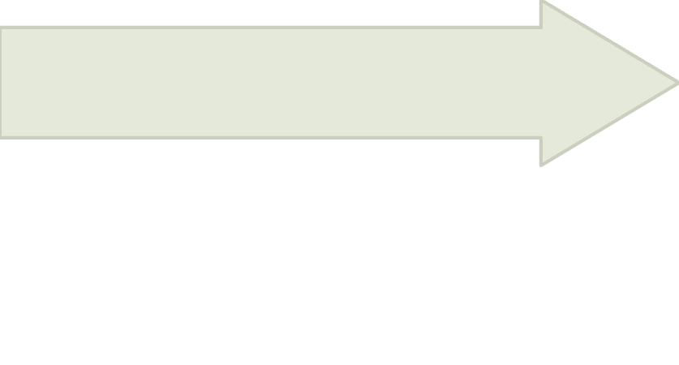
03 · INTENDED BENEFITS
From daily activity to informed choices
EcoTrack turns small records into a clearer moment of reflection.
Intend
Reflect
Set personal environmental intentions.
Estimate
Everyday patterns become visible.
Record
Frontend footprint estimates.
Habits across five activity categories.
These are intended benefits, not measured outcomes.

Slide 5




04 · USER JOURNEY
The planned user journey is easy to follow
From entry to reflection, each step has a clear next action.
Register or log in
Open the dashboard
Track an activity
Review a footprint estimate
READY
NEXT
Frontend interfaces and calculation
Authentication, persistence, and full integration

Slide 6
05 · DEVELOPMENT PATH
Build in layers. Integrate. Validate.
The project moves from understanding the need to checking the complete journey.
01
02
03
04
Understand requirements
Plan structure and UI
Build frontend pages
Implement frontend carbon calculation
05
06
07
Develop backend and database
Connect frontend and backend
Validate the complete journey
Planning · developed · working · in progress · pending validation

Slide 7





06 · INTEGRATION CHALLENGE
The hard part is making the pieces work together
Remaining work: reliable services, persistent data, and end-to-end checks.
API connection
Category consistency
Angular ↔ Express.
Travel, electricity, food, water, and waste.
Data operations
Full-journey validation
MongoDB persistence for application data.
Check the experience from login through footprint review.
Authentication
Session and user flow.

Slide 8
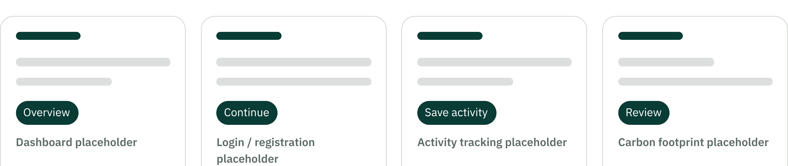
07 · INTERFACE DIRECTION
Designed for clarity, not complexity
Clear navigation, readable hierarchy, and straightforward input areas guide the experience.
Distinct categories: travel, energy, food, water, and waste.
Placeholders indicate screen roles only. No application screenshots or data are fabricated.

Slide 9


08 · THE TEAM
EcoTrack
Group 3
[Mekala Sowmya]
[Dharani Billa ]
Shared goal: make environmental impact easier to understand.
[Frontend developer]
[Frontend Developer]

Slide 10
ECOTRACK · GROUP 3
Thank you
Building awareness for a more sustainable tomorrow.
Track
Understand
Improve
Questions and answers

