Slide 1

Clean Street – Civic Issue Reporting & Tracking System
Infosys Springboard Internship | Full Stack Development Project

Slide 2
Problem Statement
Citizens face significant challenges in reporting and tracking civic issues in their communities.
Reporting Difficulties
No Centralized System
Citizens lack convenient channels to report issues like garbage dumps, potholes, water leakage, and broken streetlights.
Without a unified platform, complaints get lost across multiple departments with no clear tracking mechanism.
Transparency Gap
Poor Prioritization
Residents cannot monitor complaint resolution progress, leading to frustration and mistrust in civic authorities.
Authorities struggle to identify urgent issues and allocate resources effectively without data-driven insights.

Slide 3

Proposed Solution
Web-Based Platform
A comprehensive civic engagement system that connects citizens with authorities through a transparent digital platform.
Report issues with photo evidence and precise location tagging
Automated complaint assignment to relevant authorities
Real-time tracking of complaint status from submission to resolution
Community voting and commenting to prioritize issues
Admin dashboard with analytics and monitoring tools

Slide 4
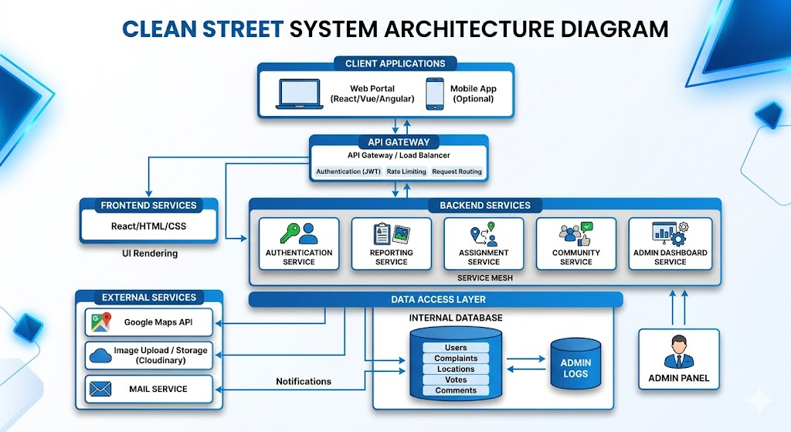

Slide 5
Technology Stack
Frontend
Backend
HTML5, CSS3, JavaScript with React for dynamic user interface and responsive design
Node.js with Express or Java Spring Boot for RESTful API development and business logic
Database
Maps API
MySQL for relational data or MongoDB for document-based storage of complaints and user data
Google Maps or Leaflet integration for location tagging and geographical visualization of issues
Image Upload
Security
Multer or similar middleware for handling photo attachments with validation and secure storage
JWT or Session-based authentication with role-based access control for different user types

Slide 6
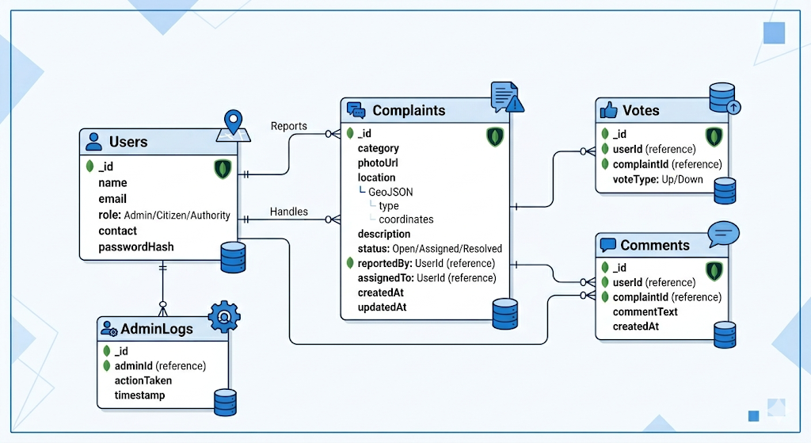
Database Design

Slide 7
Key Features
1
2
User Authentication
Issue Reporting
Secure registration and login with role-based access control for citizens, authorities, and administrators
Submit complaints with photo evidence, precise location tagging, and detailed descriptions
3
4
Complaint Tracking
Community Engagement
Real-time status updates from "Submitted" to "In Progress" to "Resolved" with timestamps
Vote on issues to prioritize, comment to share information, and view community discussions
5
6
Admin Dashboard
Report Generation
Comprehensive monitoring interface with analytics, complaint management, and reporting tools
Export complaint data, resolution statistics, and performance metrics in various formats

Slide 8
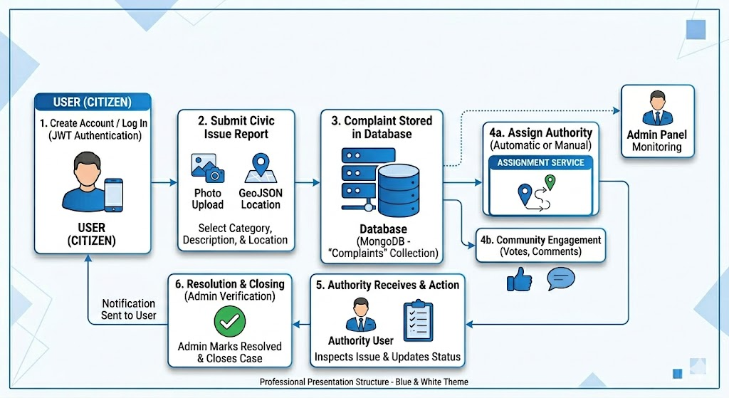
System Workflow

Slide 9

Results & Impact
Improved Reporting
Streamlined process reduces complaint submission time from days
to minutes
Enhanced Transparency
Real-time tracking builds trust between citizens and civic authorities
Community Participation
Voting and commenting features increase civic engagement and
awareness
Efficient Resolution
Automated assignment and prioritization leads to faster issue
resolution

Slide 10




Future Enhancements
Next-generation features to expand system capabilities and user reach.
Mobile App
AI Detection
Real-Time Alerts
Native iOS and Android applications for on-the-go reporting
Image recognition to automatically categorize issue types
Push notifications for status updates and new issues
Conclusion
The Clean Street system bridges the communication gap between citizens and authorities, enabling transparent, efficient civic issue management that leads to cleaner, better-maintained communities.

Slide 11

THANK YOU

