Slide 1

Autonomous Cognitive Engine for Deep Research and Long-Horizon Tasks
Presented by,
Divyadharshini.S

Slide 2
Overview:
AI-based system for complex, long-running research workflows
Designed to maintain context, planning, and execution over time
Uses a multi-agent, state-driven architecture
Automates research-oriented tasks such as:
Information retrieval
Summarization
Task tracking
Memory management

Slide 3
Problem Statement:
Why This Project?
Traditional LLM systems:
Lose context in long conversations
Lack structured planning
Produce inconsistent outputs
Manual research workflows are:
Time-consuming
Difficult to track
Error-prone

Slide 4
Approach & System Architecture:
Agent-Driven Modular Approach
System follows a Supervisor–Worker architecture
Each agent has a clear, dedicated responsibility
Execution is state-driven and sequential
Shared state ensures context continuity
Core Components
Supervisor Agent
Worker Agent
Virtual File System (VFS)
LangGraph-based workflow orchestration

Slide 5
Agents :
Agent Responsibilities
Supervisor Agent
Interprets user intent
Generates structured TODO plans
Controls execution flow
Worker Agent
Executes tasks step-by-step
Stores intermediate outputs
Updates shared state

Slide 6
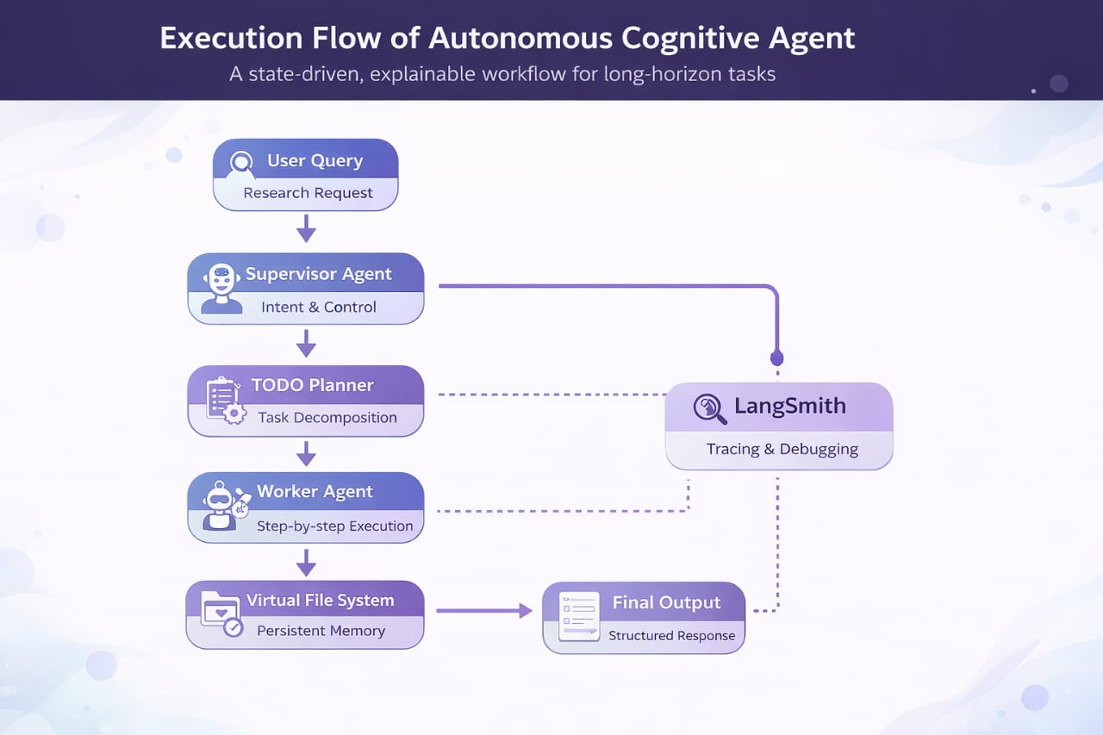
Workflow Execution:

Slide 7
Technology Stack:
Tools & Technologies Used
Programming Language:
Python 3.10+
Agent Frameworks: LangChain, LangGraph
LLM Integration: Groq API (LLaMA 3.1)
Environment Management: python-dotenv
Observability: LangSmith
User Interface: Streamlit
Version Control: Git & GitHub (branch-based workflow)

Slide 8
User Interface (Streamlit UI):
Interactive User Experience
Chat-based interface
Real-time agent responses
Persistent session state
Clear visualization of task execution
UI Advantage
Easy interaction with autonomous agents
Suitable for both research and automation use cases

Slide 9
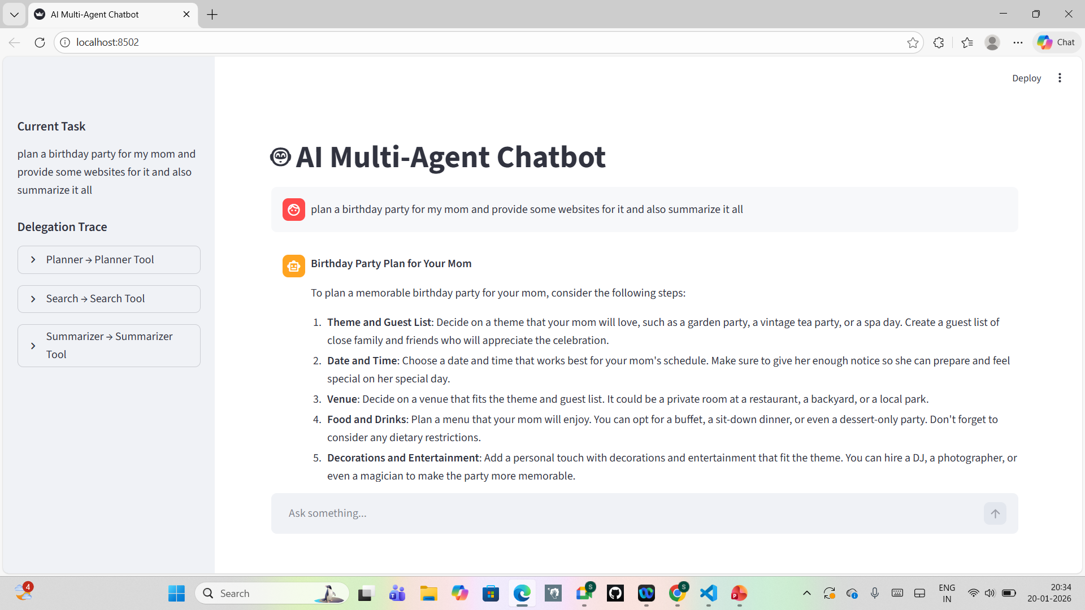
Streamlit User Interface:

Slide 10
LangSmith Observability & Debugging
LangSmith Integration
Tracks agent execution paths
Visualizes:
Task decomposition
LLM calls
State transitions
Helps in:
Debugging recursion issues
Improving prompt design
Understanding agent behavior
Benefit
Makes the system transparent and explainable

Slide 11
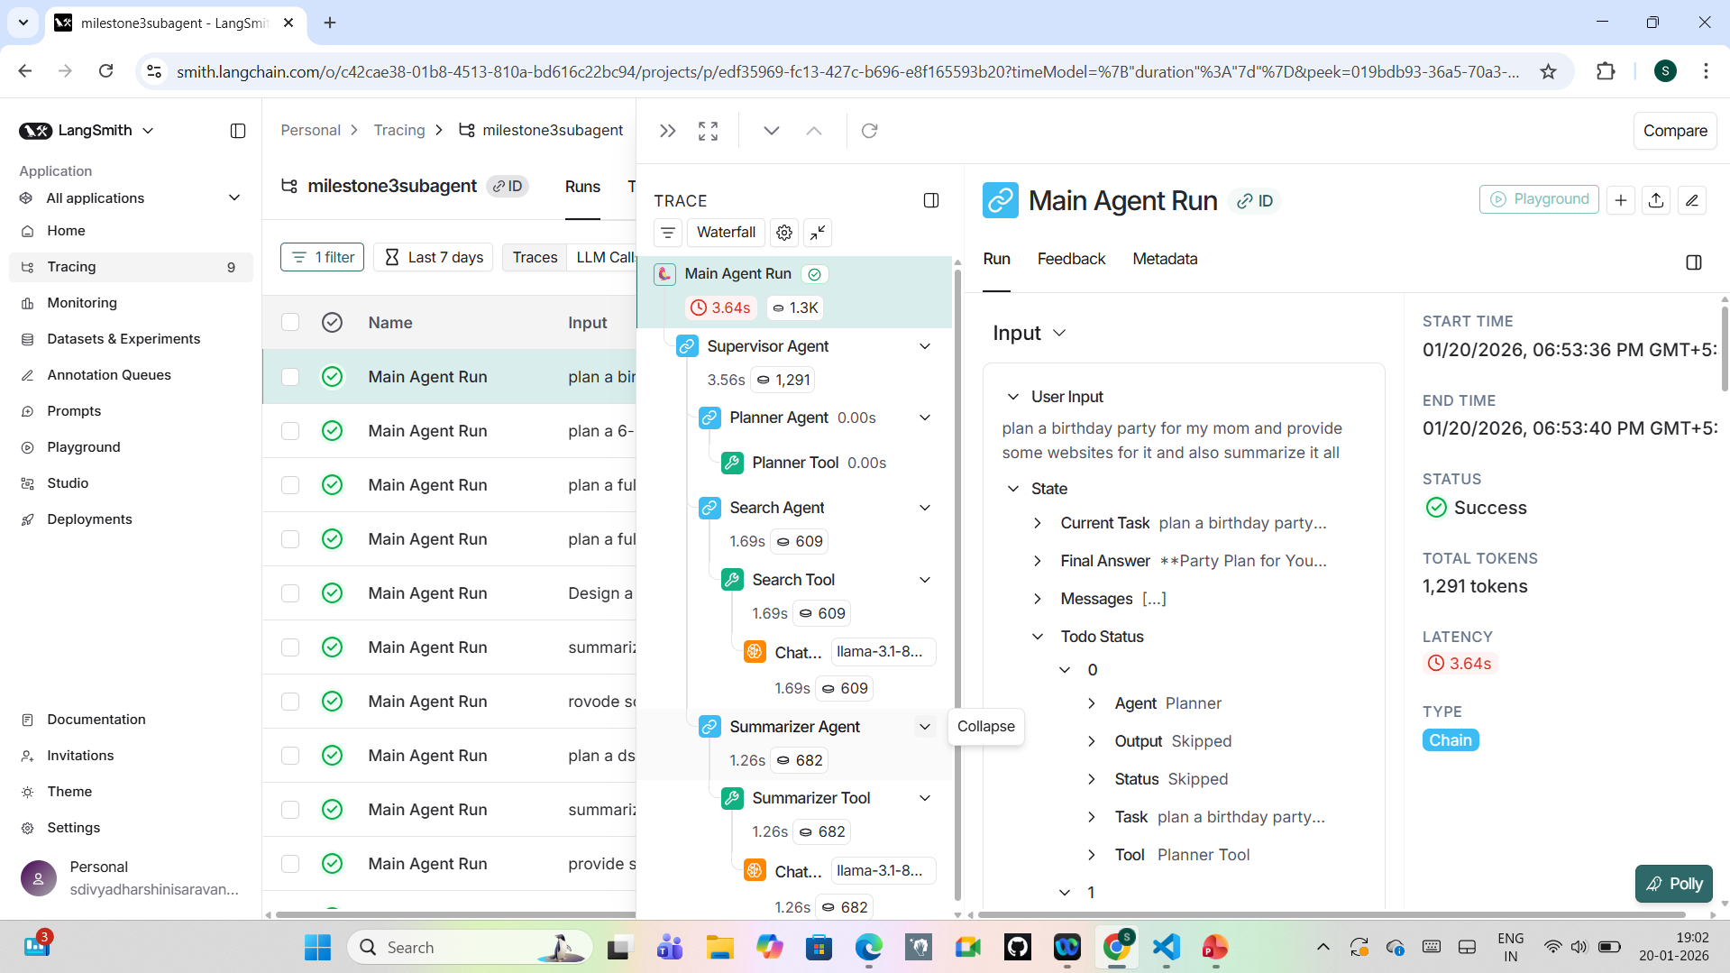
Langsmith Tracing:

Slide 12
Challenges Faced:
Managing long-term context within LLM limits
State recursion errors in LangGraph workflows
Coordinating shared state across multiple agents

Slide 13
Future Scope:
Parallel execution using multiple worker agents
Distributed cloud-based memory
Integration with external tools (web search, APIs)
Advanced task prioritization and scheduling

Slide 14
Conclusion:
Demonstrates a scalable autonomous agent system
Effectively combines:
Planning
Reasoning
Execution
Persistent memory
Provides a strong foundation for advanced AI research and automation

Slide 15
Q & A

Slide 16
THANK YOU!

