Slide 1
EcoPackAI – AI-Powered Sustainable Packaging Recommendation System

Slide 2
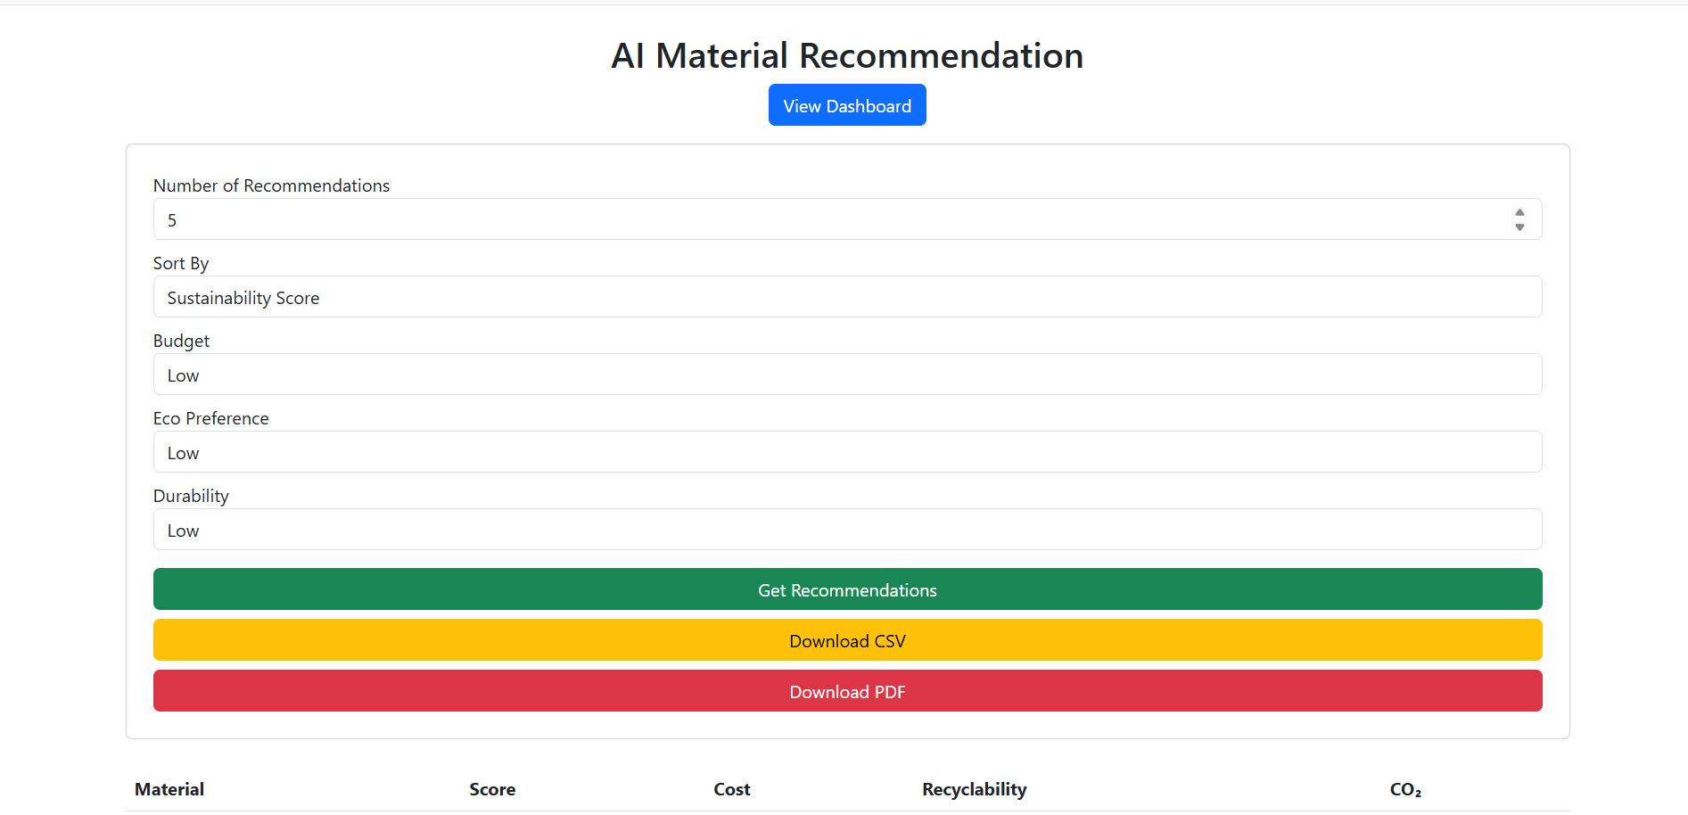
HOME PAGE

Slide 3
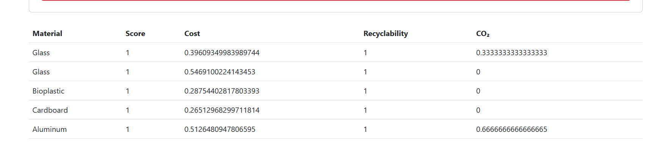
MATERIAL RECOMMENDATIONS

Slide 4
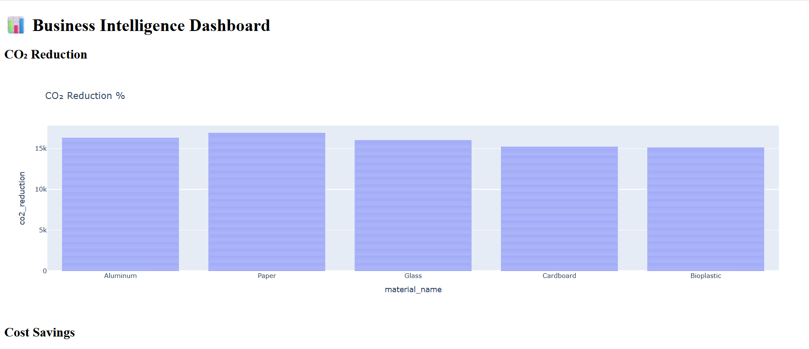
CO2 Reduction graph

Slide 5
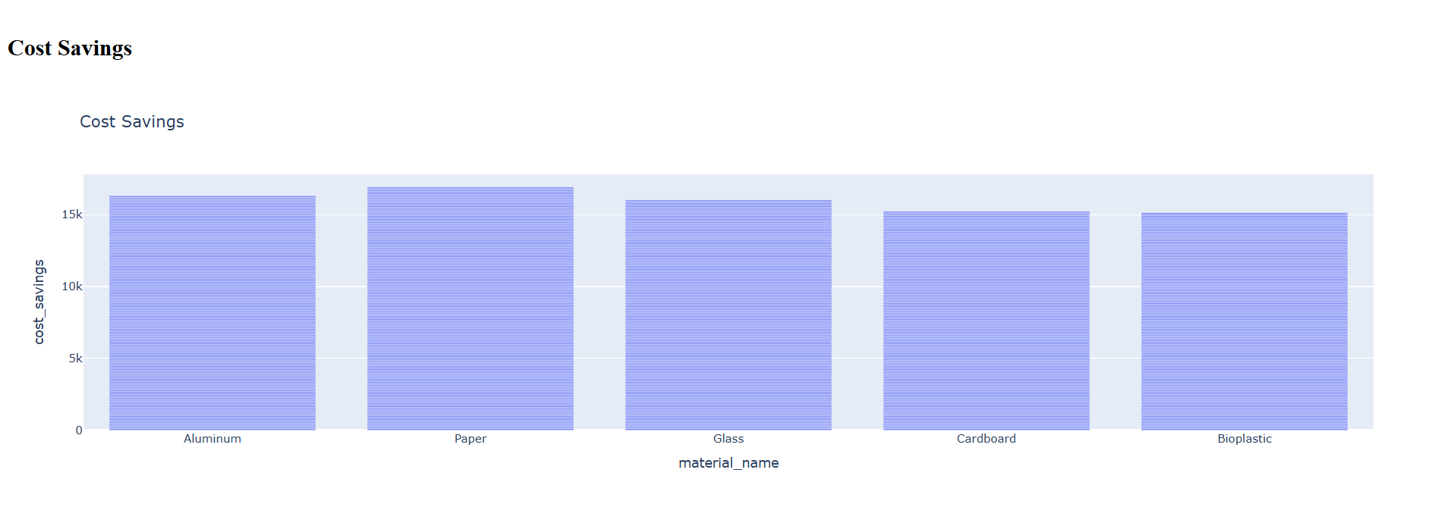
Cost Savings graph

Slide 6
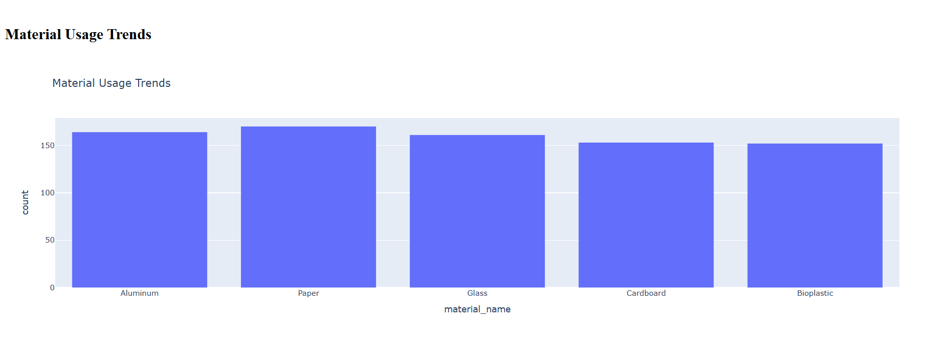
Material Usage graph

