Slide 1
EcoPackAI - Milestone 3
AI Framework for Sustainable Packaging
Prepared on 03 Mar 2026

Slide 2
Milestone 3 Goal
Deliver end-to-end integration of ML, backend API, and frontend dashboard.
Upgrade data realism using original base dataset and minimum 600 records.
Expose production-style recommendation endpoints with validation and error handling.

Slide 3
System Architecture Delivered
Data pipeline: base dataset -> realistic generation -> feature engineering -> model training.
Backend Flask API: health check, metadata, dataset recommendation, custom recommendation.
Frontend dashboard: backend status, ranked recommendations, custom input scoring.

Slide 4
Backend Completion
Implemented backend/app.py with robust model and dataset path fallback.
Added endpoints: GET /health, GET /metadata/material-types, GET/POST /recommend.
Enabled validation for payload fields, numeric parsing, and unknown material-type rejection.
Added CORS headers for browser-based frontend integration.

Slide 5
Frontend Completion
Replaced raw JSON output with polished cards, KPI blocks, and ranked materials table.
Integrated direct API calls for health, dataset recommendation, and custom recommendation.
Added dynamic material-type loading from backend metadata endpoint.
Responsive layout optimized for demo and stakeholder review.

Slide 6
Data Realism and Production Readiness
Regenerated dataset from original 25-row base source to 720 realistic rows.
Applied domain-aware constraints across strength, cost, CO2, recyclability, and biodegradability.
Added data quality gate script with checks for row count, nulls, range, duplicates, and correlation.
Retrained models and refreshed scaler/artifacts using improved dataset.

Slide 7
Model Performance (Milestone 3)
Evaluation on refreshed 720-row realistic dataset
Cost Model RMSE: 0.759
Cost Model MAE: 0.541
Cost Model R2: 0.988
CO2 Model RMSE: 0.150
CO2 Model MAE: 0.110
CO2 Model R2: 0.997
Corr(cost, strength): 0.734
Corr(co2, recyclability): -0.726

Slide 8
Milestone 3 Outcomes
Integrated recommendation workflow is running from UI to trained model predictions.
Dataset quality and realism are significantly improved for demo and pre-production testing.
Codebase now supports reproducible retraining and quality checks before deployment.

Slide 9
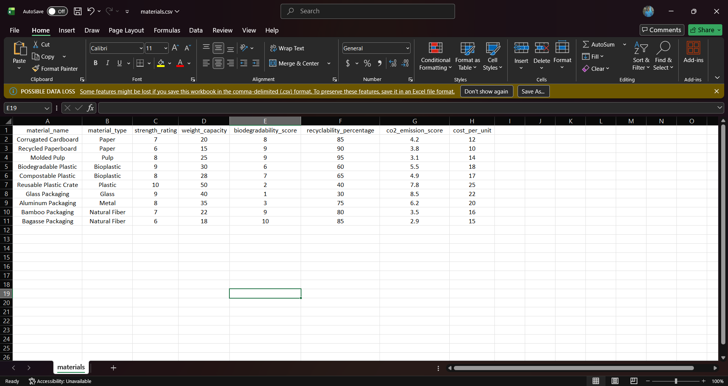
Demo Screenshot 1
Milestone 3 implementation snapshot

Slide 10
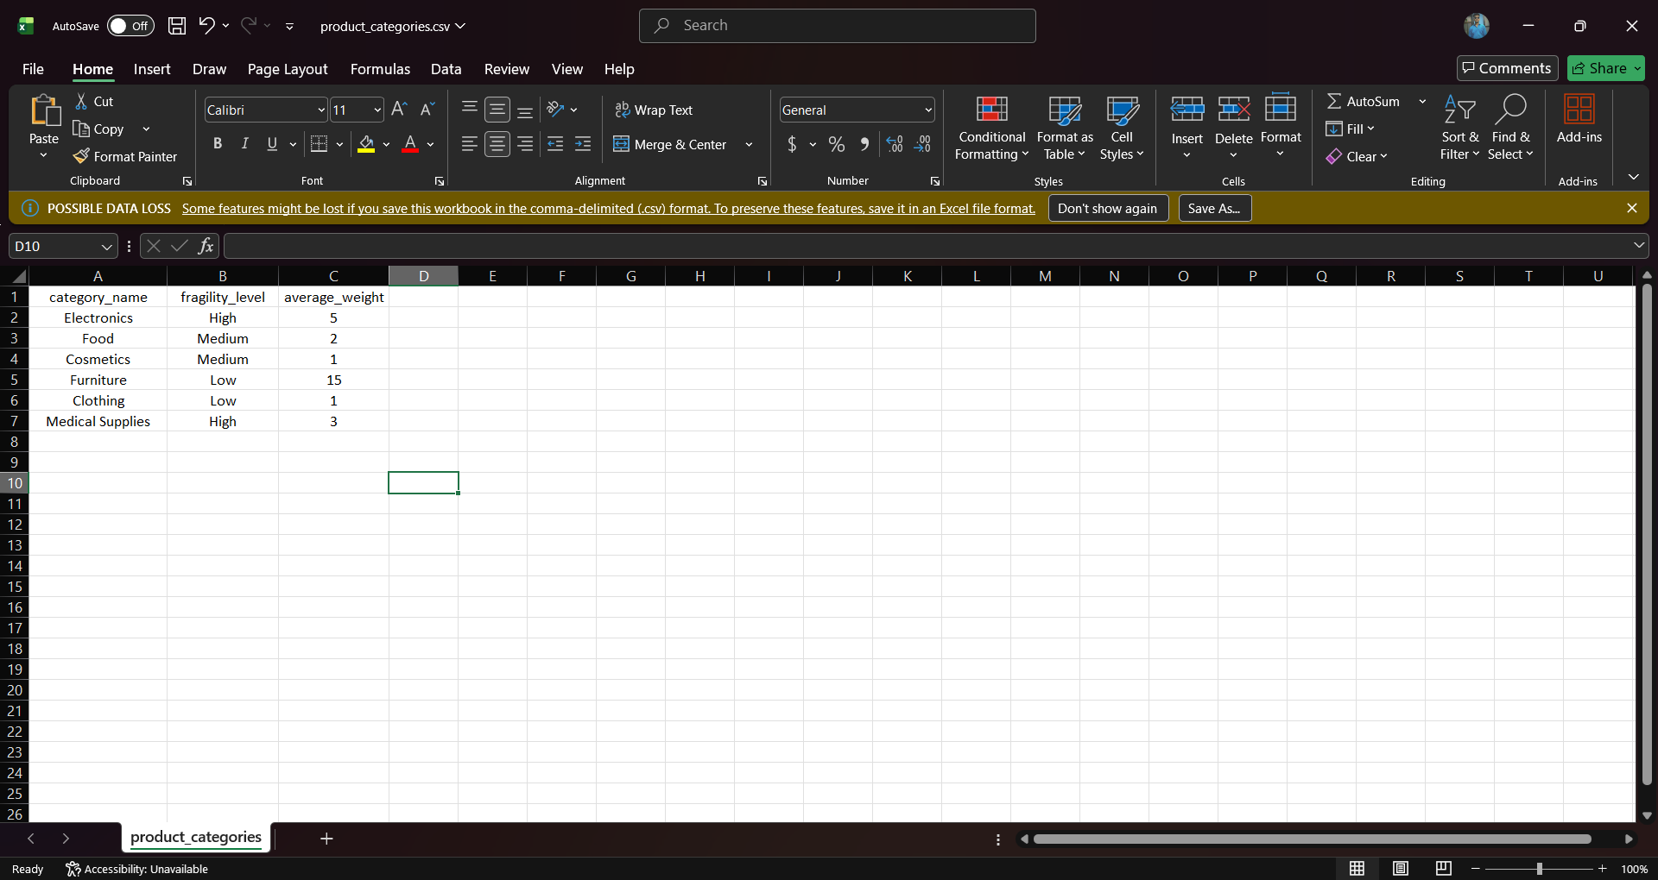
Demo Screenshot 2
Milestone 3 implementation snapshot

Slide 11
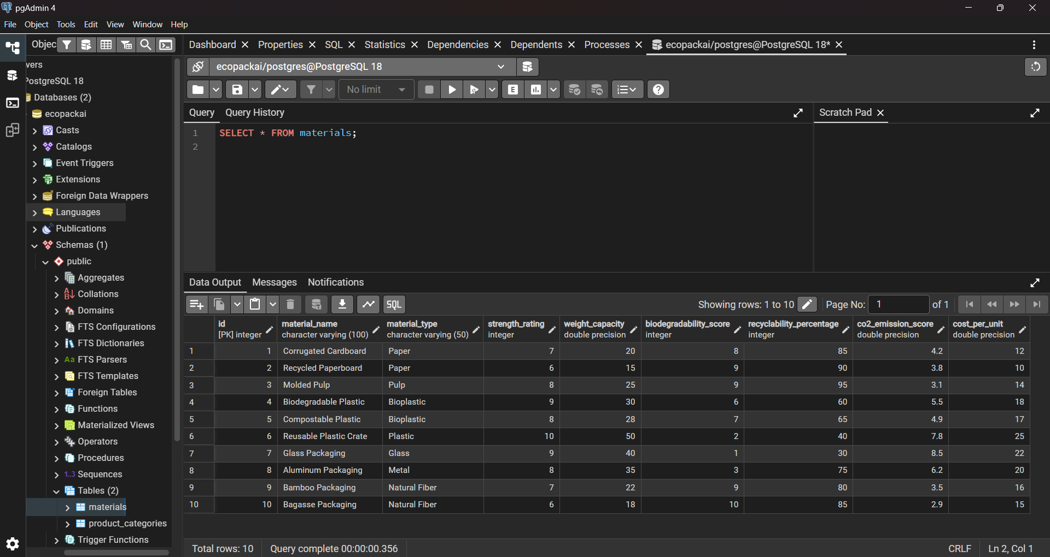
Demo Screenshot 3
Milestone 3 implementation snapshot

Slide 12
Next Steps (Post Milestone 3)
Replace synthetic generation with supplier ERP/LCA data ingestion pipeline.
Add automated test suite and CI checks for data quality, API contracts, and model drift.
Containerize backend and dashboard for production deployment.

