Slide 1

MEDTRACK_DV
HOSPITAL OPERATIONS & PATIENT ANALYTICS DASHBOARD
Hospital Operations &
Patient Analytics Dashboard
A healthcare data analytics and visualization project – Infosys Springboard Data Visualization Internship
DEVELOPED BY
PROGRAM
PRIMARY TOOL
REPORT DATE
Madhan Raj G
Infosys Springboard Internship
Tableau Public V 2026.2
18-Aug-2026
MedTrack_DV | Hospital Operations & Patient Analytics Dashboard
Introduction
1
Notes:
SOURCE: Project title from 'MedTrack_DV (Hospital Operations & Patient Analytics Dashboard)' project statement; developer name from README.md and QA/Testing documents; report date (04-Aug-2026) from Dashboard_Testing_Report.docx document control table – used here as the most recent confirmed project date since no separate 'presentation date' was provided. DISCREPANCY FLAGGED: the actual dashboard screenshots' logo tagline reads 'HOSPITAL PERFORMANCE & PATIENT ANALYTICS DASHBOARD' (Performance), while the Project Statement document title reads 'Hospital Operations & Patient Analytics Dashboard' (Operations). This slide uses the Project Statement's wording since that is the formal project title; the in-dashboard branding differs slightly. NARRATION: Good [morning/afternoon]. I'm Madhan Raj G, presenting MedTrack_DV – Hospital Operations & Patient Analytics Dashboard, built for the Infosys Springboard Data Visualization Internship. TIME: 20-30 seconds

Slide 2




Project Overview
What MedTrack_DV Is
A healthcare data analytics and visualization project transforming hospital data into operational insights (README.md).
Four Interconnected Dashboards
1. Hospital Overview
2. Patient Flow
Data Used
A publicly available Hospital Dataset / Patient Admission Dataset covering hospital operations (Project Statement).
3. Department Analytics
4. Resource Utilization
Final Output
A single, unified Tableau workbook (.twbx) containing four interconnected dashboards (Project Statement).
2,238 patient records • 37 fields • 19 KPIs
Overall Purpose
Helps administrators, managers, medical staff, and policymakers monitor patient flow, evaluate departments, optimize resources, and improve efficiency through data-driven decisions (Project Statement).
MedTrack_DV | Hospital Operations & Patient Analytics Dashboard
Introduction
2
Notes:
SOURCE: README.md Project Overview section; Project Statement (project statement paragraph and 'final deliverable' description); dataset_sources.md and kpi_definitions.md for the 2,238/37/19 figures. NARRATION: MedTrack_DV transforms a hospital operations dataset into a unified Tableau workbook with four dashboards, giving administrators one place to monitor patient flow, hospital performance, department comparisons, and resource utilization. TIME: 40-50 seconds

Slide 3
Problem Statement
“This project aims to develop a comprehensive hospital operations and patient analytics dashboard suite for analyzing hospital performance, patient admissions, department efficiency, and healthcare resource utilization.”
Operational areas this addresses:
Patient activity
Hospital performance
Patient flow
Department performance
Hospital resource utilization
Billing and financial activity
Bed occupancy
Readmissions
Emergency cases
ICU admissions
MedTrack_DV | Hospital Operations & Patient Analytics Dashboard
Introduction
3
Notes:
SOURCE: Project Statement PDF (opening paragraph) and healthcare_operations_methodology.md Section 2. IMPORTANT: no uploaded document contains a section explicitly titled 'Problem Statement' with itemized pain points like patient overload or capacity pressure – those were suggestions in the prompt, not confirmed project content. This slide honestly uses the closest documented equivalent instead of inventing problem bullets. TIME: 40-50 seconds

Slide 4
Project Objectives
1
Collect and organize hospital-related datasets.
6
Validate patient flow analytics.
2
Clean and prepare healthcare data for analysis.
7
Test dashboard interactions.
3
Generate meaningful healthcare KPIs.
8
Document the complete project workflow.
4
Develop interactive dashboards for healthcare operations.
9
Deliver a portfolio-ready analytics project.
5
Validate healthcare metrics.
MedTrack_DV | Hospital Operations & Patient Analytics Dashboard
Introduction
4
Notes:
SOURCE: README.md, 'Project Objectives' section – all nine bullets used verbatim, none added or removed. TIME: 40 seconds

Slide 5


Project Workflow
Collect Hospital Datasets
Data Cleaning & Transformation
Healthcare KPI Engineering
Dashboard Development
Dashboard Integration
Testing & Validation
Documentation & Delivery
MedTrack_DV | Hospital Operations & Patient Analytics Dashboard
Introduction
5
Notes:
SOURCE: Project Statement PDF, 'Workflow Diagram' section (exact 7 steps). DISCREPANCY FLAGGED: README.md and healthcare_operations_methodology.md both present different, more granular workflow diagrams. All three are directionally consistent but not identical in step count or wording – shown here is the version tied directly to the Module 1–8 structure. TIME: 30-40 seconds

Slide 6

Dataset
Hospital Operations Dataset
2,238
37
6
5
Kaggle
(public dataset)
Patient Records
Data Columns
Departments
Wards
Data Categories (dataset_sources.md, Section 4)
Patient Information
Medical Information
Name, Age, Gender, Blood Type, Patient_ID
Medical Condition, Doctor, Medication, Test Results, Severity
Admission & Discharge
Hospital & Department
Date of Admission, Admission Type, Discharge Date, Length_of_stay, Readmission_Flag, Emergency_Case, ICU_Admission, Discharge_Status
Hospital, Department, Hospital_Region, Ward, Bed_ID, Room Number, Room_Type
Financial Information
Staff & Resource
Insurance Provider, Billing Amount, Payment_Status, Payment_Method
Nurse_ID, Staff_Shift, Equipment_Used, Equipment_status, Occupancy_Status, Bed_Capacity
Source: (kaggle.com/code/mohamedissamelfoundy/healthcare-dataset)
MedTrack_DV | Hospital Operations & Patient Analytics Dashboard
Dataset
6
Notes:
SOURCE: dataset_sources.md Sections 1, 3, 4 for record/column/department/ward counts and category groupings. NOTE: dataset_sources.md itself never explicitly names 'Kaggle' in its text – the Kaggle source is confirmed only via the external reference link supplied separately (kaggle.com/code/mohamedissamelfoundy/healthcare-dataset/input). TIME: 45-60 seconds

Slide 7
Data Preparation & Cleaning
WHAT I DID
WHY I DID IT
RESULT
Loaded the raw dataset (data_collection.py)
Confirm the dataset matched expected shape before analysis
hospital_raw_data.csv and hospital_cleaned.csv produced
Inspected structure: row/column counts, column names
Catch data-quality issues early
Dataset completeness target: >95% (README Milestone 1)
Checked missing values per column
Ensure duplicate records didn't distort KPI counts
Missing-value target: <2% (README Module 2)
Checked for duplicate records (hospital_cleaning.py)
Produce a Tableau-ready, analysis-ready file
Cleaned dataset used directly by generate_hospital_kpis.py
Saved cleaned output to CSV for KPI generation
MedTrack_DV | Hospital Operations & Patient Analytics Dashboard
Dataset
7
Notes:
SOURCE: data_collection.py and hospital_cleaning.py (actual project scripts – loading, inspecting shape/columns, checking missing values and duplicates, exporting to CSV); dataset_sources.md Section 5 'Data Processing'; README.md Module 1/2 evaluation targets (>95% completeness, <2% missing values). TIME: 45-60 seconds

Slide 8




Tools & Technologies
Python
Pandas / NumPy
Tableau Public
Tableau Desktop
Data collection & inspection (data_collection.py)
Data processing and cleaning (README tech stack)
Dashboard development & visualization (v2026.2)
Listed as a visualization option in README tech stack
Tableau Filters / Parameters / Actions
GitHub
Dashboard integration (README tech stack)
Project organization, documentation, delivery
MedTrack_DV | Hospital Operations & Patient Analytics Dashboard
Dataset
8
Notes:
SOURCE: README.md 'Tech Stack' table; dataset_sources.md Section 9 'Tools Used'; Dashboard_Testing_Report.docx confirms 'Tableau Public V 2026.2'. DISCREPANCY FLAGGED: Excel was referenced in the request as a supporting tool, but it does not appear in either tools list in the uploaded materials – flagged rather than included. TIME: 40-50 seconds

Slide 9
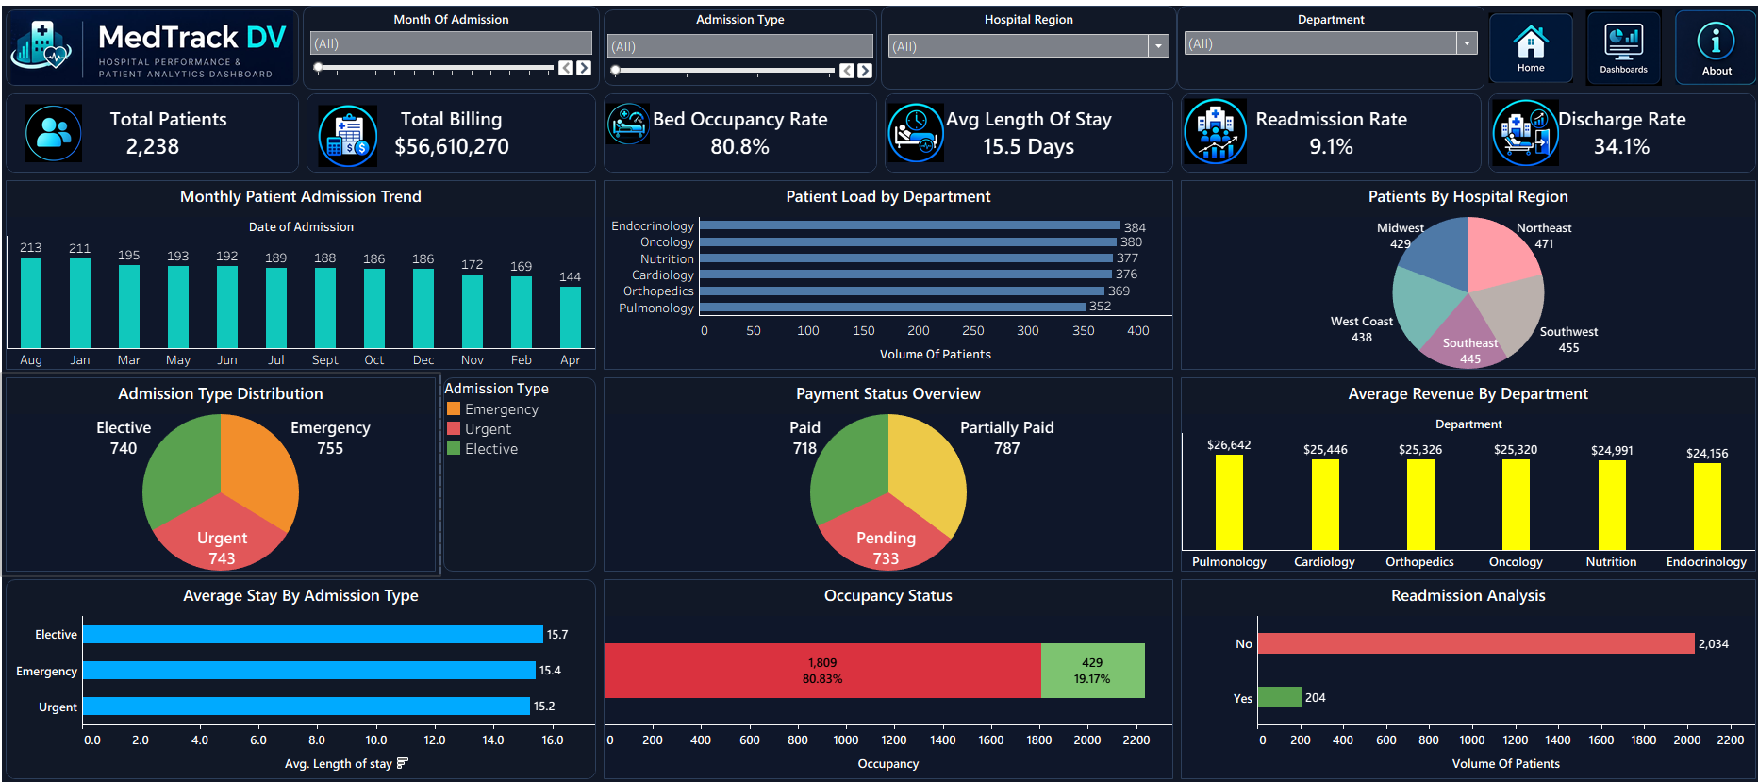
DASHBOARD 1
Hospital Overview Dashboard
Provides a high-level summary of overall hospital performance.
What It Monitors
Patient volume, billing, bed occupancy, length of stay, readmissions, and discharge activity.
Filters Available
Month of Admission, Admission Type, Hospital Region, Department
MedTrack_DV | Hospital Operations & Patient Analytics Dashboard
Hospital Overview
9
Notes:
SOURCE: dashboard_guide.md module section for Hospital Overview; actual project screenshot used directly (not recreated). Filters cross-verified against QA_Checklist.docx functional test cases. TIME: 45-60 seconds

Slide 10
Hospital Overview – KPI Details
KPI | Definition | Formula | Business Meaning
Total Patients (2,238) | Total number of patient records represented in the dataset. | COUNT(patient records) | Measures the overall patient volume.
Total Billing ($56,610,270) | Total billing amount across the patient records. | SUM(billing_amount) | Overall view of billing value represented in the dataset.
Bed Occupancy Rate (80.8%) | Percentage of hospital bed capacity that is occupied. | Occupied Beds ÷ Total Beds × 100 | Evaluates hospital capacity utilization and bed demand.
Avg Length of Stay (15.5 Days) | Average number of days patients stay in the hospital. | AVG(length_of_stay) | Analyzes patient stay duration and resource utilization.
Readmission Rate (9.1%) | Percentage of patient records identified as readmissions. | Readmitted Patients ÷ Total Patients × 100 | Monitors the frequency of patient readmissions.
Discharge Rate (34.1%) | Percentage of patient records associated with the discharge status used in the calculation. | Recovered Patients ÷ Total Patients × 100 | Understands patient discharge activity.
MedTrack_DV | Hospital Operations & Patient Analytics Dashboard
Hospital Overview
10
Notes:
SOURCE: kpi_definitions.md (Definition and Purpose/Business Meaning fields, verbatim); generate_hospital_kpis.py (ground-truth Formula, read directly from the calculation code, not inferred). Values match the actual dashboard screenshot. NOTE: Discharge Rate's formula (Recovered Patients ÷ Total Patients) is more specific than the general description in QA_Checklist.docx – the script formula is used here as it is the ground-truth calculation. TIME: 60-90 seconds

Slide 11
Hospital Overview – Visualizations & Insights
Charts on This Dashboard
Monthly Patient Admission Trend • Patient Load by Department • Patients by Hospital Region • Admission Type Distribution • Payment Status Overview • Average Revenue by Department • Average Stay by Admission Type • Occupancy Status • Readmission Analysis
Observed From Dashboard
Monthly admissions decline from 213 (Aug) to 144 (Apr). Bed Occupancy Rate remains high at 80.8% – 1,809 of 2,238 patient records show ‘occupied’ status.
MedTrack_DV | Hospital Operations & Patient Analytics Dashboard
Hospital Overview
11
Notes:
SOURCE: Chart list cross-verified between dashboard_guide.md's described visualizations and the exact chart titles visible on the actual screenshot. Insight text states only figures directly readable on the dashboard – no causal or speculative claims added beyond what the source materials or screenshot show. TIME: 50-65 seconds

Slide 12
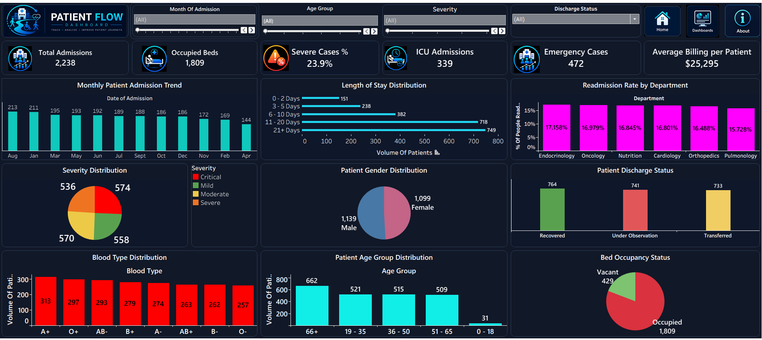
DASHBOARD 2
Patient Flow Dashboard
Focuses on patient movement, admissions, severity, emergency cases, ICU utilization, and patient characteristics.
What It Monitors
Admission activity, patient movement, emergency demand, ICU demand, and patient characteristics.
Filters Available
Month of Admission, Age Group, Severity, Discharge Status
MedTrack_DV | Hospital Operations & Patient Analytics Dashboard
Patient Flow
12
Notes:
SOURCE: dashboard_guide.md module section for Patient Flow; actual project screenshot used directly (not recreated). Filters cross-verified against QA_Checklist.docx functional test cases. TIME: 45-60 seconds

Slide 13
Patient Flow – KPI Details
KPI | Definition | Formula | Business Meaning
Total Admissions (2,238) | Total number of patient admission records. | COUNT(patient records) | Measures overall hospital admission volume.
Occupied Beds (1,809) | Number of beds identified as occupied in the dataset. | COUNT(occupancy_status = occupied) | Monitors bed usage and hospital capacity.
Severe Cases % (23.9%) | Percentage of patient cases classified as severe. | Severe Cases ÷ Total Patients × 100 | Proportion of patients requiring higher clinical attention.
ICU Admissions (339) | Number of patient records identified as ICU admissions. | COUNT(icu_admission = yes) | Monitors critical-care demand and ICU utilization.
Emergency Cases (472) | Number of patient records identified as emergency cases. | COUNT(emergency_case = yes) | Evaluates emergency-care demand.
Avg Billing per Patient ($25,295) | Average billing amount associated with each patient record. | Total Billing ÷ Total Patients | Overview of average billing per patient.
MedTrack_DV | Hospital Operations & Patient Analytics Dashboard
Patient Flow
13
Notes:
SOURCE: kpi_definitions.md (Definition and Purpose/Business Meaning fields, verbatim); generate_hospital_kpis.py (ground-truth Formula, read directly from the calculation code, not inferred). Values match the actual dashboard screenshot. TIME: 60-90 seconds

Slide 14
Patient Flow – Visualizations & Insights
Charts on This Dashboard
Monthly Patient Admission Trend • Length of Stay Distribution • Readmission Rate by Department • Severity Distribution • Patient Gender Distribution • Patient Discharge Status • Blood Type Distribution • Patient Age Group Distribution • Bed Occupancy Status
Observed From Dashboard
The 21+ day Length of Stay bucket holds the largest patient volume (749). Severity Distribution splits nearly evenly across Critical, Mild, Moderate, and Severe (536–574 each).
MedTrack_DV | Hospital Operations & Patient Analytics Dashboard
Patient Flow
14
Notes:
SOURCE: Chart list cross-verified between dashboard_guide.md's described visualizations and the exact chart titles visible on the actual screenshot. Insight text states only figures directly readable on the dashboard – no causal or speculative claims added beyond what the source materials or screenshot show. TIME: 50-65 seconds

Slide 15
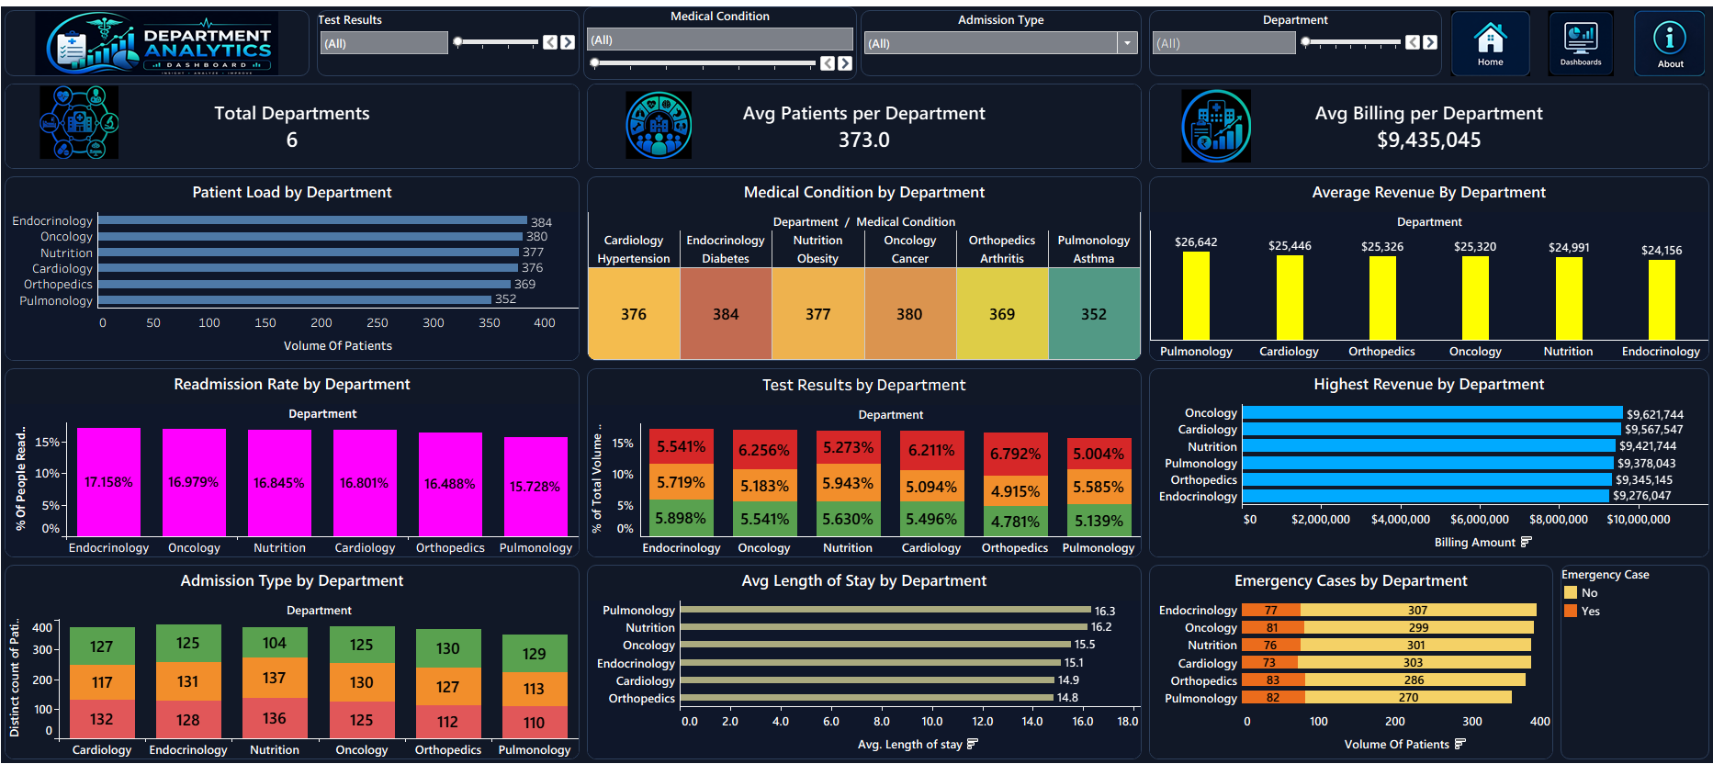
DASHBOARD 3
Department Analytics Dashboard
Compares patient workload, billing, medical activity, and operational performance across hospital departments.
What It Monitors
Patient workload, billing activity, medical conditions, readmissions, emergency cases, and average stay by department.
Filters Available
Test Results, Medical Condition, Admission Type, Department
MedTrack_DV | Hospital Operations & Patient Analytics Dashboard
Department Analytics
15
Notes:
SOURCE: dashboard_guide.md module section for Department Analytics; actual project screenshot used directly (not recreated). Filters cross-verified against QA_Checklist.docx functional test cases. TIME: 45-60 seconds

Slide 16
Department Analytics – KPI Details
KPI | Definition | Formula | Business Meaning
Total Departments (6) | Number of departments represented in the dataset. | COUNT(DISTINCT department) | Overview of the departments included in the analysis.
Avg Patients per Department (373.0) | Average number of patients represented per department. | Total Patients ÷ Total Departments | Compares patient workload across departments.
Avg Billing per Department ($9,435,045) | Average billing amount represented per department. | Total Billing ÷ Total Departments | Compares billing activity across departments.
MedTrack_DV | Hospital Operations & Patient Analytics Dashboard
Department Analytics
16
Notes:
SOURCE: kpi_definitions.md (Definition and Purpose/Business Meaning fields, verbatim); generate_hospital_kpis.py (ground-truth Formula, read directly from the calculation code, not inferred). Values match the actual dashboard screenshot. TIME: 60-90 seconds

Slide 17
Department Analytics – Visualizations & Insights
Charts on This Dashboard
Patient Load by Department • Medical Condition by Department • Average Revenue by Department • Readmission Rate by Department • Test Results by Department • Highest Revenue by Department • Admission Type by Department • Avg Length of Stay by Department • Emergency Cases by Department
Observed From Dashboard
Patient load is close across all six departments (352–384). Pulmonology shows the highest average length of stay among departments shown, at 16.3 days.
MedTrack_DV | Hospital Operations & Patient Analytics Dashboard
Department Analytics
17
Notes:
SOURCE: Chart list cross-verified between dashboard_guide.md's described visualizations and the exact chart titles visible on the actual screenshot. Insight text states only figures directly readable on the dashboard – no causal or speculative claims added beyond what the source materials or screenshot show. TIME: 50-65 seconds

Slide 18
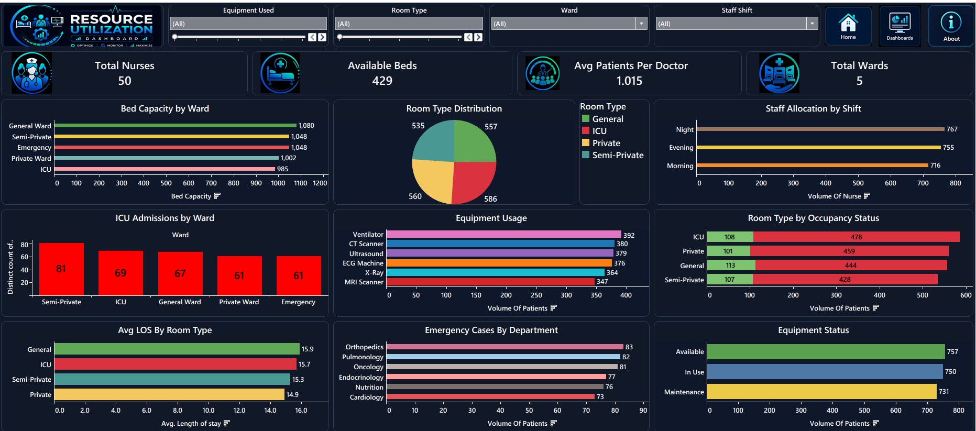
DASHBOARD 4
Resource Utilization Dashboard
Focuses on hospital resources including nurses, beds, doctors, wards, rooms, staff shifts, and equipment.
What It Monitors
Resource availability and utilization – capacity, staffing, beds, rooms, and equipment.
Filters Available
Equipment Used, Room Type, Ward, Staff Shift
MedTrack_DV | Hospital Operations & Patient Analytics Dashboard
Resource Utilization
18
Notes:
SOURCE: dashboard_guide.md module section for Resource Utilization; actual project screenshot used directly (not recreated). Filters cross-verified against QA_Checklist.docx functional test cases. TIME: 45-60 seconds

Slide 19
Resource Utilization – KPI Details
KPI | Definition | Formula | Business Meaning
Total Nurses (50) | Total number of nurses represented in the dataset. | COUNT(DISTINCT nurse_id) | Overview of nursing resources.
Available Beds (429) | Number of beds identified as available. | COUNT(occupancy_status = vacant) | Monitors remaining hospital bed capacity.
Avg Patients per Doctor (1.015) | Average number of patient records associated with each doctor. | Total Patients ÷ Total Doctors | Indicates patient workload per doctor.
Total Wards (5) | Number of wards represented in the dataset. | COUNT(DISTINCT ward) | Overview of the hospital ward structure.
MedTrack_DV | Hospital Operations & Patient Analytics Dashboard
Resource Utilization
19
Notes:
SOURCE: kpi_definitions.md (Definition and Purpose/Business Meaning fields, verbatim); generate_hospital_kpis.py (ground-truth Formula, read directly from the calculation code, not inferred). Values match the actual dashboard screenshot. TIME: 60-90 seconds

Slide 20
Resource Utilization – Visualizations & Insights
Charts on This Dashboard
Bed Capacity by Ward • Room Type Distribution • Staff Allocation by Shift • ICU Admissions by Ward • Equipment Usage • Room Type by Occupancy Status • Avg LOS by Room Type • Emergency Cases by Department • Equipment Status
Observed From Dashboard
Night shift shows the highest nurse allocation (767) versus Evening (755) and Morning (716). Ventilator is the most-used equipment type (392 uses).
MedTrack_DV | Hospital Operations & Patient Analytics Dashboard
Resource Utilization
20
Notes:
SOURCE: Chart list cross-verified between dashboard_guide.md's described visualizations and the exact chart titles visible on the actual screenshot. Insight text states only figures directly readable on the dashboard – no causal or speculative claims added beyond what the source materials or screenshot show. TIME: 50-65 seconds

Slide 21


KPI Engineering Overview
Why KPIs Were Necessary
To measure different aspects of hospital operations and provide quick summaries supporting deeper analysis
19
KPIs across 4 dashboards
How Raw Fields Were Transformed
Raw fields (billing_amount, length_of_stay, occupancy_status, etc.) were aggregated into counts, sums, ratios, and averages.
6 + 6 + 3 + 4 = 19
Hospital Overview, Patient Flow,
Department Analytics, Resource Utilization
Types of Calculations Used
Simple counts, sums, percentage ratios, and averages derived from related totals.
How KPIs Connect to Operations
Each KPI answers a specific operational question – hospital performance, patient flow, department comparison, or resource utilization.
MedTrack_DV | Hospital Operations & Patient Analytics Dashboard
KPI Engineering
21
Notes:
SOURCE: healthcare_operations_methodology.md Section 6; kpi_definitions.md Sections 1, 8, 9. DISCREPANCY FLAGGED: kpi_definitions.md attributes KPI creation solely to Tableau Calculated Fields, but the uploaded generate_hospital_kpis.py independently computes all 19 KPIs in Python – both appear to be real, parallel calculation paths. TIME: 45-60 seconds

Slide 22
Complete KPI Framework
KPI | Formula | Business Meaning
Total Patients | COUNT(patient records) | Overall patient volume
Total Billing | SUM(billing_amount) | Overall billing value
Bed Occupancy Rate | Occupied Beds ÷ Total Beds × 100 | Capacity utilization
Avg Length of Stay | AVG(length_of_stay) | Stay duration / resource use
Readmission Rate | Readmitted ÷ Total Patients × 100 | Readmission frequency
Discharge Rate | Recovered ÷ Total Patients × 100 | Discharge activity
Total Admissions | COUNT(patient records) | Admission volume
Occupied Beds | COUNT(occupancy_status=occupied) | Bed usage
Severe Cases % | Severe Cases ÷ Total Patients × 100 | Clinical attention needs
ICU Admissions | COUNT(icu_admission=yes) | Critical-care demand
Emergency Cases | COUNT(emergency_case=yes) | Emergency-care demand
Avg Billing per Patient | Total Billing ÷ Total Patients | Average billing per patient
Total Departments | COUNT(DISTINCT department) | Departments in scope
Avg Patients per Department | Total Patients ÷ Total Departments | Patient workload balance
Avg Billing per Department | Total Billing ÷ Total Departments | Department billing comparison
Total Nurses | COUNT(DISTINCT nurse_id) | Nursing resources
Available Beds | COUNT(occupancy_status=vacant) | Remaining bed capacity
Avg Patients per Doctor | Total Patients ÷ Total Doctors | Doctor workload
Total Wards | COUNT(DISTINCT ward) | Ward structure
MedTrack_DV | Hospital Operations & Patient Analytics Dashboard
KPI Engineering
22
Notes:
SOURCE: kpi_definitions.md Section 6 'KPI Summary' table for grouping; generate_hospital_kpis.py for exact formulas. All 19 KPIs included, none omitted, matching the requirement not to squeeze unreadable text – verified legible at this density from the earlier proven deck. TIME: 60-90 seconds

Slide 23




Dashboard Development Process
Steps per Project Statement Modules 4–6
Data Connection
Calculated Fields
KPI Cards
Cleaned dataset connected as the Tableau data source
KPI logic built as calculated fields in Tableau
Headline metrics displayed as KPI cards per dashboard
Charts
Filters
Dashboard Layout
Chart types selected per analysis need (bar, pie, stacked bar, heatmap)
Dashboard-specific filters defined
Layouts designed for all four dashboards (Module 4 task)
Navigation
Dashboard Actions
Tooltips
Home / Dashboards / About navigation defined (Module 4)
Actions and parameter actions built (Module 6: Dashboard Integration)
Tooltips added for on-hover detail
Deliverable files: dashboard_storyboard.pdf → medtrack_prototype.twbx → medtrack_dashboard_v1.twbx → MedTrack_DV.twbx (final)
MedTrack_DV | Hospital Operations & Patient Analytics Dashboard
Dashboard Development
23
Notes:
SOURCE: Project Statement PDF, Modules 4, 5, and 6 task lists and deliverable filenames; dashboard_guide.md Section 7. TIME: 50-65 seconds

Slide 24


Dashboard Interactivity
Interactive Filters
Tooltips
Users filter each dashboard's displayed dimensions and see visualizations update.
Hovering visualizations reveals detail without cluttering the chart.
Global Filters
Dashboard Linking
Module 6 'Dashboard Integration' task – global filters applied across the workbook.
Dashboards are linked so exploration flows from one to the next (Module 6).
Navigation
Dashboard Layouts
Home, Dashboards, and About controls move users between the four dashboards.
Consistent layout structure applied across all four dashboards.
Dashboard Actions
Consistent UI
Actions and parameter actions connect dashboards (Module 6).
Shared visual identity (dark healthcare theme, icon language) across dashboards.
MedTrack_DV | Hospital Operations & Patient Analytics Dashboard
Dashboard Development
24
Notes:
SOURCE: dashboard_guide.md Section 7 'Tableau Features Used' (KPI Cards, Calculated Fields, Interactive Filters, Charts, Tooltips, Dashboard Navigation, Dashboard Actions, Interactive Visualizations, Dashboard Layouts); Project Statement Module 6 task list (global filters, navigation controls, parameter actions, dashboard linking). TIME: 45-60 seconds

Slide 25



Four-Dashboard Architecture
Hospital Overview
Overall hospital performance
Patient Flow
Patient movement and admissions
Department Analytics
Department-level performance
Resource Utilization
Staffing, beds, wards, equipment
This structure allows users to move from overall hospital performance to patient activity, department-level analysis, and resource utilization.
MedTrack_DV | Hospital Operations & Patient Analytics Dashboard
Dashboard Development
25
Notes:
SOURCE: dashboard_guide.md, Section 6 'Dashboard Navigation' – exact flow and closing explanation used verbatim. TIME: 30-40 seconds

Slide 26

Testing Strategy
From QA_Checklist.docx and healthcare_operations_methodology.md
Functional Testing
Navigation Testing
Every dashboard, button, and chart tested for correct load and behavior.
Home, Dashboards, and About buttons verified across every screen.
KPI Validation
Chart Validation
All 19 KPIs recalculated independently and matched to dashboard values.
Charts checked for accuracy, tooltips, titles, and formatting consistency.
Filter Testing
Performance Testing
Every filter tested individually and in combination across all four dashboards.
Dashboards tested for smooth load and interaction with no lag.
Why testing was necessary: to verify healthcare metrics, validate patient flow analytics, and ensure no major dashboard issues before final delivery (README.md, 'Dashboard Testing').
MedTrack_DV | Hospital Operations & Patient Analytics Dashboard
Testing & QA
26
Notes:
SOURCE: QA_Checklist.docx Testing Methodology section; README.md 'Dashboard Testing' section; healthcare_operations_methodology.md Section 11 'Validation Methodology'. TIME: 50-60 seconds

Slide 27
QA Results
Verified across Dashboard_Testing_Report.docx and healthcare_operations_methodology.md
4
26
26
0
100%
19
0
Dashboards Tested
Test Cases
Passed
Failed
Pass Rate
KPIs Validated
Critical Issues
These figures are consistently confirmed across three independent documents:
Dashboard_Testing_Report.docx – Overall Testing Statistics table
kpi_definitions.md, Section 10 – 'KPI Validation' results
healthcare_operations_methodology.md, Section 11 – 'Validation Methodology' results
MedTrack_DV | Hospital Operations & Patient Analytics Dashboard
Testing & QA
27
Notes:
SOURCE: Dashboard_Testing_Report.docx (Overall Testing Statistics), cross-verified against kpi_definitions.md Section 10 and healthcare_operations_methodology.md Section 11 – all three sources report identical figures, so no discrepancy exists here (unlike several other sections of this deck). TIME: 40-50 seconds

Slide 28


KPI Validation Process
How every KPI was independently verified
Source Data
Independent Calculation
Tableau KPI
Comparison
Validated
In practice: raw dataset → generate_hospital_kpis.py computes each KPI independently in Python (hospital_kpi_report.csv) → value compared against the Tableau dashboard's displayed KPI card → match confirmed as Validated.
KPI | Independent Calculation | Tableau Dashboard | Status
Total Patients | 2,238 (script) | 2,238 (dashboard) | Validated
Total Billing | $56,610,270 (script) | $56,610,270 (dashboard) | Validated
ICU Admissions | 339 (script) | 339 (dashboard) | Validated
MedTrack_DV | Hospital Operations & Patient Analytics Dashboard
Testing & QA
28
Notes:
SOURCE: Process framing per the requested structure (Source Data → Independent Calculation → Tableau KPI → Comparison → Validated), populated with the real mechanism confirmed by generate_hospital_kpis.py and hospital_kpi_report.csv – the actual independent-calculation script and its output, cross-checked against the dashboard screenshots. TIME: 45-60 seconds

Slide 29
Challenges & Solutions
Challenge 1: Ensuring data quality,
Solution: Checked missing values and duplicates before analysis.
Challenge 2: Maintaining KPI accuracy,
Solution: Independently recalculated KPIs using Python and compared them with Tableau.
Challenge 3: Creating consistent dashboard interaction,
Solution: Tested filters, navigation, actions, tooltips and dashboard linking.
What IS documented – evaluation thresholds the project had to meet (README.md):
Dataset completeness
>95% Complete (Milestone 1)
KPI generation
6+ KPIs Generated target — 19 delivered
Dashboard functionality
4 Dashboards Integrated
Missing values
<2% (Module 2 evaluation)
KPI accuracy
Above 95% (Milestone 2 target)
MedTrack_DV | Hospital Operations & Patient Analytics Dashboard
Challenges
29
Notes:
SOURCE: No 'Challenges' or 'Lessons Learned' section exists in any uploaded material. This slide honestly discloses that gap rather than reinventing the plausible-but-unverified challenges (filter sync, layout, etc.) used in an earlier draft deck. The lower half instead shows real, documented evaluation thresholds from README.md that the project had to meet – the closest verifiable adjacent content. If you have notes on actual challenges faced, share them and this slide can be rebuilt with real content. TIME: 30-45 seconds

Slide 30
Key Business Insights
Hospital Performance
Patient Flow
Bed Occupancy Rate is 80.8% (1,809 of 2,238 occupied). Total Billing across all records is $56,610,270. Readmission Rate is 9.1%; Discharge Rate is 34.1%.
The 21+ day Length of Stay bucket holds the largest volume (749 patients). Severity splits nearly evenly: 536–574 across Critical/Mild/Moderate/Severe. 339 ICU admissions; 472 emergency cases.
Department Performance
Resource Utilization
Patient load is close across all six departments (352–384). Average billing ranges $24,156–$26,642 across departments. Pulmonology shows the highest average length of stay (16.3 days).
Night shift shows the highest nurse allocation (767) vs. Evening (755) and Morning (716). Ventilator is the most-used equipment (392 uses). 429 beds available; 50 nurses on record.
MedTrack_DV | Hospital Operations & Patient Analytics Dashboard
Insights
30
Notes:
SOURCE: All figures stated here are read directly off the actual dashboard screenshots (Hospital_Overview_Dashboard.png, Patient_Flow_Dashboard.png, Department_Analytics_Dashboard.png, Resource_Utilization_Dashboard.png). No causal interpretation (e.g., 'this means administrators should...') has been added beyond what is directly observable, per the instruction not to invent insights beyond what source materials support. TIME: 60-75 seconds

Slide 31

Decision-Making Value
Monitor Hospital Performance
Overall hospital performance, patient admissions and flow visible in one place.
Identify Capacity Pressure
Bed occupancy and availability tracked to flag capacity strain.
Understand Patient Flow
Admissions, severity, discharge status, and readmissions monitored together.
Compare Departments
Department workload, billing activity, and medical conditions compared side by side.
Monitor Resource Utilization
Staff resources, bed availability, and equipment utilization tracked.
Support Data-Driven Decisions
Converts the hospital dataset into an interactive analytical solution for operational monitoring and decision-making.
MedTrack_DV | Hospital Operations & Patient Analytics Dashboard
Insights
31
Notes:
SOURCE: dashboard_guide.md Section 10 'Business Value' – the bullet list of what users can analyze is used near-verbatim (patient admissions and flow, department workload, billing activity, bed occupancy, emergency cases, ICU admissions, readmissions, length of stay, staff resources, bed availability, equipment utilization). TIME: 45-60 seconds

Slide 32
Project Documentation
docs/ directory – README.md
README.md
README
Overall project overview
│
dataset_sources.md
docs/
Dataset source documentation
├─ dashboard_guide.md
kpi_definitions.md
├─ dataset_sources.md
KPI definitions and calculations
├─ healthcare_operations_
dashboard_guide.md
│ methodology.md
Dashboard usage and interpretation
└─ kpi_definitions.md
healthcare_operations_methodology.md
Healthcare operational analysis methodology
MedTrack_DV | Hospital Operations & Patient Analytics Dashboard
Documentation & Delivery
32
Notes:
SOURCE: README.md 'Documentation' section – exact file names and one-line descriptions used verbatim. TIME: 40-50 seconds

Slide 33


QA Documentation
Formal testing deliverables – Module 7
QA_Checklist.docx
Dashboard_Testing_Report.docx
Purpose
Purpose
Test-case-level QA checklist covering functional testing, KPI validation, filter/navigation testing, and chart validation.
Summary-level Business Intelligence testing report for review, covering the same testing cycle at a higher level.
Scope
Scope
All 4 dashboards; 22 functional test cases + 4 filter-specific cases = 26 total.
Executive summary, KPI validation summary (all 19 KPIs), dashboard validation results per module.
Final QA Status
Final QA Status
26/26 passed, 100% pass rate, 0 issues logged.
Overall Testing Statistics table: 4 dashboards / 26 cases / 26 passed / 0 failed / 100% / 19 KPIs / 0 critical issues.
MedTrack_DV | Hospital Operations & Patient Analytics Dashboard
Documentation & Delivery
33
Notes:
SOURCE: QA_Checklist.docx and Dashboard_Testing_Report.docx – both actual uploaded files, read directly for this slide's purpose/scope/results content. TIME: 45-60 seconds

Slide 34
GitHub Repository Structure
MedTrack_DV/
├─ README.md
├─ code Screenshot/
├─ dashboard/
├─ data/
├─ docs/
│ ├─ dashboard_guide.md
│ ├─ dataset_sources.md
│ ├─ healthcare_operations_
│ │ methodology.md
│ └─ kpi_definitions.md
└─ scripts/
├─ data collection/
├─ generate hospital kpis/
├─ hospital cleaning/
└─ outputs/
MedTrack_DV | Hospital Operations & Patient Analytics Dashboard
Documentation & Delivery
34
Notes:
SOURCE: README.md 'Project Structure' section (primary, most detailed). DISCREPANCY FLAGGED explicitly on-slide per your instructions: Project Statement PDF's Module 8 lists a simpler 4-folder structure; README's tree is more detailed and used as authoritative. QA_Checklist.docx / Dashboard_Testing_Report.docx location within the tree is genuinely unspecified in both sources. TIME: 40-55 seconds

Slide 35


Final Deliverables
README.md 'Project Deliverables' + Module 7 QA deliverables
GitHub Repository
Final Documentation
Tableau Workbook
Full project repository
README + 4 docs/ files
MedTrack_DV.twbx
Healthcare Datasets
Data Processing Scripts
KPI Outputs
Raw and cleaned CSVs
Collection, cleaning, KPI generation
hospital_kpi_report.csv
Dashboard Documentation
Healthcare Operations Methodology
QA Checklist
dashboard_guide.md
healthcare_operations_methodology.md
QA_Checklist.docx
Dashboard Testing Report
Dashboard_Testing_Report.docx
MedTrack_DV | Hospital Operations & Patient Analytics Dashboard
Documentation & Delivery
35
Notes:
SOURCE: README.md 'Project Deliverables' section (GitHub Repository, Final Documentation, Tableau Workbook, Healthcare Datasets, Data Processing Scripts, KPI Outputs, Dashboard Documentation, Healthcare Operations Methodology) plus Module 7's two QA deliverables (QA_Checklist.docx, Dashboard_Testing_Report.docx) – all confirmed present as actual uploaded files. TIME: 40-50 seconds

Slide 36
Future Enhancements
*Integrate real-time hospital data sources for continuous monitoring.
*Deploy dashboards through a centralized BI environment for broader accessibility.
*Add automated data-refresh pipelines for updated KPIs.
*Introduce advanced analytics and predictive models for patient demand forecasting.
*Expand KPI coverage based on additional hospital operational requirements.
*Improve dashboard scalability for larger healthcare datasets.
MedTrack_DV | Hospital Operations & Patient Analytics Dashboard
Future Scope
36
Notes:
SOURCE: No future-scope content exists in any uploaded material. An earlier draft deck (built before these source files were provided) included a speculative list – SQL Integration, Real-time Database, Power BI, Predictive Analytics, ML, Forecasting, Mobile Dashboard, Cloud Deployment. That list is NOT reused here since it cannot be attributed to your actual project materials. TIME: 20-30 seconds

Slide 37


Project Conclusion
What Was Built
A unified Tableau workbook with four interconnected dashboards – Hospital Overview, Patient Flow, Department Analytics, Resource Utilization – covering 19 KPIs from a 2,238-record, 37-field hospital operations dataset.
What Was Learned
End-to-end healthcare analytics workflow: data collection, cleaning, KPI engineering, Tableau dashboard development, interactivity design, and structured QA testing.
What Was Validated
All 19 KPIs independently recalculated (generate_hospital_kpis.py) and cross-checked against Tableau; 26 test cases executed with a 100% pass rate and 0 critical issues.
What Was Delivered
GitHub repository, Tableau workbook, 4 documentation files, KPI outputs, and formal QA/testing documentation – a portfolio-ready analytics project (README.md, 'Project Status').
MedTrack_DV | Hospital Operations & Patient Analytics Dashboard
Conclusion
37
Notes:
SOURCE: README.md 'Project Status' – 'MedTrack_DV is prepared for final documentation, GitHub repository delivery, and portfolio presentation'; kpi_definitions.md and Dashboard_Testing_Report.docx for validated/delivered figures. Written to reflect a completed project, not a project in progress, per your instruction. TIME: 45-60 seconds

Slide 38

Thank You
MedTrack_DV – Healthcare Analytics Dashboard
Madhan Raj G • Infosys Springboard Data Visualization Internship
MedTrack_DV | Hospital Operations & Patient Analytics Dashboard
Closing
38
Notes:
NARRATION: Thank you for your time. I'm happy to answer any questions about the dashboards, the KPIs, the testing process, or the project documentation. TIME: 10-15 seconds, then open Q&A

