Slide 1


MEDTRACK_DV
HOSPITAL OPERATIONS & PATIENT ANALYTICS DASHBOARD
Milestone 4:
Testing & Delivery
Module 7 – Testing & Validation | Module 8 – Documentation & Project Delivery
PRESENTED BY
PROGRAM
TIMEFRAME
STATUS
Madhan Raj G
Infosys Springboard Internship
Weeks 7–8
Complete
MedTrack_DV | Milestone 4: Testing & Delivery
Introduction
1
Notes:
1

Slide 2

Milestone 4 Overview
The final milestone in the MedTrack_DV project plan – Weeks 7 and 8
Milestone 4 closes out the project by confirming that everything built in Milestones 1 through 3 actually works as intended, and by packaging the finished project for delivery. It covers two modules:
Module 7
Module 8
Testing & Validation
Documentation & Project Delivery
Validate KPI calculations, verify healthcare metrics, test dashboard interactions, and validate patient flow analytics. Delivers a QA Checklist and a Dashboard Testing Report.
Prepare complete project documentation, organize the project structure, and deploy the finished project to GitHub. Delivers the GitHub Repository, Final Documentation, and the Tableau Workbook.
MedTrack_DV | Milestone 4: Testing & Delivery
Introduction
2
Notes:
2

Slide 3
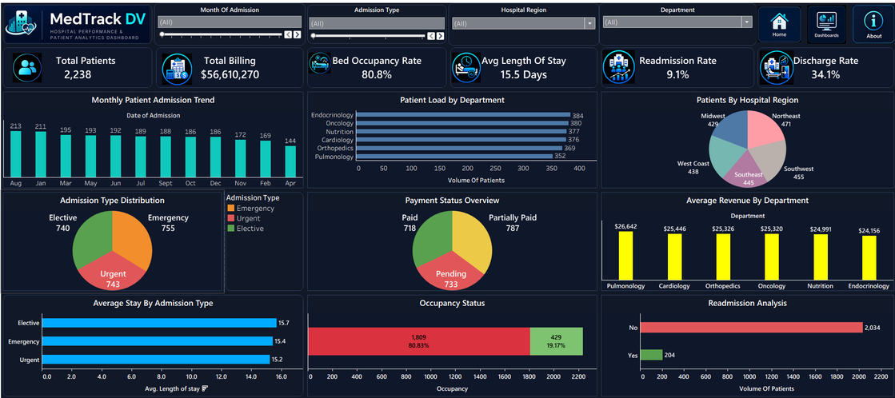
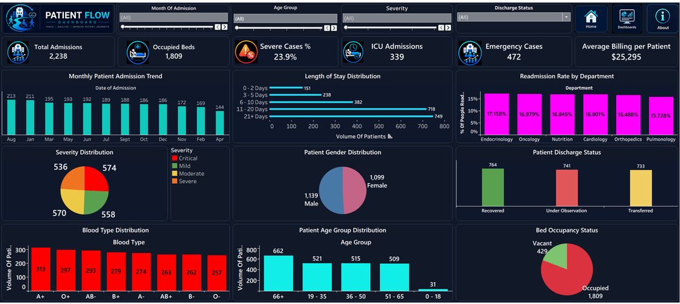
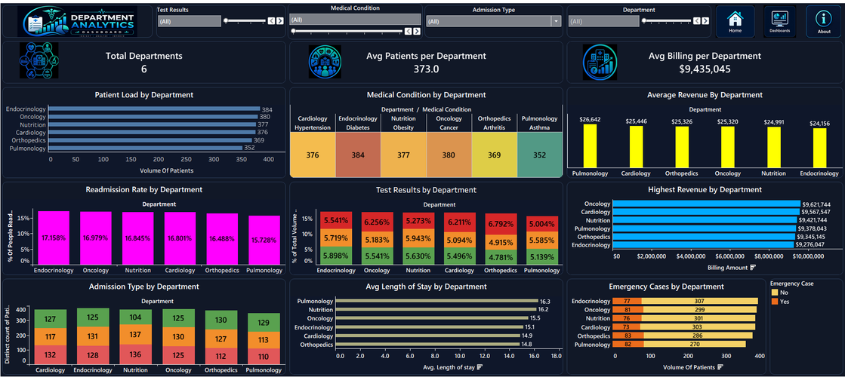
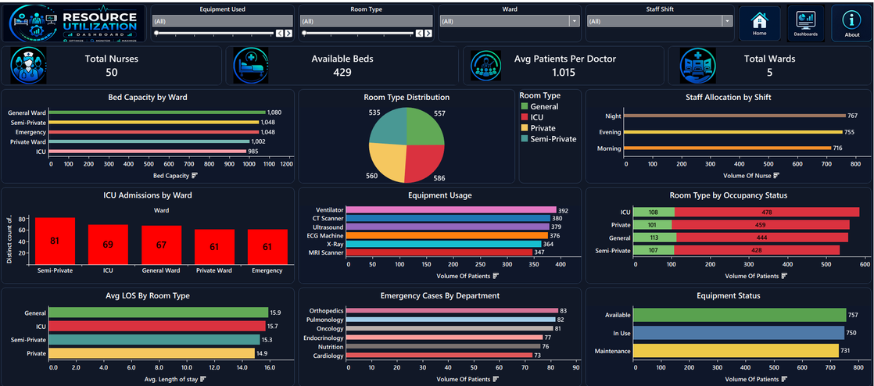
The Four Dashboards
Tested in Module 7 and delivered in Module 8
Hospital Overview Dashboard
Patient Flow Dashboard
Department Analytics Dashboard
Resource Utilization Dashboard
MedTrack_DV | Milestone 4: Testing & Delivery
Introduction
3
Notes:
3

Slide 4





MODULE 7
Testing & Validation – Objectives
What this module set out to verify before the project could be marked complete
Validate KPI Calculations
Every one of the 19 KPIs recalculated independently and checked against the value shown on its Tableau dashboard.
Module 7 Deliverables
QA Checklist
Verify Healthcare Metrics
Confirmed that hospital performance, patient flow, department, and resource metrics all reflect the underlying dataset accurately.
Test-case-level detail covering functional, KPI, filter, and navigation testing.
Test Dashboard Interactions
Dashboard Testing Report
Every button, filter, and navigation control tested across all four dashboards.
A summary-level report of the full testing cycle, prepared for review.
Validate Patient Flow Analytics
Patient movement, admissions, severity, and discharge analytics checked for consistency across dashboards.
Evaluation target: No major dashboard issues, KPI accuracy above 95%
MedTrack_DV | Milestone 4: Testing & Delivery
Module 7 – Testing
4
Notes:
4

Slide 5




MODULE 7
Testing Approach
Six categories of testing were applied across all four dashboards
Functional Testing
KPI Validation
Filter Testing
Every dashboard, button, and chart tested for correct load and behavior.
All 19 KPIs recalculated independently and matched to dashboard values.
Every filter tested individually and in combination across all four dashboards.
Navigation Testing
Chart Validation
Performance Testing
Home, Dashboards, and About buttons verified across every screen.
Charts checked for accuracy, tooltips, titles, and formatting consistency.
Dashboards tested for smooth load and interaction with no lag.
MedTrack_DV | Milestone 4: Testing & Delivery
Module 7 – Testing
5
Notes:
5

Slide 6




MODULE 7
KPI Validation Process
How every one of the 19 KPIs was independently verified
Source Data
Independent Calculation
Tableau KPI
Comparison
Validated
In practice: the raw dataset was used to independently calculate each KPI in Python, that value was compared against the Tableau dashboard's displayed KPI card, and a match confirmed the KPI as validated.
KPI | Independent Calculation | Tableau Dashboard | Status
Total Patients | 2,238 (independent calculation) | 2,238 (dashboard) | Validated
Total Billing | $56,610,270 (independent calculation) | $56,610,270 (dashboard) | Validated
ICU Admissions | 339 (independent calculation) | 339 (dashboard) | Validated
Bed Occupancy Rate | 80.83% (independent calculation) | 80.8% (dashboard) | Validated
MedTrack_DV | Milestone 4: Testing & Delivery
Module 7 – Testing
6
Notes:
6

Slide 7
MODULE 7
Testing Results
Final results from the complete testing cycle
4
26
26
0
100%
19
0
Dashboards Tested
Test Cases
Passed
Failed
Pass Rate
KPIs Validated
Critical Issues
Testing Category | Result
Functional Testing (dashboards, buttons, charts) | All passed
KPI Validation (all 19 KPIs) | All matched independent calculations
Filter & Navigation Testing | Every filter and control passed
Chart & Performance Validation | No formatting or lag issues found
No critical or major defects were identified during this testing cycle.
MedTrack_DV | Milestone 4: Testing & Delivery
Module 7 – Testing
7
Notes:
7

Slide 8


MODULE 7
QA Checklist
The first of two formal testing deliverables produced in this module
Purpose
A test-case-level QA checklist recording exactly what was tested, the expected result, the actual result, and a pass/fail status for each case.
Scope
22 functional test cases covering dashboard loading, KPIs, charts, tooltips, and formatting, plus 4 filter-specific test cases – one per dashboard – covering every documented filter by name.
Structure
Includes a cover page, document purpose, scope, test environment, the functional checklist, a KPI validation checklist, a dashboard validation summary, an issue log, and a final QA summary.
Outcome
All 26 test cases passed, with every result logged individually rather than summarized – giving a complete, auditable record of the testing cycle.
MedTrack_DV | Milestone 4: Testing & Delivery
Module 7 – Testing
8
Notes:
8

Slide 9

MODULE 7
Dashboard Testing Report
The second formal testing deliverable – a summary report for review
Purpose
A Business-Intelligence-style testing report that summarizes the QA Checklist's results for a reviewer, rather than repeating every individual test case.
Contents
Executive summary, project overview, testing objectives, a dashboards-tested table, a testing summary, a full KPI validation summary, and dashboard-by-dashboard validation results.
Defects Log
A formal issues log confirming no KPI mismatches, broken calculations, navigation issues, filter issues, or visualization issues were found.
Conclusion
States plainly that all dashboards passed testing, all KPIs were validated, and the project is approved for final submission.
MedTrack_DV | Milestone 4: Testing & Delivery
Module 7 – Testing
9
Notes:
9

Slide 10
MODULE 7
Module 7 – Evaluation Against Target
TARGET
ACTUAL RESULT
No major dashboard issues
0 critical issues; 0 defects logged across 26 test cases
TARGET
ACTUAL RESULT
KPI accuracy above 95%
100% match rate – all 19 KPIs matched their independent calculation exactly
MedTrack_DV | Milestone 4: Testing & Delivery
Module 7 – Testing
10
Notes:
10

Slide 11


MODULE 8
Documentation & Project Delivery – Objectives
Packaging the tested project for final delivery
Prepare Project Documentation
Four documentation files covering dataset sources, KPI definitions, the dashboard guide, and the healthcare operations methodology.
Module 8 Deliverables
GitHub Repository
Organize Project Structure
Separated the project into clear folders – scripts, data, dashboard assets, and documentation – so anything can be found without guesswork.
Final Documentation
Deploy the Project
Published the completed project to a GitHub repository, with the Tableau workbook available via Tableau Public.
Tableau Workbook
Evaluation target: Fully documented project, portfolio-ready dashboard suite
MedTrack_DV | Milestone 4: Testing & Delivery
Module 8 – Delivery
11
Notes:
11

Slide 12
MODULE 8
Project Documentation Delivered
Five documents accompany the finished dashboard suite
Document | Covers
README.md | Overall project overview, objectives, tech stack, and structure
dataset_sources.md | Dataset source, structure, and field-level documentation for all 37 fields
kpi_definitions.md | Definitions, formulas, and business meaning for all 19 KPIs
dashboard_guide.md | Purpose, KPI cards, and usage guidance for each of the four dashboards
healthcare_operations_methodology.md | The end-to-end methodology used for the healthcare operations analysis
MedTrack_DV | Milestone 4: Testing & Delivery
Module 8 – Delivery
12
Notes:
12

Slide 13
MODULE 8
Project Structure
How the finished project is organized for delivery
Four Clear Folders
MedTrack_DV/
Scripts, data, dashboard, and docs are kept fully separate, so anyone opening the repository can find what they need immediately.
├─ /scripts
│ (data collection, cleaning,
Scripts Kept Reusable
│ KPI generation)
Data collection, cleaning, and KPI generation each live in their own script, rather than one large file.
├─ /data
│ (raw and cleaned datasets)
Dashboard Assets Included
├─ /dashboard
Screenshots of all four dashboards are included alongside the Tableau workbook itself.
│ (Tableau workbook & screenshots)
└─ /docs
Documentation Centralized
All five documentation files live in a single /docs folder for easy reference.
(all project documentation)
MedTrack_DV | Milestone 4: Testing & Delivery
Module 8 – Delivery
13
Notes:
13

Slide 14
MODULE 8
Deployment
Where the finished project is published
GitHub Repository
Tableau Public
The full project – scripts, data, dashboard assets, and documentation – is published to a GitHub repository as the primary delivery channel.
The Tableau workbook is made available through Tableau Public, allowing the dashboard suite to be viewed and explored directly in a browser.
MedTrack_DV | Milestone 4: Testing & Delivery
Module 8 – Delivery
14
Notes:
14

Slide 15
MODULE 8
Module 8 – Evaluation Against Target
TARGET
ACTUAL RESULT
Fully documented project
5 documentation files delivered, covering dataset, KPIs, dashboards, and methodology
TARGET
ACTUAL RESULT
Portfolio-ready dashboard suite
4 tested dashboards, 19 validated KPIs, and formal QA records, all published to GitHub
MedTrack_DV | Milestone 4: Testing & Delivery
Module 8 – Delivery
15
Notes:
15

Slide 16
Milestone 4 – Final Deliverables
Everything produced across Module 7 and Module 8
QA Checklist
Dashboard Testing Report
GitHub Repository
Final Documentation (5 files)
Tableau Workbook
Module 7
Module 7
Module 8
Module 8
Module 8
Together, these five deliverables confirm that the MedTrack_DV project has been tested end to end and packaged for final submission.
MedTrack_DV | Milestone 4: Testing & Delivery
Summary
16
Notes:
16

Slide 17
Milestone 4 Summary
Testing Was Thorough
26 test cases across functional, KPI, filter, navigation, chart, and performance testing, all passed with zero critical issues.
Every KPI Was Verified Twice
All 19 KPIs were independently recalculated and matched exactly against their Tableau dashboard values.
Documentation Is Complete
Five documentation files, a QA Checklist, and a Dashboard Testing Report accompany the delivered project.
The Project Is Delivered
The finished dashboard suite is published to GitHub, with the Tableau workbook available via Tableau Public – ready for portfolio use.
MedTrack_DV | Milestone 4: Testing & Delivery
Summary
17
Notes:
17

Slide 18

Thank You
MedTrack_DV – Milestone 4: Testing & Delivery
Madhan Raj G • Infosys Springboard Data Visualization Internship
MedTrack_DV | Milestone 4: Testing & Delivery
Closing
18
Notes:
18

