Slide 1
Dashboard Storyboard
MedTrack_DV – Hospital Analytics Dashboard
Prepared For: Infosys Springboard Virtual Internship (Data Virtualization)
Prepared By: Madhan Raj G
Module: Module 4 – Dashboard Planning & Prototyping

Slide 2
Project Overview
Purpose of the Dashboard
The MedTrack_DV dashboard suite provides hospital stakeholders with a consolidated view of patient care, admissions, billing, and resource utilization. This storyboard documents the planned dashboard layouts, KPIs, charts, filters, and navigation to guide Tableau dashboard development..
Why Hospital Analytics Is Important
Hospitals generate large volumes of data across departments, wards, and patient records every day. A well-designed analytics dashboard makes this information accessible at a glance and supports faster, more informed decision-making across the hospital.
MedTrack_DV – Dashboard Storyboard
2

Slide 3
Objectives & Target Users
Objectives
Target Users
Design dashboards covering hospital-wide, patient-level, department-level, and resource-level analytics
Plan KPIs, charts, and filters based on the available dataset before developing the dashboards in Tableau
Ensure dashboards are intuitive for non-technical hospital staff
Maintain a consistent, healthcare-appropriate visual design across all four dashboards
Hospital Administrator | High-level view of hospital performance, occupancy, and patient volumes
Department Head | Department-specific patient and severity breakdowns for staff and ward planning
Management Team | Billing, payment status, and resource utilization views for financial monitoring
MedTrack_DV – Dashboard Storyboard
3

Slide 4
Dashboard Planning
Based on the hospital dataset—including patient demographics, admissions, billing, departments, severity, test results, wards, occupancy, payment status, and hospital regions—four dashboards were planned. Each dashboard includes interactive visualizations, KPIs, and filters.
# | Dashboard | Primary Focus
1 | Hospital Overview | Hospital-wide summary of admissions, occupancy, and regional distribution
2 | Patient Flow | Patient journey from admission to discharge
3 | Department Analytics | Department-wise patient load, severity mix, and billing patterns
4 | Resource Utilization | Ward occupancy, bed utilization, and room distribution across the hospital.
MedTrack_DV – Dashboard Storyboard
4

Slide 5
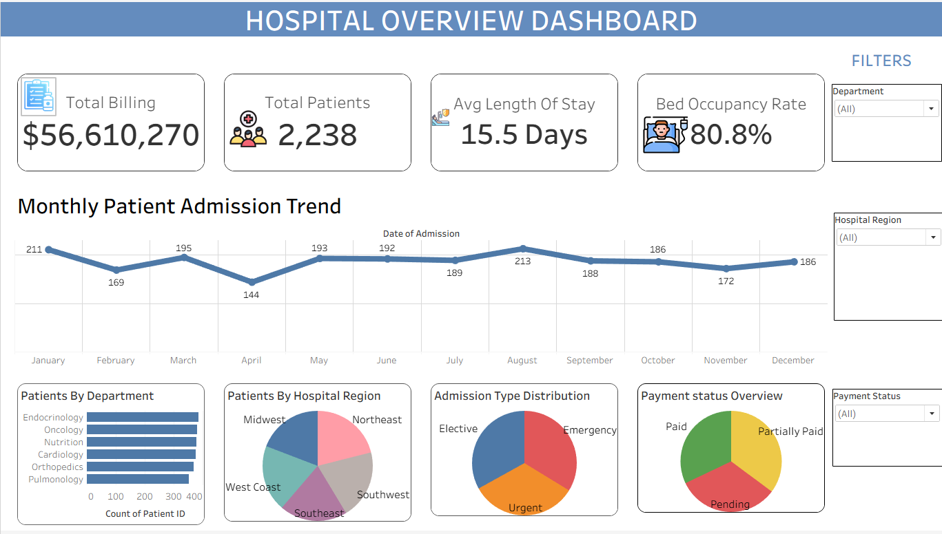
Dashboard 1 – Hospital Overview
Purpose: Provides a high-level overview of hospital performance, including patient volume, occupancy, admissions, and regional distribution.
KPIs Planned | Charts Used | Filters Planned
Total Billing Total Patients Average Length of Stay Bed Occupancy Rate | Line Chart (Monthly Patient Admission Trend) Horizontal Bar Chart (Patients by Department) Pie Chart (Patients by Hospital Region) Pie Chart (Admission Type Distribution) Pie Chart (Payment Status Overview) | Department Hospital Region Payment Status
Navigation: Main dashboard providing an overview of hospital operations.
[ Insert Hospital Overview Dashboard Screenshot Here ]
5

Slide 6
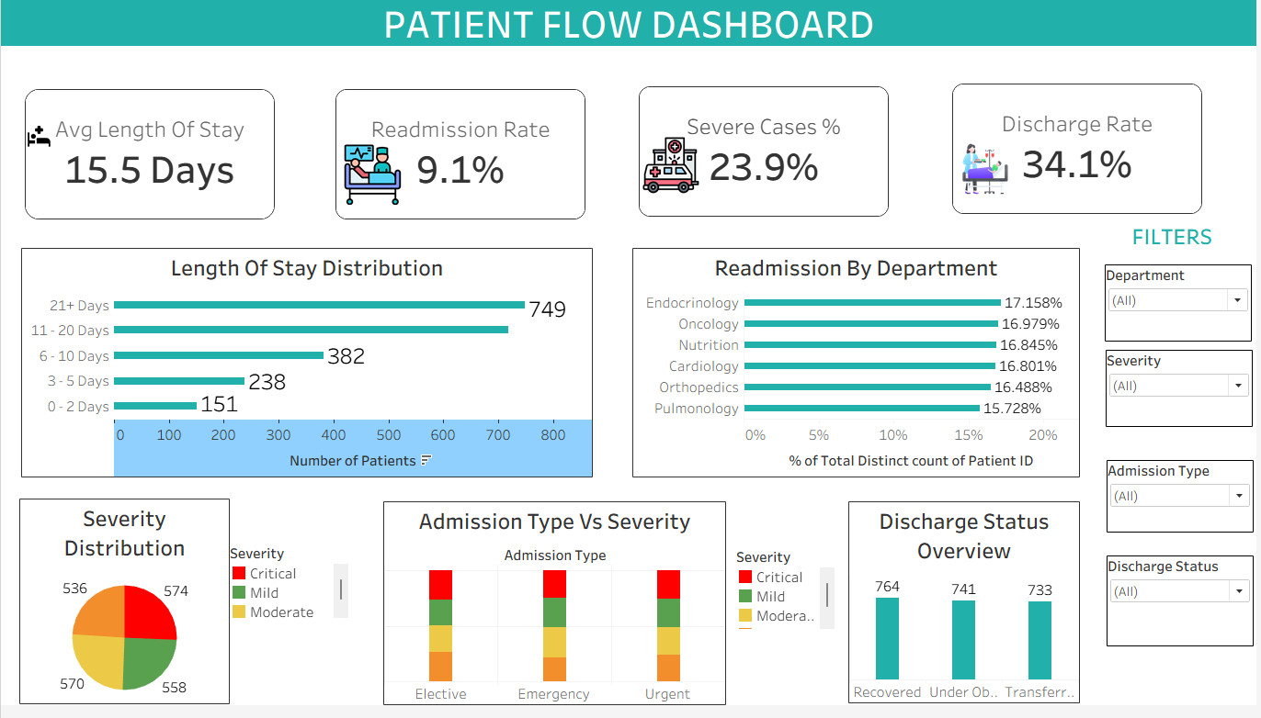
Dashboard 2 – Patient Flow
Purpose: Visualizes patient movement from admission to discharge, along with severity, readmission, and discharge patterns.
KPIs Planned | Charts Used | Filters Planned
Average Length of Stay Readmission Rate Severe Cases % Discharge Rate | Horizontal Bar Chart – Length of Stay Distribution Horizontal Bar Chart – Readmission by Department Pie Chart – Severity Distribution Stacked Bar Chart – Admission Type vs Severity Bar Chart – Discharge Status Overview | Department Severity Admission Type Discharge Status
Navigation: Focuses on patient movement and clinical flow across the hospital.
[ Insert Patient Flow Dashboard Screenshot Here ]
6

Slide 7
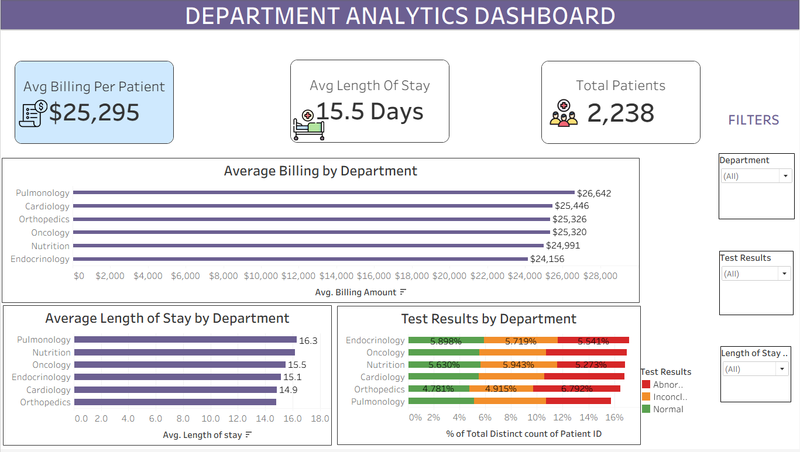
Dashboard 3 – Department Analytics
Purpose: Gives department heads a focused view of patient load, severity mix, and billing patterns within their department.
KPIs Planned | Charts Used | Filters Planned
Average Billing Per Patient Average Length of Stay Total Patients | Horizontal Bar Chart: Average Billing by Department Horizontal Bar Chart: Average Length of Stay by Department Stacked Horizontal Bar Chart: Test Results by Department | Department Test Results Length of Stay
Navigation: Provides department-level performance analysis.
[ Insert Department Analytics Dashboard Screenshot Here ]
7

Slide 8
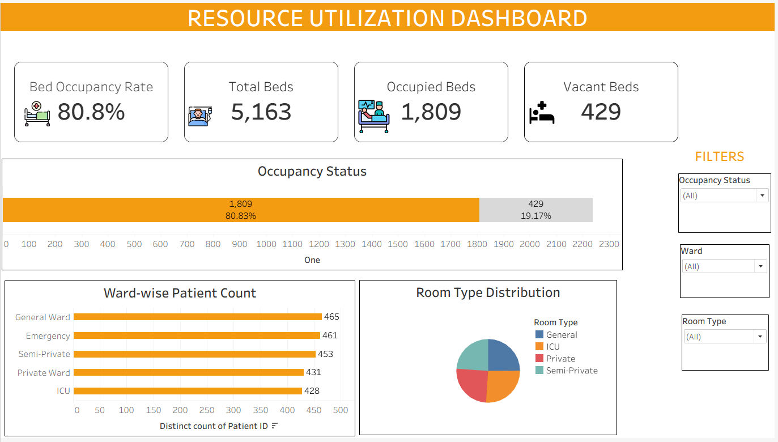
Dashboard 4 – Resource Utilization
Purpose: Tracks bed occupancy, ward utilization, and room distribution to monitor hospital resource utilization and operational efficiency.
KPIs Planned | Charts Used | Filters Planned
Bed Occupancy Rate Total Beds Occupied Beds Vacant Beds | Horizontal Bar Chart – Occupancy Status Horizontal Bar Chart – Ward-wise Patient Count Pie Chart – Room Type Distribution | Occupancy Status Ward Room Type
Displays hospital resource and occupancy utilization.
Navigation:
[ Insert Resource Utilization Dashboard Screenshot Here ]
8

Slide 9
Dashboard Interactivity
Planned prototype features – not yet implemented
Filters & Sorting
Interactive Charts
Design Intent
Global date range filter across all dashboards
Department, ward, and severity filters scoped to relevant dashboards
Payment Status filters for Hospital Overview and Occupancy/Ward filters for Resource Utilization.
Sortable tables (department/ward summary) by column value
Ranked bar charts sorted by metric value
Click-to-filter interactions between summary and detail views
Tooltips on hover showing underlying metric values
All interactivity is planned with non-technical hospital staff in mind – clear labels, minimal clicks, and consistent filter placement across dashboards.
Navigation
Navigation buttons planned between the four dashboards
Planned drill-down from Hospital Overview to Department Analytics for department-level analysis.
MedTrack_DV – Dashboard Storyboard
9

Slide 10
Design Considerations
Consistency | Same color palette, fonts, and KPI card style used across all four dashboards
Simple Layout | Clear top-to-bottom reading order: KPI cards first, then supporting charts
Healthcare-Friendly Visualization | Calm blue/white palette; bright colors reserved for flagging severity
Ease of Navigation | Consistent filter placement and navigation buttons across dashboards
Readable Charts | Clear titles, labeled axes, limited categories per chart to avoid clutter
Professional Structure | Each dashboard follows the same template: title, KPI row, chart grid, filter panel
MedTrack_DV – Dashboard Storyboard
10

Slide 11
Future Enhancements
Beyond the scope of the current planning module
Advanced KPIs – derived metrics such as cost per patient or department efficiency scores
Predictive Analytics – forecasting future admissions or occupancy using historical trends
Real-Time Monitoring – live data refresh for occupancy and admissions
Role-Based Dashboards – tailored views for administrators, department heads, and management
Drill-Down Analysis – deeper drill-down paths from hospital-level to patient-level detail
Alerts – automated notifications when metrics cross planned thresholds
Mobile Dashboard Support – responsive layouts for tablets and mobile devices.
MedTrack_DV – Dashboard Storyboard
11

Slide 12
Conclusion
This storyboard documents the planning and prototype design for the four MedTrack_DV dashboards – Hospital Overview, Patient Flow, Department Analytics, and Resource Utilization. It Captures the intended dashboard layout, KPIs, visualizations, filters, and navigation flow for each dashboard, along with placeholders for screenshots once the dashboards are built.
This document forms the foundation for the full Tableau implementation to be carried out in the subsequent modules of the Infosys Springboard Data Visualization Virtual Internship.
MedTrack_DV – Dashboard Storyboard
12

