Slide 1
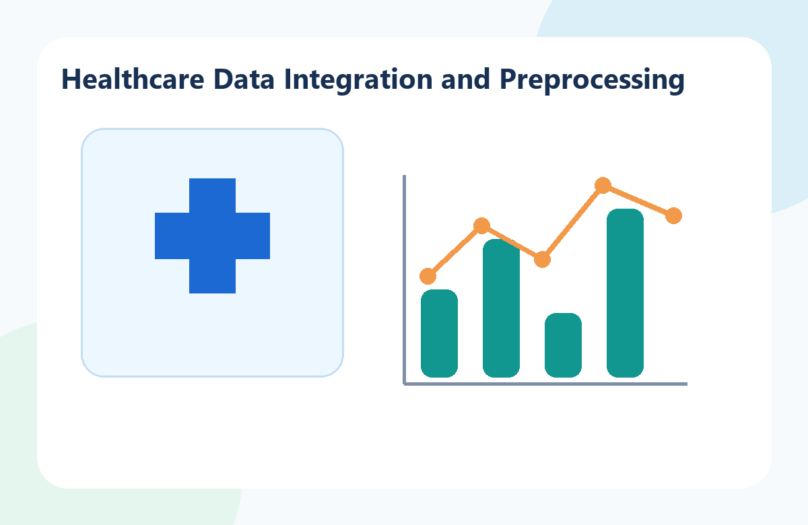
01
MedTrack_DV (Hospital Operations & Patient Analytics Dashboard)
Infosys Springboard Internship
Presented by: Miriyam Revathi
Healthcare Data Integration & Preprocessing
Home
Prev
1
2
3
4
5
6
7
8
Next

Slide 2
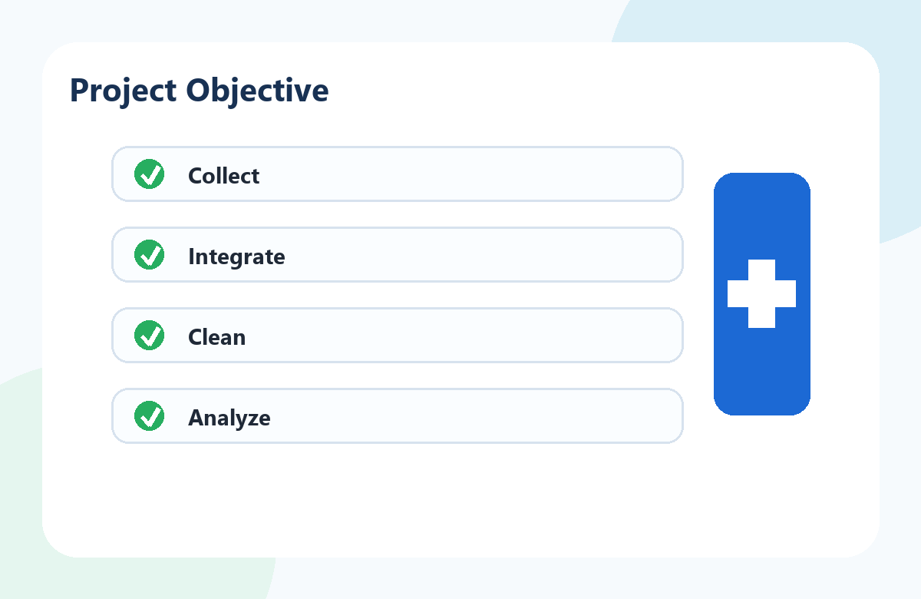
02
Module Objective
Collect healthcare datasets from Kaggle
Integrate multiple datasets into one dataset
Clean and preprocess the data
Prepare a reliable dataset for further analysis
Healthcare Data Integration & Preprocessing
Home
Prev
1
2
3
4
5
6
7
8
Next

Slide 3
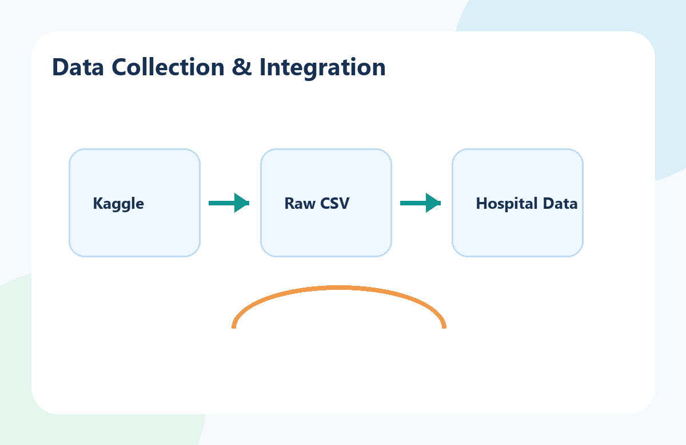
03
Data Collection & Integration
Source: Kaggle Healthcare Datasets
India.gov
Reviewed dataset structure and selected relevant attributes
Integrated datasets into hospital_raw_data.csv
Initial dataset: 300 records, 47 columns
Healthcare Data Integration & Preprocessing
Home
Prev
1
2
3
4
5
6
7
8
Next

Slide 4
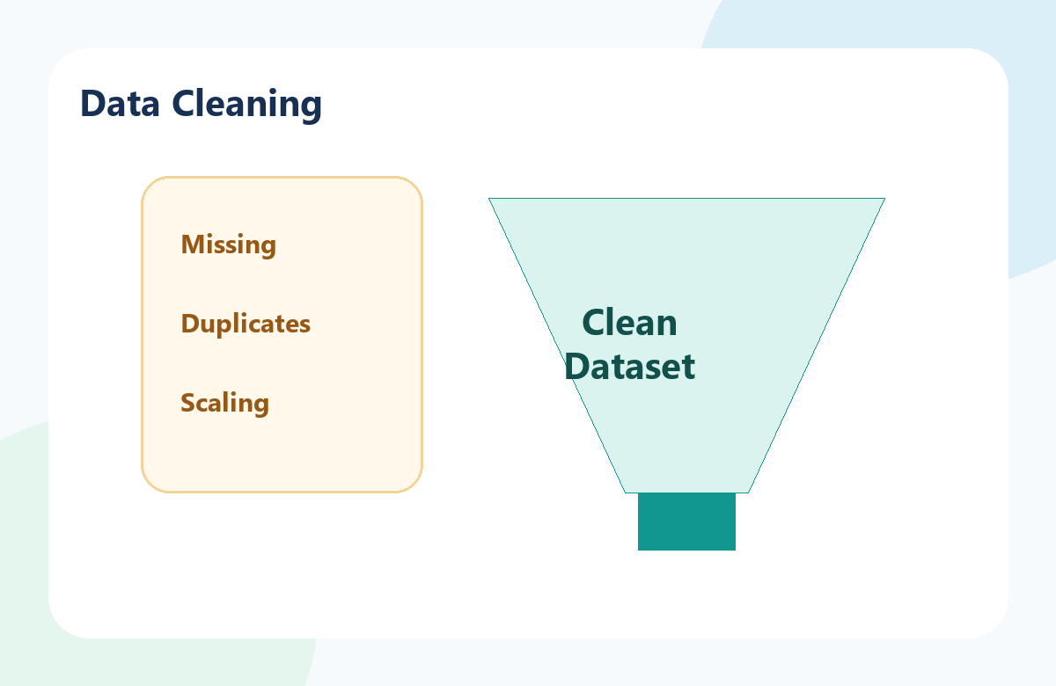
04
Data Cleaning
Removed 18 duplicate records
Handled missing values (Median for numerical, Mode for categorical)
Standardized department names
Normalized selected healthcare indicators using Min-Max scaling
Healthcare Data Integration & Preprocessing
Home
Prev
1
2
3
4
5
6
7
8
Next

Slide 5
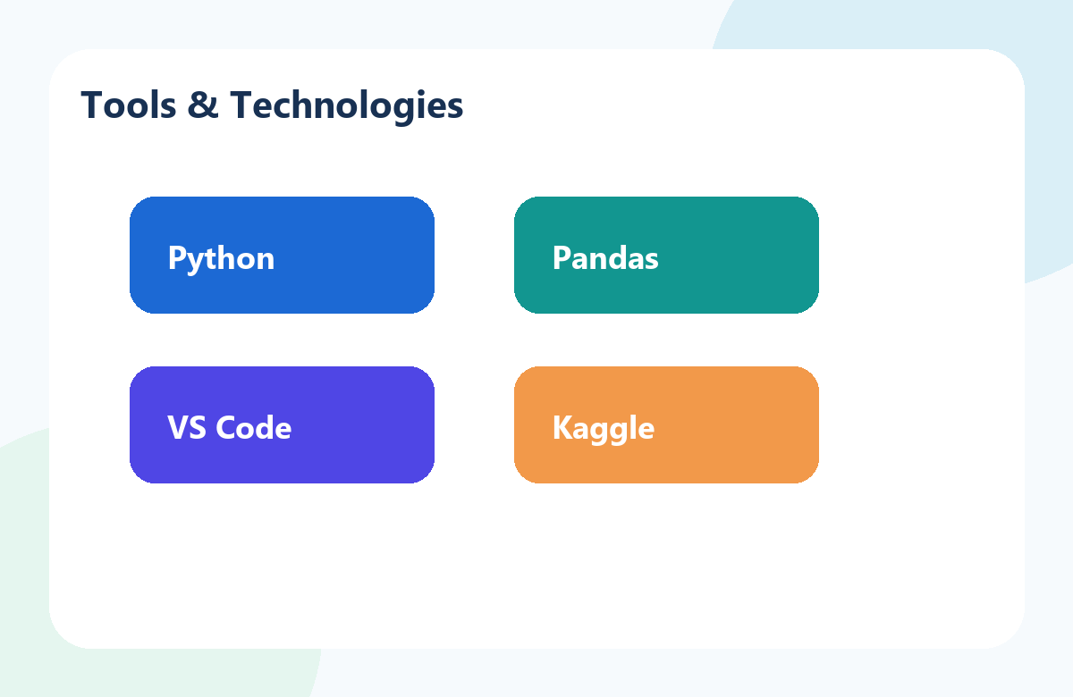
05
Tools & Technologies
Python
Pandas
Visual Studio Code
Kaggle
Healthcare Data Integration & Preprocessing
Home
Prev
1
2
3
4
5
6
7
8
Next

Slide 6
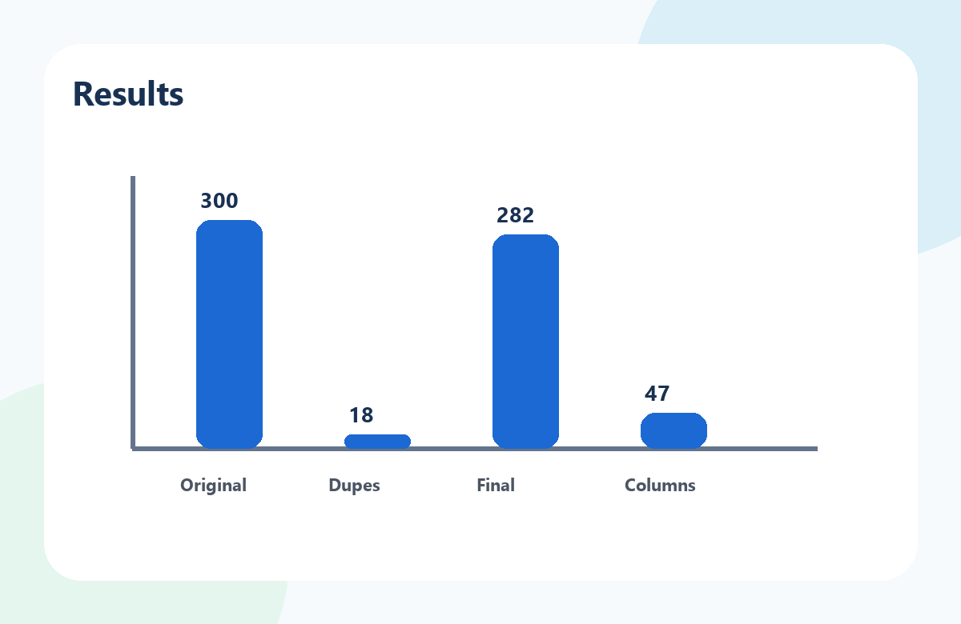
06
Results
Raw data:2.5k+
Original Records: 300
Duplicate Records Removed: 18
Final Records: 282
Columns: 47
Output Files: hospital_raw_data.csv, hospital_cleaning.csv
Healthcare Data Integration & Preprocessing
Home
Prev
1
2
3
4
5
6
7
8
Next

Slide 7
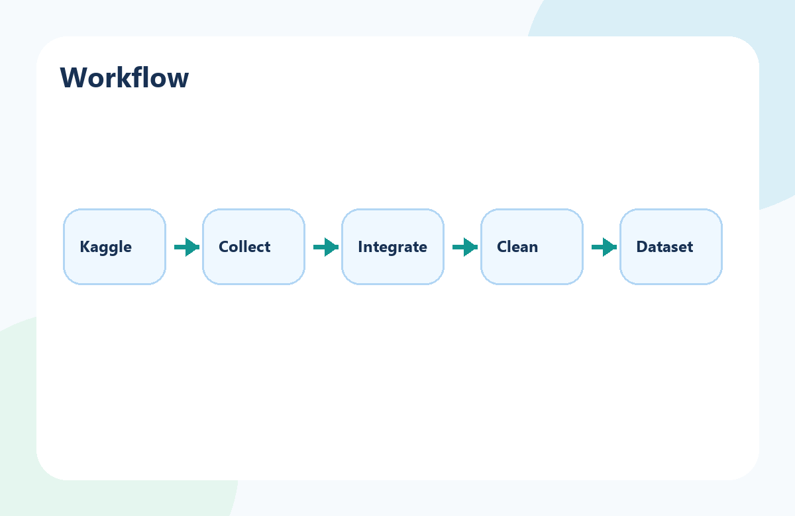
07
Workflow
Kaggle Dataset → Data Collection → Data Integration → Data Cleaning → Clean Dataset
Healthcare Data Integration & Preprocessing
Home
Prev
1
2
3
4
5
6
7
8
Next

Slide 8
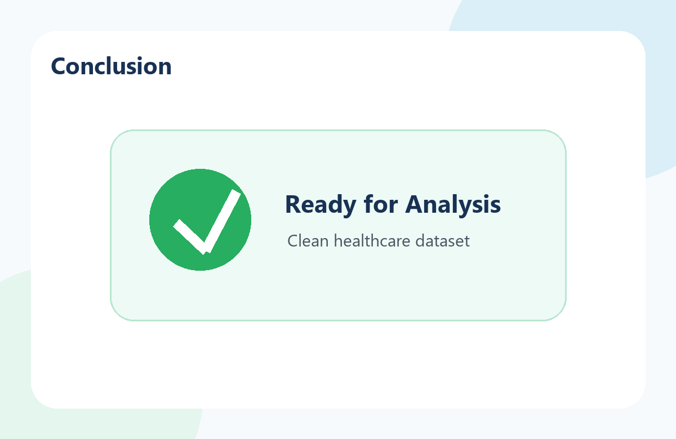
08
Conclusion
Successfully created a clean and consistent healthcare dataset.
Dataset is ready for analysis in the next phase of the internship.
Thank You!
Healthcare Data Integration & Preprocessing
Home
Prev
1
2
3
4
5
6
7
8
Start

