Slide 1

St. ANN’S COLLEGE OF ENGINEERING & TECHNOLOGY
(Department of Computer Science & Engineering)
FOODSYNTHNET: GENERATIVE AI FRAMEWORK FOR CREATING CLASS BALANCED FOOD IMAGE DATASETS AND INTELLIGENT CLASSIFICATION
FOR NUTRITION MONITORING AND FOOD RECOGNITION APPLICATION
PRESENTED BY (BATCH-C13) Guided by:
Shaik Afrin (22F01A05F0) Mr.T.SeshaSai
Reddy Tejaswi (22F01A05E1) Assistant Professor
Tatikonda Sathvik (22F01A05H0) Domain:Generative AI

Slide 2
CONTENTS
Abstract
Introduction
Objective of the Project
Scope of the Project
Literature Review
Existing System
Drawbacks of Existing System
Proposed System
System Requirements
Modules
UML Diagrams
Algorithm
Implementation
Testing
Conclusion
Future Scope
References

Slide 3
ABSTRACT
Food recognition is essential for promoting healthy dietary habits and preventing lifestyle-related diseases. Existing systems often face challenges such as class imbalance, limited food variety, and poor nutritional integration. FoodSynthNet proposes a Generative AI–based framework using Conditional Generative Adversarial Networks (cGANs) to create class-balanced food image datasets and improve classification accuracy. The system combines food recognition with detailed nutrition analysis and health recommendations through a web application.

Slide 4
INTRODUCTION
FoodSynthNet is a Generative AI–based web application that identifies food items from images and provides detailed nutritional information. The system uses class-balanced datasets generated through Generative AI to improve the accuracy of food classification. Users can upload images through a simple interface and receive details such as calories, nutrients, vitamins, minerals, and health suggestions, helping them make better dietary decisions.

Slide 5
SCOPE OF THE PROJECT
The scope of this project is to develop a web-based intelligent food recognition and nutrition monitoring system that identifies food items from images using deep learning models trained on class-balanced datasets generated through Generative AI techniques. The system provides detailed nutritional information, including calories and health benefits, and offers dietary recommendations to support healthy eating habits.

Slide 6
OBJECTIVE OF THE PROJECT
The primary objective of this project is to generate class-balanced food image datasets using Generative AI techniques to improve food classification accuracy. The system accurately identifies food items from uploaded images and presents detailed nutritional information, including health benefits and dietary recommendations. Overall, the project aims to promote nutrition awareness and support preventive healthcare through intelligent food monitoring.

Slide 7
EXISTING SYSTEM
Existing food recognition systems primarily rely on Convolutional Neural Networks (CNNs) and traditional Neural Network (NN) models for identifying food items from images. These models are usually trained on imbalanced and limited food image datasets,which leads to biased learning and reduced classification accuracy, especially for less-represented food categories. Moreover, most existing systems focus only on food identification and provide inaccurate or incomplete nutritional values, lacking detailed information such as vitamins, minerals, and health benefits. They also do not incorporate personalized health analysis or dietary recommendations, limiting their usefulness in nutrition monitoring and preventive healthcare applications.

Slide 8
DRAWBACKS OF EXISTING SYSTEM
Uses CNN and neural network models trained on imbalanced datasets, leading to low classification accuracy.
Unable to correctly recognize a wide variety of food items.
Fails to predict accurate and detailed nutrition values.
Does not provide personalized health or dietary recommendations.
Lacks integration of advanced Generative AI techniques for dataset enhancement

Slide 9
PROPOSED SYSTEM
FoodSynthNet is a Generative AI–based food recognition and nutrition monitoring system that uses Conditional GANs (cGANs) to generate class-balanced food image datasets. This helps overcome data imbalance and improves the accuracy of food classification models. The system identifies food items from uploaded images and provides detailed nutritional information such as calories, nutrients, vitamins, minerals, and health benefits. It also offers health-aware dietary recommendations through a secure and user-friendly web interface, supporting better nutrition monitoring and preventive healthcare.

Slide 10
LITERATURE REVIEW
Goodfellow, I., Pouget-Abadie, J., Mirza, M., et al. (2014) – Introduced GANs for generating realistic synthetic data, widely used to improve dataset size and diversity.
Mirza, M., & Osindero, S. (2014) – Proposed cGANs, enabling controlled image generation based on class labels, useful for balancing datasets.
Min, W., Jiang, S., Liu, L., Rui, Y., & Jain, R. (2019) – Provided a survey on food computing, focusing on food recognition, retrieval, and nutrition analysis, and emphasized integrating visual data with health information.

Slide 11
MODULES
User Management Module – Handles user authentication
Image Processing & Recognition Module – Performs food image upload, preprocessing, and CNN layers-based classification.
Synthetic Data Generation Module – Uses CGAN to create class-balanced food images.
Nutrition & Health Analysis Module – Provides nutritional values and dietary recommendations.
Web Application Module – Implements the Flask-based user interface and routing.

Slide 12
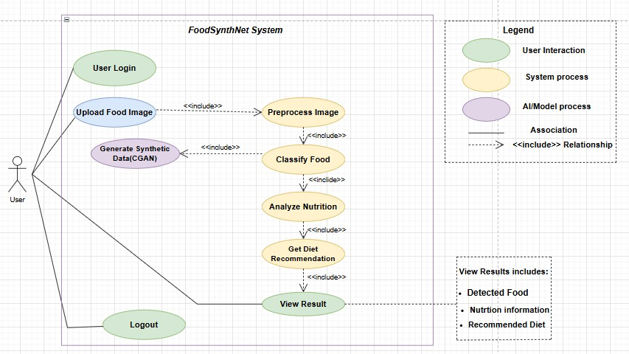
UML DIAGRAMS
USE CASE DIAGRAM

Slide 13
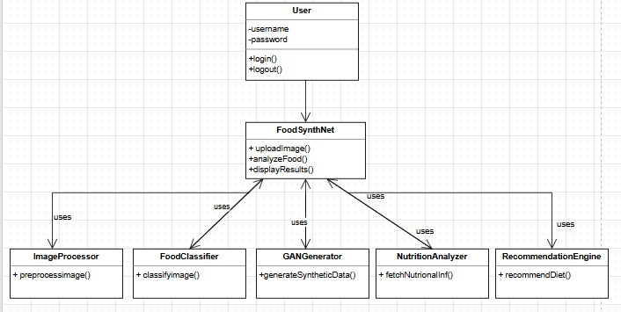
CLASS DIAGRAM

Slide 14
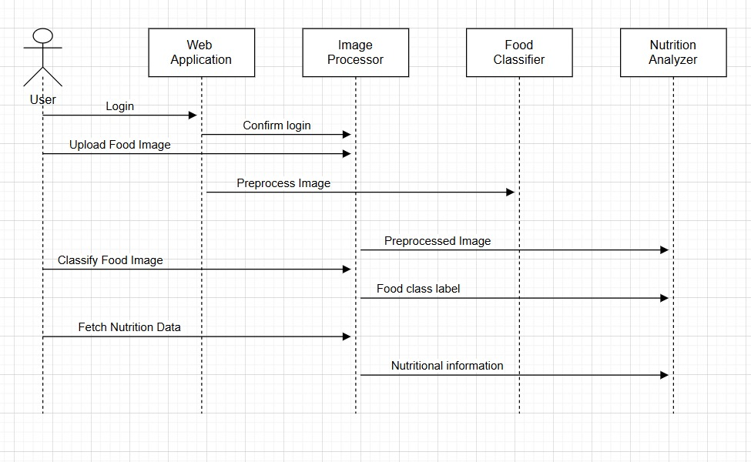
SEQUENCE DIAGRAM

Slide 15
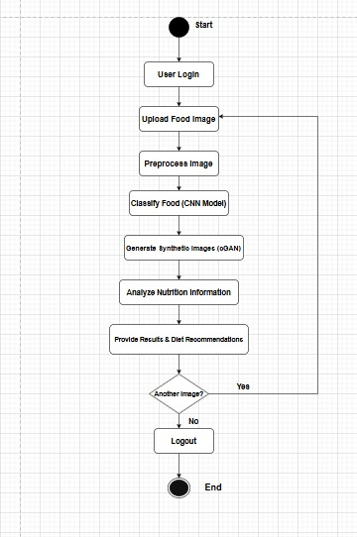
ACTIVITY DIAGRAM

Slide 16
SOFTWARE AND HARDWARE REQUIREMENTS
Software Requirements
Anaconda Navigator
Jupyter Notebook
VS Code
Flask

Slide 17
Hardware Requirements
Processor: Intel i3 / i5 (or equivalent)
RAM:4 GB or 8GB RAM
Other: Stable internet connection (for dataset retrieval & web app deployment)

Slide 18
ALGORITHMS
Conditional Generative Adversarial Networks (cGAN)
Used for generating class-balanced synthetic food images.
The generator network learns complex food textures, shapes, and colors, producing realistic images that closely resemble real food samples.
The discriminator distinguishes between real and generated images, improving dataset diversity.
Helps address class imbalance and improves deep learning model accuracy.

Slide 19
IMPLEMENTATION
SAMPLE CODE
from flask import Flask, request, render_template
import torch, torch.nn as nn
from torchvision import transforms
from PIL import Image
import os
app = Flask(__name__)
# Image preprocessing
transform = transforms.Compose([
transforms.Resize((150,150)),
transforms.ToTensor()])
class FoodCNN(nn.Module):
def __init__(self, n):
super().__init__()
self.net = nn.Sequential(
nn.Conv2d(3,32,3,padding=1), nn.ReLU(),
nn.MaxPool2d(2),
nn.Conv2d(32,64,3,padding=1), nn.ReLU(),
nn.MaxPool2d(2),
nn.Flatten(),
nn.Linear(64*37*37,128), nn.ReLU(),
nn.Linear(128,n)
)
def forward(self,x): return self.net(x)
# Load model
classes = ['corn','fried_rice','jalebi','mango','orange','watermelon']
model = FoodCNN(len(classes))
model.load_state_dict(torch.load("classifier.pth", map_location="cpu"))
model.eval()
# Nutrition mapping (short)
nutrition = {
"biryani":"High calories",
"chapati":"Healthy food",
"jalebi":"High sugar",
"watermelon":"Low calorie"
}

Slide 20
users = {}
@app.route('/', methods=['GET', 'POST'])
def signin():
if request.method == 'POST':
users[request.form['username']] = request.form['password']
session['username'] = request.form['username']
return redirect('/home')
return render_template('signin.html')
@app.route('/signup', methods=['GET', 'POST'])
def signup():
if request.method == 'POST':
username = request.form['username']
password = request.form['password']
# prevent duplicate users
if username in users:
return "User already exists!"
users[username] = password
return redirect('/')
return render_template('signup.html')
@app.route('/home')
def home():
return render_template('home.html')
@app.route('/detection', methods=['GET', 'POST'])
def detection():
if request.method == 'POST':
img = request.files['image']
path = os.path.join("static", img.filename)
img.save(path)
predicted_class, nutrition = predict_image(path)
return render_template(
"detection.html",
predicted_class=predicted_class,
nutrition=nutrition,
image_path=path
)
return render_template("detection.html")
if __name__ == "__main__":
app.run(debug=True, use_reloader=False)

Slide 21
TESTING AND TEST CASES
Functional Testing: Ensured that each feature of the system works as expected, including user login, image upload, food prediction, and nutrition display.
Unit Testing: Tested individual functions like image preprocessing, food prediction, and nutrition data retrieval to ensure correct outputs.
User Interface (UI) Testing: Checked the proper rendering and navigation of web pages including signup, signin, home, and detection pages.
Input Validation Testing: Ensured safe handling of invalid inputs such as unsupported image formats, empty uploads, and duplicate user credentials.

Slide 22
TEST CASES
Test Case ID | Test Description | Input | Expected Output | Result Type
TC01 | Upload food image | Image of Mango | System predicts “Mango” | Positive
TC02 | Image Classification | Image of Biryani | System shows “Biryani” with nutrition details | Positive
TC03 | Display nutrition information | Food prediction result | Displays vitamins, minerals, best time to eat, and other nutritional details. | Positive
TC04 | Web page loading | Open home page | Home page loads successfully. | Positive
TC05 | Uploading non-image file | .txt/.pdf file | System displays an error message and rejects the invalid file | Negative
TC06 | Unknown food image | Random/ Unsupported image | System shows a low -confidence or default output | Negative

Slide 23
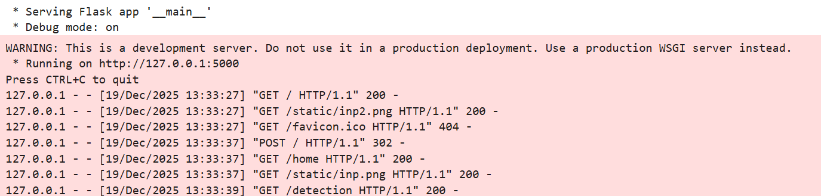
RESULTS

Slide 24
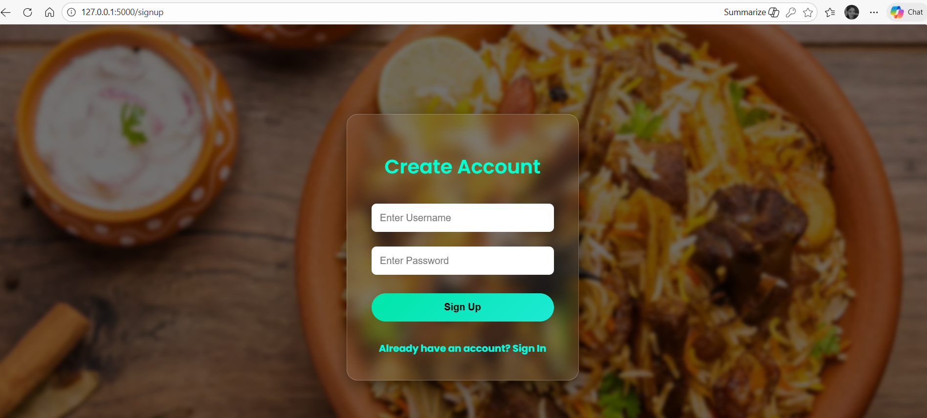
SIGN UP PAGE

Slide 25

SIGN IN PAGE

Slide 26
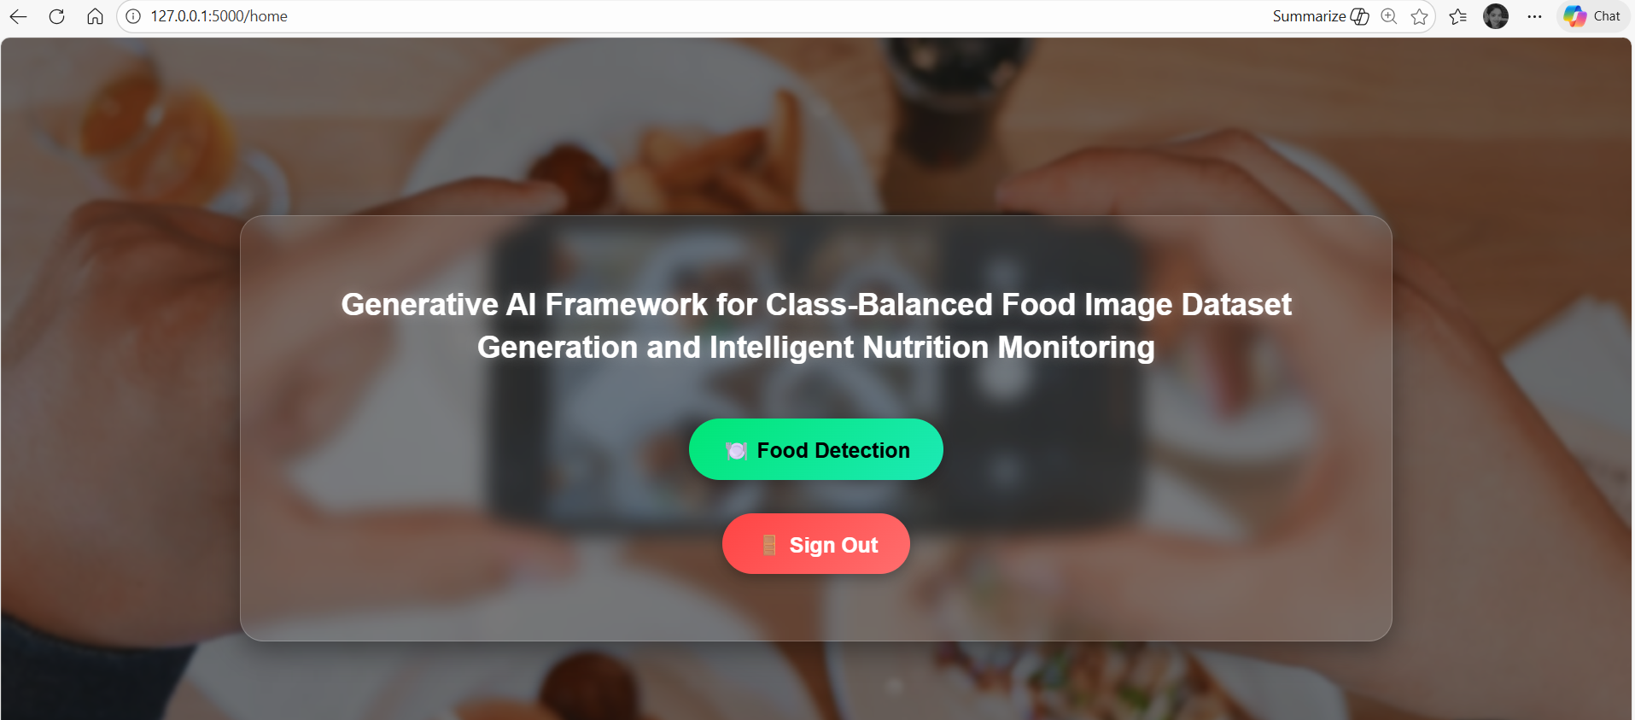
HOME PAGE

Slide 27
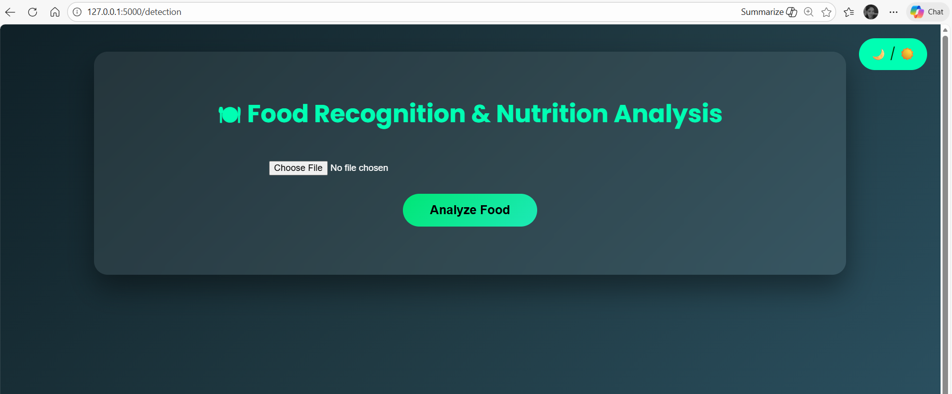
UPLOAD FOOD IMAGE

Slide 28
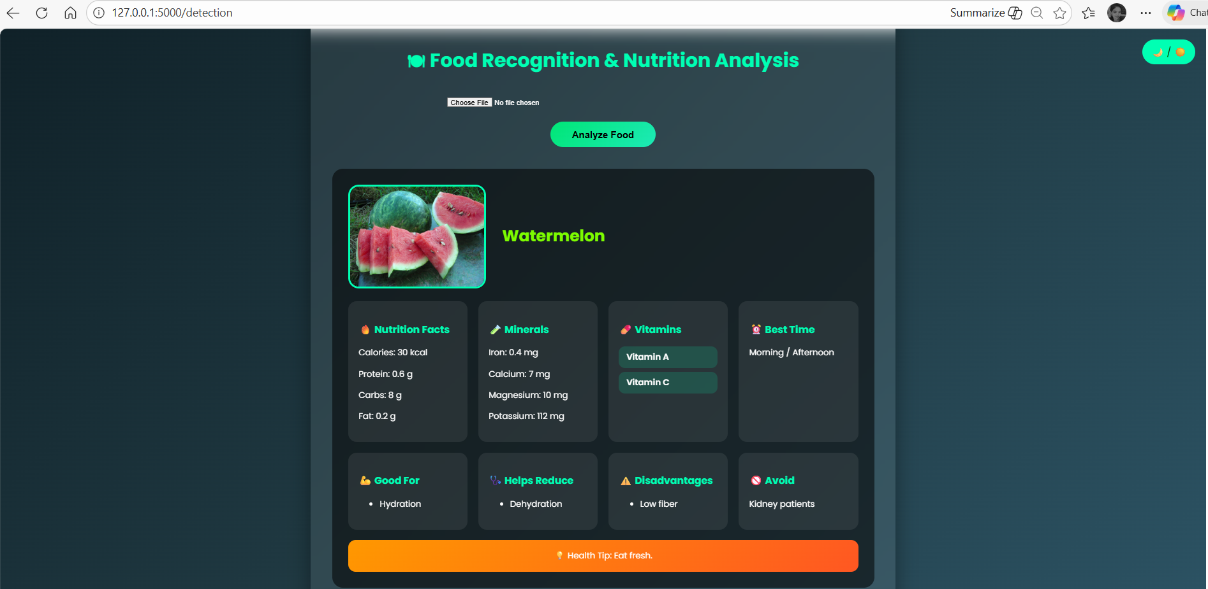
FOOD RECOGNITION

Slide 29
CONCLUSION
The FoodSynthNet project demonstrates an intelligent food recognition and nutrition monitoring system using deep learning and Generative AI techniques. By integrating CGAN-generated class-balanced datasets, the system improves food recognition accuracy and nutritional analysis. It successfully identifies food items from images and provides detailed nutritional values, health benefits, disadvantages, and dietary suggestions, helping users make informed and healthier food choices.

Slide 30
FUTURE EXTENSION
The system can be enhanced by using a larger and diverse food dataset, enabling accurate recognition of regional and global cuisines. Adding real-time calorie tracking, camera-based food detection, and wearable device integration can further improve usability and health monitoring.

Slide 31
REFERENCES
Chen, M., Dhingra, K., Wu, W., Yang, L., Sukthankar, R., & Yang, J. (2009) – Proposed a probabilistic model for food recognition in restaurant environments. Their approach showed that contextual information can enhance recognition accuracy in real-world scenarios.
Min, W., Jiang, S., Liu, L., Rui, Y., & Jain, R. (2019) – Provided a comprehensive survey on food computing, covering food recognition, retrieval, and nutrition analysis. The work emphasized the importance of integrating visual analysis with health-related information.
Krizhevsky, A., Sutskever, I., & Hinton, G. E. (2012) – ImageNet Classification with Deep Convolutional Neural Networks. NeurIPS. This research established CNNs as a powerful approach for image recognition, applied here for food classification.

Slide 32
THANK YOU

