Slide 1
Expert Decision Replay Platform
(EDRP)
🎯 MILESTONE 3 — FINAL PRESENTATION
A centralized platform for documenting, managing, replaying and reviewing strategic organizational decisions.
FastAPI
PostgreSQL
Flask
JWT + OTP
Docker
Group 5 | Academic Year 2025–26
Expert Decision Replay Platform (EDRP) | Milestone 3 | Group 5

Slide 2
🎯 Project Overview & User Roles
What EDRP solves and who uses it
❌ The Problem
✅ EDRP Solution
• Decisions made verbally or in scattered docs • No visibility into WHY an alternative was rejected • No accountability trail for approvals • Repeating past mistakes — lost institutional knowledge • No reporting for leadership visibility
• Structured mandatory decision record for every choice • Alternative Analysis module — pros/cons, cost, risk • Multi-level approval workflow with full audit log • Searchable Knowledge Repository with tags/categories • Analytics dashboards + exportable reports for leadership
👥 User Roles
ADMIN AD-xxx
MANAGER MN-xxx
REVIEWER RW-xxx
EMPLOYEE EMP-xxx
System owner Full access, user mgmt Audit logs, config
Team decisions Approval authority Team analytics
Approve / Reject Comment & evaluate Assigned decisions
Create decisions Comment on assigned View own records
Expert Decision Replay Platform (EDRP) | Milestone 3 | Group 5

Slide 3
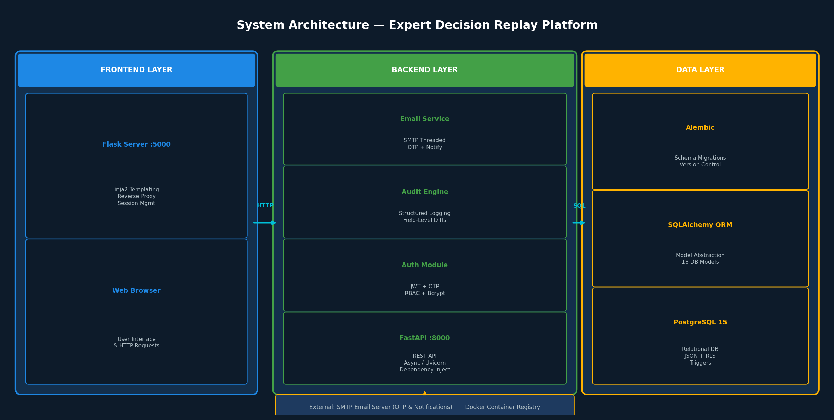
🏗️ System Architecture
Three-tier layered architecture — Frontend · Backend · Database
Expert Decision Replay Platform (EDRP) | Milestone 3 | Group 5

Slide 4
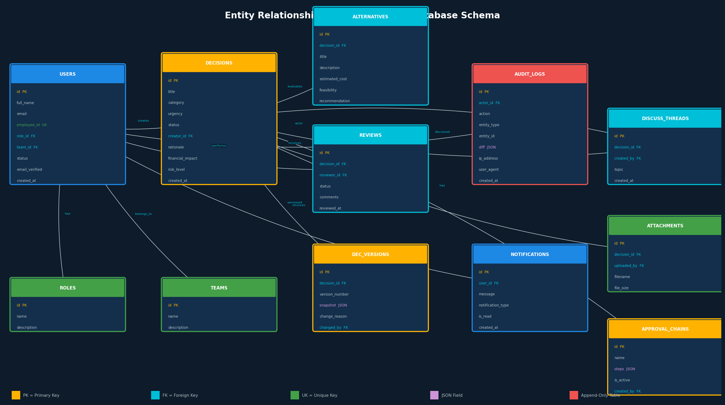
🗄️ Entity Relationship Diagram
18 database tables — PostgreSQL 15 with JSON support, RLS & triggers
Expert Decision Replay Platform (EDRP) | Milestone 3 | Group 5

Slide 5
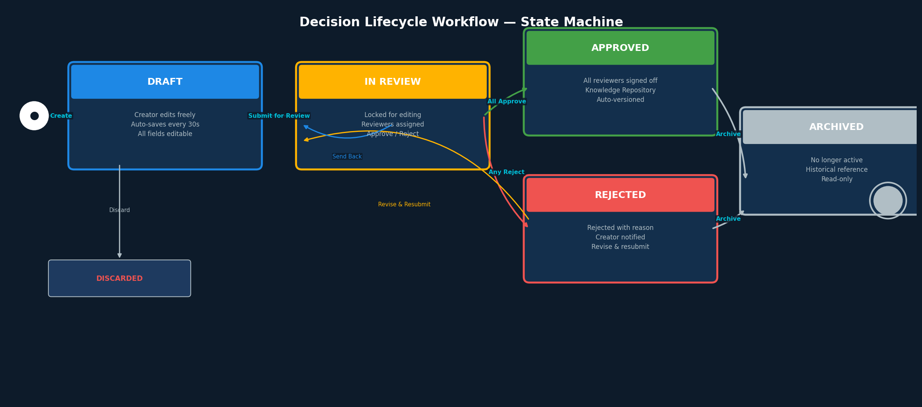
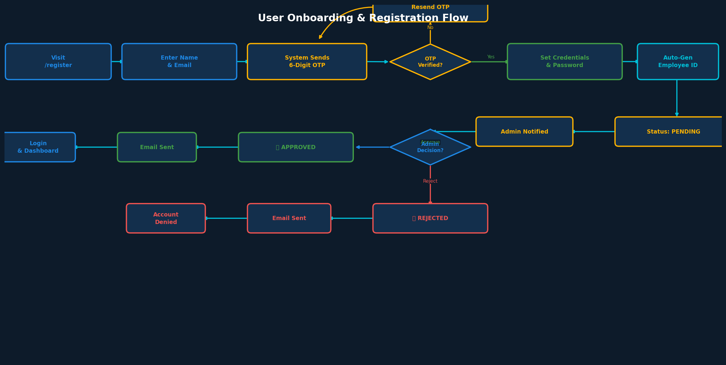
🔄 Core Workflows
Decision Lifecycle State Machine & User Onboarding Registration Flow
Decision Lifecycle
User Onboarding Flow
State Definitions:
• DRAFT — Creator fills structured form; auto-saved every 30s; all fields editable • IN REVIEW — Locked; assigned reviewers can approve / reject / request revision • APPROVED — All required levels signed off; added to permanent Knowledge Repository; auto-versioned • REJECTED — Approver rejected with reason; creator can revise and resubmit or discard • ARCHIVED — No longer active but remains searchable for historical reference
Expert Decision Replay Platform (EDRP) | Milestone 3 | Group 5

Slide 6
⭐ Key Features & Technology Stack
27 features across 3 milestones — full enterprise-grade implementation
Milestones 1 & 2 — Foundation + Lifecycle
Milestone 3 — Security & Approval Chains
TECH STACK
✓ User Registration + Login (JWT auth) ✓ RBAC — 4 roles with OTP email verify ✓ Decision CRUD + Alternative Evaluation ✓ Decision Replay Engine (step-by-step) ✓ Discussion Threads + Meeting Notes ✓ Reviewer Assignment System ✓ File Uploads (PDF, DOCX, PPTX) ✓ 72-hr Persistent Sessions (Remember Me) ✓ Admin Approval Workflow + Email Notifs ✓ Real-Time Audit Dashboard (5s refresh)
✓ Structured Audit Logs (JSON field diffs) ✓ Append-Only Audit Table (PG triggers) ✓ Decision Audit Trail Timeline API ✓ Field-Level Diff Engine (before/after) ✓ Approval Chain Configuration (multi-step) ✓ Decision Versioning (auto-snapshot) ✓ Row-Level Security (PostgreSQL RLS) ✓ Least-Privilege DB Roles (edrp_app) ✓ IP & User-Agent Tracking in audit ✓ CSV Export for Compliance Reporting
FastAPI
PostgreSQL 15
Flask 3.1
SQLAlchemy
JWT + Bcrypt
Docker Compose
Expert Decision Replay Platform (EDRP) | Milestone 3 | Group 5

Slide 7
🔌 API, Security & Conclusion
18 REST API routers · Enterprise security · Milestone 3 achievements
REST API Endpoints (18 Routers)
Security Features
Prefix | Module | Description
🔒 Bcrypt Password Hashing
🔑 JWT Auth (72-hr sessions)
/users
/roles
/teams
🛡️ RBAC Endpoint Guards
📧 Email OTP Verification
/decisions
/alternatives
/reviews
/replays
/audit-logs
/approval-chains
✅ Admin Approval Workflow
📋 Append-Only Audit Logs
/dashboard
/profile
/notifications
🔐 PostgreSQL RLS Policies
👤 Least-Privilege DB Roles
/discussions
/upload
/reports
🌐 IP & User-Agent Tracking
📊 Field-Level Diff Logging
/repository
/settings
/support
🎉 Milestone 3 — Complete
✅ Full 3-Tier Architecture: Flask + FastAPI + PostgreSQL ✅ 18 DB Tables · 20 API Routers · 36 UI Templates · 19 ORM Models ✅ Enterprise Security: JWT, RBAC, OTP, Bcrypt, Append-Only Audit, RLS ✅ Decision Replay Engine + Versioning + Approval Chain Configuration ✅ Docker Compose Deployment — Production-Ready Containerized App
Expert Decision Replay Platform (EDRP) | Milestone 3 | Group 5

