Slide 1
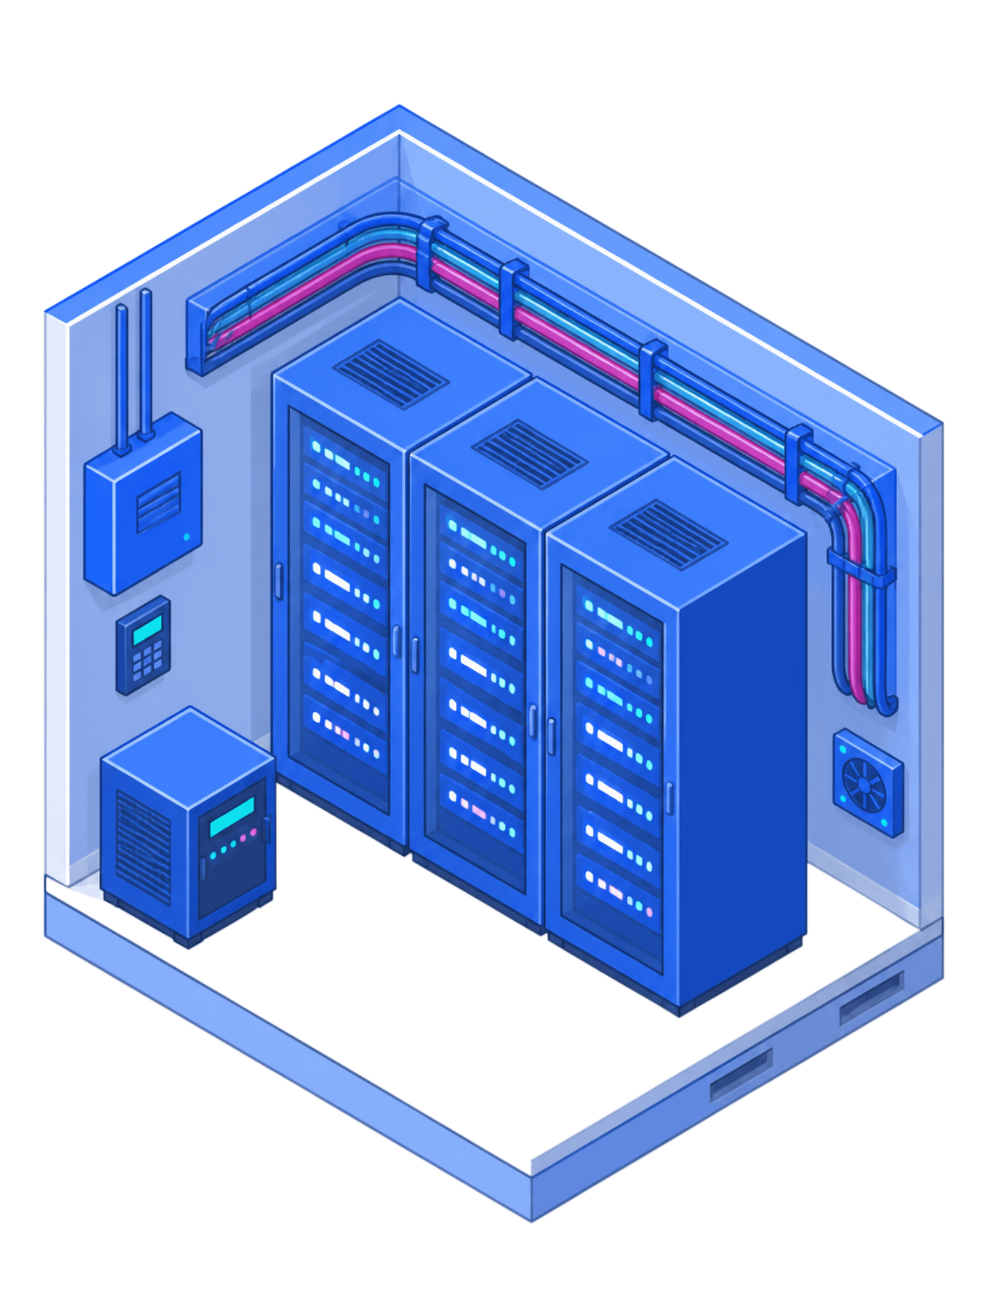
Expert Decision Replay Platform (EDRP)
A centralized platform for recording, reviewing, and learning from organizational decisions

Slide 2
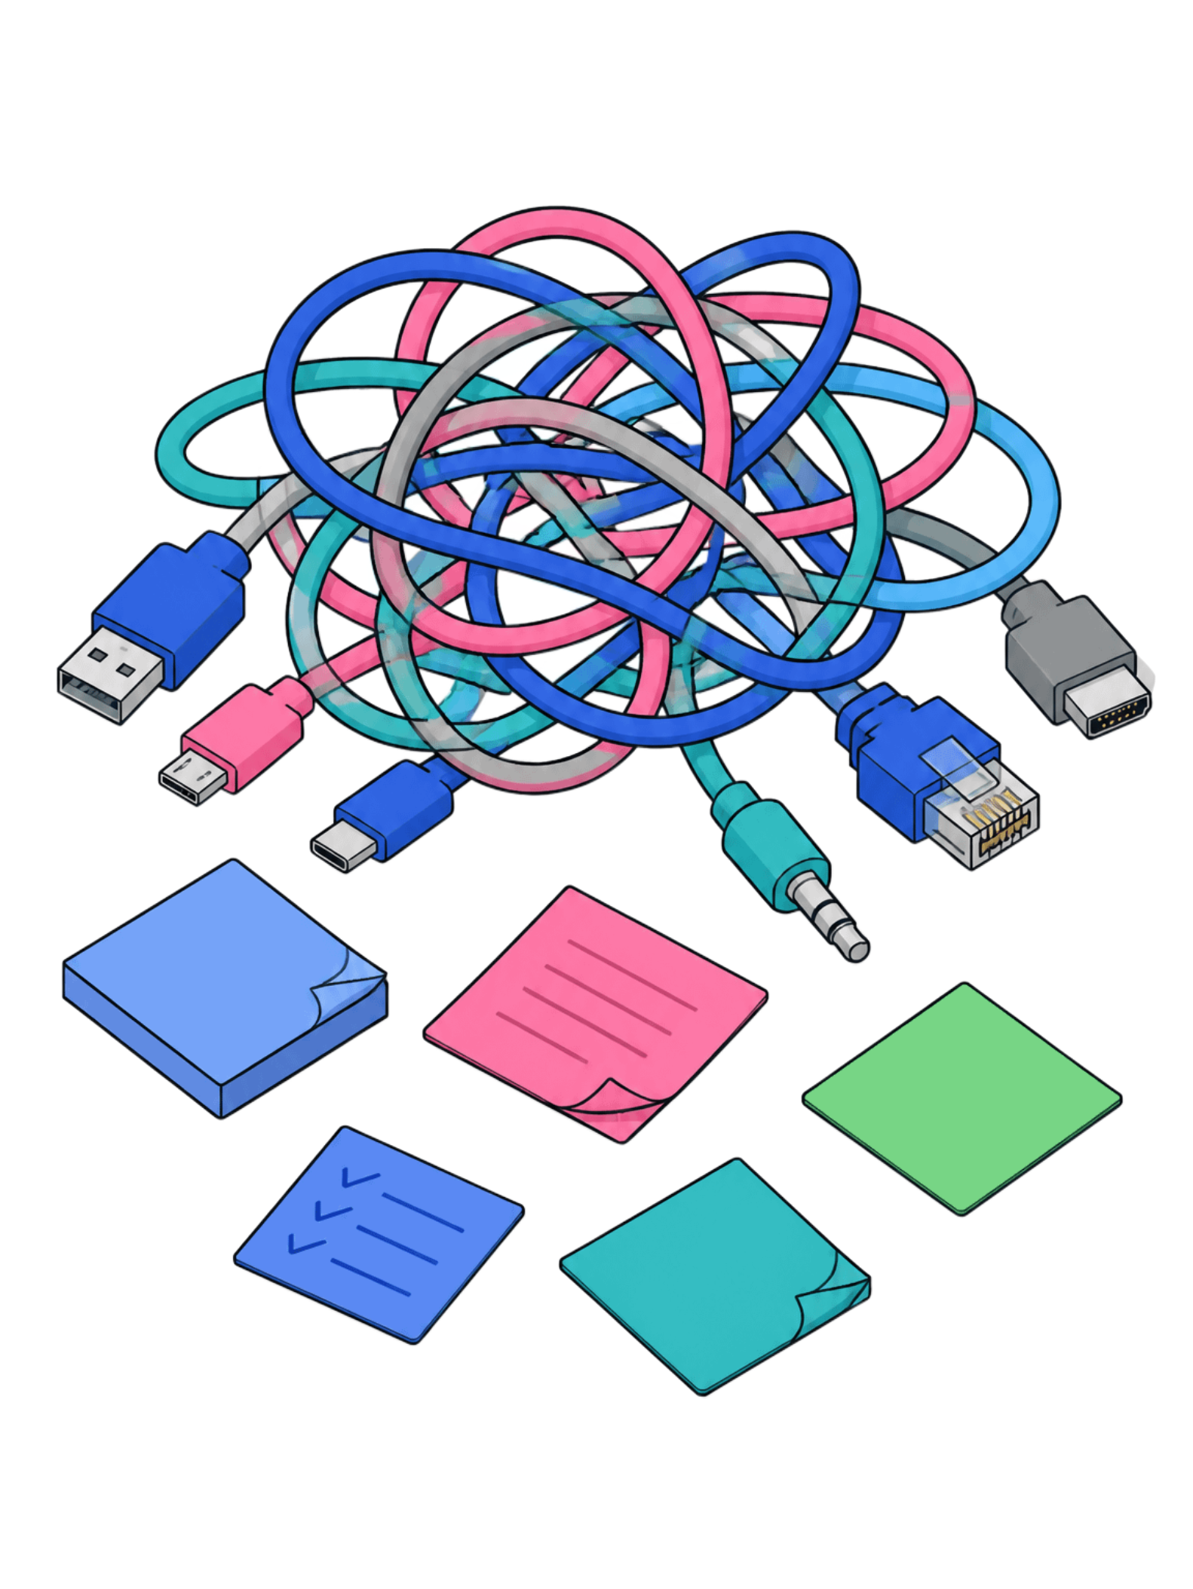
Decisions Are Made — Then Lost
No Paper Trail
Critical decisions happen over chat, email, or verbal conversations — reasoning vanishes when people forget or leave.
Repeated Mistakes
Without recorded context, teams relitigate the same problems and make the same errors again and again.
Slow Onboarding
New hires have no way to understand why things are the way they are — institutional knowledge lives only in people's heads.
No Accountability
No audit trail means no way to trace who decided what, when, or why.

Slide 3
What EDRP Does
EDRP gives organizations a structured system to capture, review, approve, and search decisions — turning informal choices into institutional memory.
Structured Capture
Approval Workflow
Discussion Threads
Problem statement, alternatives, and risk assessment per decision.
Multi-level sequential review with SLA-based escalation.
Contextual comments tied directly to each decision.
Version History & Audit Logs
Knowledge Repository
Full change trail, tamper-evident and always accessible.
Approved decisions become searchable organizational memory.

Slide 4
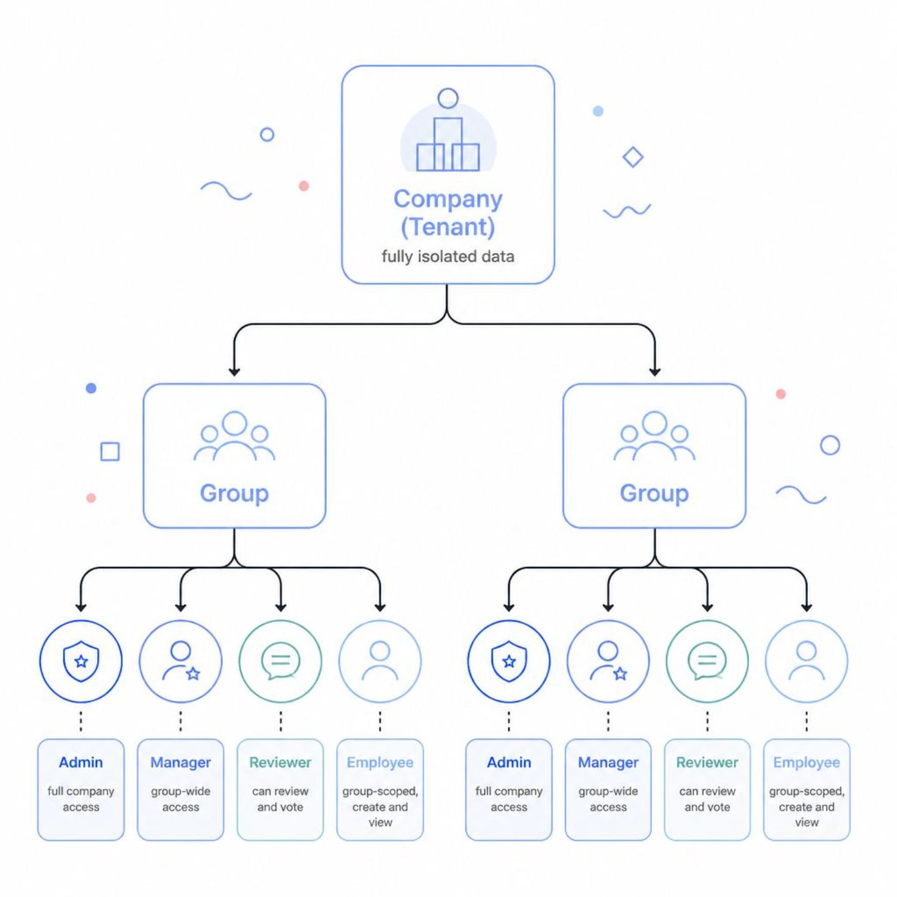
Roles & Access — Hierarchical, Multi-Tenant
Multi-Tenant Isolation
Company (Tenant): Fully isolated — data never crosses tenant boundaries.
Groups: Sub-units within a company, like GitHub Teams. Users belong to one or more groups.
Admin: Full access across the entire company
Manager: Full access within their assigned groups
Reviewer: Can review and vote on decisions in their groups
Employee: Scoped to their groups only — create and view decisions

Slide 5
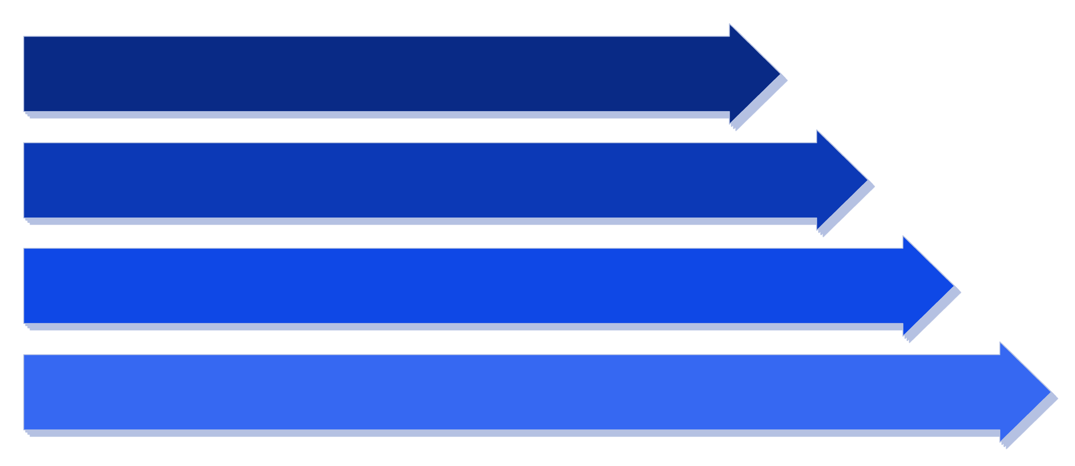
Decision Lifecycle Workflow
Draft
Under Review
Approved / Rejected
Archived
Each stage is connected by a clear handoff: employees submit, approvers act sequentially with SLA enforcement, and approved decisions are permanently indexed — never lost.

Slide 6
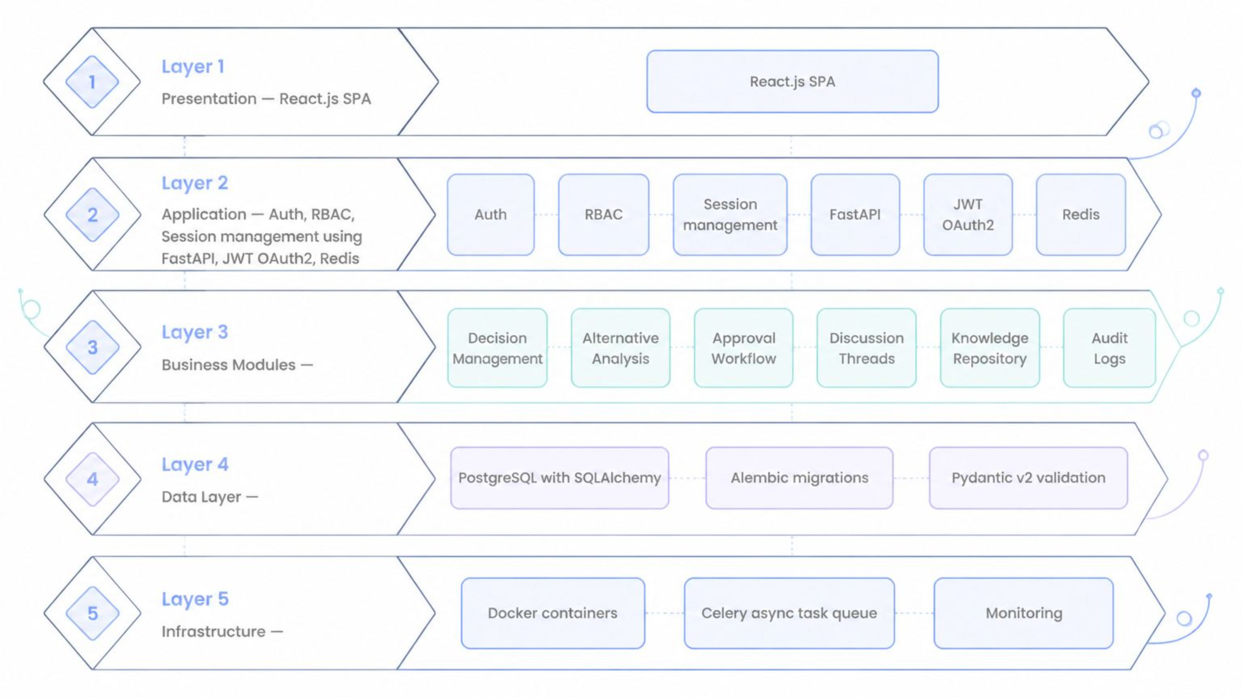
System Architecture
PRESENTATION
APPLICATION
DATA LAYER
INFRASTRUCTURE
React.js SPA
FastAPI · JWT · Redis
PostgreSQL · SQLAlchemy · Alembic
Docker · Celery · Monitoring

Slide 7
What I've Built So Far
✅ Auth System
JWT/OAuth2 login, Redis token blacklisting, Admin/Employee toggle — including circular import & registration bug fixes.
✅ RBAC
Role-based access control enforced across all protected routes.
✅ Decision Creation + Alternative Analysis
Module fully functional end-to-end.
✅ Approval Engine
Sequential multi-level logic, reject/request-changes handling, approval history preserved on resubmission.
🔄 Multi-Tenant Redesign (Company/Group Isolation)
In progress — proper data boundaries between organizations.

Slide 8
Challenges Faced & Fixed
Tenant Isolation Gaps
Validation Mismatch
Stuck "Save" Button
Lost Approval History
Audit revealed endpoints skipping company/group checks → centralized access dependency added to enforce it uniformly.
Frontend and backend disagreed on alternatives count rules → aligned both sides to the same schema.
Stale frontend validation state disabled Save on the Alternatives form → moved validation to Submit step only, Save is now freeform.
Resubmission was deleting old approval rounds → fixed to preserve all historical rounds intact.

Slide 9
What's Next
🔄 Company/Group Switcher UI
1
Let users navigate between tenants seamlessly within the app.
2
📬 Notifications
Email & SMS alerts for approvals and SLA breaches.
🔍 Knowledge Repository Search
3
Full-text search across all approved decisions.
4
📊 Reports & Export
PDF and Excel output for decision summaries.
🐳 Docker Deployment
5
Final containerized deployment + end-to-end testing pass.

Slide 10

Summary & Thank You
EDRP transforms how organizations handle decisions — replacing informal, forgettable conversations with a structured, auditable, searchable system that builds institutional memory over time. Built end-to-end during a 3-month Infosys Springboard internship.
Backend
Auth & Async
FastAPI · PostgreSQL · SQLAlchemy · Alembic · Pydantic v2
JWT/OAuth2 · Redis · Celery
Frontend & Infra
React.js · Docker

