Slide 1
Climate Scope: Weather Analysis & Risk Dashboard
Presented To: N. Shanmukha Priya Data Scientist
Presented by: Venkat ThAppetla Intern

Slide 2
2: Problems Faced
Weather data is large and complex
Difficult to identify patterns manually
No simple way to measure climate risk

Slide 3
3:Project Objective
Analyze global weather data
Identify trends and patterns
Detect extreme weather events
Build an interactive dashboard

Slide 4
4:Data Used
Source: Kaggle Global Weather Dataset
Daily global weather data
Key Features:
Temperature
Rainfall
Wind Speed

Slide 5
5: What I Built
Interactive dashboard
Risk scoring system
Data visualizations for analysis
Outcome: A system that converts raw data into meaningful insights.

Slide 6
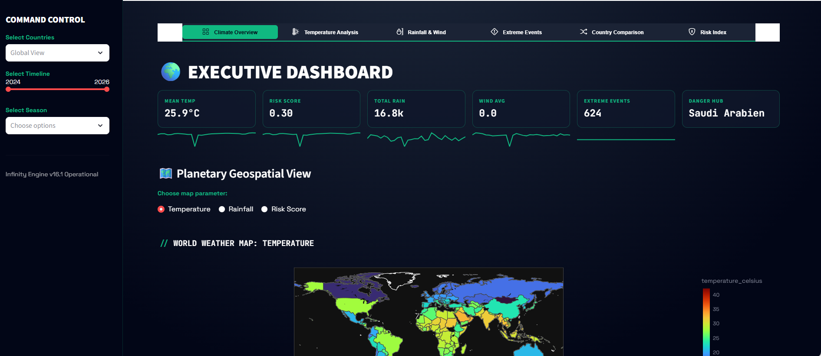
6: Dashboard Overview
User-friendly interface
Interactive filters
Multiple visualizations
Features:
Real-time exploration
Easy comparison between regions

Slide 7
7:Dashboard Sections
Climate Overview
Temperature Analysis
Rainfall & Wind
Extreme Events
Risk Score

Slide 8
8:Key Insights Found
Temperature is increasing over time
Climate risk is increasing
Some regions are more vulnerable

Slide 9
9: Extreme Events
Heatwaves (>40°C)
Floods (>100 mm rainfall)
Storms (>60 kph wind)
Insight: Extreme events are becoming more frequent.

Slide 10
10: Risk Analysis
Risk varies across regions
High-risk areas identified
Risk trend is increasing over time

Slide 11
11: Applications
Disaster management
Agricultural planning
Climate awareness

Slide 12
12: Conclusion
Built an interactive climate dashboard
Identified global weather trends
Developed a simple risk scoring model
Final Statement: Data-driven insights help in better climate understanding.

Slide 13
Thank You

