Slide 1

ClimateScope - Visualizing Global Weather Trends and Extreme Events
Milestone 1: Data Preparation & Understanding
Under the Guidance of,
Shanmukha Priya
Springboard Mentor
PRESENTED BY
G. Aishwarya

Slide 2
Dataset Overview
Total records: 122,771 rows
Total features: 41 columns
Covers 256 locations
Contains:
Temperature
Humidity
Wind
Pressure
Precipitation
Air-quality indicators
Sunrise, sunset, moon data

Slide 3
Environment & Tools Used
Programming: Python 3
Libraries:
pandas → data handling
numpy → numerical operations
matplotlib / Plotly → basic visualization
Storage: CSV files

Slide 4
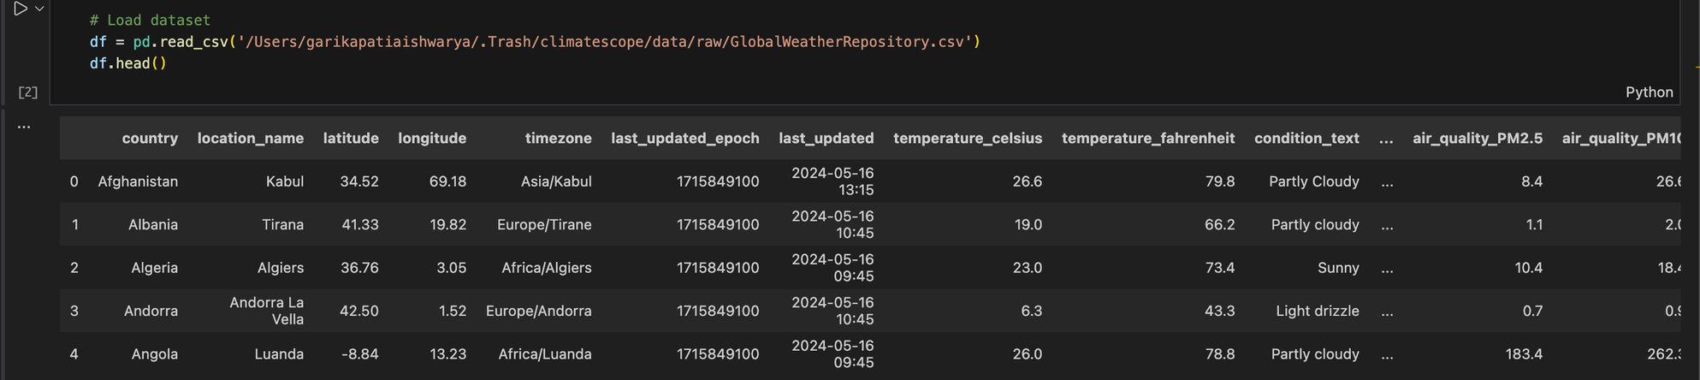
Data Loading (Code + Output)
import pandas as pd
df = pd.read_csv("GlobalWeatherRepository.csv")
df.head()

Slide 5
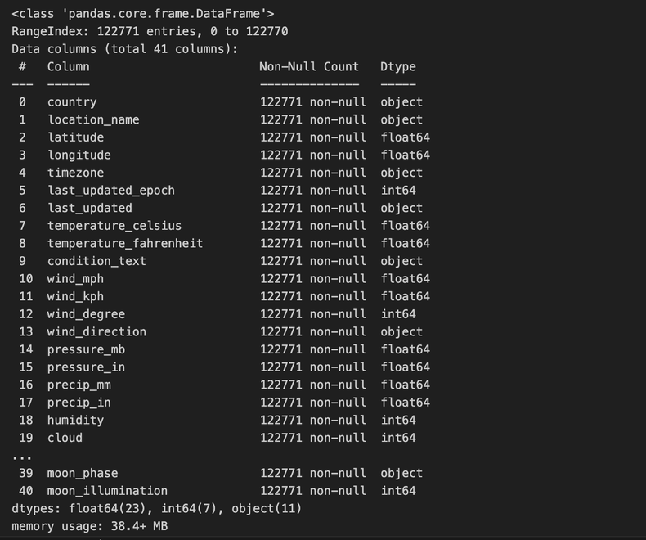
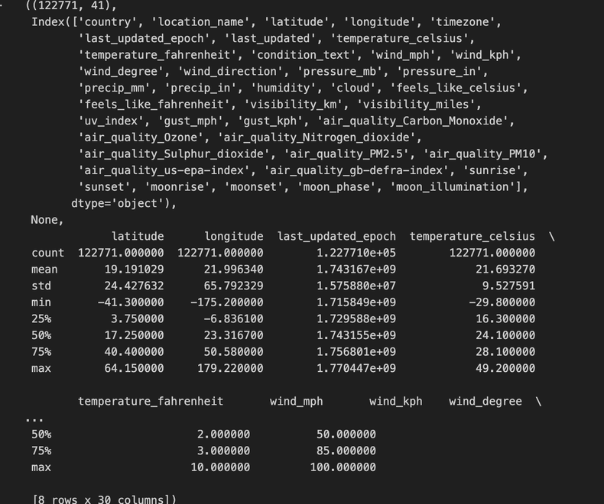
Data Understanding
# Inspect structure
df.shape, df.columns, df.info(), df.describe()
Mix of numerical + categorical columns
Examples of numeric:
temperature_celsius
humidity
wind_kph
air_quality_PM2.5
Examples of categorical:
country
condition_text
moon_phase
Key stat to observe:
Mean temperature ≈ 21.7 °C
Most common condition: Partly cloudy

Slide 6
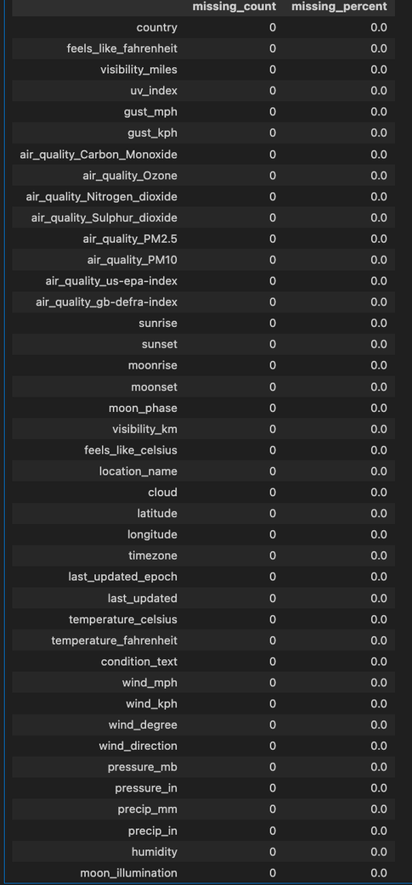
Missing Value Check
# Missing values summary
missing_counts = df.isnull().sum()
missing_percent = (missing_counts / len(df)) * 100
missing_summary = pd.DataFrame({'missing_count': missing_counts, 'missing_percent': missing_percent})
missing_summary.sort_values(by='missing_percent', ascending=False)
o/p :
No missing values in major weather columns
Dataset is already clean and complete
Only preprocessing needed → formatting & aggregation
Result - Means high-quality dataset.
#text standardization
df_cleaned_nulls['country'] = df_cleaned_nulls['country'].str.strip().str.title()
o/p:
Removed extra spaces in country names
Converted text to consistent title case
Ensured uniform country representation for analysis

Slide 7
Convert units
Fahrenhit to celsius:
df["temperature_celsius"] = (df["temperature_fahrenheit"] - 32) * 5/9
mph → km/h
df["humidity_norm"] = (df["humidity"] - df["humidity"].min()) / \
(df["humidity"].max() - df["humidity"].min())

Slide 8
Daily and Monthly agg
#daily aggregation
df_clean = df_cleaned_nulls[[
'country','location_name','latitude','longitude','last_updated',
'temperature_celsius','humidity','precip_mm','wind_kph','condition_text','uv_index'
]]
# Feature engineering
df_clean['year'] = df_clean['last_updated'].dt.year
df_clean['month'] = df_clean['last_updated'].dt.month
df_clean['month_name'] = df_clean['last_updated'].dt.month_name()
Save Pre-processed csv
# Save cleaned daily dataset
df_clean.to_csv('/Users/garikapatiaishwarya/.Trash/climatescope/data/processed/global_weather_cleaned_daily.csv', index=False)
# Save aggregated monthly dataset
monthly_df.to_csv('/Users/garikapatiaishwarya/.Trash/climatescope/data/processed/global_weather_cleaned_monthly.csv', index=False)
# Monthly aggregation
monthly_df = df_clean.groupby(['country','year','month'], as_index=False).agg({
'temperature_celsius': 'mean',
'humidity': 'mean',
'precip_mm': 'sum',
'wind_kph': 'mean',
'uv_index': 'mean'
})
monthly_df.head()

Slide 9
Milestone 1 Successfully Completed
Global weather dataset explored
Structure and statistics verified
Data quality confirmed (no major null values)
Dataset ready for analysis and visualization

