Slide 1

ClimateScope - Visualizing Global Weather Trends and Extreme Events
Milestone 2 - Core Analysis & Visualization Design
Under the Guidance of,
Shanmukha Priya
Springboard Mentor
PRESENTED BY
G. Aishwarya

Slide 2
Milestone 2 Objectives
Perform statistical analysis on weather dataset
Identify distributions, correlations, seasonal patterns
Detect extreme weather events
Compare weather conditions across regions
Design dashboard visualization structure

Slide 3
Dataset Overview
Dataset Characteristics
Variables analyzed:
Temperature
Precipitation
Humidity
Wind Speed
Date
Country
Granularity: Daily observations aggregated monthly and yearly
Purpose: Understand global climate behavior across time and regions.

Slide 4
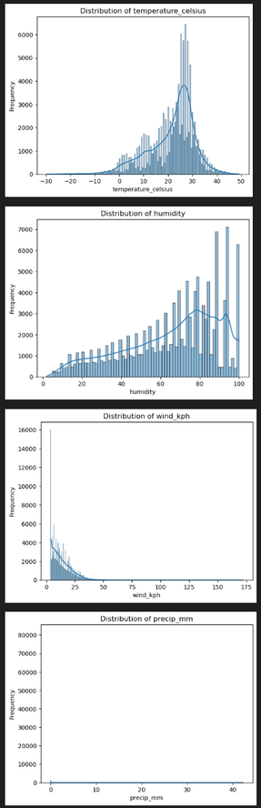
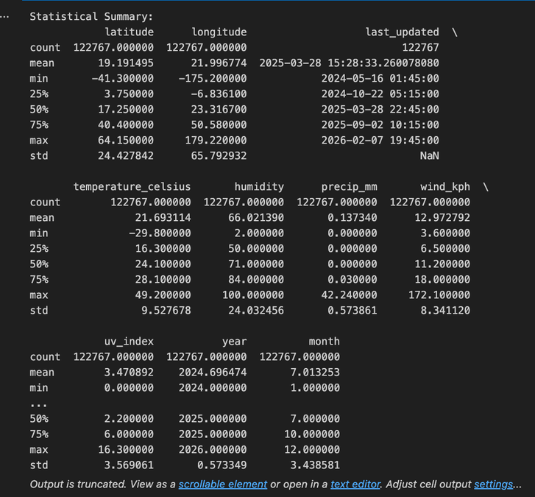
Statistical Summary Analysis
Descriptive Statistics Performed
Mean
Median
Standard Deviation
Minimum & Maximum
Insights:
Temperature shows significant variability across regions
Precipitation distribution is positively skewed
humidity remains relatively stable compared to rainfall
This establishes baseline climate behavior.

Slide 5
Distribution Analysis
Method Used:
Histograms with KDE curves
Findings:
Temperature follows near-normal distribution in most regions
Precipitation shows heavy right skew (many low values, few extreme highs)
Wind speed concentrated within moderate ranges
Purpose: Detect irregular patterns and variability.

Slide 6
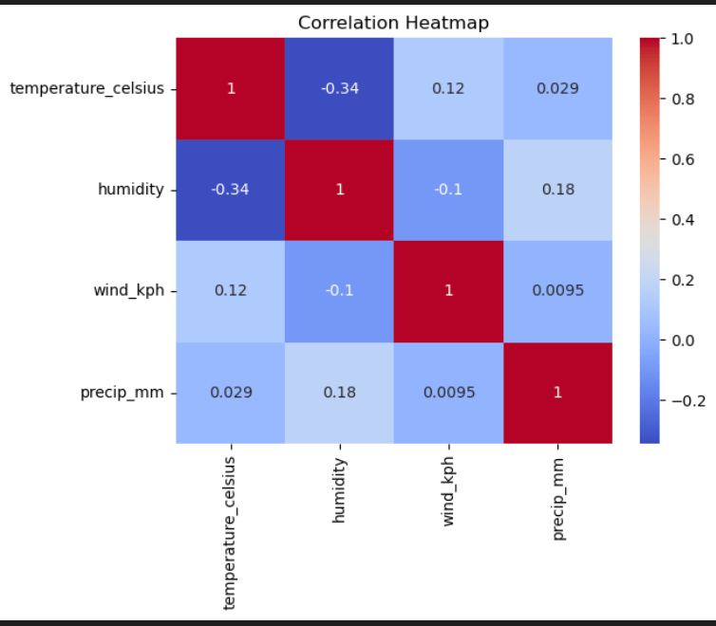
Correlation Analysis
Method Used:
Pearson correlation matrix
Heatmap visualization
Key Observations:
Moderate correlation between temperature and humidity
Weak correlation between wind speed and precipitation
Strong relationships vary by region
Why Important:
Helps understand interdependency between climate variables.

Slide 7
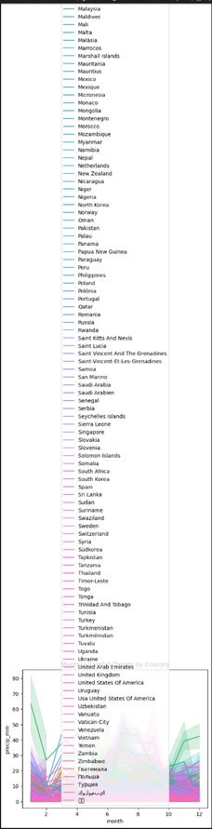
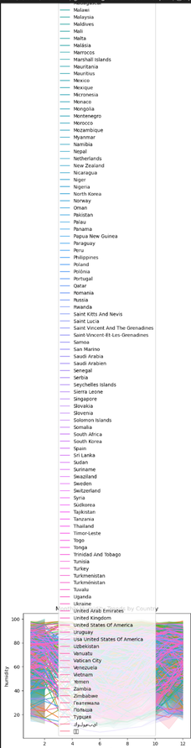
Seasonal Trend Analysis
Method:
Monthly aggregation
Line charts for time-series trends
Temperature:
Clear cyclical seasonal pattern
Peaks during mid-year months
Precipitation:
Regional seasonal variation
Monsoon-like patterns in specific regions
Humidity:
Follows rainfall patterns in many areas
Conclusion:
Strong seasonality confirmed.

Slide 8
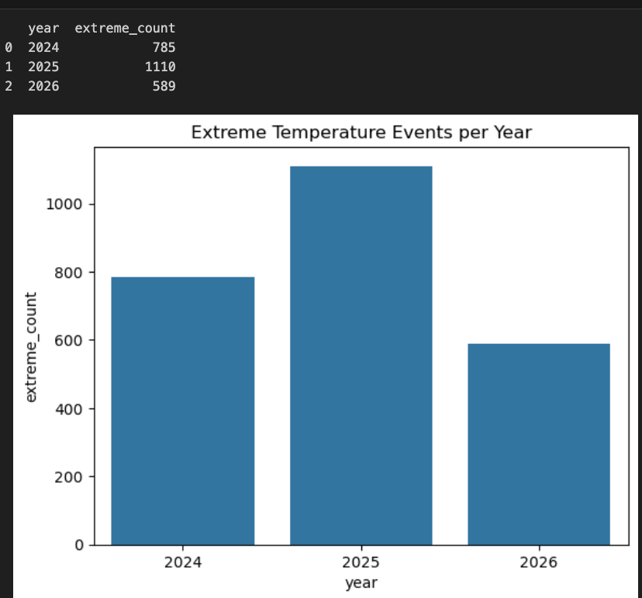
Extreme Weather Event Detection
Approach Used:
1st percentile threshold → Extreme low temperature
99th percentile threshold → Extreme high temperature
Created:
Extreme Event Flag variable
Results:
Increasing frequency in certain years
Specific countries show higher concentration of extremes
This highlights climate risk patterns.

Slide 9
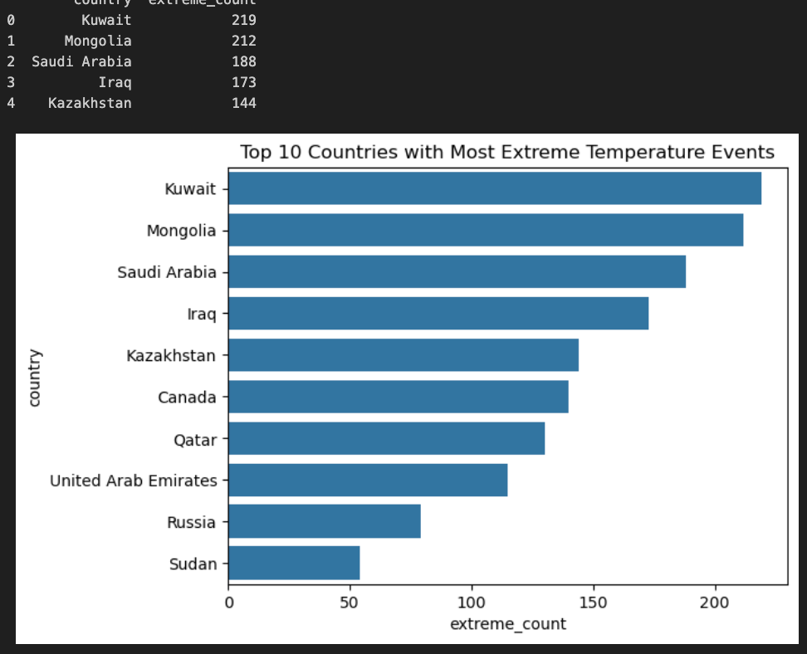
Extreme Events Trend Analysis
Year-wise Analysis:
Bar chart showing extreme events per year
Country-wise Analysis:
Top countries with highest extreme events
Insight:
Extreme weather occurrences are not evenly distributed geographically.

Slide 10
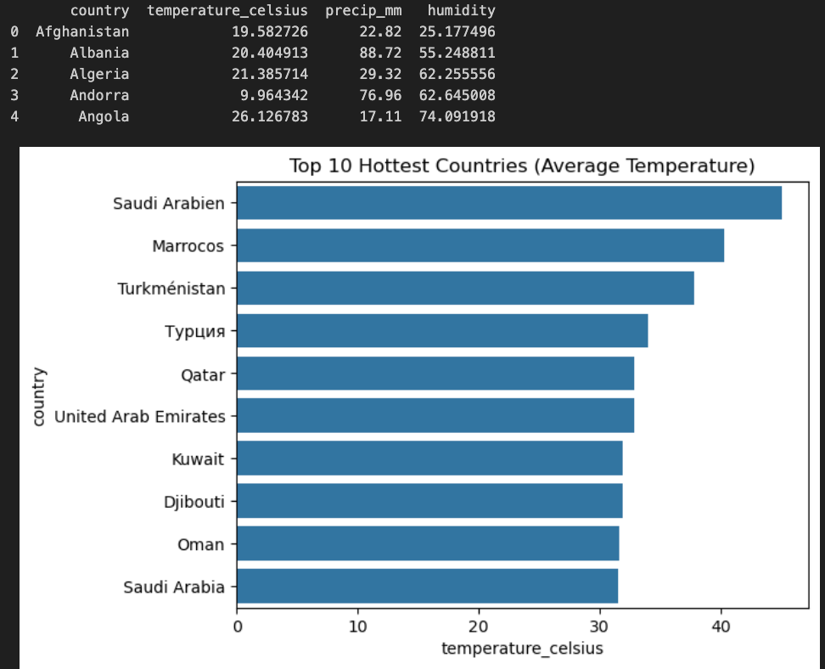
Regional Comparison
Comparative Metrics:
Average Temperature by Country
Total Precipitation by Country
Average Humidity by Country
Findings:
Clear climatic diversity across regions
Some countries consistently hotter
Some regions experience heavier rainfall patterns
This enables geographic climate benchmarking.

Slide 11
Visualization Selection Rationale
Each visualization was chosen based on analytical suitability:
Line Charts → Best for seasonal/time-series analysis
Bar Charts → Best for country comparisons
Heatmaps → Effective for correlation analysis
KPI Cards → Quick summary insights
Choropleth Map → Geographic distribution clarity
This ensures clarity, interpretability, and usability.

Slide 12
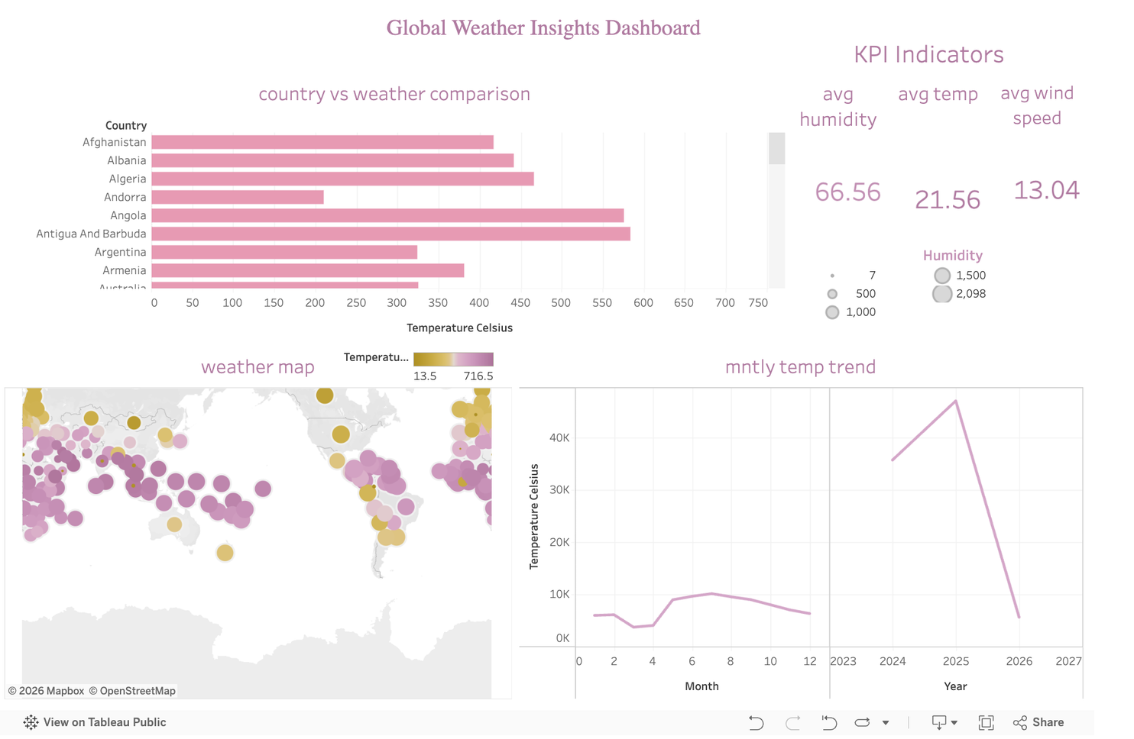
Proposed Tableau Dashboard Design
Dashboard Structure
Top Section:
KPI Summary Cards
Avg Temperature
Total Precipitation
Avg Humidity
Extreme Events Count
Middle Section:
Monthly Temperature Trend
Monthly Precipitation Trend
Monthly Humidity Trend
Lower Section:
Extreme Events per Year
Top Countries with Extreme Events
Bottom:
Regional Comparison Map
Filters:
Country
Year

Slide 13
Key Analytical Insights
Strong seasonal temperature cycles exist
Precipitation shows high variability and skewness
Certain regions show concentrated extreme weather activity
Climate variables exhibit moderate interdependence
Geographic differences are significant

Slide 14
Conclusion
Milestone 2 successfully translated processed data into structured insights.
The analytical findings are documented, and a dashboard blueprint is ready for implementation in Tableau.

