Slide 1
1.ClimateScope: Visualizing Global Weather Trends and Extreme Events
Milestone 1 – Data Cleaning & Preprocessing
Presented by :-
Venkat Thappetla
Intern
Presented To :-
Shanmukha Priya
Data Scientist

Slide 2
2.Project Objective:-
Clean and preprocess the Global Weather Repository dataset
Analyze global weather trends and extreme events
Standardize measurement units
Prepare structured data for visualization and modeling

Slide 3
3.Dataset Overview:-
Source: Kaggle – Global Weather Repository
Global weather observations across multiple countries
Includes temperature, humidity, wind, pressure, precipitation, air quality
Dataset Size (Before Preprocessing):
Rows: 122,576
Columns: 41

Slide 4
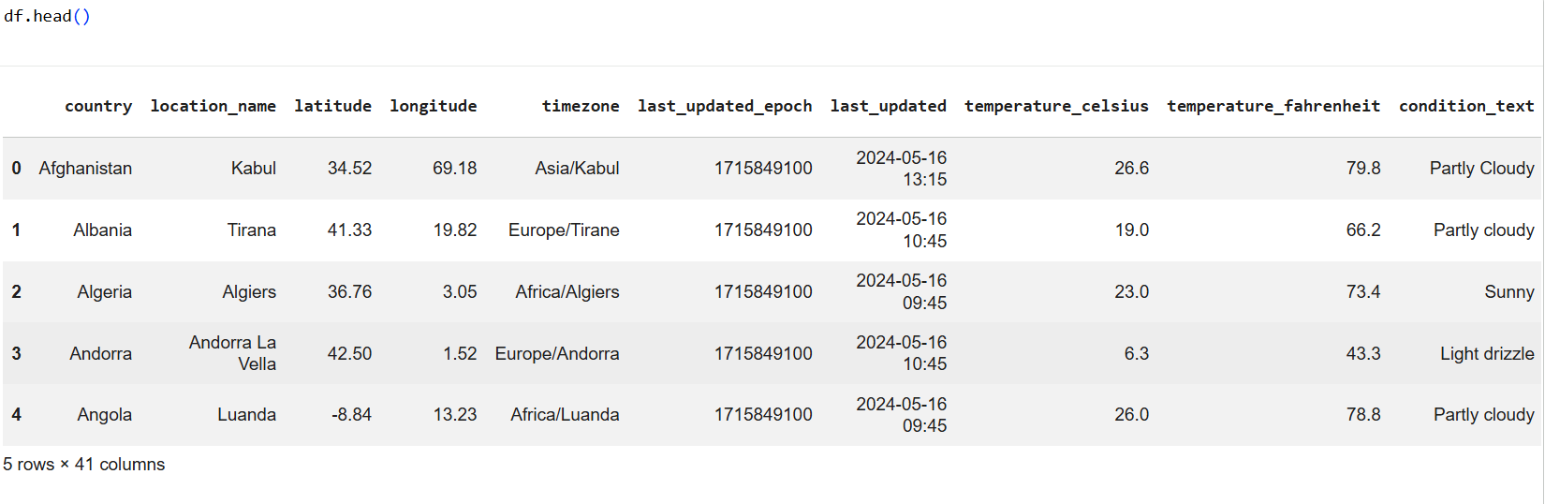
Code & Output :
Code used to load Dataset:
import pandas as pd df = pd.read_csv('GlobalWeatherRepository.csv')
print("Dataset loaded successfully")
df.head()
Output :-

Slide 5
4.Dataset Inspection:-
Used df.head() to preview sample records
Used df.shape to check dataset dimensions
Used df.info() to examine data types and non-null counts
Used df.describe() for statistical summaries
Used df.isnull().sum() to check missing values
Result: No missing values detected.

Slide 6
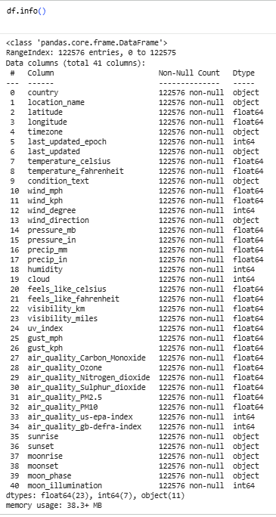

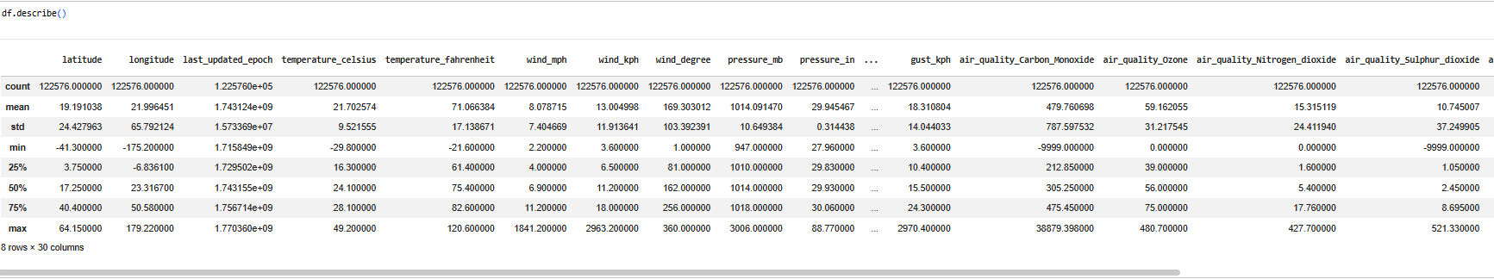
Code and Output :-

Slide 7
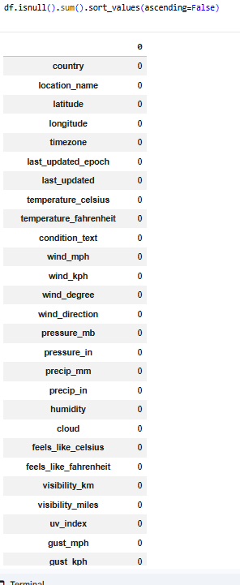

5.Data Quality Verification
Verified absence of null values
Checked duplicate records using df.duplicated().sum()
Ensured structural consistency before cleaning
Result: Dataset confirmed reliable.

Slide 8
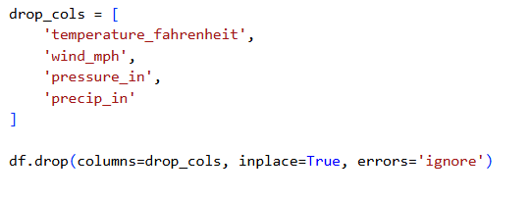
6.Data Cleaning :-
Unit Standardization
Identified redundant unit-based columns
Celsius / Fahrenheit
kph / mph
mb / inches
Removed duplicate unit columns
Retained standardized metric units
After Cleaning:
Rows: 122,576
Columns: 40
Code :

Slide 9
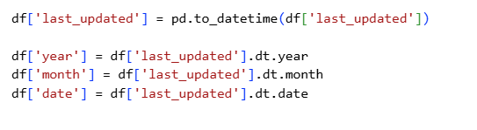
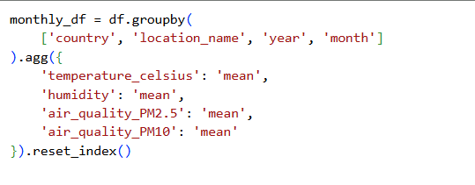
7. Data Aggregation :-
Converted last_updated to datetime format
Extracted year and month features
Grouped data by:
Country
Location
Year
Month
Calculated monthly averages for:
Temperature
Humidity
Air Quality (PM2.5 & PM10)
Monthly Aggregated Dataset:
Rows: 4,385
Columns: 8

Slide 10
8.Overall Summary – Milestone 1 :-
Verified strong data quality
Standardized measurement units
Extracted time-based features
Aggregated daily data into monthly summaries
Prepared structured datasets for visualization
Outcome: Dataset is clean, consistent, and analysis-ready.

