Slide 1

ClipMindAI - Milestone 1
AI Video Summarization & Key Moments Detection Platform
Week 1 & 2 Progress Review
Infosys Internship

Slide 2
Problem Statement
Develop an AI-powered video summarization platform that automatically generates transcripts, summaries, and key moments from uploaded videos.
Provide a secure, user-friendly system for managing video analysis.

Slide 3
Requirements
Project objectives & workflow
Architecture & database schema
UI wireframes
Frontend & backend setup
Authentication & roles
Video upload
FFmpeg integration

Slide 4
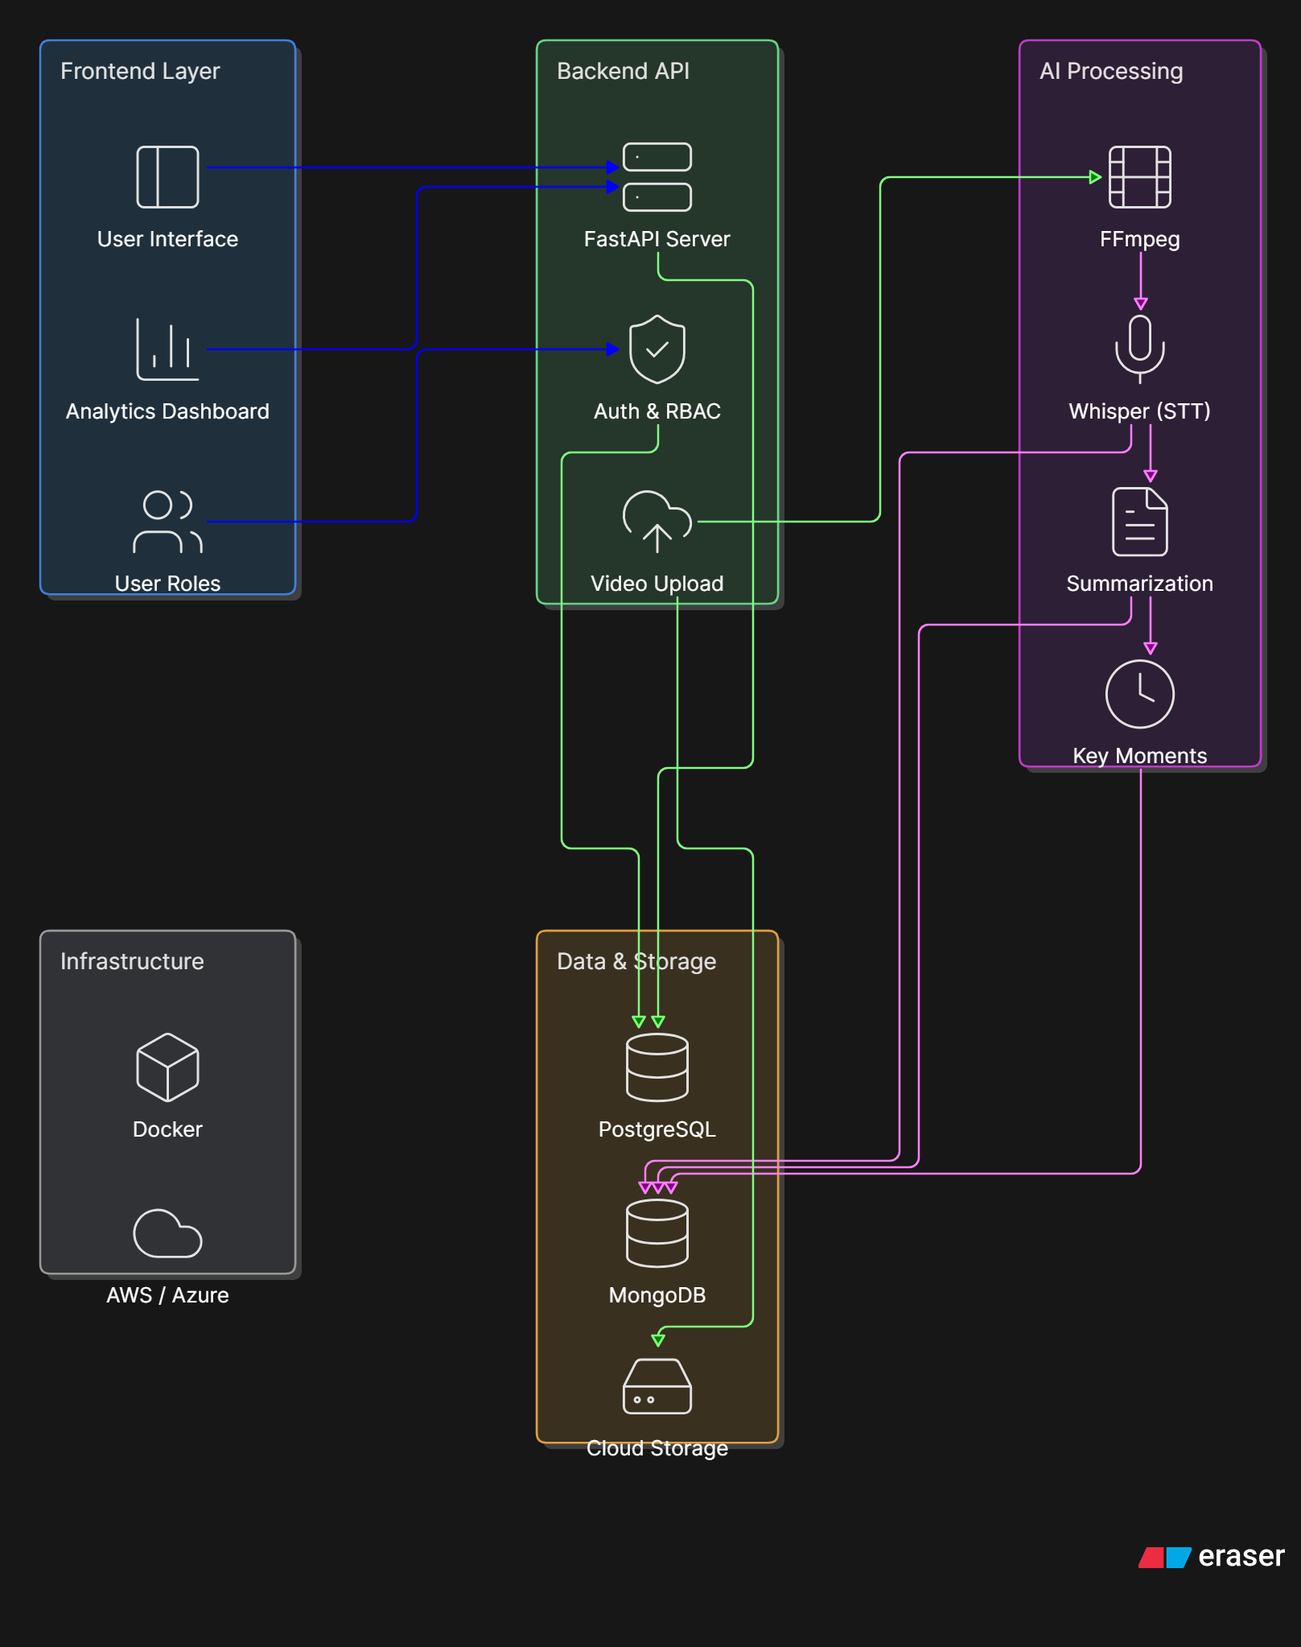
System Architecture

Slide 5
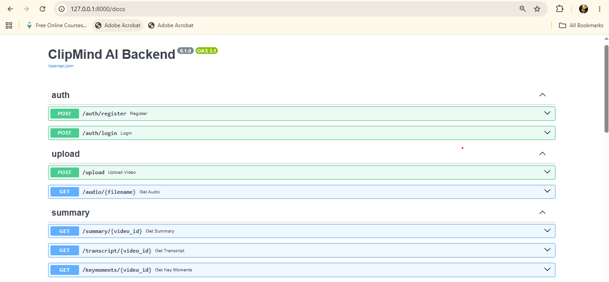
Backend Server

Slide 6

UI Wireframes

Slide 7
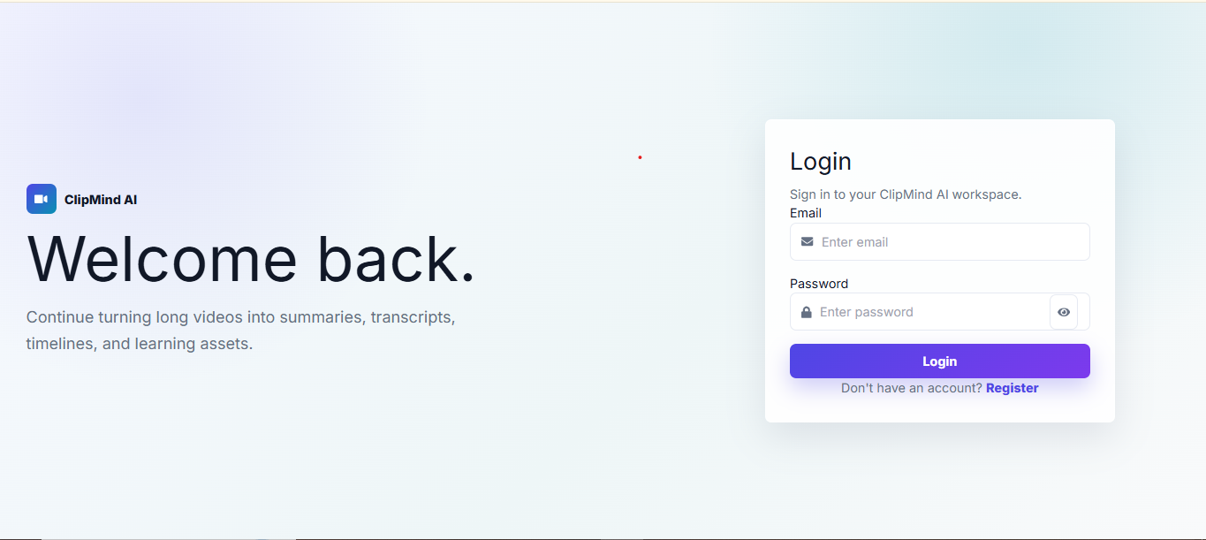
Login

Slide 8
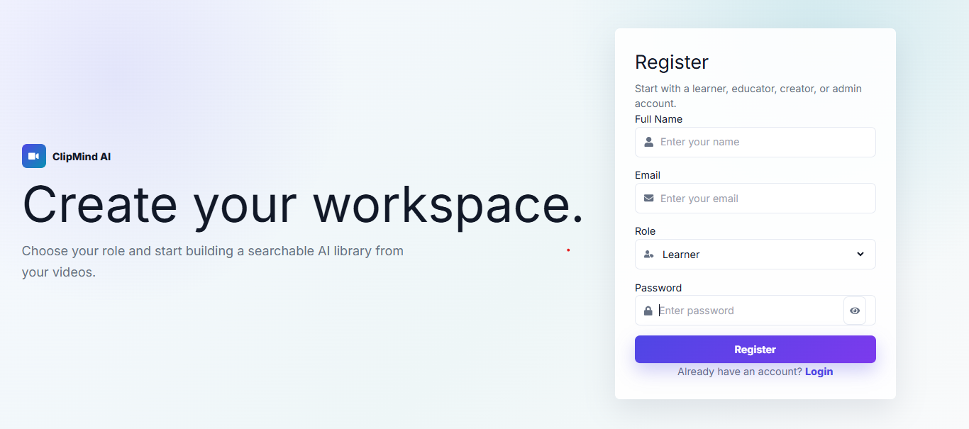
Register

Slide 9
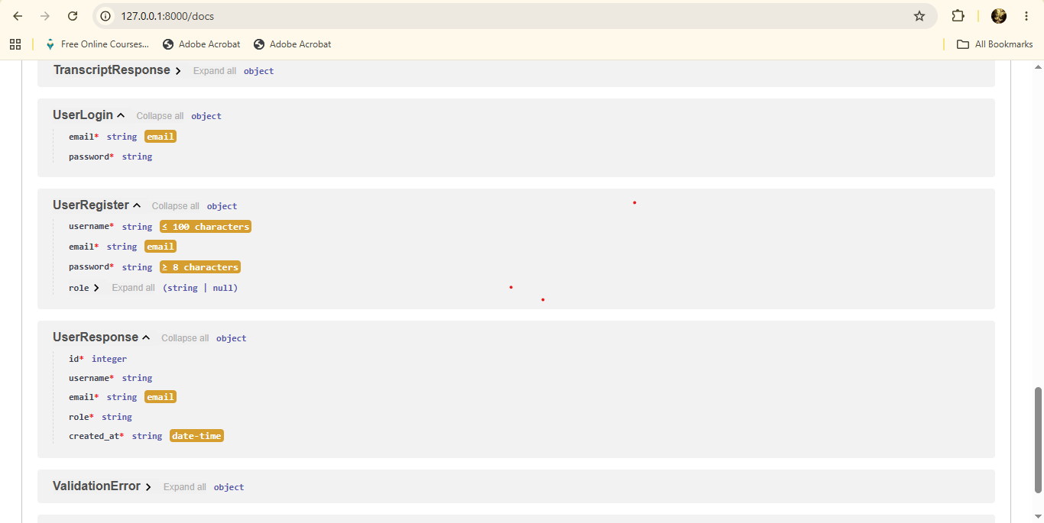
Backend Authentication

Slide 10
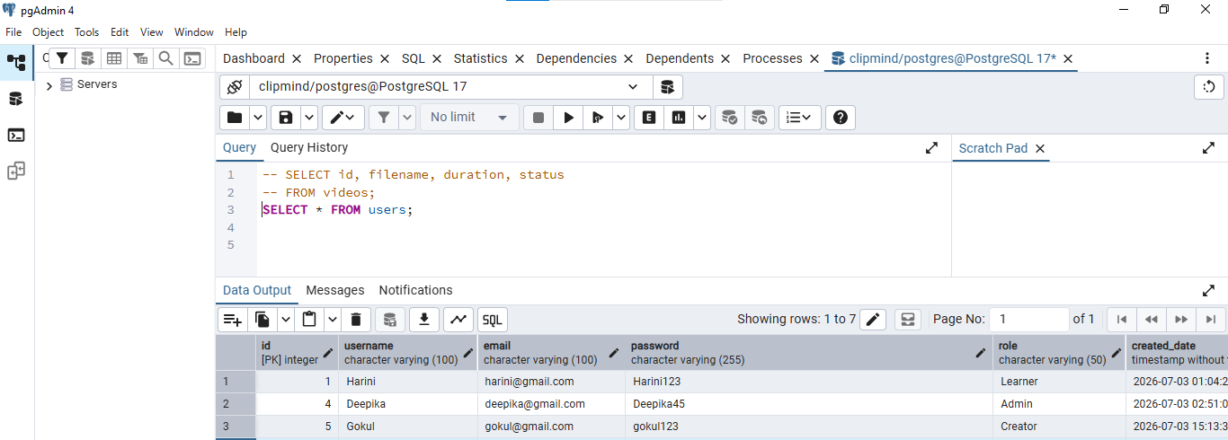
PostgreSQL Users Table

Slide 11
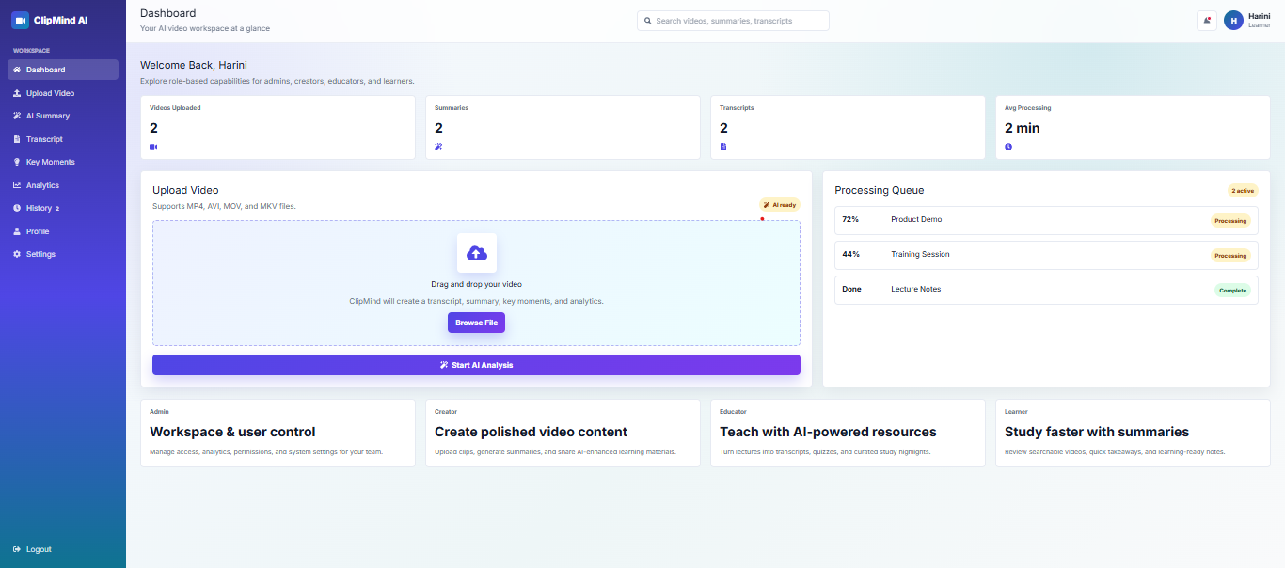
Dashboard

Slide 12
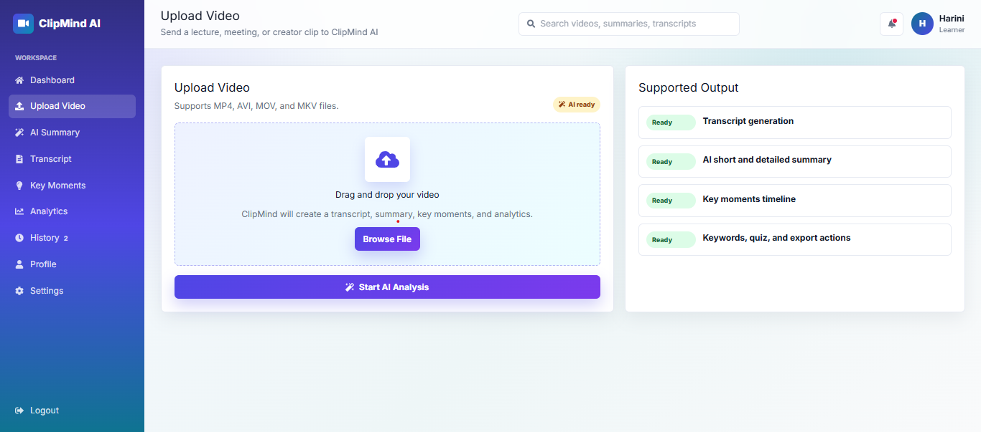
Upload

Slide 13
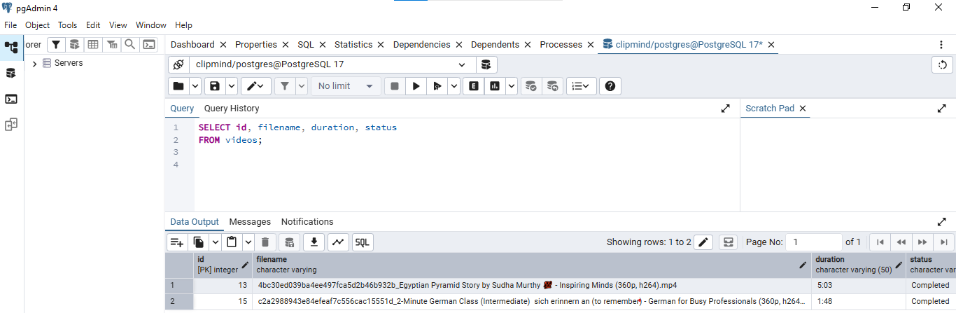
PostgreSQL Videos Table

Slide 14
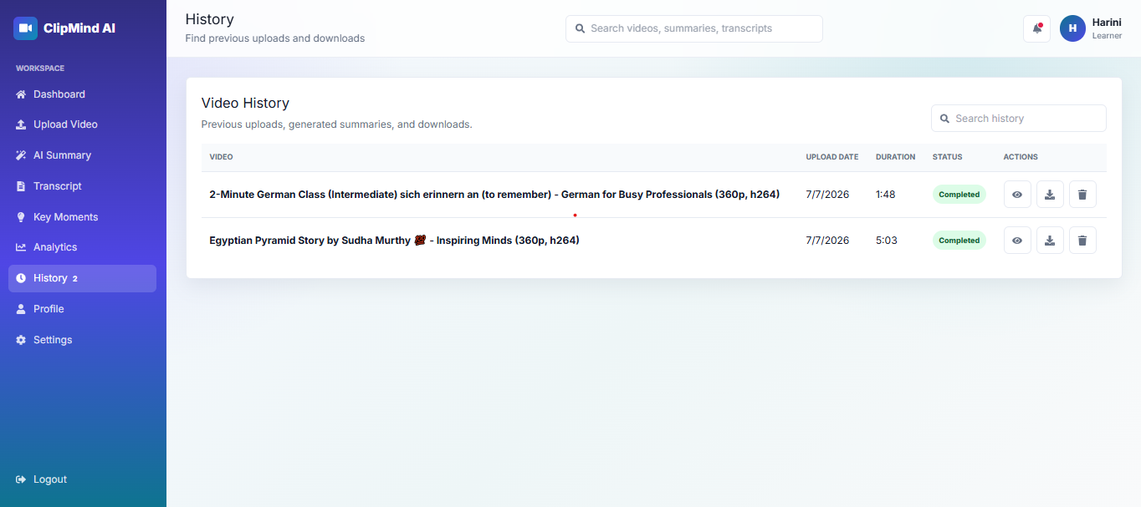
History

Slide 15
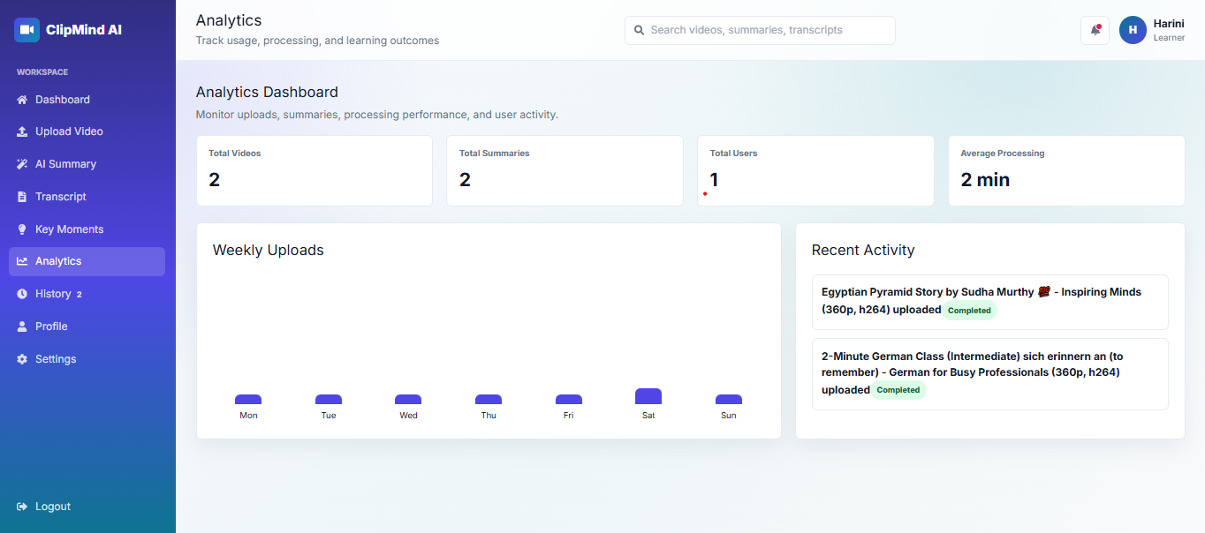
Analytics

Slide 16
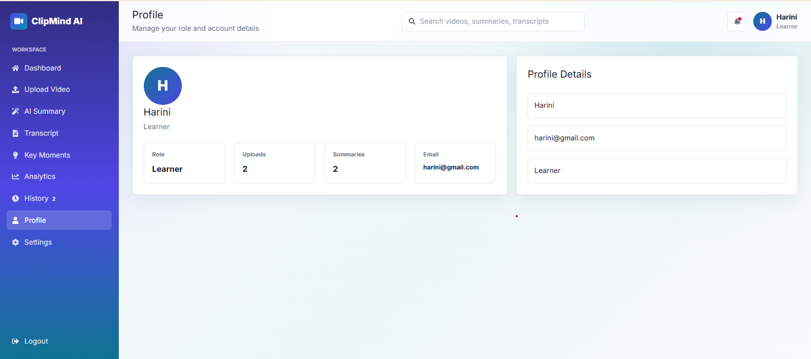
Profile

Slide 17
Milestone 1 Outcomes
Understood AI-powered video processing workflows.
Designed system architecture & database.
Initialized React + FastAPI project.
Implemented authentication and video upload workflow.

