Slide 1
✦
ClipMind AI
Video Summarization & Key Moments Detection Platform
Presented by Devanshi Malhotra
MILESTONE 1 • WEEK 1–2
Foundation, Core Setup & Working Prototype
ClipMind AI • Milestone 1
1
Notes:
Welcome everyone. Today I'm presenting Milestone 1 of ClipMind AI, an AI-powered video summarization and key-moments detection platform. This milestone covers the first two weeks of an eight-week roadmap: project initialization, system design, and getting a real working prototype live. Everything I show today is from the actual running application, not mockups.

Slide 2
Problem Statement & Objectives
!
The Problem
✦
Our Objective
Long-form video content takes hours to review manually.
Creators, students & teams waste time scrubbing timelines for the moment that matters.
No easy way to search, extract or share the key insight from a recording.
Existing tools handle either transcription or summaries — rarely both, in one platform.
Automatically transcribe, summarize & tag key moments in any uploaded video.
Deliver quick, actionable insights through a centralized analytics dashboard.
Serve multiple audiences with tailored workflows and permissions.
Built For
Content Creators
Students
Educators
Businesses
Researchers
ClipMind AI • Milestone 1
2
Notes:
Long-form video is everywhere, but consuming it is slow. Nobody wants to scrub through a 28-minute recording to find one quote. ClipMind AI's objective is simple: upload a video and instantly get a transcript, a summary, and the key moments, all through one centralized platform, built for creators, students, educators, businesses and researchers alike.

Slide 3
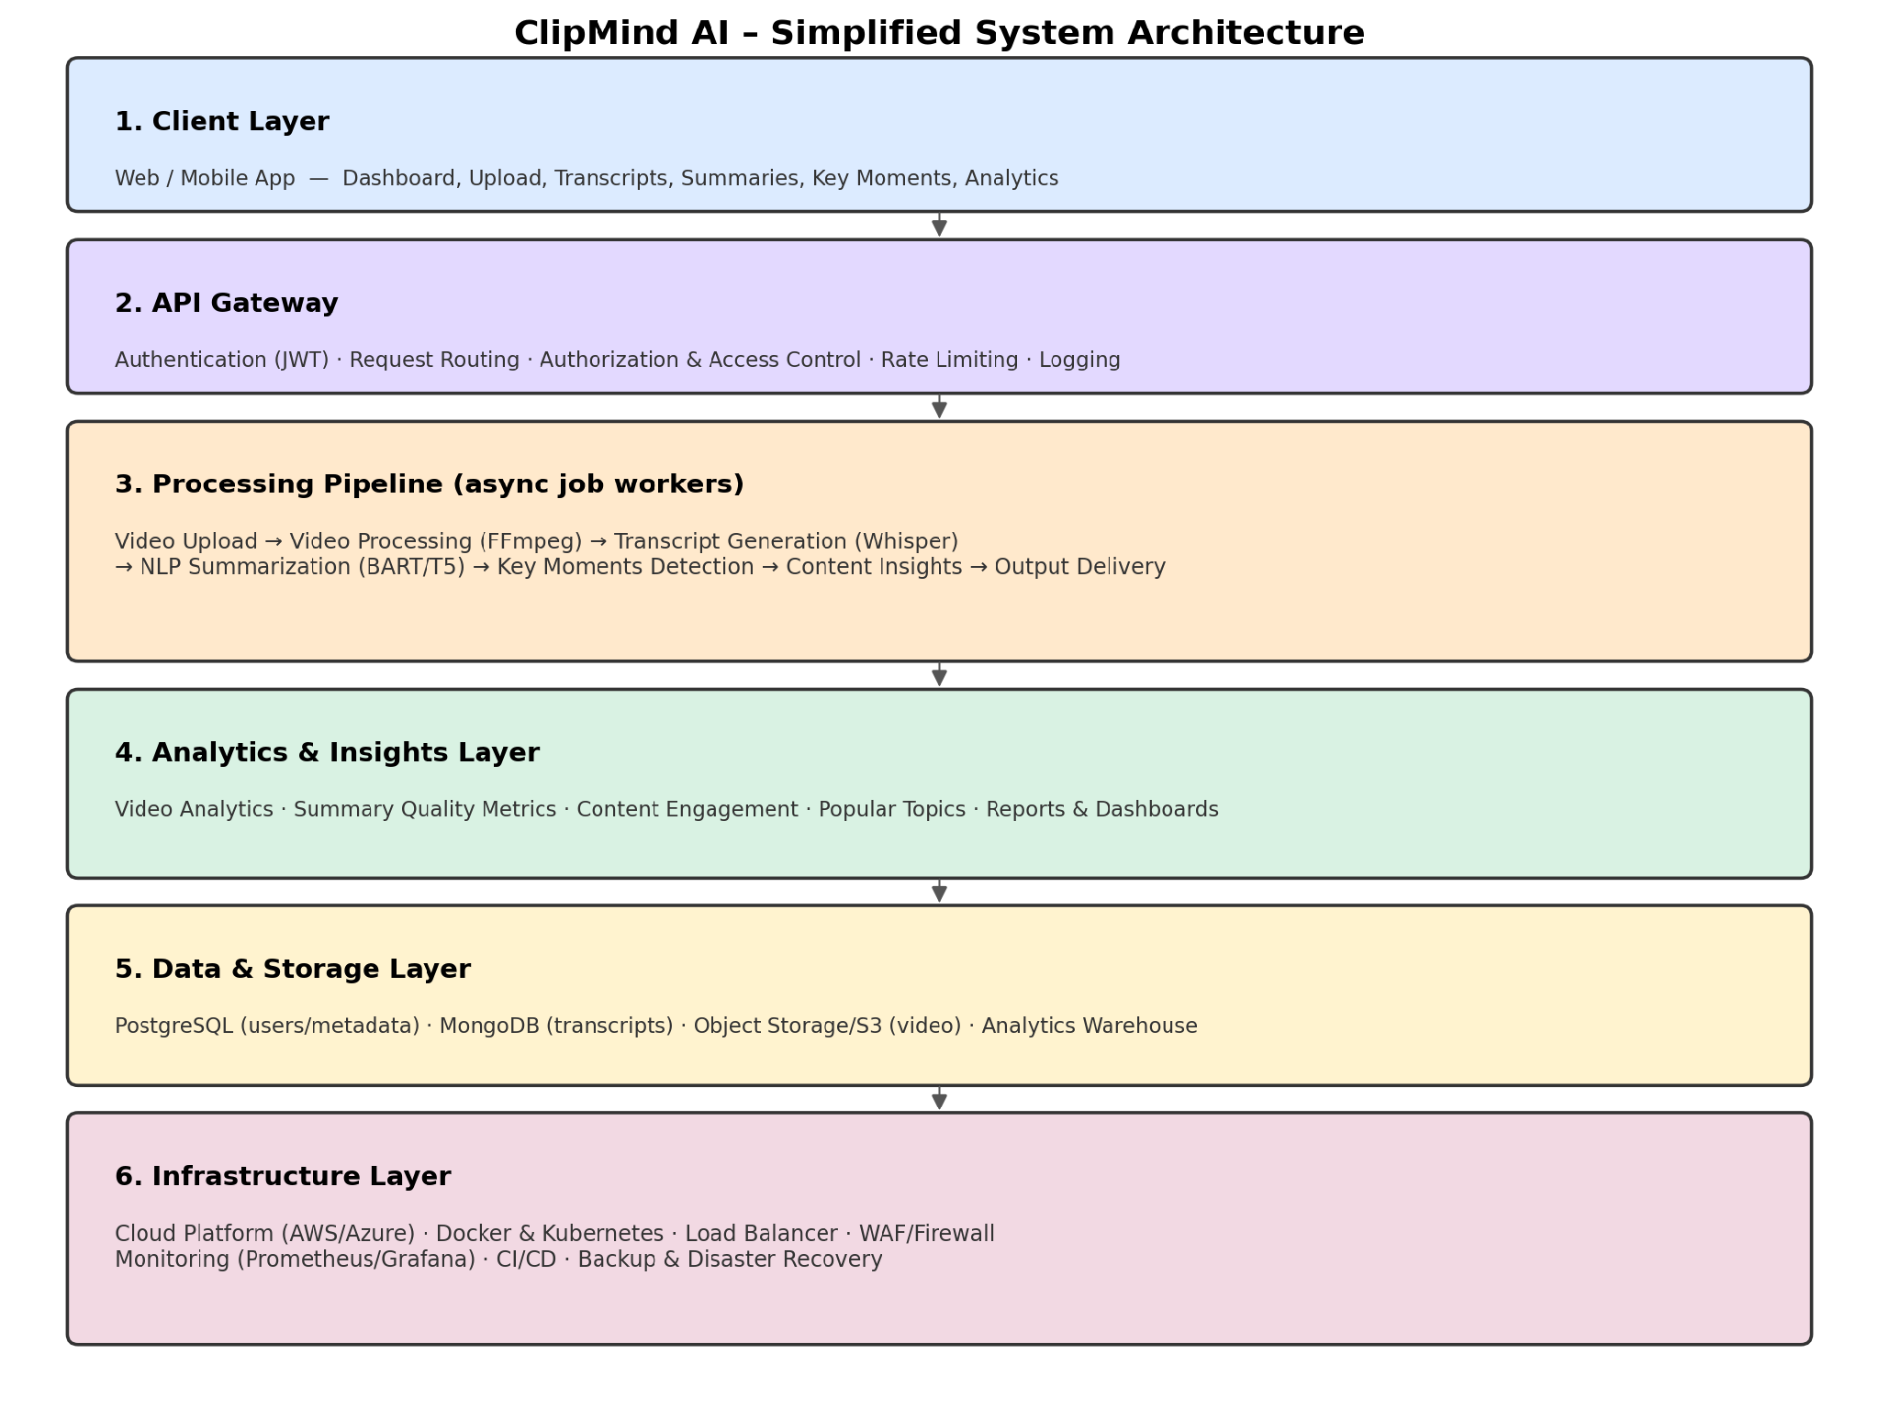
System Architecture & Tech Stack
Full target architecture (design phase, Week 1)
Milestone 1 — Live Stack
Frontend
Next.js (React)
Backend
FastAPI (Python)
Database
PostgreSQL + SQLAlchemy ORM
Media Tooling
FFmpeg (thumbnails)
Auth
JWT-based, role-aware
Deployment target
Docker → AWS / Azure
ClipMind AI • Milestone 1
3
Notes:
This is the full target architecture we designed in Week 1: users and roles, the web app, an API gateway, the AI and video processing pipeline, and the data layer. For Milestone 1 specifically, we've brought the left-hand slice of this to life: Next.js on the frontend, FastAPI on the backend, PostgreSQL through SQLAlchemy, FFmpeg for media handling, and JWT-based auth, all containerizable with Docker for AWS or Azure deployment down the line.

Slide 4
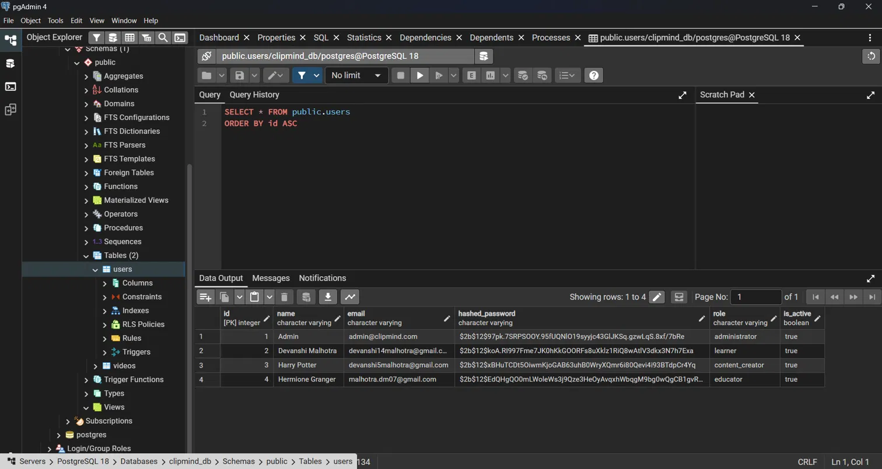
Database Schema & ORM Automation
✓
Zero manual SQL
SQLAlchemy models define Users & Videos — tables auto-create on backend startup.
✓
Secure by default
Passwords stored as bcrypt hashes, never plaintext.
✓
Role column drives RBAC
administrator, learner, content_creator, educator — read directly off the users table.
✓
Two core tables (M1)
users (identity + role) and videos (upload metadata + status).
ClipMind AI • Milestone 1
4
Notes:
One of the wins from Week 1 was full ORM automation. I never hand-wrote a single CREATE TABLE statement. SQLAlchemy models define the Users and Videos tables, and they auto-generate the moment the backend starts up. This is a live query straight from pgAdmin showing four real seeded users, each with a bcrypt-hashed password and a role, administrator, learner, content_creator, educator, which is the exact field that powers our RBAC system on the next few slides.

Slide 5
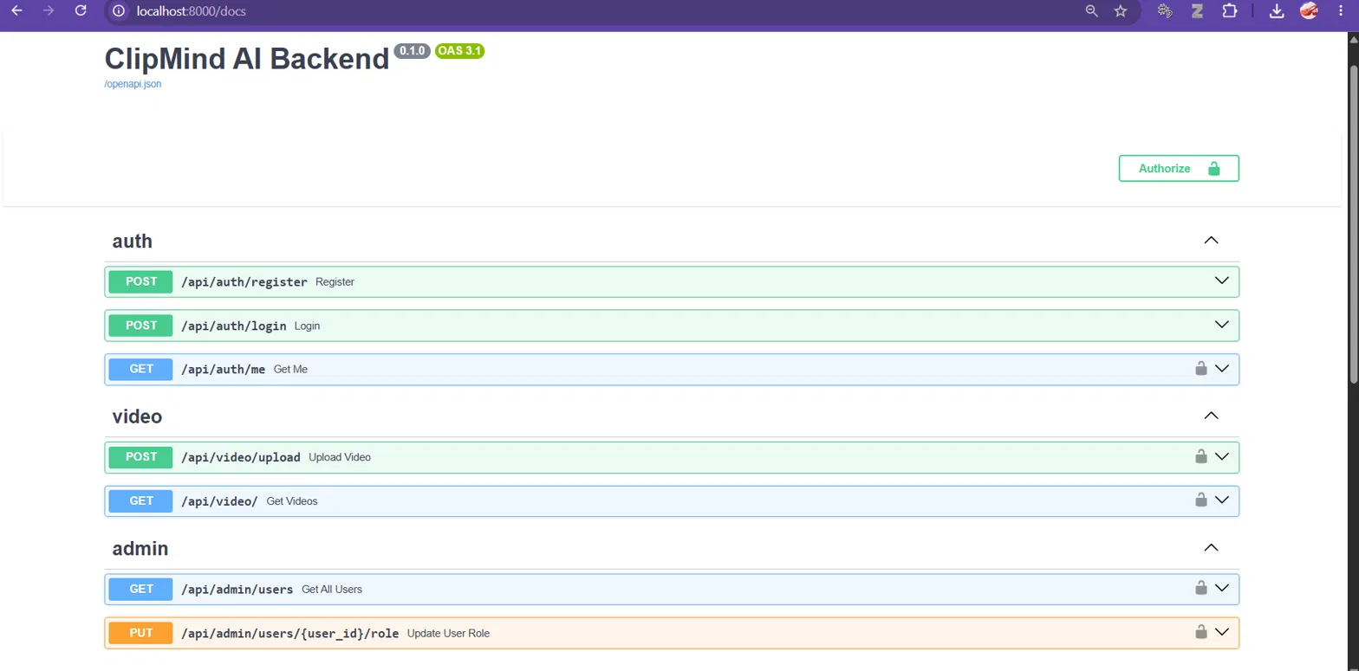
Backend API & Automated Documentation
FastAPI Swagger UI
Centralized Routing
Live Testing
Interactive, auto-generated documentation for every endpoint
Organized by modules: /api/auth, /api/video, /api/admin
Test JWT authentication and payloads directly in the browser
ClipMind AI • Milestone 1
5
Notes:
Because we built the backend in FastAPI, we get complete, interactive API documentation automatically. This is the live Swagger UI running right now. It documents our auth, video, and admin routes. You can even log in with a JWT directly in the UI to test secure endpoints without writing any code.

Slide 6
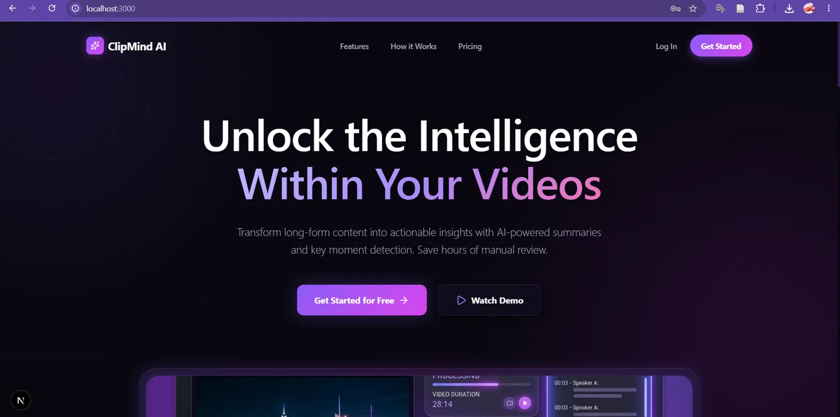
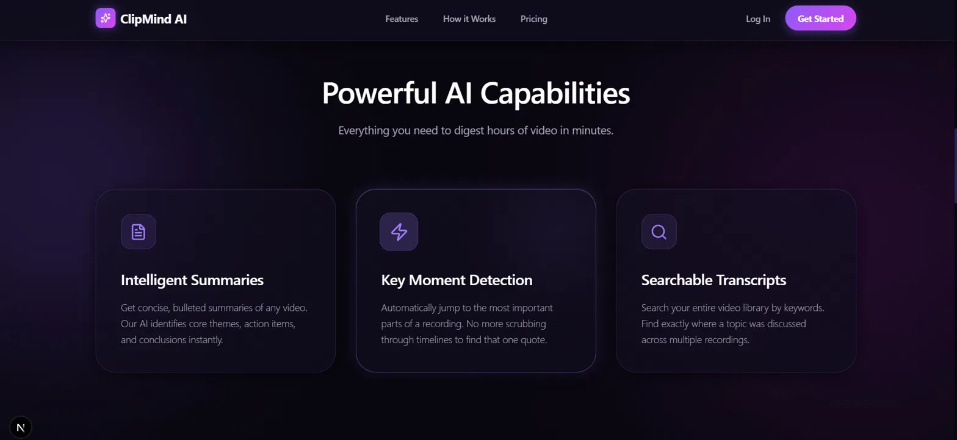
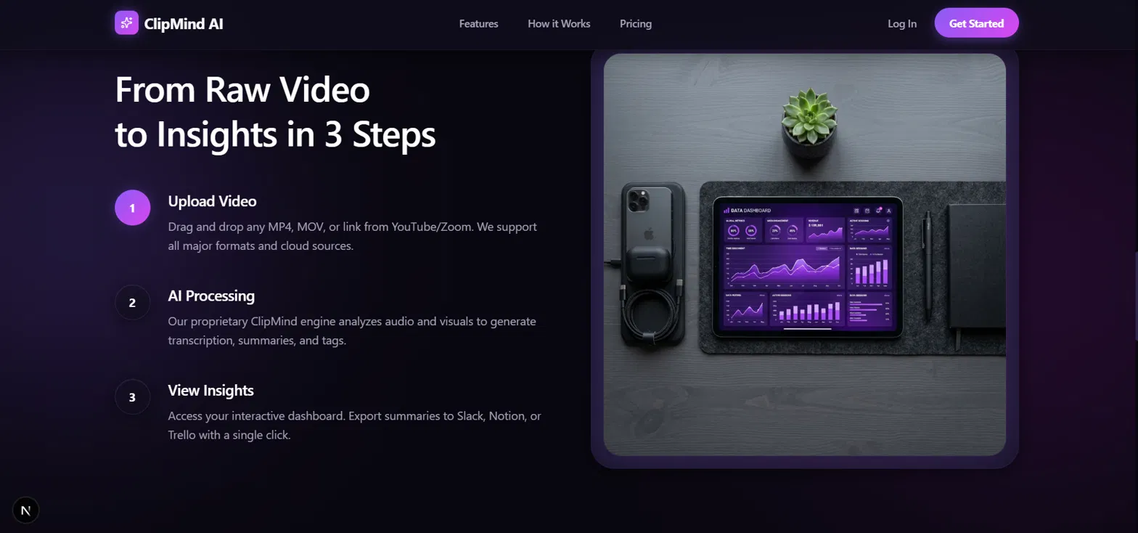
The UI/UX Design System
Dark-mode glassmorphism
Built with Next.js + Tailwind
One design language
Frosted cards, soft glow, violet→pink gradients
Component-driven, fully responsive
Marketing site and product dashboard match
ClipMind AI • Milestone 1
6
Notes:
For Milestone 1 I also wanted the UI to feel like a premium, launch-ready SaaS product, not a student prototype. Every screen, landing page, features, how it works, uses a consistent dark glassmorphism system with a violet-to-pink gradient identity, built with Next.js and Tailwind. The same design language carries through into the authenticated dashboard, which you'll see next.

Slide 7
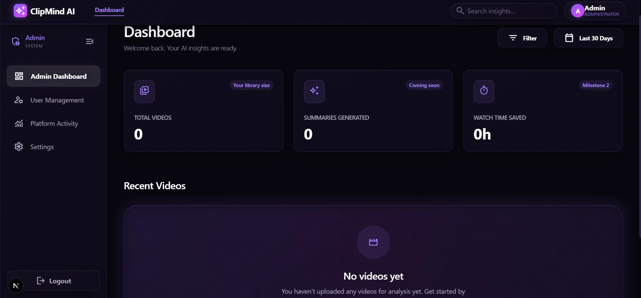
Advanced Role-Based Access Control
One login, four completely different experiences
1
Content Creator
Upload, generate summaries & transcripts, view analytics
2
Learner
Read summaries, browse transcripts, bookmark highlights
3
Educator
Share summaries, build learning materials, track engagement
4
Administrator
Manage users, roles & platform-wide activity
ClipMind AI • Milestone 1
7
Notes:
This is the real Admin Dashboard, logged in as the Administrator persona. Notice the sidebar: Admin Dashboard, User Management, Platform Activity, Settings. That entire sidebar and its routing is generated dynamically based on the logged-in user's role. A Content Creator sees upload and analytics tools, a Learner sees a read-only library, an Educator gets classroom sharing tools, and only the Administrator sees user management and platform-wide controls. This is enforced on both the frontend routing and the backend API.

Slide 8
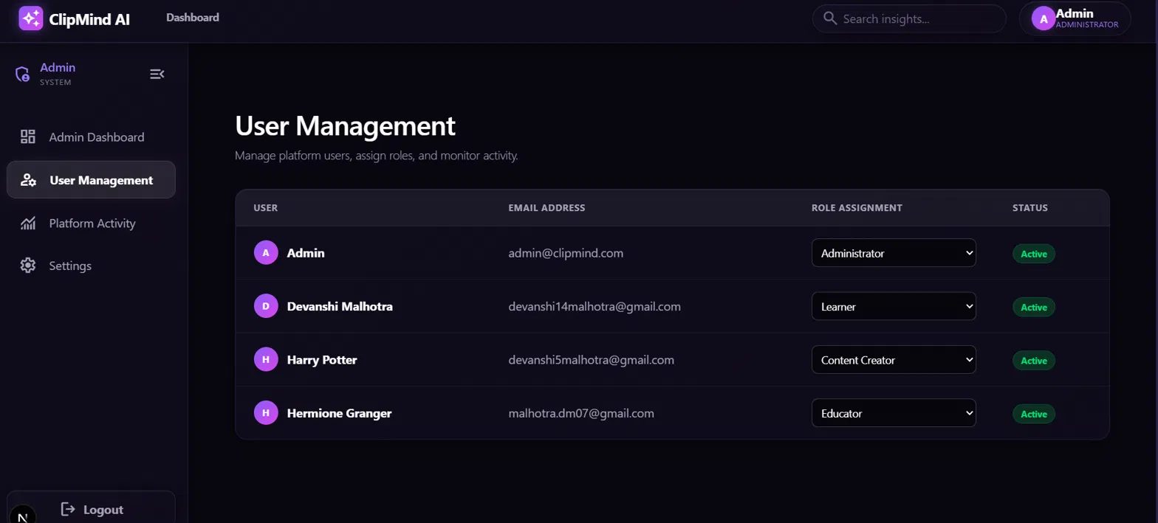
Admin Controls & User Management
Real-time role changes
Secured admin API
Live status monitoring
Promote or demote any user instantly — no redeploy needed
GET /api/admin/users & PUT /api/admin/users/{id}/role, JWT-guarded
Every account shows an Active / Inactive state at a glance
ClipMind AI • Milestone 1
8
Notes:
The User Management screen is the Administrator's control center. This table is pulling real data from Postgres through the /api/admin/users endpoint, you can see the four seeded accounts with their current roles. Using the dropdown, an admin can promote or demote any user in real time, which calls the PUT /api/admin/users/user_id/role endpoint, itself protected so only an authenticated administrator can hit it. That endpoint, and the rest of the API, is documented live through our FastAPI Swagger docs as well.

Slide 9
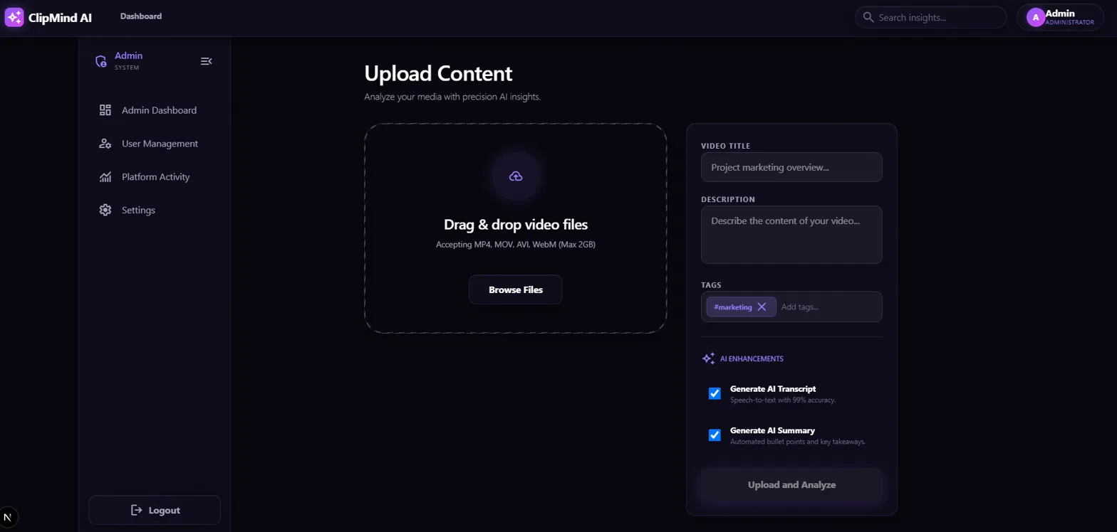
The Video Upload & FFmpeg Pipeline
1
Video is uploaded & validated (MP4/MOV/AVI/WebM, up to 2GB)
2
File is saved to storage; a background task is queued
3
FFmpeg extracts a thumbnail frame from the video
4
Backend simulates a 5-second processing delay
5
Video status flips to “completed” — ready for the dashboard
ClipMind AI • Milestone 1
9
Notes:
Here's the actual Upload Content screen and what happens behind it. A creator drags in a video, sets a title, description and tags, and toggles AI Transcript / AI Summary generation. On submit, FastAPI validates and stores the file, then kicks off a background task: FFmpeg pulls a thumbnail frame from the video, and right now we simulate a five-second processing window before the video flips to a completed status, that simulated delay is exactly where Whisper and our NLP models plug in for Milestone 2.

Slide 10
Milestone 1 Checklist & Achievements
✓
✓
✓
Tech stack initialized
Auth & RBAC live
Database automated
Next.js + FastAPI + PostgreSQL, fully wired end to end
JWT login, 4 personas, dynamic sidebar & routing
SQLAlchemy models auto-create Users & Videos on startup
✓
✓
✓
Video upload pipeline
Premium UI shipped
Admin control panel
Validation, storage, background FFmpeg thumbnailing
5 polished screens in a consistent glassmorphism system
Real-time role promotion/demotion, secured by API
ClipMind AI • Milestone 1
10
Notes:
To recap Milestone 1 against the Week 1 to 2 plan: the stack is initialized, authentication and RBAC are fully live across four personas, the database is completely automated through the ORM, the upload pipeline runs real FFmpeg processing in the background, the UI is production-quality, and the admin panel gives real-time control over users. Every box here is a working feature in the live app, not a plan.

Slide 11
What's Next?
MILESTONE 2 • WEEK 3–4
1
Real speech-to-text
Swap the simulated delay for OpenAI Whisper transcription
2
AI-powered summarization
Short & detailed summaries via BART / T5 pipelines
3
Key moments detection
Timestamp generation, topic segmentation & highlight extraction
4
Summary quality evaluation
Benchmark transcript accuracy and summary relevance
Thank you
ClipMind AI • Milestone 1
11
Notes:
Looking ahead to Milestone 2, weeks 3 and 4 of the roadmap: we'll replace the simulated processing delay with real OpenAI Whisper transcription, add BART/T5-based summarization for both short and detailed summaries, build out key-moments detection with timestamping and topic segmentation, and start evaluating transcript accuracy and summary quality. Happy to take any questions.

