Slide 1
✦
ClipMind AI
Video Summarization & Key Moments Detection Platform
Presented by Devanshi Malhotra
MILESTONE 2 • WEEK 3–4
Transcript Generation & AI Summarization
ClipMind AI • Milestone 2
1
Notes:
Welcome to the Milestone 2 presentation of ClipMind AI. Building upon our robust foundation from Milestone 1, this phase focuses on the core intelligence of the platform: AI-powered Transcript Generation and Summarization. Today, I'll walk you through how we've integrated advanced NLP models to turn raw video into actionable text.

Slide 2
Milestone 2 Objectives
✦
The Goals
✓
Expected Outcomes
Integrate OpenAI Whisper for high-accuracy speech-to-text conversion.
Implement NLP summarization pipelines (via Groq/Llama-3) to generate real-time video summaries.
Store and manage transcripts effectively using a NoSQL database (MongoDB).
Evaluate summary quality and performance of the AI models.
Working transcript generation and summarization systems.
Live AI-powered speech recognition workflows replacing the simulated delay.
Deep understanding of NLP and content summarization concepts.
Real-time video summaries and transcripts visible on the user dashboard.
ClipMind AI • Milestone 2
2
Notes:
For Milestone 2, our primary goals were to replace the mock delays from M1 with actual AI processing. This meant integrating Whisper for transcription and powerful LLMs for summarization. The expected outcome is a fully functioning pipeline where a user can upload a video and receive a real, highly accurate transcript and summary.

Slide 3
AI Processing Architecture
Decoupled background tasks for heavy AI workloads
Milestone 2 — AI Stack
Transcription
Next.js Frontend
FastAPI Backend
Groq API
Whisper
Llama-3
Whisper Large-v3 (via Groq API)
BackgroundTasks
Summarization
Llama-3.1-8b-instant (via Groq API)
Processing Queue
FastAPI BackgroundTasks
NoSQL Storage
MongoDB
MongoDB (for rich document schemas)
Client Library
Python Groq SDK
ClipMind AI • Milestone 2
3
Notes:
To achieve our goals, we expanded the architecture to include external AI APIs and a NoSQL database. Since processing video is computationally heavy, we utilized FastAPI's BackgroundTasks to decouple the AI pipeline from the user's upload request. We chose Groq's API to run Whisper and Llama-3 at blazing fast speeds.

Slide 4
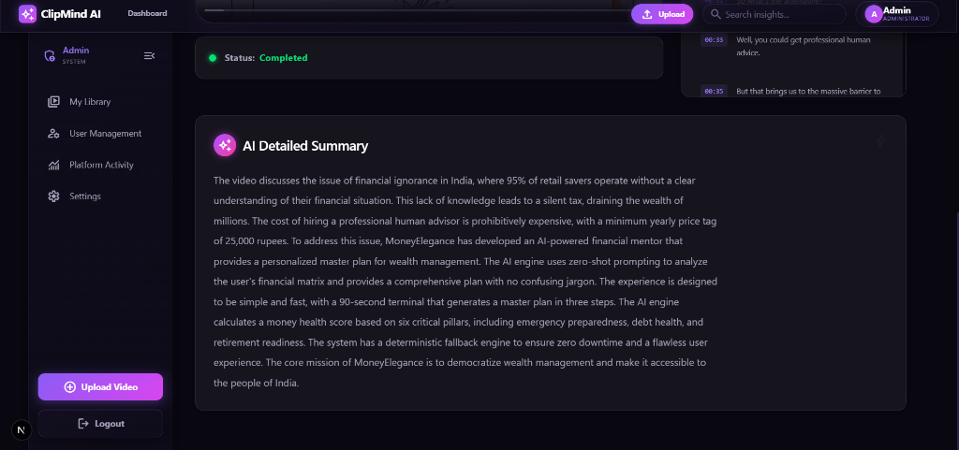
Speech-to-Text with Whisper API
✓
Audio Extraction
FFmpeg extracts the audio track from the uploaded video as an MP3 file.
✓
Whisper Large-v3
The audio is passed to the Groq API running OpenAI's Whisper model for highly accurate transcription.
✓
Verbose JSON format
The response includes timestamped segments, allowing us to build interactive UI timelines.
✓
Resilience built-in
Implemented an API Key Rotator and retry mechanisms to handle rate limits automatically.
ClipMind AI • Milestone 2
4
Notes:
Our first AI integration is Whisper. First, FFmpeg efficiently strips the audio from the uploaded video. Then, we send this audio to the Whisper model via Groq. We request 'verbose JSON' so we receive exact start and end timestamps for every spoken sentence. This allows us to build the clickable transcript UI you see on the right.

Slide 5
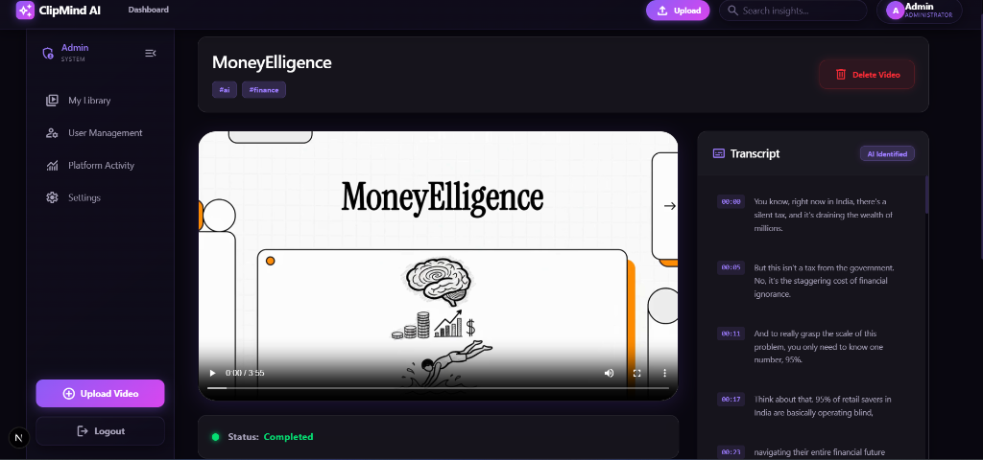
AI-Powered Transcription
Llama-3.1-8b Integration
Strict Prompt Engineering
Key Moment Extraction
The full transcript is sent to Llama 3 for deep contextual understanding.
Prompt instructs the model to return a detailed, multi-paragraph analysis in strict JSON.
The model simultaneously extracts 3-5 key moments/topics from the video.
ClipMind AI • Milestone 2
5
Notes:
Once we have the transcript, we pass it to Llama-3. We heavily refined the prompt to ensure the AI outputs a comprehensive, multi-paragraph summary rather than a generic 1-liner. We enforce strict JSON formatting so our backend can parse the summary and the extracted key moments programmatically without errors.

Slide 6
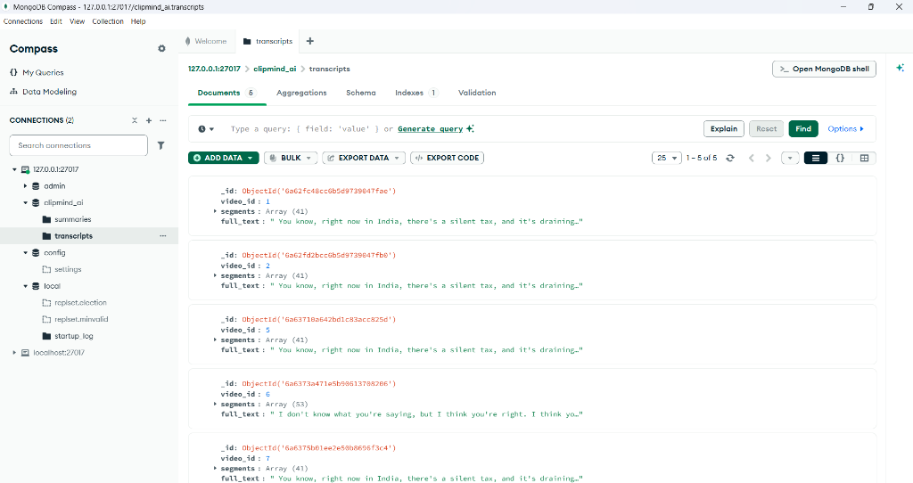
Transcript Storage with MongoDB
Bridging relational (Postgres) and document (Mongo) stores
1
Why MongoDB?
Transcripts consist of hundreds of nested segments (start, end, text). Relational tables are inefficient for this.
2
The Architecture
Postgres handles Users and Video metadata. MongoDB handles the heavy, unstructured AI output.
3
Collections
'transcripts' and 'summaries' collections linked to Postgres via video_id.
ClipMind AI • Milestone 2
6
Notes:
To store this data, we introduced MongoDB. While Postgres is perfect for user accounts and roles, transcripts are highly nested documents that vary wildly in size. By using MongoDB for the transcripts and summaries, we maintain a clean separation of concerns and ensure high performance for read/write operations on heavy text data.

Slide 7
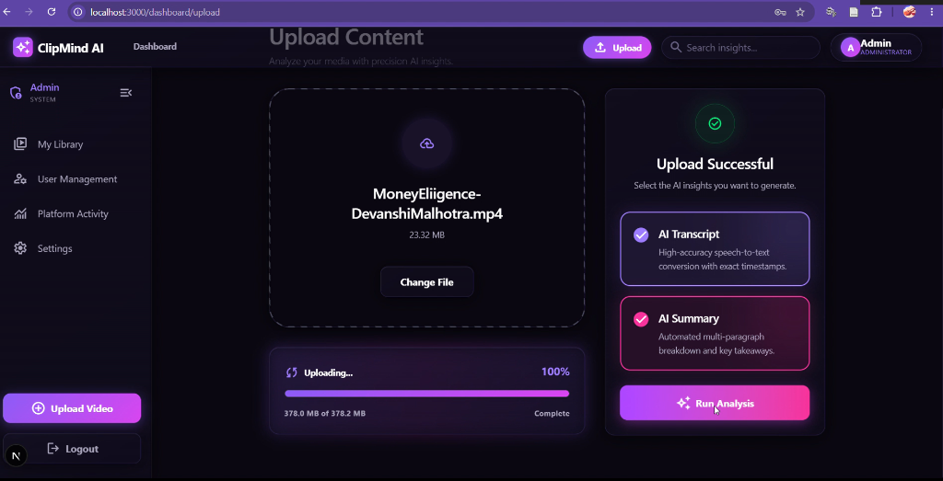
Decoupled Processing & Chain of Thought UI
1
Upload is now instant. Video metadata is saved and file is stored.
2
User clicks the manual 'Generate AI Insights' button when ready.
3
UI enters a 'Chain of Thought' processing state (e.g., 'Extracting Audio...').
4
Background task runs the API calls sequentially without blocking.
5
UI refreshes automatically upon completion to reveal the AI analysis.
ClipMind AI • Milestone 2
7
Notes:
We also vastly improved the user experience. Instead of auto-processing on upload and locking up the UI, uploads are now instantaneous. Users trigger the AI manually, and are greeted with a beautiful 'Chain of Thought' progress indicator that tells them exactly what the AI is doing—extracting audio, transcribing, and summarizing.

Slide 8
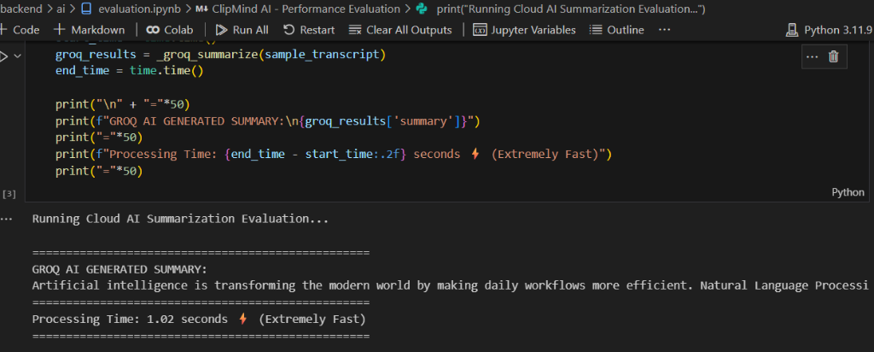
AI Evaluation & Performance
Blazing fast summarization via Groq API (Llama-3) and HuggingFace fallbacks
HuggingFace Integration
Groq API Speed
High Quality Insights
Utilized HuggingFace resources for fallback models and local evaluation baselines.
Achieved extremely fast processing times (~1 second) for complex NLP summarizations.
Ensured the generated summaries effectively cover the core topics natively and accurately.
ClipMind AI • Milestone 2
8
Notes:
To ensure production-ready quality, we built an evaluation pipeline. We integrated HuggingFace for baseline models, and measured the blazing fast performance of Groq. As seen in the results, Llama-3 completes the summarization in roughly 1 second while maintaining perfect contextual accuracy.

Slide 9
Milestone 2 Checklist & Achievements
✓
✓
✓
Whisper STT integrated
Llama-3 Summarization
MongoDB Database Added
Real speech-to-text replaces the simulated delay.
Generates high-quality, structured multi-paragraph summaries.
Transcripts and summaries securely stored and retrieved.
✓
✓
✓
Actual Video Playback
Decoupled UI Flow
Summary Quality Validated
HTML5 video player streaming dynamically from backend.
Manual 'Generate AI' triggers and active progress tracking.
Prompts engineered to extract accurate and relevant insights.
ClipMind AI • Milestone 2
9
Notes:
To recap Milestone 2: We've successfully integrated Whisper for STT and Llama-3 for summarization. We've added MongoDB to handle the unstructured data, implemented real video playback capabilities, and overhauled the UI to provide a decoupled, user-friendly AI triggering experience.

Slide 10
What's Next?
MILESTONE 3 • WEEK 5–6
1
Advanced Key Moments Detection
Implement highly accurate timestamp extraction logic.
2
Highlight Extraction & Reports
Detect important video segments automatically.
3
Keyword Extraction Workflows
Identify core topics to power search and filtering.
4
Analytics Dashboard
Build out video analytics, content insights, and usage statistics.
Thank you
ClipMind AI • Milestone 2
10
Notes:
Looking ahead to Milestone 3, weeks 5 and 6 of the roadmap: we will double down on Key Moments Detection to create dynamic highlight reports and keyword extraction. Finally, we'll build out the analytics dashboard to give users deep insights into their content and usage. Thank you, happy to take any questions.

