Slide 1
✦
ClipMind AI
Video Summarization & Key Moments Detection Platform
Presented by Devanshi Malhotra
MILESTONE 3 • WEEK 5–6
Key Moments Detection & Analytics Dashboard
ClipMind AI • Milestone 3
1

Slide 2
Milestone 3 Objectives
✦
The Goals
✓
Expected Outcomes
Implement highly accurate timestamp extraction and topic-boundary segmentation logic.
Working key-moments detection and analytics systems shipped to the dashboard.
Automatically detect important video segments and surface them as scannable highlight cards.
Content-intelligence and reporting workflows running end to end.
Extract keywords, entities & core topics to power search, filtering and auto-tagging.
Deep understanding of AI-driven media analysis and topic modeling concepts.
Build an analytics layer surfacing content insights, engagement and usage statistics.
Complete video-intelligence pipeline: upload → transcript → insight.
ClipMind AI • Milestone 3
2

Slide 3
Key Moments & Analytics Pipeline
How a transcript becomes highlight cards, tags and dashboard insight
Transcript
Topic Segmentation
Timestamp Generation
Keyword Extraction
Analytics Layer
→
→
→
→
AI-identified,
timestamped text
Detects boundaries
between sub-topics
Jump points per
key moment
Entities & core
topics tagged
Insights, reports
& dashboards
Milestone 3 — Live Stack
Analytics & Insights Layer
Segmentation
Topic-boundary detection over AI transcripts
Video Analytics
Summary Quality Metrics
Timestamps
Auto-generated jump points per key moment
Content Engagement Insights
Popular Topics & Keywords
Tagging
Auto-extracted keywords & named entities
User Activity Tracking
Reports & Dashboards
Ingestion
Local upload + YouTube link import
ClipMind AI • Milestone 3
3

Slide 4
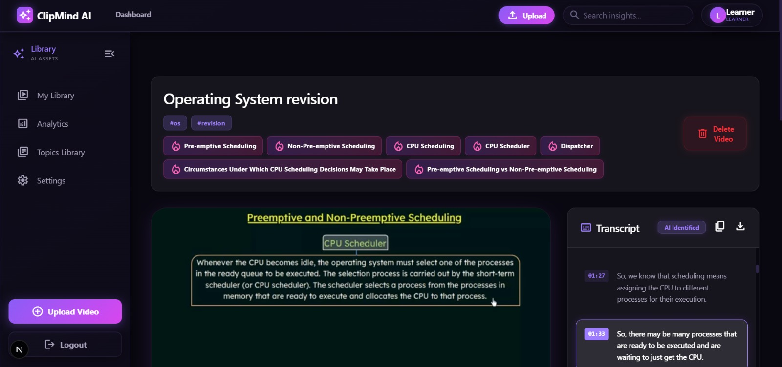
Automatic Key Moments Detection
Transcript segments become scannable, timestamped highlight cards
✦
Timestamp generation
Each moment gets a precise jump-to timecode (00:00, 04:01, 06:03…).
✦
Segment identification
Topic-boundary detection groups the transcript into distinct moments.
✦
AI detailed summary
A full narrative summary is generated alongside the moment cards, with copy/download.
ClipMind AI • Milestone 3
4

Slide 5
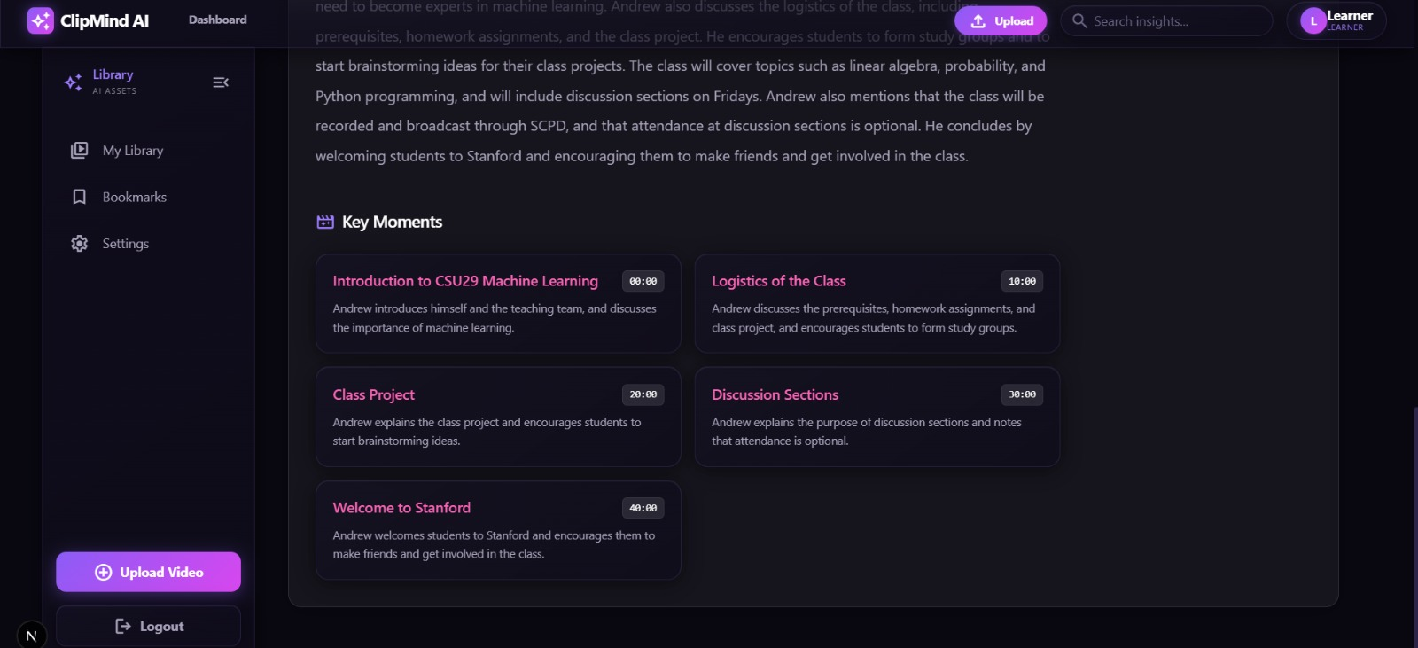
Consistent Across Content Types
Validated on a 40-minute Stanford lecture, not just short clips
✦
Per-moment descriptions
Every key moment ships with a one-line summary, not just a bare timestamp.
✦
Long-form ready
Segments span a 40-minute lecture (00:00 → 40:00) cleanly.
✦
Generalizes across domains
Works equally well on CS lecture, OS revision and ML content.
ClipMind AI • Milestone 3
5

Slide 6
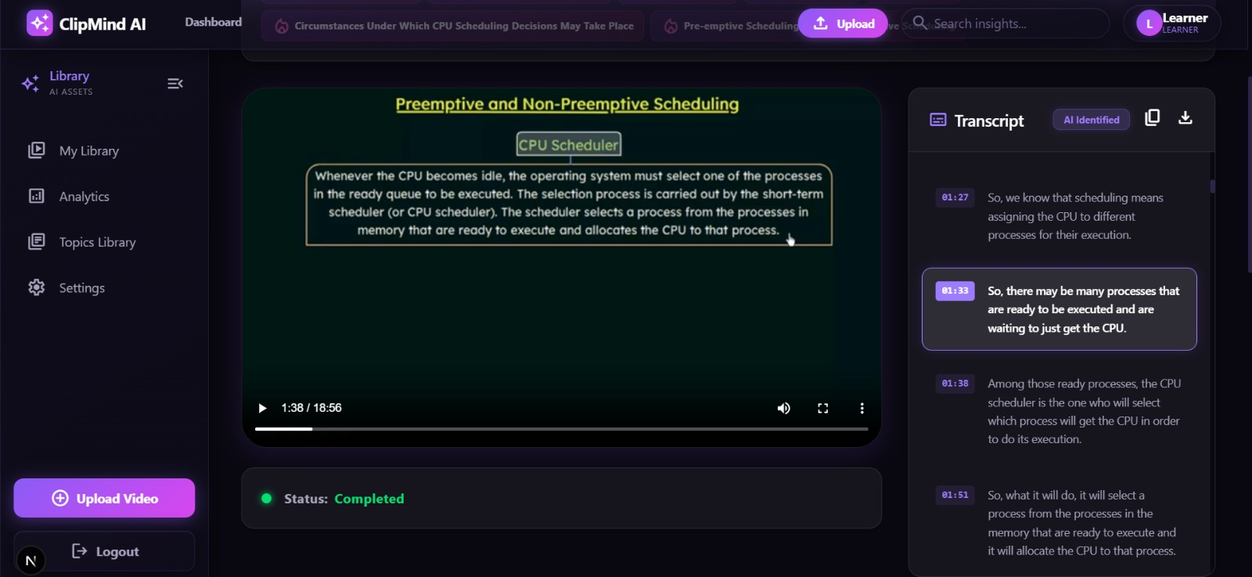
Transcript Synced to Playback
The active transcript segment tracks the video timestamp in real time
✦
Live segment highlight
The transcript line matching the current playhead is auto-highlighted.
✦
AI Identified transcript
Segments are attributed and timestamped by the AI pipeline.
✦
Click-to-seek
Any transcript line can jump the player to that exact moment.
ClipMind AI • Milestone 3
6

Slide 7
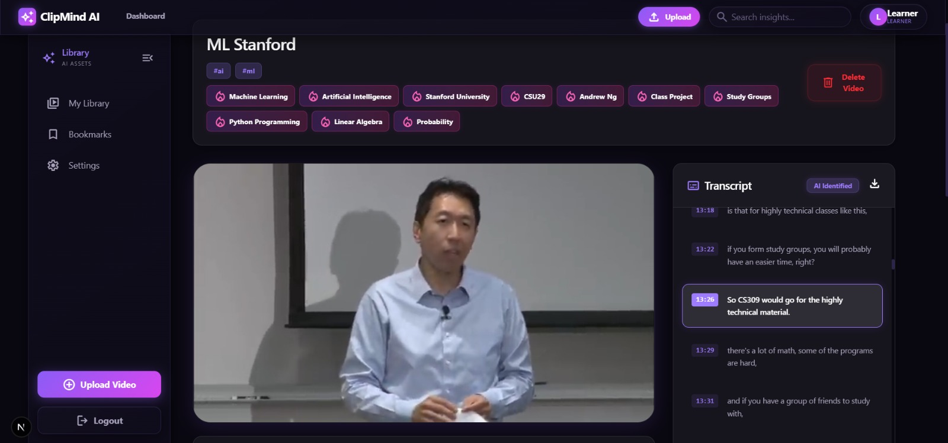
Automatic Keyword & Topic Extraction
Every upload is auto-tagged with entities and core topics
✦
Entity extraction
People, orgs & concepts — Andrew Ng, Stanford University, CSU29 — pulled straight from the transcript.
✦
Topic tagging
Core subjects like Machine Learning, Linear Algebra and Probability surfaced as chips.
✦
Powers search & filtering
Tags feed the dashboard search bar and the Topics Library.
ClipMind AI • Milestone 3
7

Slide 8
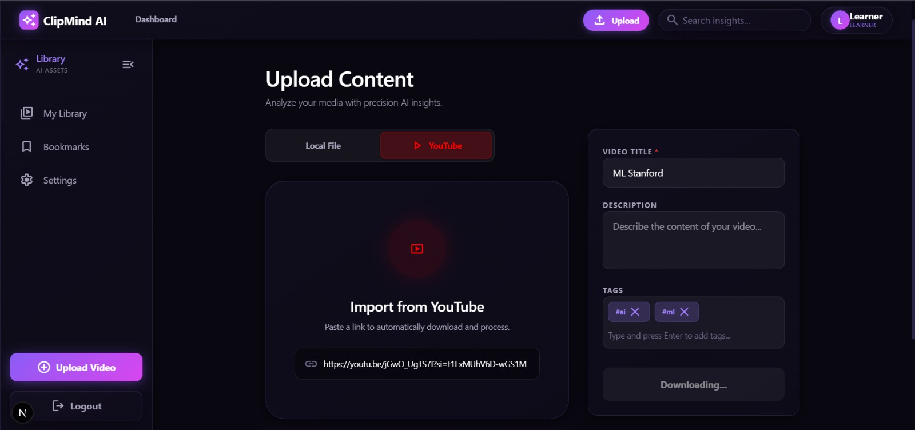
Expanded Content Ingestion
A YouTube link now feeds the same key-moments & analytics pipeline
✦
Paste-a-link import
Users drop a YouTube URL and the platform auto-downloads and queues it.
✦
Same AI pipeline
Imported videos flow through transcript, key moments and tagging identically to uploads.
✦
More data for analytics
Wider ingestion means richer usage and content-insight reporting.
ClipMind AI • Milestone 3
8

Slide 9
Milestone 3 Checklist & Achievements
✓
Timestamp extraction engine
✓
Key moments detection live
✓
Keyword & topic extraction
Auto-generates key-moment jump points from transcript segments.
Multi-card breakdown with per-moment summaries on the dashboard.
Auto-tagged content validated across ML, CS and OS lecture examples.
✓
Synced transcript highlighting
✓
YouTube import pipeline
✓
AI detailed summaries
Active segment tracks playback position in real time.
Paste-a-link ingestion feeding the same analytics pipeline.
Per-video long-form summary shipped with copy/download.
ClipMind AI • Milestone 3
9

Slide 10
What's Next?
MILESTONE 4 • WEEK 7–8
1
Validate transcript & summary quality
Benchmark AI outputs for transcript accuracy and summary relevance.
2
Optimize performance
Tune video processing pipelines and dashboard responsiveness.
3
Deploy to the cloud
Containerize with Docker and ship to AWS / Azure.
4
Final docs & live demo
Prepare professional documentation and the end-to-end platform demonstration.
Thank you
ClipMind AI • Milestone 3
10

