Slide 1
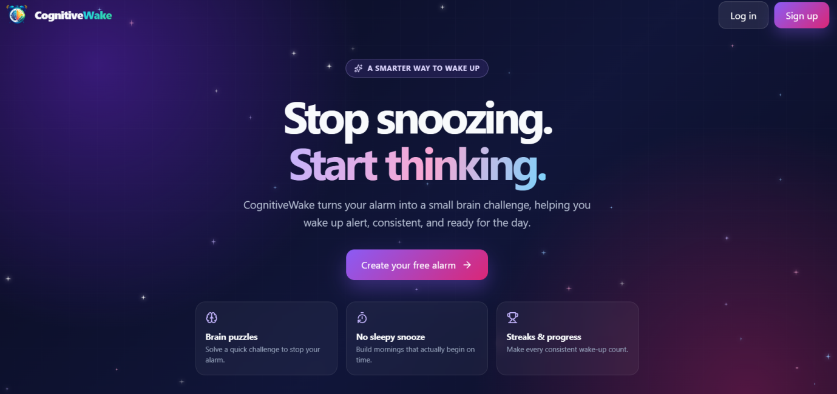
AI-Driven Cognitive Wake-Up Platform
for Personalized Challenges and Habit Formation
Infosys Springboard Virtual Internship 7.0
Presented by:
Tharunya Manokaran
Notes:
Welcome everyone. Today I will present my Infosys Springboard internship project: CognitiveWake, an AI-based cognitive wake-up alarm platform.

Slide 2
What we will cover
1
2
3
4
Introduction
Overview, features, benefits
Objective
One common goal
Architecture
Layers, components, flow
Internship
Challenges and solutions
5
6
7
Project work
Requirements, build, results
Deployment
Docker and Compose
Conclusion
Key takeaways
Notes:
Walk through the seven chapters of the report in order.

Slide 3
Overview
Challenge before dismissal
Complete a cognitive task to turn the alarm off
CognitiveWake
1
An AI-based cognitive alarm platform that makes waking up interactive and effective.
Personalised alarms
Custom settings and brain exercises
2
Habit score and streaks
Monitor progress over time
3
Friendly interface
Builds consistent morning routines
4
Notes:
Unlike traditional alarms, CognitiveWake requires a cognitive challenge before the alarm can be dismissed.

Slide 4
The problem and our answer
The problem
Traditional alarms are dismissed easily, causing repeated snoozing and irregular habits
Why it matters
1
Waking on time is hard for students, professionals and anyone with a busy schedule.
Maths problems
Quick calculations to wake the brain
2
Memory exercises
Short recall tasks
3
Pattern recognition
Spot the pattern to stop the alarm
4
Notes:
Challenges must be completed to switch off the alarm; habit scores and streaks reward consistency.

Slide 5
Key features
Registration & login
Secure user accounts
Alarm management
Customisable alarms
Cognitive challenges
Interactive, with difficulty levels
Personal dashboard
Habit scores and streaks
Role-based access
Users, moderators, administrators
Responsive design
Desktop, tablet and mobile
Notes:
Six feature groups; difficulty levels sit with the challenges.

Slide 6
Who can use it
Students
Professionals
Habit builders
Wake up on time
Classes and examinations
Academic activities
Improve punctuality
Fits daily schedules
Short mental warm-up
Track waking consistency
Keep regular schedules
Personal development
Notes:
Cognitive challenges give short mental activities when responding to the alarm.

Slide 7
Benefits over traditional alarms
No simple dismissal
A challenge is required
Why CognitiveWake
1
Alarm management, cognitive activities and habit tracking in one system.
Active engagement
Interactive tasks on waking
2
Progress tracking
Habit scores and streaks
3
Flexibility
Personalised alarms, adjustable difficulty
4
Notes:
Together these give an engaging approach to consistent morning routines.

Slide 8
Objective of the internship
To build CognitiveWake, a responsive AI-based alarm platform that requires a cognitive challenge before an alarm can be dismissed, while gaining practical experience in designing, developing and deploying a complete application.
Learn
Build
Grow
Real-world problem-solving and logical thinking
Authentication, alarms, challenges, habit scores and streaks
Debugging, project management and career-ready skills
Notes:
One common objective covering learning, technical and career goals.

Slide 9
Three-tier architecture
Presentation layer
Application layer
Data layer
The user interface built with React, HTML, CSS and JavaScript
Backend services handling core functionality and APIs
MongoDB storing and retrieving data
The layers work together for efficient, maintainable and responsive communication.
Notes:
Presentation, application and data layers.

Slide 10
System components
User authentication
Registration and login
Alarm management
Create and manage alarms
Cognitive challenge
Interactive brain exercises
Habit tracking
Scores and waking streaks
Role-based access
User, moderator, admin
API integration
Frontend to backend
Database (MongoDB)
Users, alarms, challenges, progress
Notes:
Seven components make up the system.

Slide 11
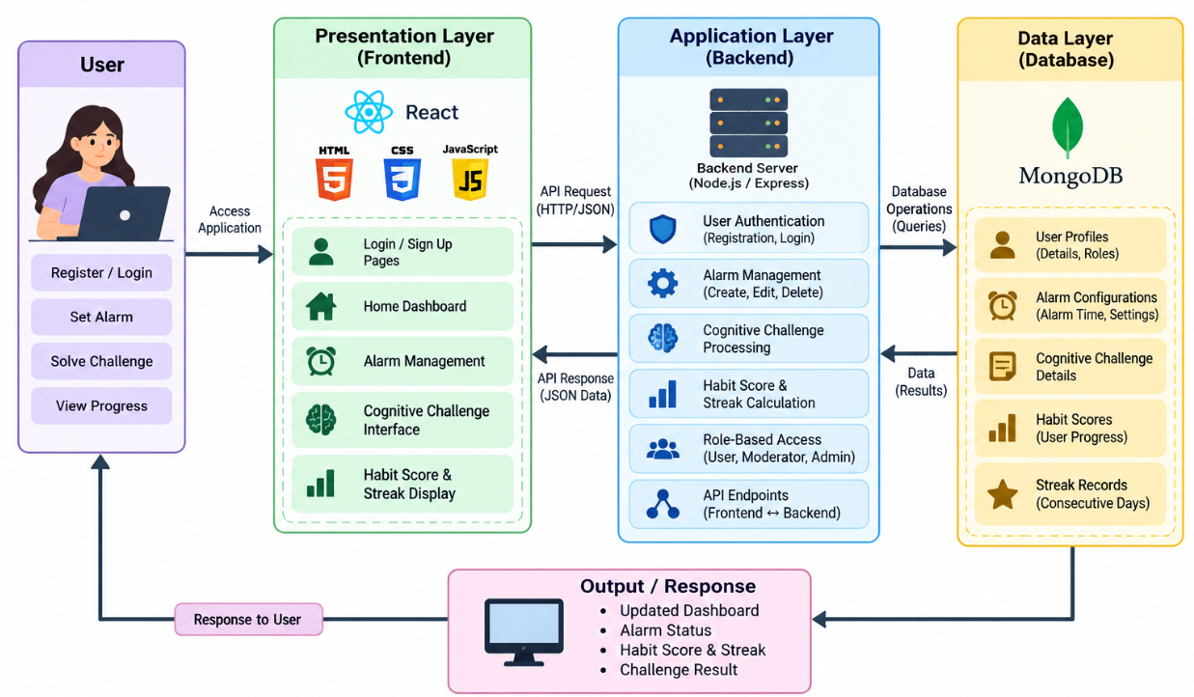
Architecture flow
Request
UI calls backend via HTTP/JSON
Process
Auth, alarms, challenges, scores
Store
MongoDB queries and records
Respond
Dashboard, streak, result
Notes:
Follow the arrows: user, frontend, backend, database, and back to the user.

Slide 12
Challenges and solutions
Frontend–backend connection
Checked API configurations
Result
1
A more user-friendly, responsive and reliable application.
Authentication and features
Tested and debugged code
2
Desktop and mobile layout
Modified CSS styles
3
Deployment issues
Checked code changes, GitHub, Render status
4
Notes:
Each challenge and how it was resolved.

Slide 13
Project overview
Challenge to dismiss
Not just one tap
CognitiveWake
1
Wake up actively and keep consistent morning routines.
Core features
Authentication, alarms, brain exercises, habit score, streaks
2
Technology
React frontend, backend APIs, MongoDB
3
Responsive
Desktop and mobile
4
Notes:
Primary goal: make waking up interactive and build regular habits.

Slide 14
Business requirement analysis
Problem
Hard to wake on time
The need
1
Conventional alarms are stopped without meaningful interaction.
Solution
Engaging alarms with challenges and progress tracking
2
Users
Students, professionals, anyone improving mornings
3
Notes:
Requirements guide a practical, accessible platform.

Slide 15
Functional and non-functional requirements
Functional
Non-functional
Registration and login
Alarm creation and management
Challenge execution
Habit score and streaks
Role-based access control
User-friendly interface
Responsive design
Reliable data storage
Secure authentication
Efficient performance
Notes:
What the system does, and how well.

Slide 16
Implementation process
1
2
3
4
Analyse
Requirements
Plan
Architecture and UI
Frontend
React screens
Backend
API integration
5
6
7
8
Database
MongoDB storage
Features
Challenges, habit score, streaks
Test
Fix errors, mobile UI
Deploy
Live online
Notes:
Eight stages from analysis to deployment.

Slide 17
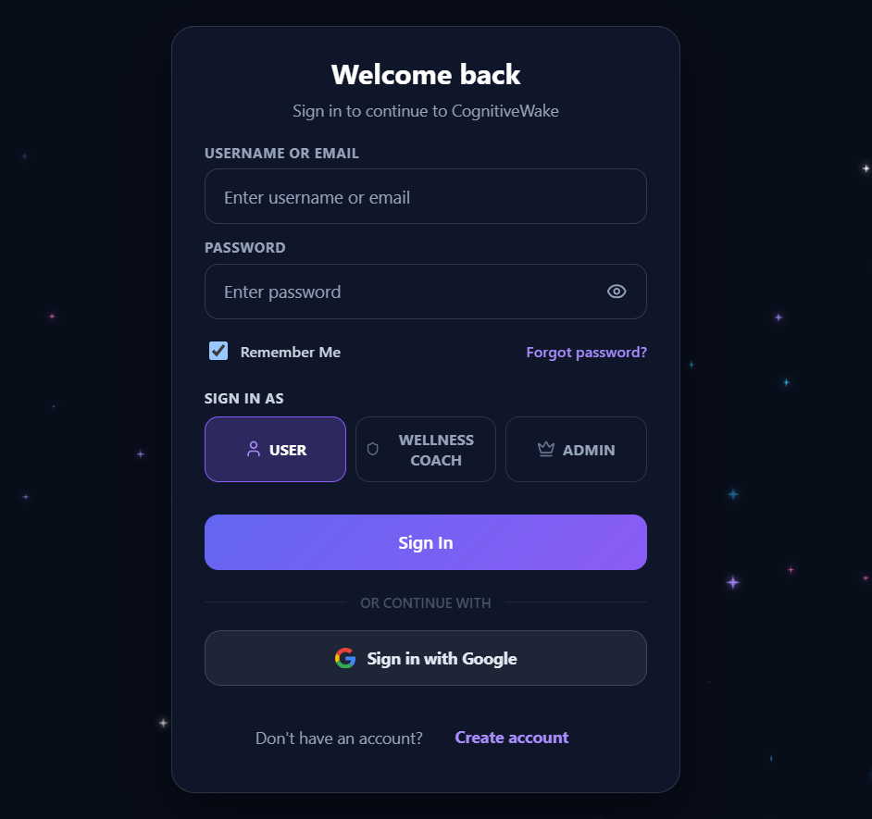
Homepage & login
Homepage: smart alarms, brain puzzles and streak tracking.
Login: email/username, role (User, Wellness Coach, Admin), Google sign-in.
Notes:
Explain what the screen does, then move on.

Slide 18
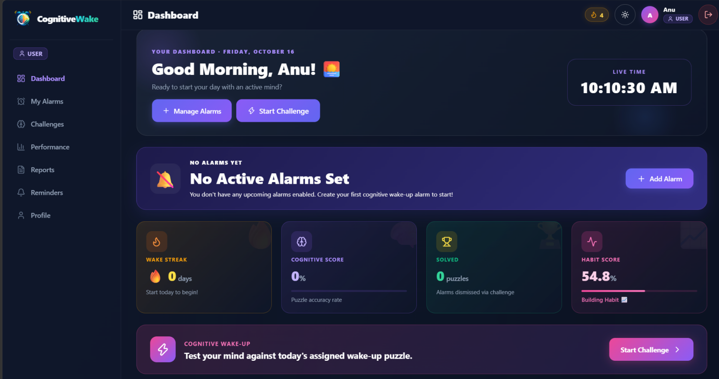
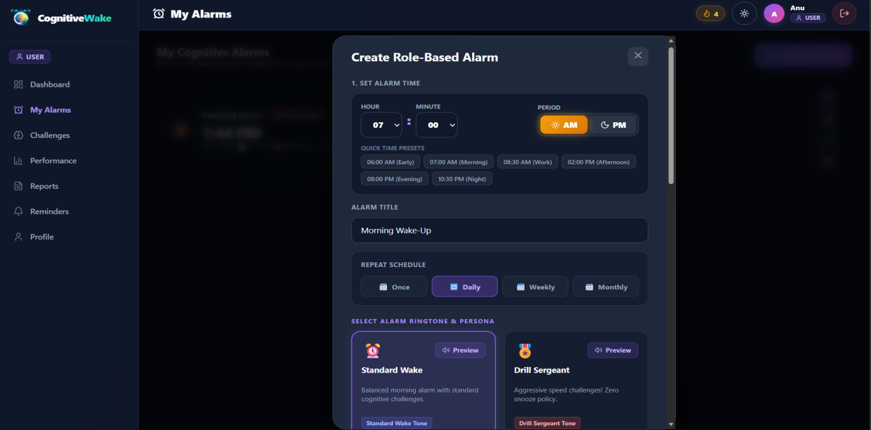
Dashboard & alarm management
Dashboard: live time, alarms, wake streak, cognitive and habit scores.
Alarms: set times, repeat schedules, tones and wake-up styles.
Notes:
Explain what the screen does, then move on.

Slide 19
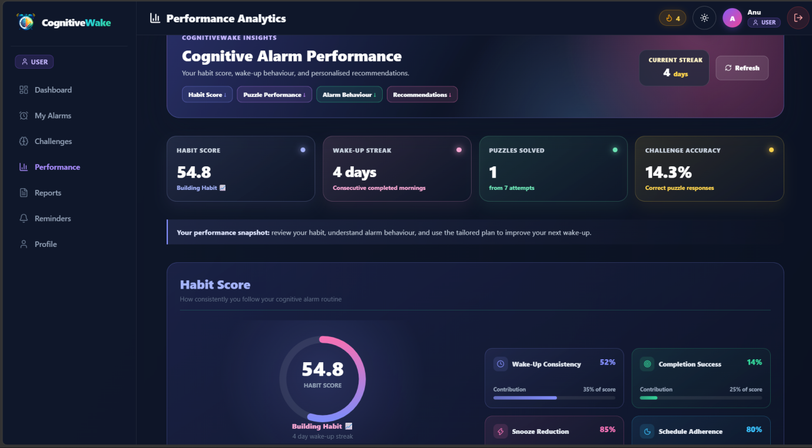
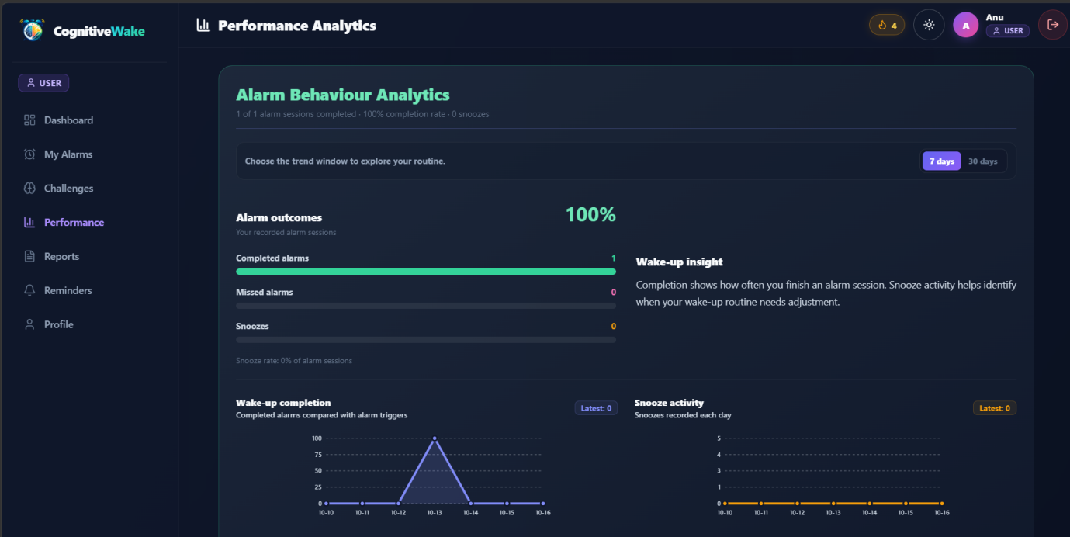
Performance & alarm behaviour
Performance analytics: scores, streaks, accuracy and insights.
Alarm behaviour: completed, missed, snoozed, with trends.
Notes:
Explain what the screen does, then move on.

Slide 20
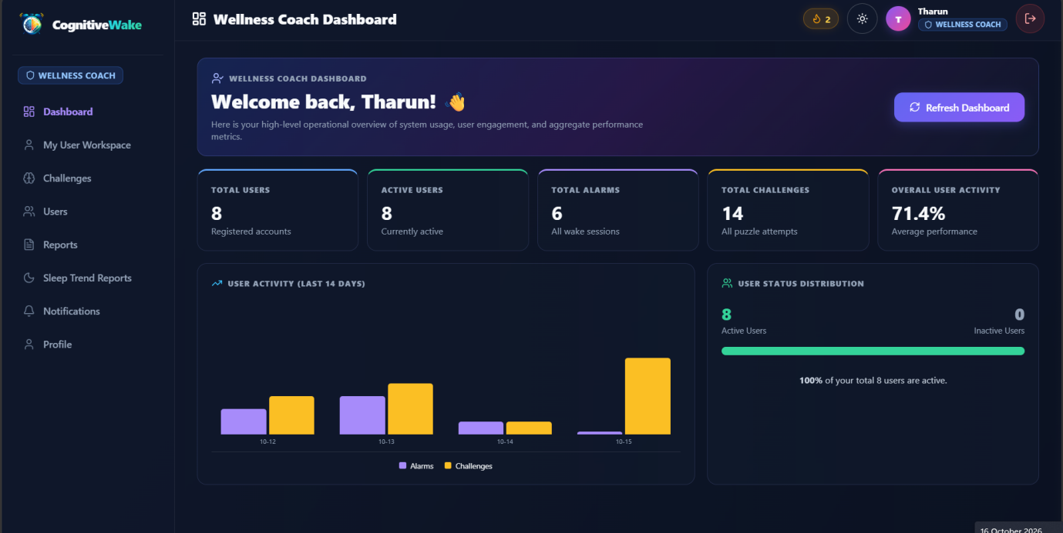
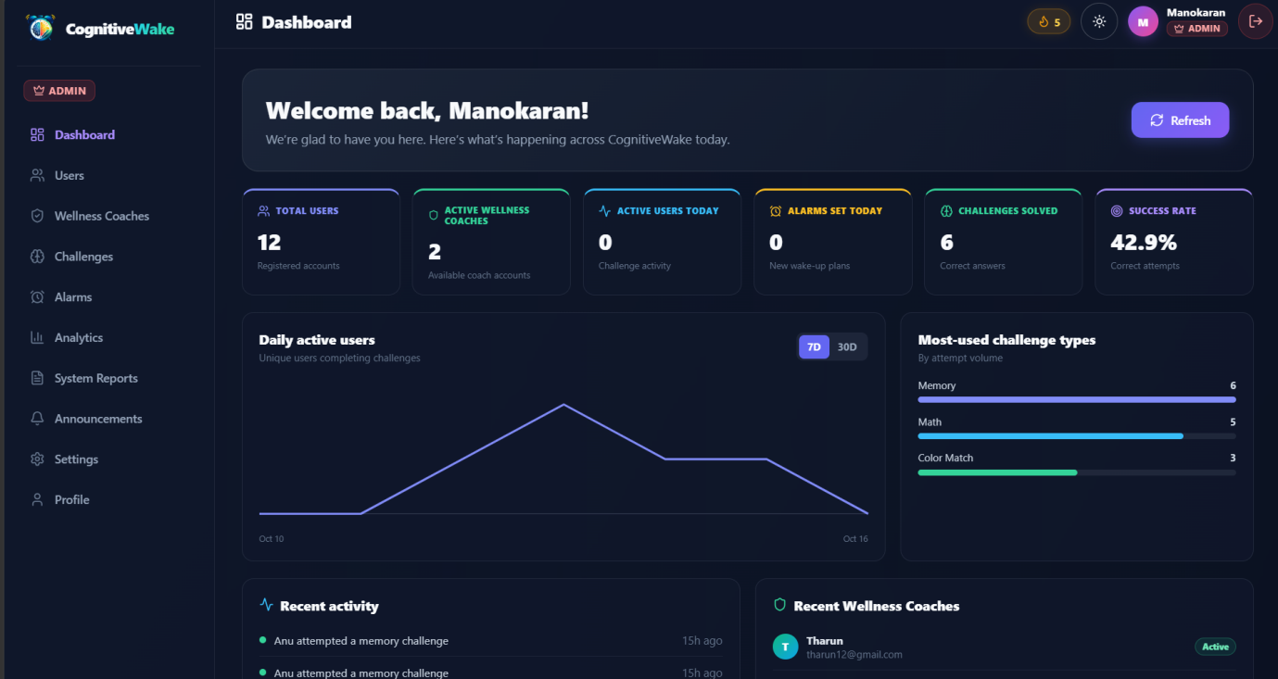
Coach & admin dashboards
Coach dashboard: users, alarms, challenges and engagement.
Admin dashboard: users, coaches, alarms, success rates.
Notes:
Explain what the screen does, then move on.

Slide 21
Deployment with Docker
Docker Compose manages all three services
Frontend
Backend
Database
React + Vite
FastAPI + Uvicorn
MongoDB
$ docker compose up --build
Builds the images and launches the configured containers
Notes:
Docker containerises each component; Compose configures and manages them together.

Slide 22
Testing and benefits
Authentication
User login works
Verified
1
The running application was tested end to end.
Alarms and challenges
Management and cognitive tasks
2
Dashboard and database
Functionality and connectivity
3
Benefit
Simpler setup, consistent services, easy to maintain
4
Notes:
Verification steps and benefits.

Slide 23
Conclusion
CognitiveWake makes the alarm interactive: users must complete a cognitive challenge before dismissing it.
Personalised alarms, analytics and habit tracking encourage consistent waking routines
Hands-on experience designing, developing, testing and deploying a complete web application
Notes:
Summarise the main takeaway.

Slide 24
Thank you
Notes:
Thank the audience and invite questions.

