Slide 1
Milestone-1
Project: Intelligent Cognitive Alarm Platform

Slide 2
Introduction:
Traditional alarms only provide a basic time-based alert.
Users can easily dismiss or snooze alarms without becoming fully alert.
The proposed system combines smart alarms with cognitive challenges.
User sleep, wake-up, and habit preferences are considered.
The system aims to encourage better waking habits and daily productivity.

Slide 3
Objectives:
Develop an intelligent alarm management system.
Role based access - user, admin, coach
Allow users to create and manage alarms easily.
Maintain user sleep, wake-up, and habit preferences.
Introduce cognitive challenges for wake-up verification.
Provide personalized wellness recommendations to users.

Slide 4
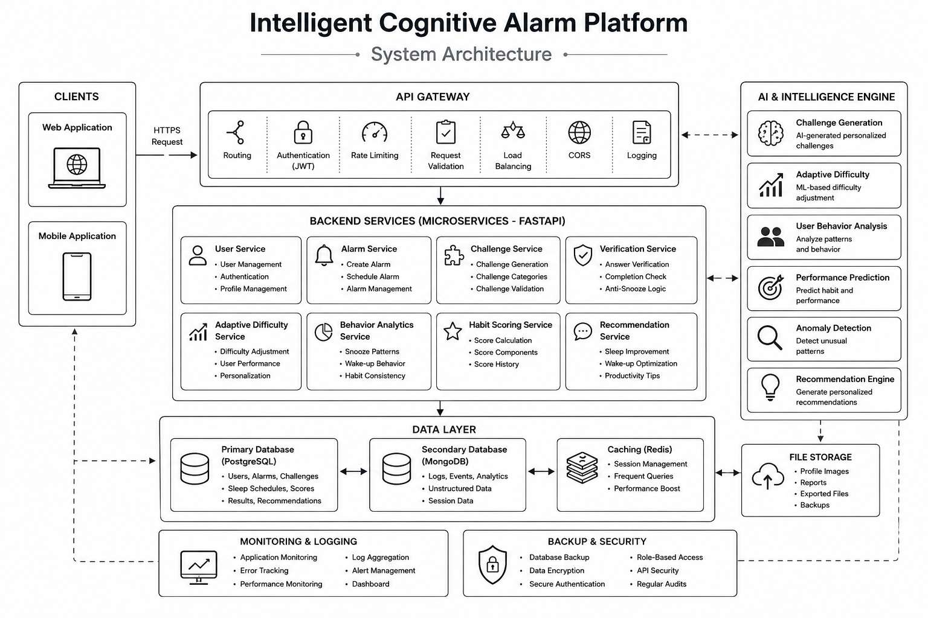
System Architecture:
User Interface – React.js
Backend Server – FastAPI / Python
Database – PostgreSQL
Cognitive Challenge Engine – Wake-up verification
Recommendation Module – Personalized wellness suggestions

Slide 5
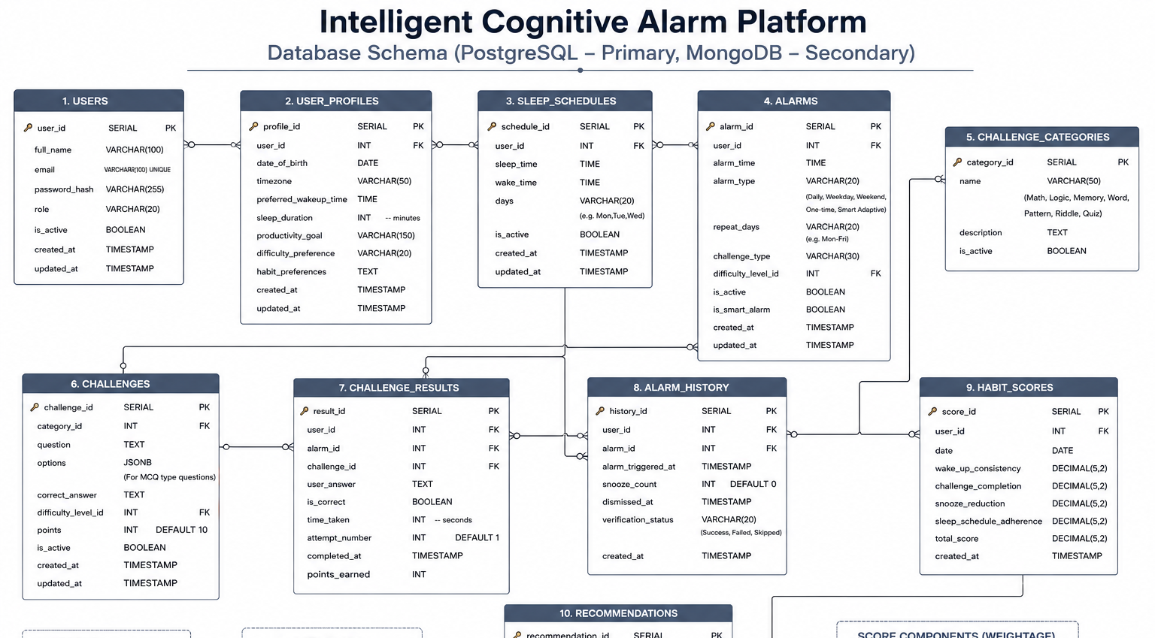
Database schema:

Slide 6
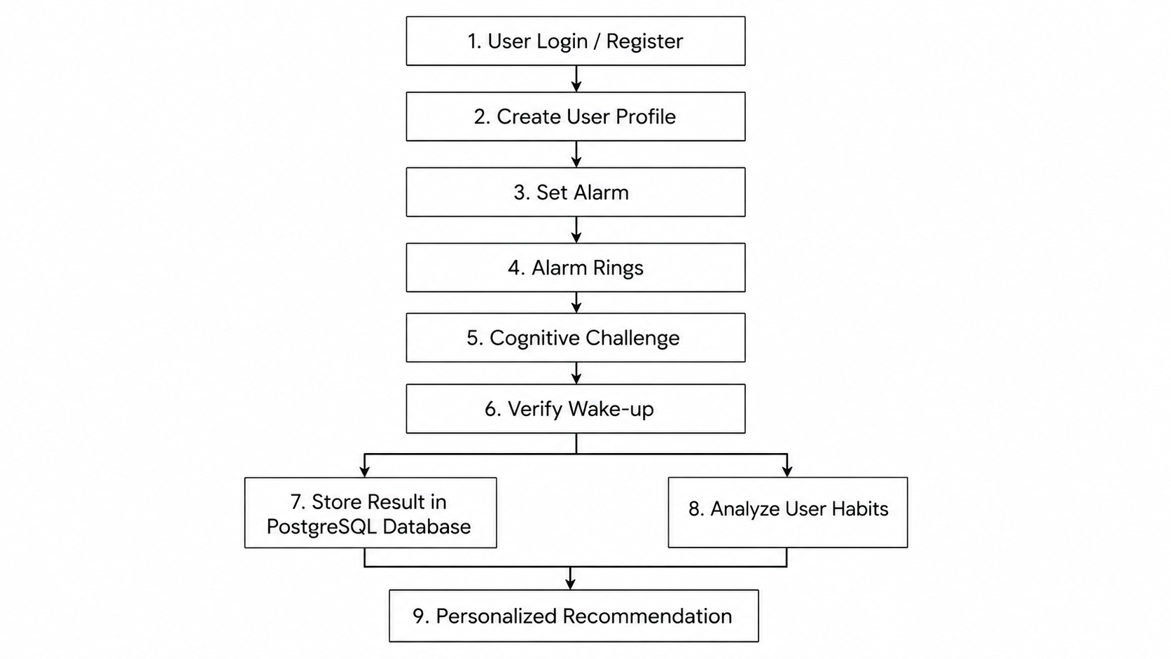
UI Framework:
Frontend: React.js for a modern and responsive user interface.
Design: Clean, simple, and user-friendly navigation.
Features: Interactive dashboard, alarms, challenges, recommendations, and profile management.
WORKFLOW:

Slide 7
Frontend & Backend Setup:
Frontend: React.js with HTML/CSS for a responsive and user-friendly interface.
Backend: FastAPI with Python for authentication, alarms, profiles, and application logic.
Database: PostgreSQL connected with the backend to store user, alarm, profile, and challenge data.
Authentication & User Management:
Authentication: Secure user login and registration.
Role-Based Access: Different access for Users, Coaches, and Admins.
Profile & Habit Management: Manage sleep patterns, wake-up preferences, and daily habits.

Slide 8
Alarm Scheduling:
Create Alarms: Set alarm time, label, and repeat options.
Manage Alarms: Edit, delete, enable, or disable alarms.
Wake-up Control: Alarm triggers the wake-up process and prepares for cognitive verification.

