Slide 1
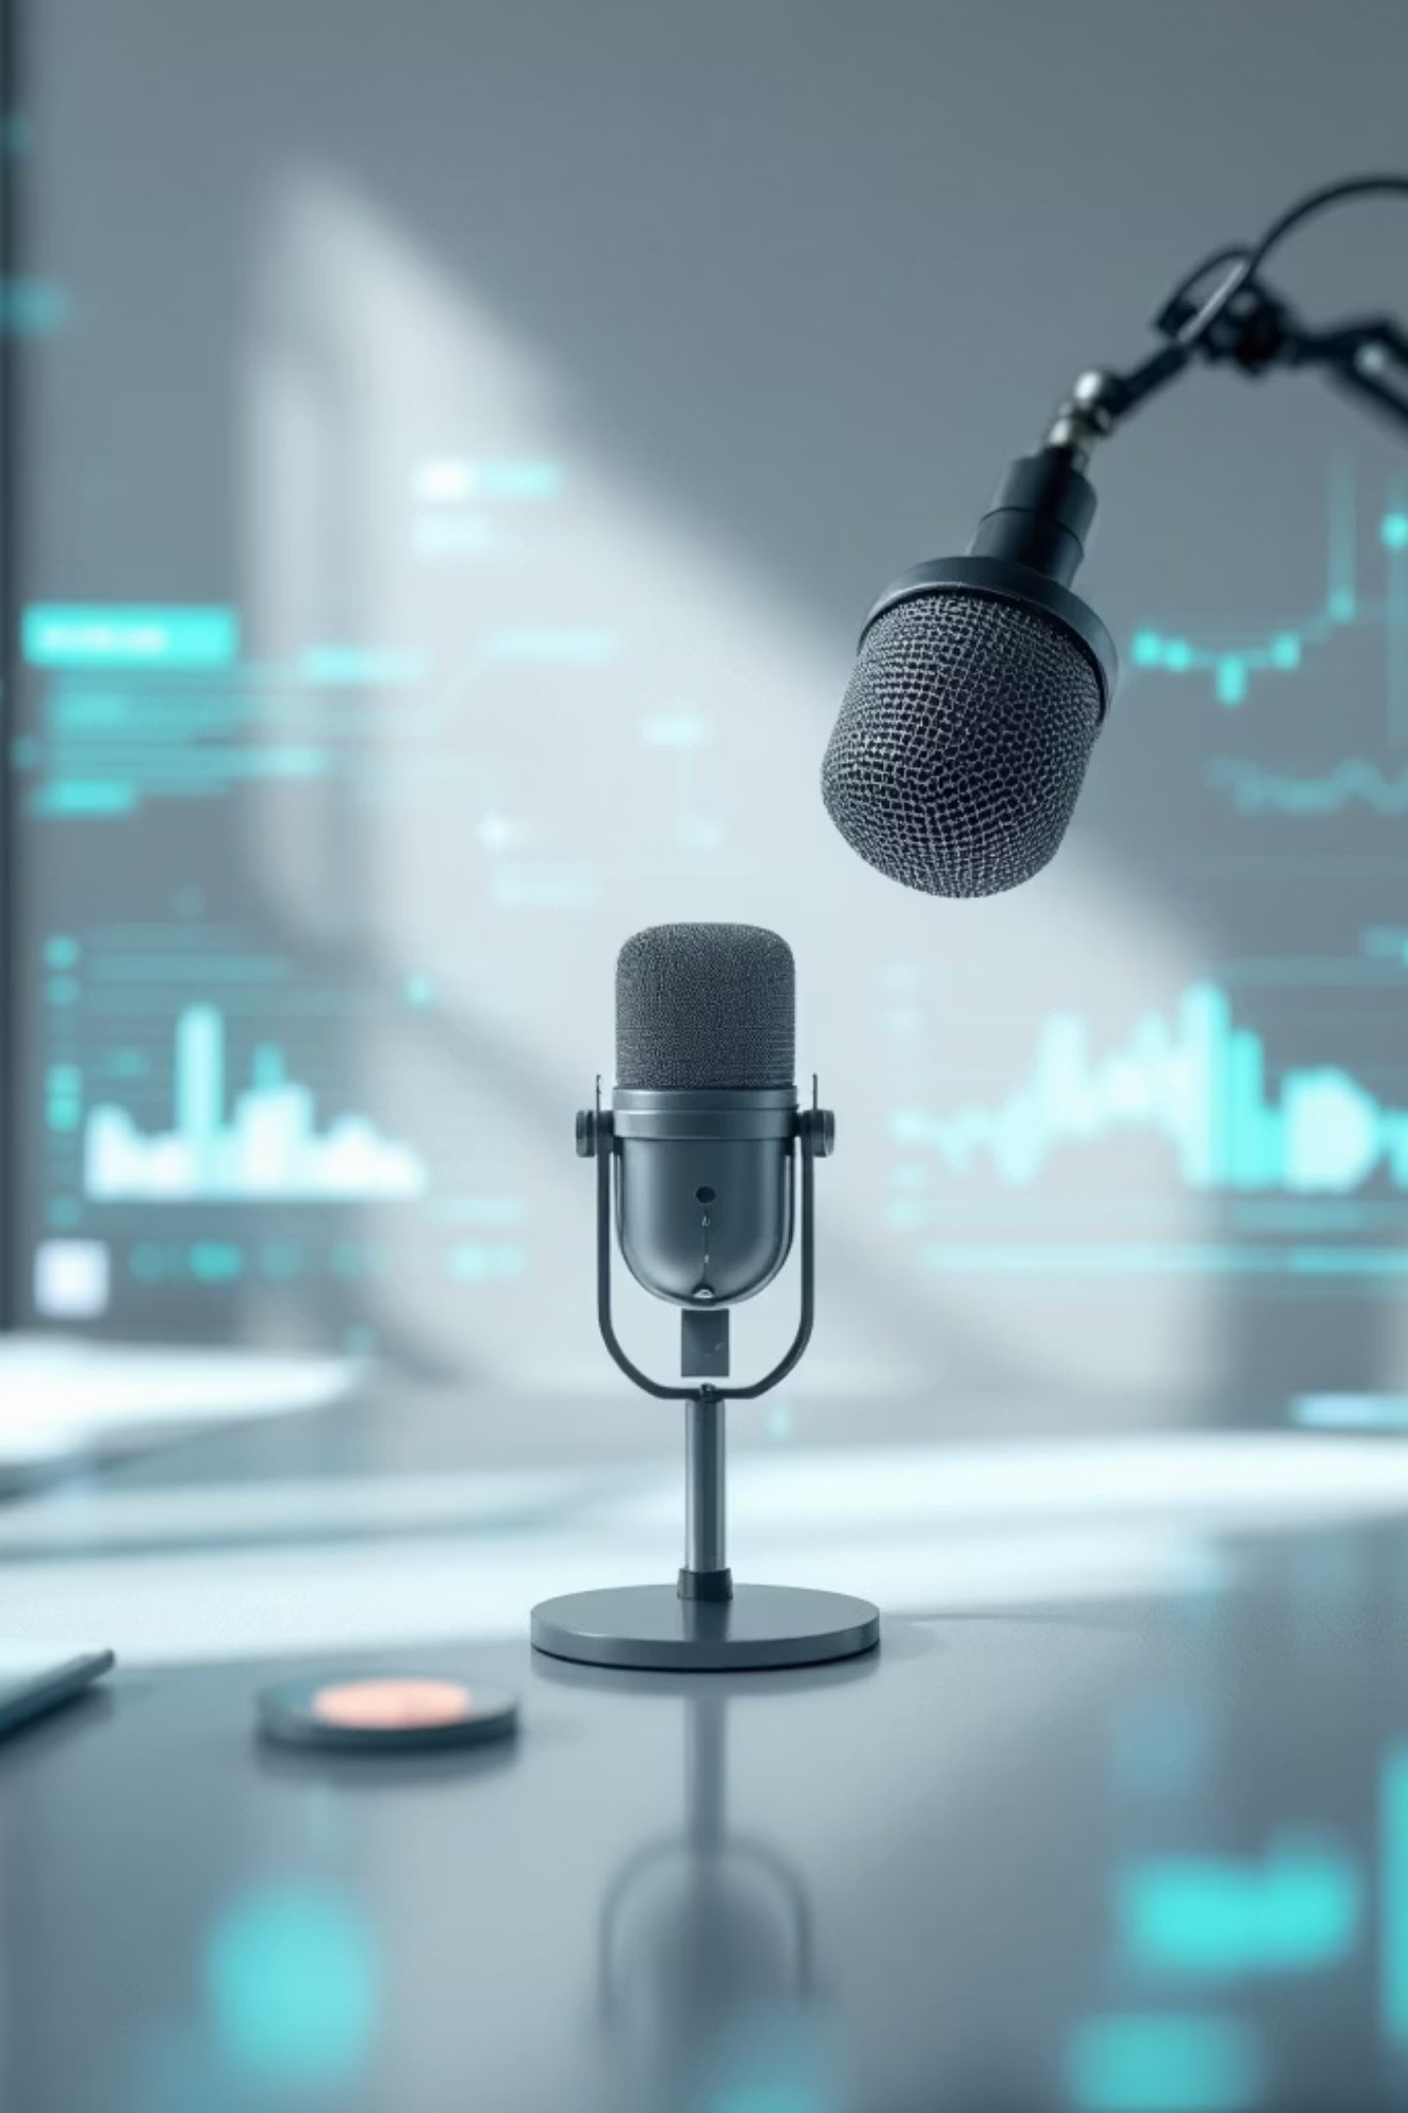
EchoAI: Automated Podcast Transcription & Intelligent Topic Segmentation System
Presented by: Mydhili Alladi | Infosys Springboard 6.0 (Batch 11)

Slide 2




Problem Statement
The podcast industry has experienced explosive growth, with millions of hours of audio content created daily. However, this abundance creates significant challenges for content discovery, analysis, and accessibility. Long-form audio content remains largely unstructured and difficult to navigate, creating barriers for both content creators and consumers.
Search Difficulties
Manual Inefficiency
Long-form podcasts and discussions are difficult to search and analyze efficiently, forcing users to listen through entire episodes to find specific content.
Manual transcription is time-consuming and error-prone, requiring 4-6 hours to transcribe one hour of audio with human error rates of 5-10%.
Unstructured Data
Retrieval Inefficiency
Lack of structured insights from unsegmented audio data prevents meaningful analysis and content discovery.
Inefficient retrieval of specific topics or sentiments within large audio files frustrates users and limits content utilization.

Slide 3




Proposed Solution
EchoAI represents an intelligent, end-to-end solution that transforms unstructured audio content into structured, searchable, and analyzable insights. Our system leverages cutting-edge AI and natural language processing technologies to automate the entire transcription and segmentation pipeline.
Audio Processing
AI-driven system for automated transcription and intelligent topic segmentation of podcast content.
Analysis Engine
Integrates speech-to-text, topic modeling, and sentiment analysis for comprehensive content understanding.
Structured Insights
Converts unstructured audio into searchable, structured insights with topic boundaries and emotional context.
Visualization
Provides an interactive dashboard for exploration and visualization of segmented content.

Slide 4
System Architecture
Our pipeline orchestrates multiple AI and NLP components to deliver seamless audio-to-insights transformation. The architecture follows a sequential processing flow that ensures accuracy, efficiency, and scalability.
01
02
03
Audio Input
Whisper Transcription
Text Segmentation
User uploads audio file (MP3, WAV, M4A) through the Streamlit interface
OpenAI's Whisper model generates accurate multilingual transcription with timestamps
TextTiling and TF-IDF algorithms identify topic boundaries in the transcribed text
04
05
Sentiment Analysis
Dashboard Visualization
TextBlob adds emotional context with polarity and subjectivity scoring
Streamlit UI presents interactive visualizations and structured insights

Slide 5





Core Algorithms
EchoAI combines five powerful algorithms to deliver accurate transcription, intelligent segmentation, and meaningful sentiment analysis. Each component plays a critical role in transforming raw audio into actionable insights.
Whisper
TF-IDF
TextTiling
Multilingual speech-to-text model for accurate transcription across 99 languages. Provides timestamped output and handles various audio qualities.
Term Frequency-Inverse Document Frequency for keyword extraction and topic relevance scoring. Identifies important terms within each segment.
Topic boundary detection algorithm that identifies transitions in long-form text. Analyzes lexical cohesion to determine where topics change.
SBERT
TextBlob
Sentence-BERT for semantic similarity analysis. Clusters related segments using contextual embeddings and cosine similarity metrics.
Sentiment polarity and subjectivity analysis. Provides numerical scores for emotional tone and content objectivity in each segment.

Slide 6
Technology Stack
Core Language
Framework
Audio Processing
Python - Modern, versatile language with extensive AI and NLP libraries for rapid development and deployment.
Streamlit - Open-source framework for building interactive web applications with minimal code. Enables rapid UI development.
Librosa - Comprehensive library for audio analysis and processing. Handles format conversion and audio feature extraction.
NLP Libraries
Visualization
NLTK, scikit-learn, Sentence-Transformers - Industry-standard libraries for natural language processing, machine learning, and semantic analysis.
Matplotlib, WordCloud - Data visualization libraries for generating charts, graphs, and word cloud visualizations.

Slide 7
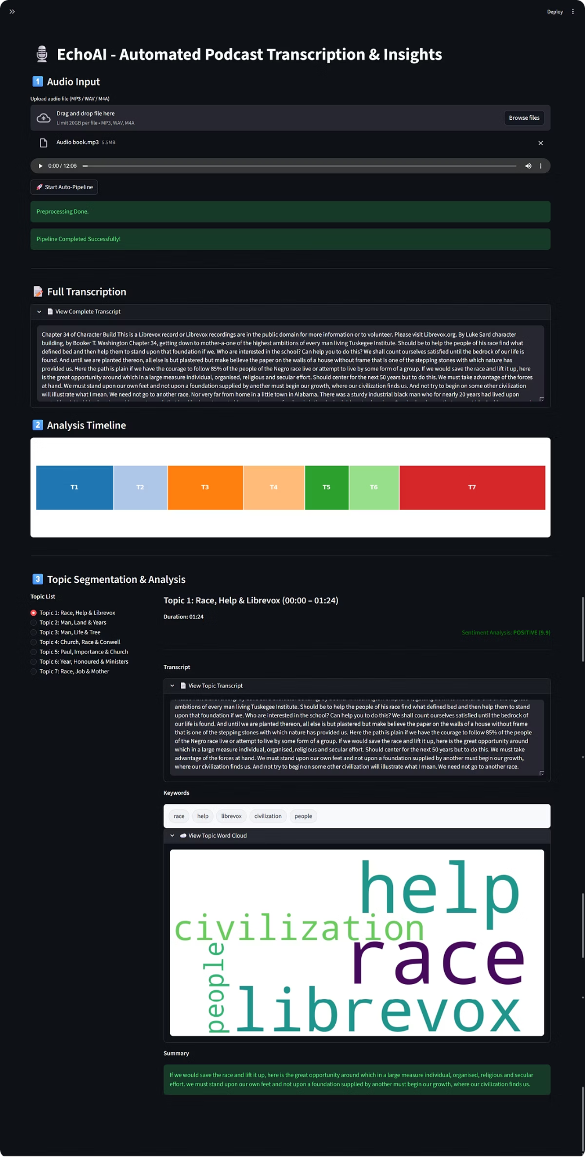
Prototype Demonstration
UI Features & Capabilities
1
Audio Upload & Transcription Panel
Drag-and-drop interface for audio file upload with automatic format detection and progress tracking
2
Real-Time Progress & Analysis Timeline
Visual progress bar showing transcription status and estimated completion time with detailed processing metrics
3
Topic Segmentation with Color-Coded Sections
Intuitive color-coding system that visually represents different topics and their boundaries throughout the transcript
4
Word Cloud Visualization for Topic Keywords
Dynamic word cloud that highlights most frequent and relevant terms in each topic segment for quick comprehension
5
Sentiment Summary & Transcript Viewer
Comprehensive sentiment analysis dashboard showing emotional tone distribution and complete searchable transcript with timestamps

Slide 8
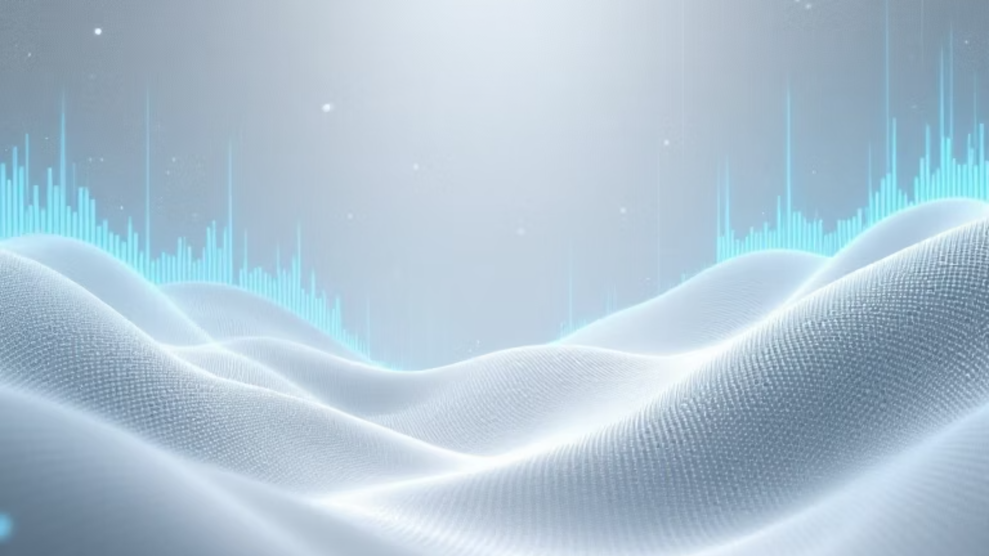
System Capabilities & Constraints
Capabilities
Constraints
Handles long-form audio efficiently with optimized processing pipelines
Provides structured topic and sentiment insights with visual representations
Interactive and visually minimal dashboard for intuitive user experience
Supports multiple audio formats including MP3, WAV, and M4A
Generates timestamped transcripts for precise content navigation
Creates searchable, structured content from unstructured audio
Dependent on Whisper model accuracy and training data quality
Processing time increases with audio length and complexity
Requires stable internet and GPU for optimal performance
Limited to single-speaker audio in current implementation
Accuracy varies with audio quality and background noise levels
Resource-intensive processing may require cloud infrastructure

Slide 9
Performance Considerations
Optimized Processing
Performance Enhancements
System optimized for medium-length podcasts (30-90 minutes). Processing time averages 3-5x real-time for 60-minute episodes with standard hardware.
Implement caching mechanisms and parallelization strategies for faster inference. Batch processing capability for large datasets improves throughput by 40%.
Evaluation Metrics
Scalability
Comprehensive evaluation framework using Word Error Rate (WER) for transcription accuracy, segmentation precision for topic boundary detection, and sentiment accuracy benchmarks.
Cloud-ready architecture supports horizontal scaling. Processing capacity can be expanded based on demand with load balancing and distributed computing.

Slide 10



Conclusion & Future Scope
EchoAI successfully transforms unstructured audio into structured, searchable insights, addressing critical challenges in podcast content discovery and analysis. The system enhances accessibility and analysis of long-form content, making millions of hours of audio content discoverable and actionable.
Multi-Speaker Diarization
Real-Time Processing
Platform Integration
Future implementation will identify and separate different speakers in audio content
Live transcription and topic tracking for streaming audio content and live broadcasts
Direct integration with podcast platforms and APIs for seamless content processing

