Slide 1

PodIntel AI
An end-to-end podcast and audio analysis system that transforms raw audio into structured, actionable insights using AI-powered transcription, topic segmentation, and natural language processing.

Slide 2





What PodIntel AI Does
Speech-to-Text
Topic Segmentation
Smart Summaries
Accurate transcription using Whisper AI
Automatic content clustering
Concise topic overviews
Sentiment Analysis
Keyword Extraction
Emotional tone detection
Relevant term identification

Slide 3
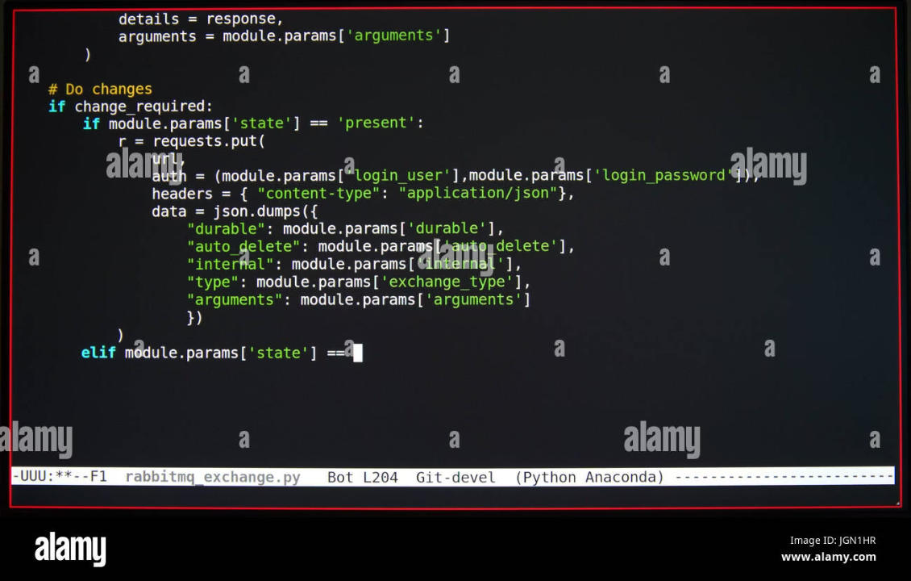
Technology Stack
Core Frameworks
FastAPI backend for request handling
Streamlit frontend for user interface
Python 3.9+ base language
AI & ML Libraries
OpenAI Whisper for speech recognition
Sentence Transformers for embeddings
Scikit-learn for TF-IDF analysis
TextBlob for sentiment classification
NLTK for text processing
Audio Processing
FFmpeg for format conversion
Pydub for audio manipulation

Slide 4
Complete Pipeline Workflow
The system processes audio through 11 sequential stages, from upload to final insights generation.
01
02
03
Upload Audio
Format Conversion
Audio Chunking
User uploads via Streamlit interface
Convert to 16kHz mono WAV
Split into fixed segments
04
05
06
Transcription
Text Cleaning
Sentence Segmentation
Whisper processes audio
Remove timestamp noise
Split into sentences
07
08
09
Topic Detection
Summarization
Sentiment Analysis
Embedding-based clustering
Generate topic summaries
Classify emotional tone
10
11
Keyword Extraction
Save Results
Identify key terms
Session-based storage

Slide 5
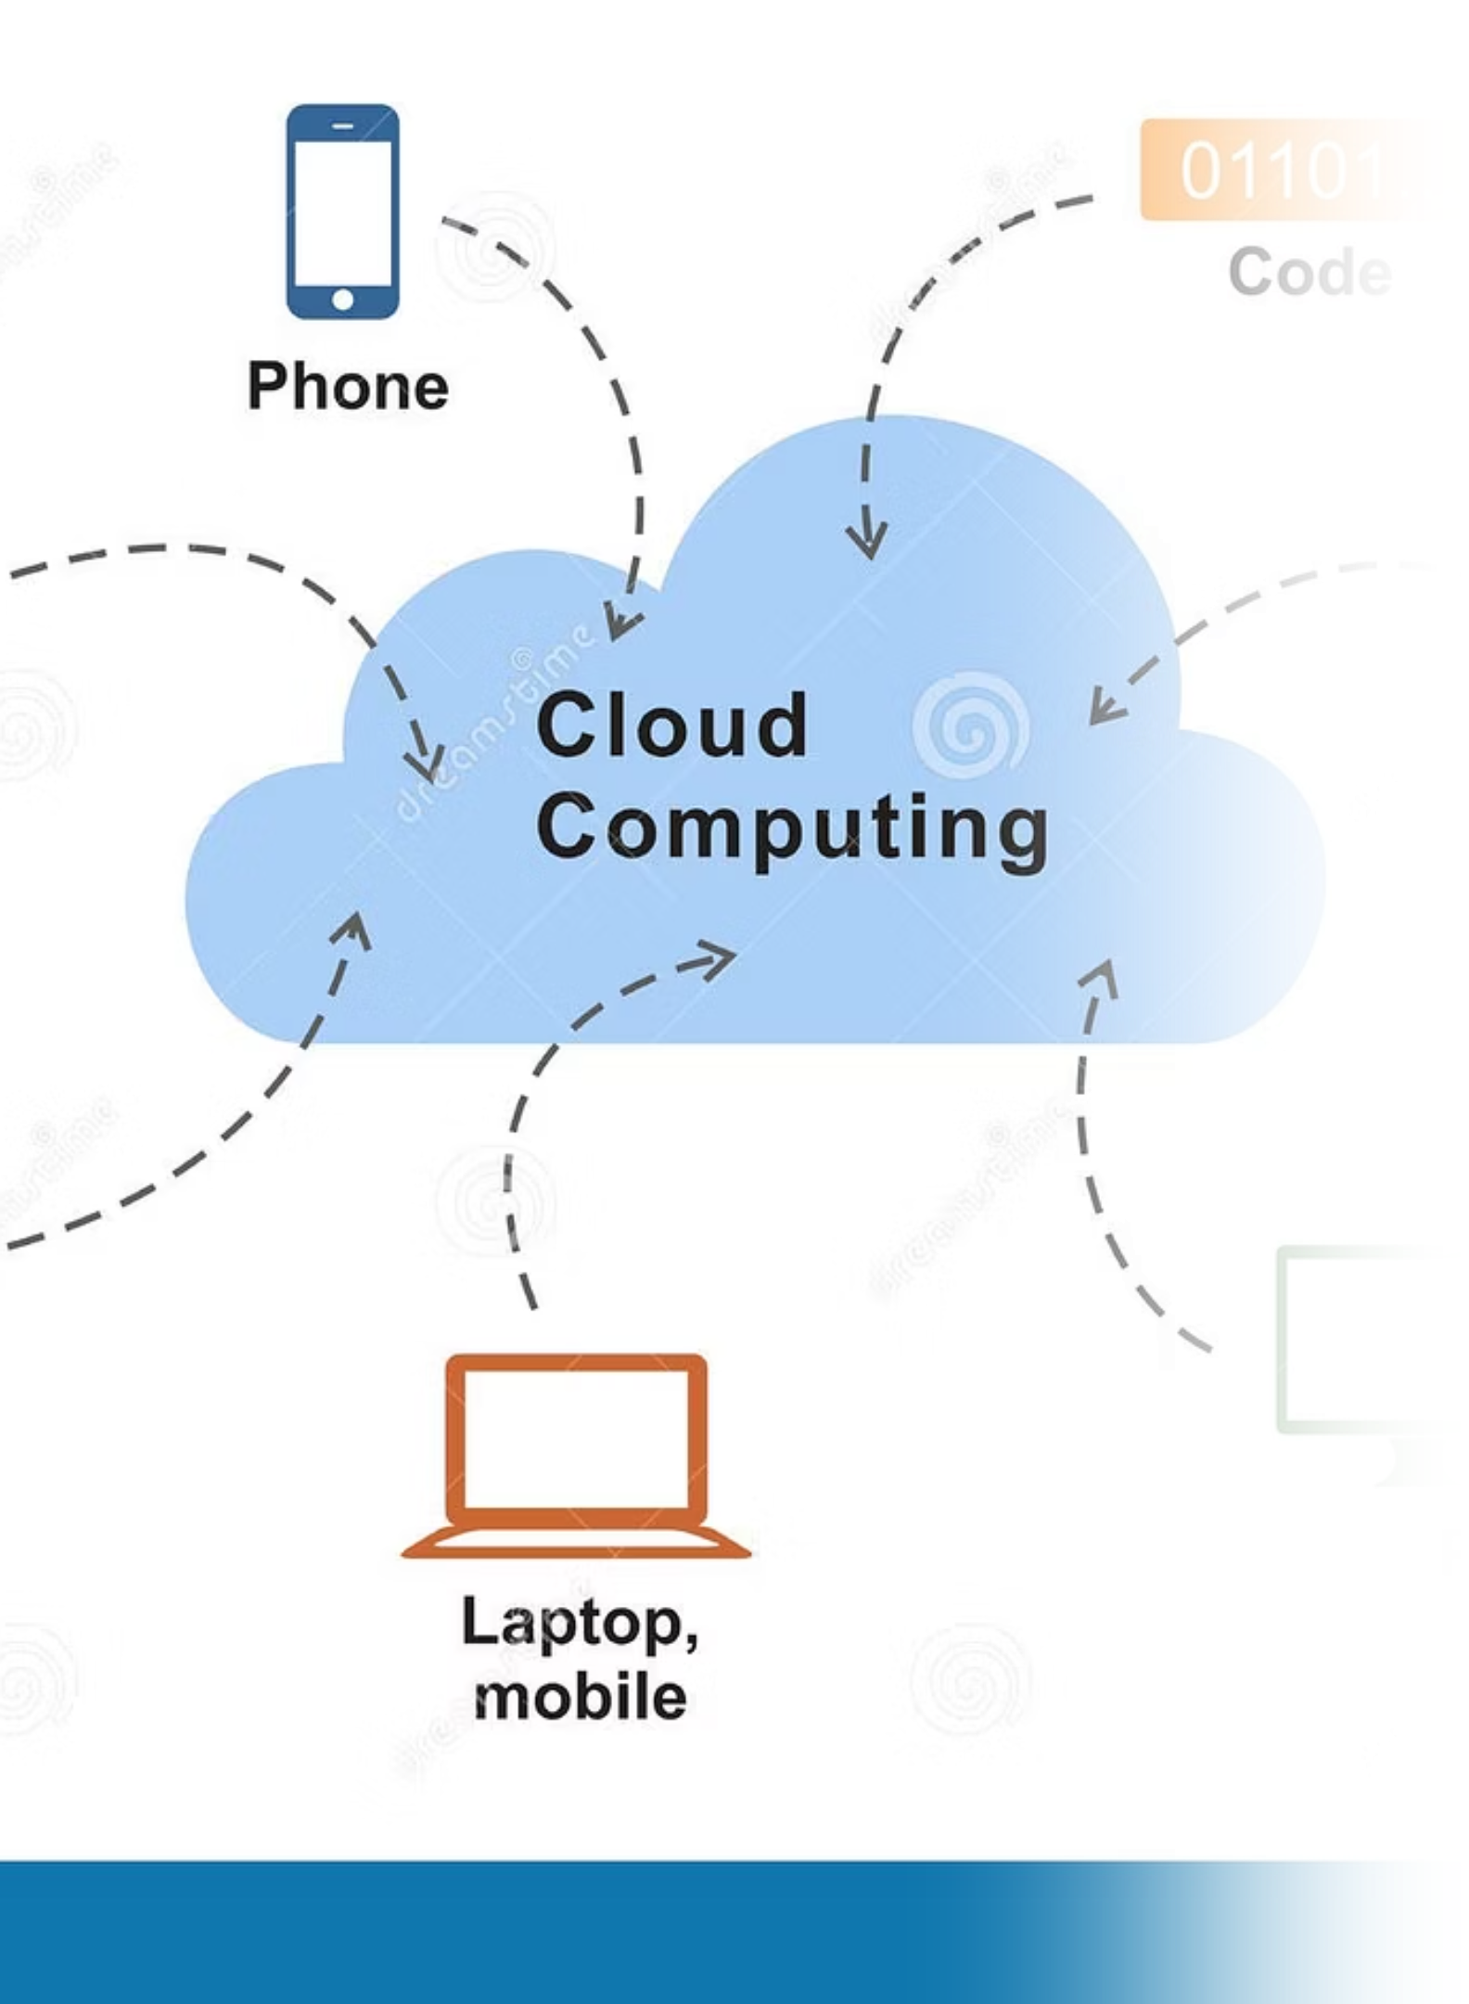
System Architecture
Frontend Layer
Streamlit interface handles user interactions, file uploads, and session management with intuitive visualization of results.
Backend API
FastAPI processes requests, manages pipeline execution, and serves structured data to the frontend.
AI Processing Engine
Modular pipeline performs audio conversion, transcription, NLP analysis, and generates insights.
Data Storage
Session-based folder system isolates user data and maintains processing history.

Slide 6
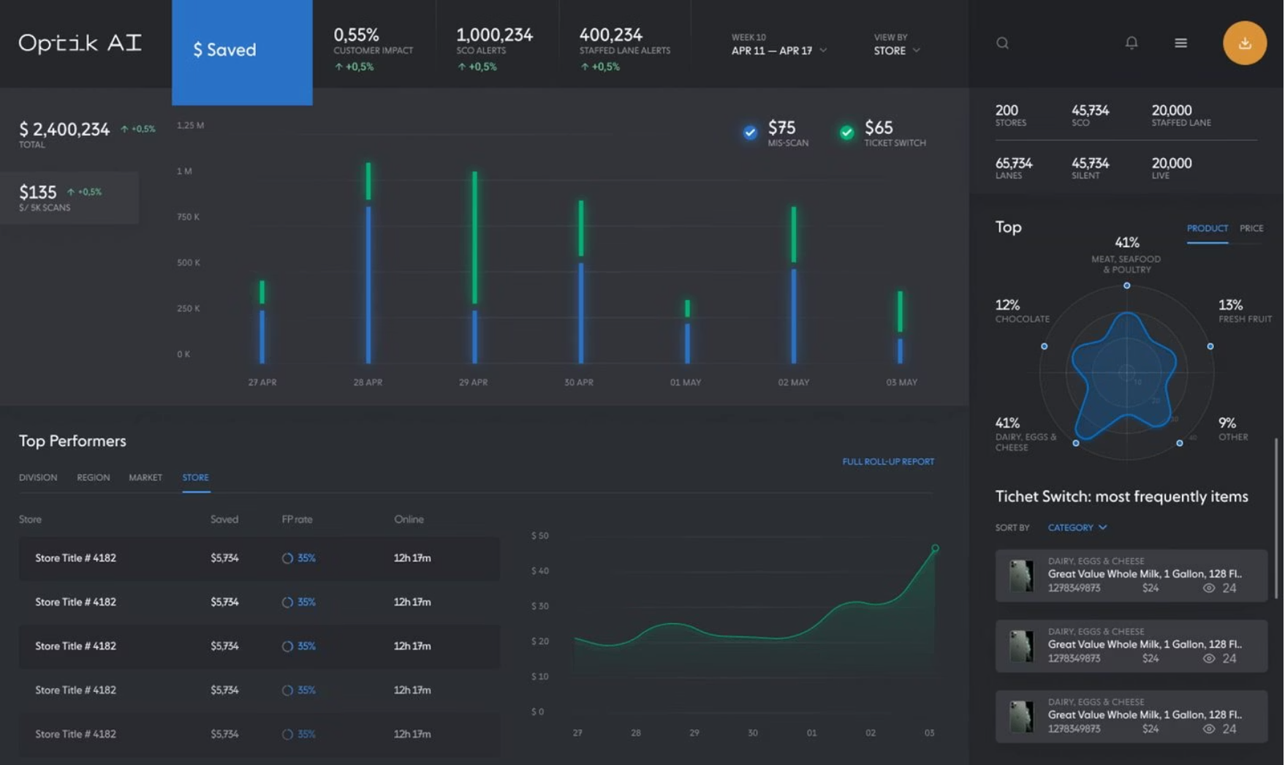
Key Features
Session-Based Processing
Isolated user sessions prevent data mixing and ensure privacy
Automatic Topic Detection
Embedding-based clustering identifies content themes without manual input
Extractive Summarization
Key sentences extracted to create concise topic overviews
Sentiment Classification
Positive, negative, or neutral emotional tone detection
Clean Keyword Extraction
TF-IDF algorithm identifies relevant terms while filtering noise

Slide 7
Challenges Encountered
Large Audio Files
Model Loading Time
Transcript Noise
Managing multi-hour podcasts required chunking strategy and memory optimization to prevent system overload during processing.
Whisper model initialization added significant startup latency, requiring careful resource management and caching strategies.
Raw Whisper output contained timestamp artifacts and formatting issues that required robust cleaning algorithms.
Session Management
Chunk Size Optimization
Preventing duplicate session mixing while maintaining user history required careful state management design.
Finding the right balance between processing speed and topic segmentation accuracy required extensive testing.

Slide 8





Future Enhancements
Faster Models
Upgrade to Whisper variants or DistilWhisper for reduced latency
Cloud Deployment
AWS/GCP infrastructure for scalability and reliability
Speaker Diarization
Identify different speakers in multi-person conversations
PDF Reports
Downloadable formatted reports with visualizations
Real-Time Processing
Live transcription for streaming audio content

Slide 9
Implementation Highlights
Project Structure
Modular Design
Each processing step implemented as independent module, enabling easy maintenance and feature addition.
podcast_project/
├── app.py
├── backend/
│ ├── main.py
│ ├── pipeline.py
│ ├── audio_convert.py
│ ├── audio_chunk.py
│ ├── transcribe_all.py
│ ├── clean_transcripts.py
│ ├── sentence_split.py
│ ├── topic_segmentation.py
│ ├── summarization.py
│ ├── sentiment_analysis.py
│ └── keyword_extraction.py
└── dataset/uploads/
Session-Based Storage
Unique session folders prevent data conflicts while maintaining processing history.
Clean Separation
Frontend and backend communicate through defined API endpoints.

Slide 10

Conclusion
PodIntel AI successfully demonstrates an end-to-end AI pipeline for podcast analysis, integrating speech recognition, natural language processing, and embedding-based topic segmentation into a clean, user-friendly web interface.
Modular
Scalable
Independent components enable easy updates and maintenance
Architecture supports cloud deployment and increased load
Production-Ready
Extensible
Robust error handling and session management
Ready for additional features and improvements

