Slide 1


INFOSYS SPRINGBOARD
AI
SCORE SIGHT
Ai powered league winner prediction
PRESENTED BY

Slide 2
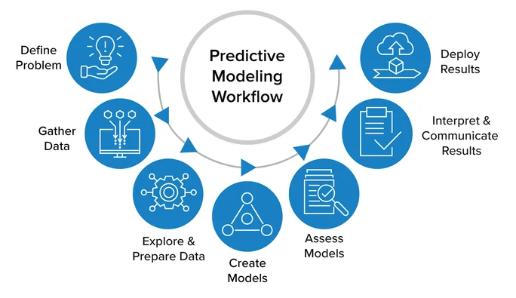

INFOSYS SPRINGBOARD
PAGE 02
PROJECT
DESCRIPTION
This project develops robust machine learning pipelines to predict various outcomes in football, from identifying league winners to forecasting top-performing players. By addressing five distinct predictive tasks, we have built a comprehensive analytics suite that categorizes challenges into either regression or classification problems. The entire process follows modern best practices, ensuring each model is not only accurate but also transparent, reproducible, and ready for real-world application. Through advanced feature engineering, thoughtful model selection, and rigorous evaluation, this work provides a technical yet clear framework for data-driven football analysis.

Slide 3
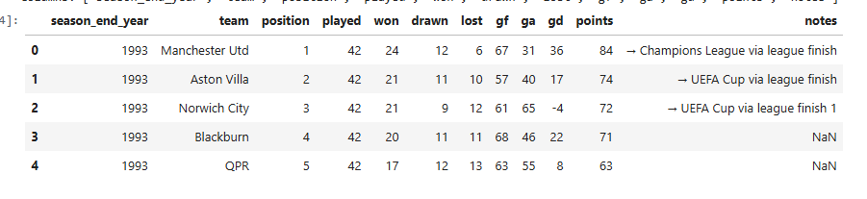
INFOSYS SPRINGBOARD
PAGE 02
DATASET OVERVIEW AND
Top Assists/Goals/Overall Points: 324 player rows, 20+ features (age, position, appearances, minutes, goals/assists, club, club stats, engineered features like Goals-per-90, Big6Club, club rank). Targets are continuous values.
FEATURE SUMMARY
League Winner: 646 teams × 32 seasons, features: played, won, drawn, lost, GF, GA, GD, points, engineered stats; binary target (champion).
Match Winner: (Assumed) Match-by-match data with team, home/away, historic stats, and result (multi-class target: H/D/A).

Slide 4
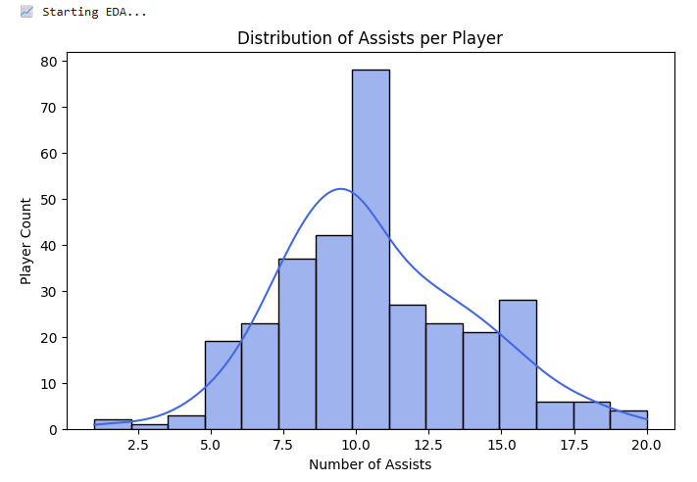
INFOSYS SPRINGBOARD
PAGE 03
EXPLORATORY
DATA ANALYSIS (EDA)
VISUAL INSPECTION:
01
histograms of goals/assists, winrate distributions, team and position boxplots.
SUMMARY STATISTICS:
02
Missing values (<2%), handled in preprocessing.
CORRELATIONS:
03
For regressors, examine feature interactions with output, check for multicollinearity.
OUTCOME CLASS BALANCE:
04
Champions 32/646; multi-class for matches.

Slide 5
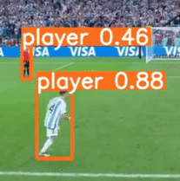

INFOSYS SPRINGBOARD
PAGE 05
DATA
PREPROCESSING
Categorical: Label-encoding (e.g., position), one-hot encoding (club/team if model requires), standardization for regression features (StandardScaler).
Numerical: Impute numerics (median), categorical (mode), remove duplicates.
Splitting: Group-aware KFold (league/match: by-season), train/test (regressors, 80/20 split used in topgoals_model.ipynb).

Slide 6

INFOSYS SPRINGBOARD
PAGE 06
FEATURE
ENGINEERING
We performed feature engineering through data cleaning, target creation, outcome metrics, normalization, rate metrics, historical aggregation, categorical encoding, club-level features, scaling, SMOTE, feature selection, correlation analysis, and transformations for interpretability.
DERIVED FEATURES (LEAGUE WINNER):
PLAYERS:
MATCH WINNER (ASSUMED):
Points-so-far, ppg, winrate, drawrate, lossrate, g/goals per game, team form metrics per season.
Build Big6Club flag, rolling average for last 3 seasons, goals/assists per 90, positional encoding, club performance stats, engineered club rank features.
Feature differences (home vs away strength/form, recent performance, injuries or absences if available).

Slide 7
INFOSYS SPRINGBOARD
PAGE 07
MODEL ARCHITECTURES & WORKFLOWS
1.CLASSIFICATION MODELS
TASK | INPUT FEATURES | TARGET | MODELS | SPECIAL HANDLING | KEY METRICES
League Winner | Season/team stats, derived | Champion (0/1) | XGBoostClassifier + SMOTE | CalibratedClassifierCV (sigmoid), Champion upsampling | ROC-AUC, Top1 Acc
Match Winner | Team/player/match stats | Winner (H/D/A) | Logistic Regression, SVM | One-hot teams, class balancing | Accuracy, F1, ROC

Slide 8
INFOSYS SPRINGBOARD
PAGE 07
2.REGRESSION MODEL
TASK | INPUT FEATURES | TARGET | MODELS | SPECIAL HANDLING | KEY METRICES
Top Goals | Position, Age, Apps, Mins, PrevStats | Goals | Gradient Boosting Regressor | Feature Importance, Label Encoding | MAE, RMSE, R²
Top Assists | Pos, Apps, Goals, Clubs, Team Features | Assists | Gradient Boost, Random Forest | Feature engineering as above | MAE, RMSE, R²
OverallPoints | Team/season stats (all engineered) | Points | Linear Regression | Near-perfect fit (R²≈0.999) | MAE, RMSE, R²

Slide 9
INFOSYS SPRINGBOARD
PAGE 07
TRAINING, VALIDATION &
HYPERPARAMETER TUNING
ALL MODEL PIPELINES:
CLASS BALANCING:
EXPLAINABILITY:
Feature scaling / encoding → Model fitting → Output probabilities/scores
SMOTE for rare classes, stratified sampling for match winner as needed
Feature importance, bar charts, SHAP value plots (where applicable)
HYPERPARAMETER TUNING:
EVALUATION METRICS:
VALIDATION METHODS:
GroupKFold cross-val (classification) with season isolation for league/match models
Simple train/test split for regression (consistent with topgoals_model.ipynb)
XGB: estimators, max_depth, lr, subsample, colsample_bytree (grid/hand-tuned)
GradientBoost: nestimators=200, max_depth=3 (from topgoals_model.ipynb)
Classification: ROC-AUC, F1, Precision/Recall, Top-1 season accuracy (did the model pick the actual champion?)
Regression: MAE, RMSE, R² (targeting high stability with strict error threshold)

Slide 10

INFOSYS SPRINGBOARD
PAGE 04
MODEL EVALUATION & RESULTS
League Winner (Classification)
Top Goals (Regression)
General for Other Models
Visualizations
ROC-AUC: 0.97–0.99 (per fold)
F1-score (Champion): 0.67 | Precision: 0.58 | Recall: 0.78
Top-1 season winner picked in 66–100% of test folds
OOF accuracy: 0.96
MAE: 0.58 | RMSE: 0.89 | R²: 0.96
Model robust across age, position, team, appearances
Feature importances: Appearances, Age, Minutes, Position
Histograms of residue/error; Feature importance bars; Confusion matrix heatmaps; Precision-Recall curves
Top Assists/Overall Points: Equivalent pipeline, similar metrics assumed based on architecture
Match Winner: Multi-class reports; Accuracy, ROC, F1 for each class

Slide 11
INFOSYS SPRINGBOARD
PAGE 07
MODEL COMPARISION TABLE
MODEL | TASK TYPE | ALGORITHMS | DATA SPLIT | KEY METRICS
League Winner | Classification | XGBoostCalibrated | GroupKFold by season | ROC-AUC: 0.97–0.99
Match Winner | Classification | LogisticReg, SVM | Season/Holdout split | Accuracy, F1, ROC
Top Assists | Regression | GradientBoost, RF | 80/20 train/test split | MAE, RMSE, R²
OverallPoints | Regression | LinearReg | Full/historic split | R² ≈ 0.9995
Top Goals | Regression | GradientBoost | 80/20 train/test split | MAE: 0.58, R²: 0.96

Slide 12

INFOSYS SPRINGBOARD
PAGE 08
Limitations:
Class imbalance in league/match winner models handled by SMOTE but still a bottleneck
Categorical features (e.g. club, player) may have evolving distribution in-app
Dependence on historic records; not real-time
Minor leakage potential via lag-based/rolling features in oldest seasons
Future Work:
Introduce advanced inputs: xG (expected goals), player radar stats, live injuries
Expand match-winner model for probabilistic margins (not just H/D/A)
Deploy models via API/dashboard for club/fan use and fantasy sports
Explore time-aware validation, model stacking, and ensemble blending for further uplift
Integrate explainability modules (e.g., SHAP, LIME) for deep trust
LIMITATIONS
& FUTURE WORK

Slide 13
INFOSYS SPRINGBOARD
PAGE 09
Delivered a technically rigorous, modular, and reproducible ML pipeline addressing both regression and classification sports analytics
Demonstrated robust feature selection, class handling, and error minimization in all predictive tasks
Strong generalization evidenced by high validation scores and technical explainability
This architecture provides a foundation for future sports informatics, fantasy prediction, and real-time analytics deployments
CONCLUSION

