Slide 1
Visualizing-US-Natural-Disaster-Declarations-Trends-and-Patterns

Slide 2
Dataset Overview
The Dataset Contains:
Tools Used:
Python (EDA & cleaning)
Power BI Desktop (visualization)
State and region
Disaster type
Incident dates
Request status
Assistance programs requested

Slide 3
Data Cleaning & Preparation
Steps Performed:
Checked missing values using EDA
Retained missing end dates as they represent ongoing or single-day disasters
Removed non-analytical ID columns
Ensured correct data types (date, numeric, categorical)
Colab Link:
https://colab.research.google.com/drive/1cJkzspuwOXlw9A1Cf9M6G8i6HY0pnJtf?usp=sharing

Slide 4
Data Modeling & Measures
Data Modeling
Centralized fact table for disaster declaration requests
Dimension attributes include State, Disaster Type, and Year
Relationships designed to support multi-dimensional analysis
Optimized data model for accurate aggregation and performance
DAX Measures
Developed multiple DAX measures to support dynamic analysis
Measures used for:
  Total and filtered disaster request counts
  State-wise and disaster-type-wise analysis
  Year-wise and trend-based insights
DAX measures enable:
  Consistent calculations across all visuals
  Interactive filtering using slicers
  Improved report scalability and performance

Slide 5
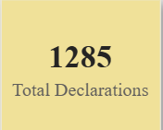


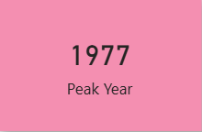
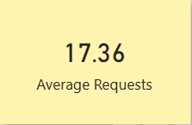
KPI(Key Performance Indicators) Summary
Explanation of KPI:
Total Disaster Declaration Requests
Overall count of disaster requests across all states
Most Affected State
State with the highest number of disaster declarations
Most Frequent Disaster Type
Disaster category with maximum occurrence
Peak Disaster Year
Year with the highest number of disaster requests
Average Requests per State
Average number of disaster declaration requests across states

Slide 6
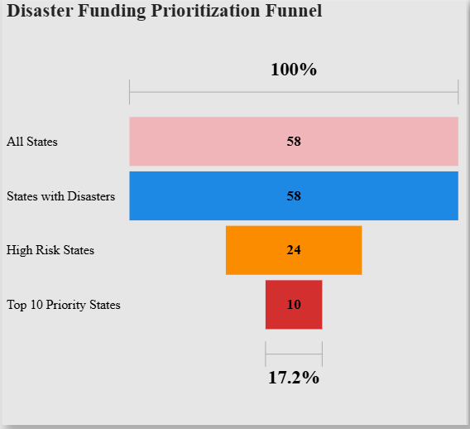
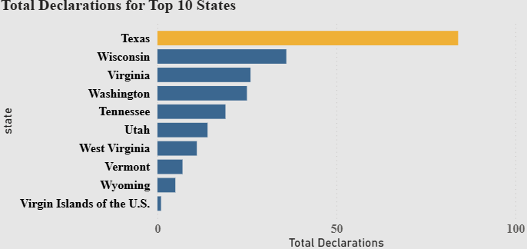
Visual Analysis
Charts Included:
Top 10 States by Total Declarations
Disaster Funding Prioritization Funnel
Total Declarations by State
Annual Disaster Declarations Trend (1953–2025)
Total Declarations by Decade
Top Disaster Types by Declaration Share
Key Visual Observations
Total disaster declarations recorded are 1285
Flood is shown as the top disaster type
Texas is identified as the top impact state
From the funnel analysis:
  58 states reported disasters
  24 states are categorized as high-risk
  10 states fall under top priority, representing 17.2%
The annual trend shows a peak of 123 declarations in the year 1977

Slide 7
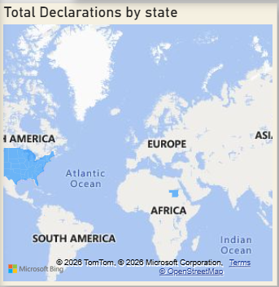
Geographic Analysis
Explanation:
Visuals Used
Total Declarations by State
Top 10 States by Total Declarations
Key Geographic Observations
Disaster declarations are unevenly distributed across states
Texas records the highest number of disaster declarations
A small group of states contributes a major share of total declarations
Several states show moderate to low declaration counts in comparison
Geographic visualization highlights state-level variation in disaster impact

Slide 8
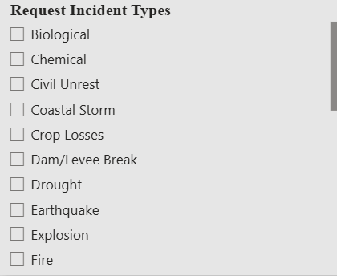
Interactivity – Filters (Slicers)
Filters Used
Request Incident Type slicer to filter disaster categories
Interactive filters allow selection of specific disaster types
All visuals update dynamically based on slicer selection
Impact of Interactivity
Enables focused analysis for individual disaster types
Supports state-wise and time-based exploration
Improves usability and clarity of the dashboard

Slide 9
Conclusion:
Content
A total of 1285 disaster declarations are recorded in the dataset
Flood emerges as the most frequent disaster type
Texas is identified as the most impacted state based on total declarations
Disaster declarations are concentrated in a limited number of states, as shown in state-wise and geographic analysis
Trend analysis highlights a peak of 123 declarations in 1977, with variations across years
Decade-wise analysis shows higher disaster activity during specific decades, especially the 1970s
The dashboard effectively supports data-driven disaster risk assessment and funding prioritization

