Slide 1
Future Cart: AI-Driven Demand Prediction for Smarter Retail
- Enhancing E-Commerce through Effective Demand Forecasting
Presented By: Team 3
Uday Sankar De
Sasi Kaladhar
Bharath Kumar

Slide 2
Introduction
In the e-commerce sector, accurate demand forecasting is crucial for business success. This presentation outlines the development of a demand forecasting model that leverages time series analysis and multivariate regression, using historical sales data and Google Analytics performance indicators.

Slide 3
Project Statement
1. Objective: To develop a demand forecasting model.
2.Focus: Predict future product demand using historical sales data.
3.Utilized KPIs: Google clicks and Facebook impressions, which indicate customer interest.

Slide 4
Expected Outcomes
1. Improved Inventory Management: Enhanced accuracy to reduce stock-outs and excess inventory.
2. Enhanced Marketing Efficiency: Identifying demand periods for optimized resource allocation.
3. Data-Driven Decision Making: Reliable forecasts for informed business decisions.
4.Accurate Demand Predictions: High accuracy levels to improve customer service.
5.Scalable Solution: Capable of managing large datasets and varying demand patterns.

Slide 5
Implementation Plan
Module 1: Data Collection - Understanding the problem statement and gathering relevant sales data.
Module 2: EDA and Data Preprocessing - Formatting data and handling missing values.
Module 3: Time Series Modeling - Exploring univariate models and optimizing parameters.
Module 4: Dynamic Multivariate Regression - Incorporating lagged values to influence future sales.

Slide 6
Methodology Overview
Time Series Analysis:
Time Series Analysis for Future Cart Demand Forecasting involves using historical data to predict future demand by identifying trends, seasonality, and patterns.
Key steps include data preprocessing to handle missing values and outliers, EDA with decomposition techniques, and stationarity checks like the Augmented Dickey-Fuller test.
Forecasting models range from ARIMA and SARIMA for seasonal trends to advanced machine learning models like XGBoost and LSTM for multivariate analysis. Performance is evaluated using metrics like MAE, RMSE, and MAPE.

Slide 7
Dynamic regression :
It is a forecasting method that combines time series and regression techniques to model relationships between a dependent variable and one or more independent predictors, including lagged values.
It captures both immediate and lagged effects of predictors, making it suitable for handling time-dependent interactions Incorporating multiple predictors to improve forecasts.
Model Evaluation Metrics:
Employing MAE, RMSE, and Adjusted R-squared for performance comparisons.

Slide 8
Results & Insights
1. Visualizations of Forecasts: Presentation of predicted vs. actual sales.
2. Key Takeaways: Identification of optimal marketing strategies based on demand insights.
3. Business Implications: Recommendations for resource allocation and pricing adjustments.

Slide 9
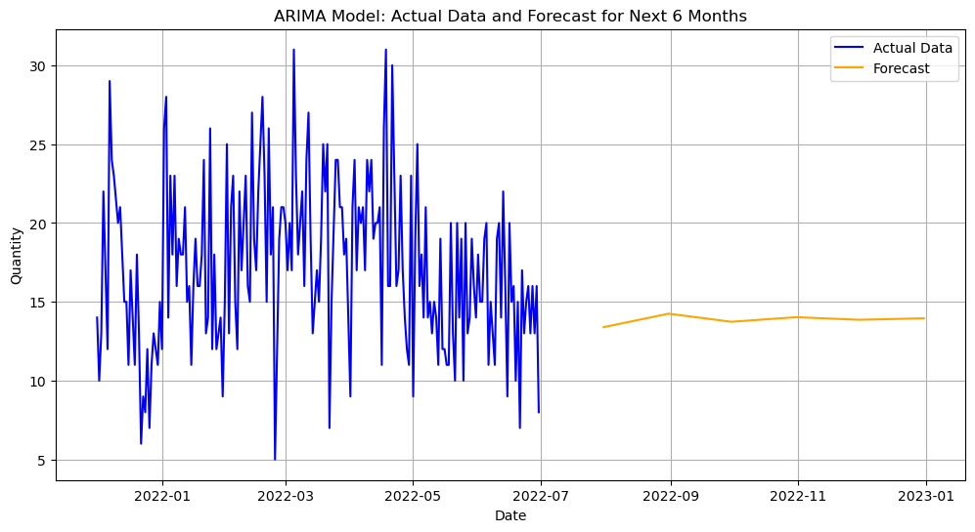
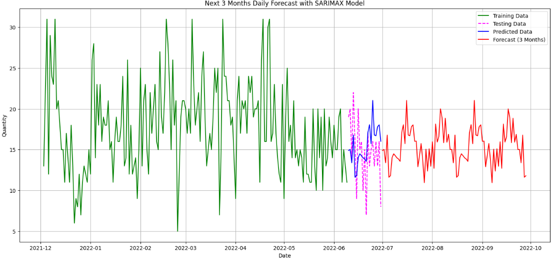

Slide 10
SARIMAX Model Forecast for demand Prediction
Key Insights:
The SARIMAX model was used to forecast the Quantity for the next 3 months based on historical data.
The green line represents the actual observed data, which shows significant fluctuations and volatility.
The red line represents the forecasted values, indicating stabilization of future demand with reduced variability.
This forecast provides insights into expected trends and can assist in:
Inventory Management: Ensuring sufficient stock levels.
Operational Planning: Preparing for stable demand.
Marketing Efficiency: Targeting campaigns to optimize sales.

Slide 11
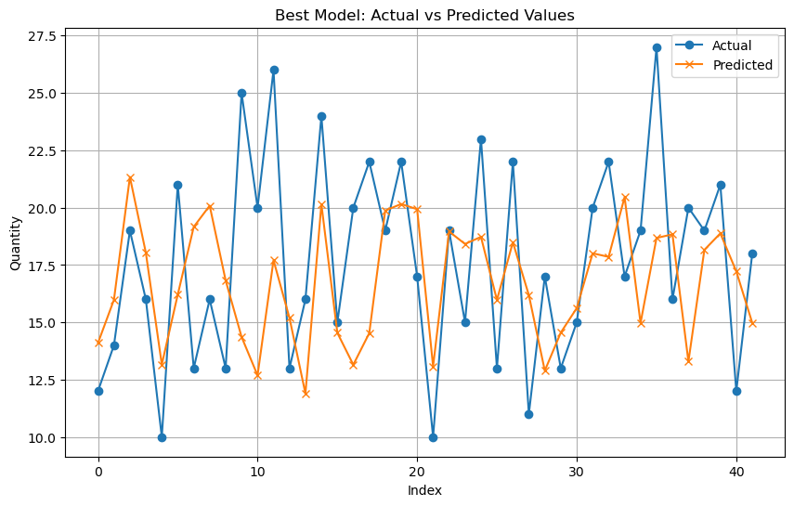

Slide 12
Best Model: Actual vs Predicted Values
This slide visualizes and compares the performance of our best model in predicting actual values.
The line chart shows the comparison between the actual values (blue line) and the predicted values (orange line) generated by our best model.
The x-axis likely represents the time period or some other independent variable, while the y-axis represents the quantity or target variable.

Slide 13
Conclusion
Here , by using the SARIMAX model I have forecasted the next six months data. Here in the above plot we can observe the forecasted sales plot.
The red line represents the SARIMAX model's forecast for the next three months. This projection is based on historical patterns and trends observed in the input data.
The x-axis is formatted to show calendar months, making it easy to interpret the temporal progression of both the historical data and the forecast.

Slide 14
The y-axis represents the predicted values of Quantity. The red forecast line allows stakeholders to understand expected changes or trends over the forecast period.
The forecast highlights potential growth, decline, or stability in Quantity over the next three months, enabling data-driven decision-making and planning. Any sharp increases or decreases in the forecast can signal significant shifts in underlying factors.

Slide 15
Thank You!

