Slide 1
FUTURECART - AI DRIVEN DEMAND PREDICTION
Presented By: Arava Jagadeeswari

Slide 2




CONTENTS
Introduction Problem Statement Objectives Methodology
Time series modeling Visualisation Forecast Conclusion

Slide 3



INTRODUCTION
Retail businesses face significant challenges in accurately forecasting demand due to rapidly changing market conditions, evolving consumer preferences, and external factors like economic shifts and seasonal trends.
By integrating advanced machine learning models, businesses can make smarter, data-driven decisions to optimize inventory, reduce costs, and align marketing strategies with anticipated demand.

Slide 4

PROBLEM STATEMENT
In the E-commerce industry, accurately forecasting product demand is crucial for optimizing inventory, minimizing costs, and maximizing sales. However, traditional forecasting approaches often fail to account for dynamic factors such as online customer behavior and marketing performance.
This project addresses the challenge of developing a robust demand forecasting model that integrates historical sales data with Google Analytics KPIs, such as Google clicks and Facebook impressions, to predict future product demand effectively

Slide 5





OBJECTIVES
1
2
3
4
Develop a robust demand forecasting model: Integrate historical sales data with Google Analytics KPIs.
Improve forecasting accuracy:
Enable better inventory management and marketing decisions.
Enhanced Decision- Making:
Enable data-driven strategies for improved retail efficiency.
Optimize resource allocation:
Reduce costs and maximize sales through more accurate demand predictions.

Slide 6



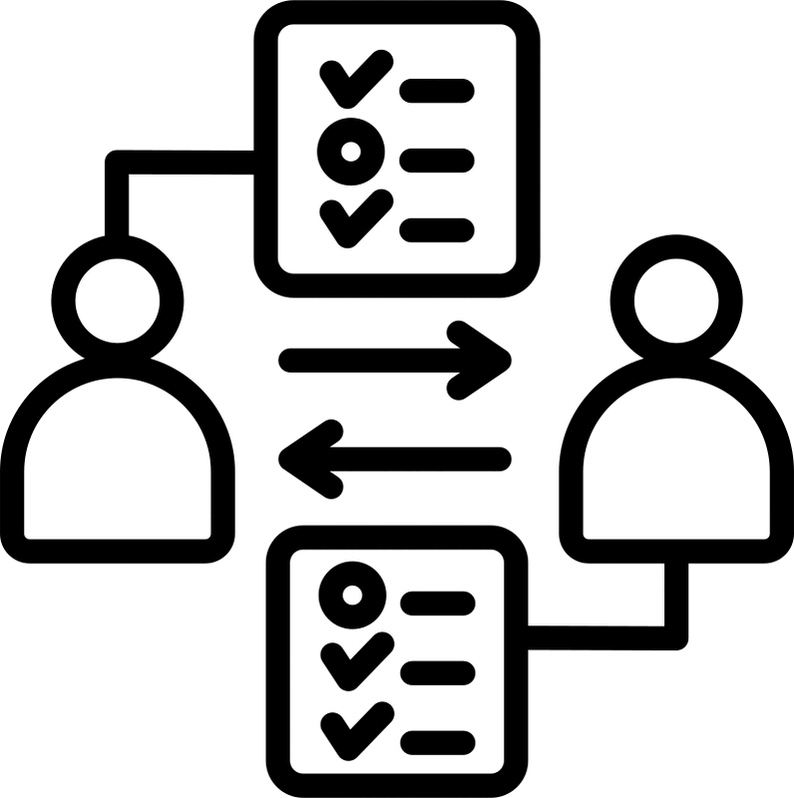
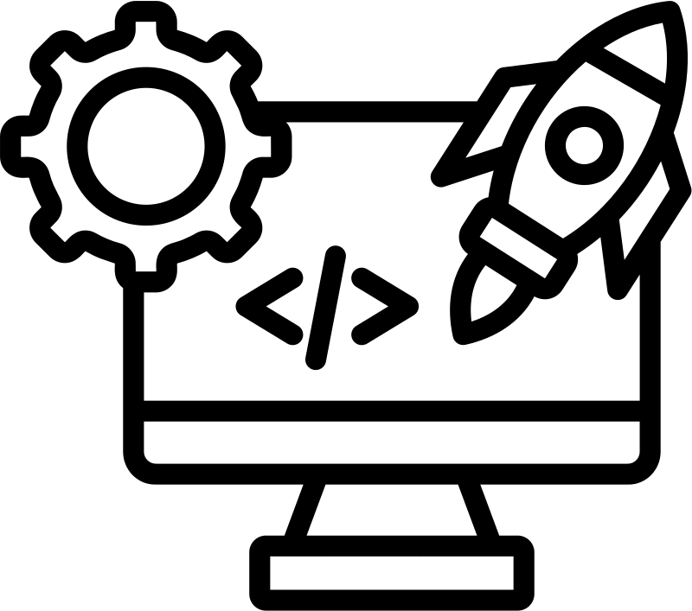
Data Collection and Preparation: Gather historical sales data, Google Analytics KPIs, and relevant market data.
Model Selection and Training:
Employ advanced machine learning algorithms, such as ARIMA to train a predictive model.
Model Evaluation and Optimization:
Assess model performance using metrics like accuracy, precision ,and refine the model based on the results.
Deployment and Monitoring:
Integrate the model into existing systems and continuously monitor its performance to ensure accuracy and adjust as needed.
METHODOLOGY

Slide 7

TIME SERIES MODELLING
AR (Autoregressive): Predicts future values using past values.
MA (Moving Average): Models the error of the past predictions.
ARIMA (AR + Integrated + MA): Combines AR and MA with differencing to make data stationary.
SARIMA (Seasonal ARIMA): Extends ARIMA to support seasonality.
ARIMAX (ARIMA with Exogenous Variables): Incorporates external variables like clicks and impressions.
SARIMAX (Seasonal ARIMAX): Combines SARIMA with exogenous variables.

Slide 8

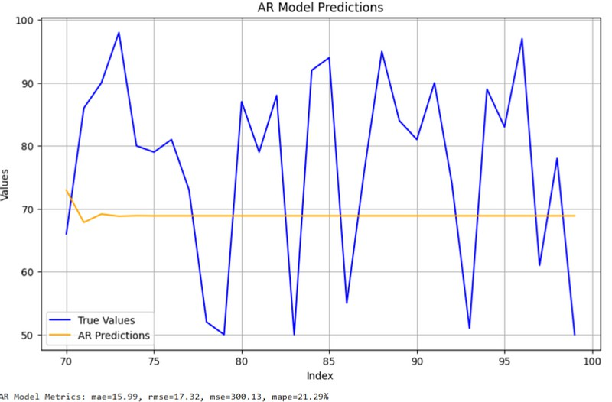
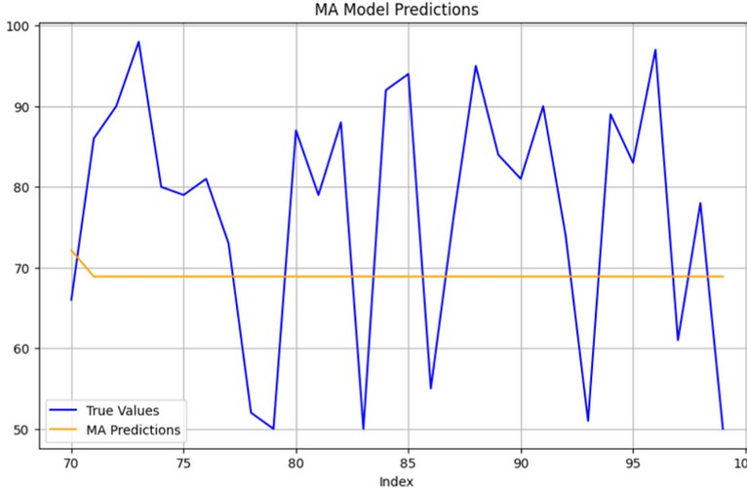
AR & MA MODELS

Slide 9

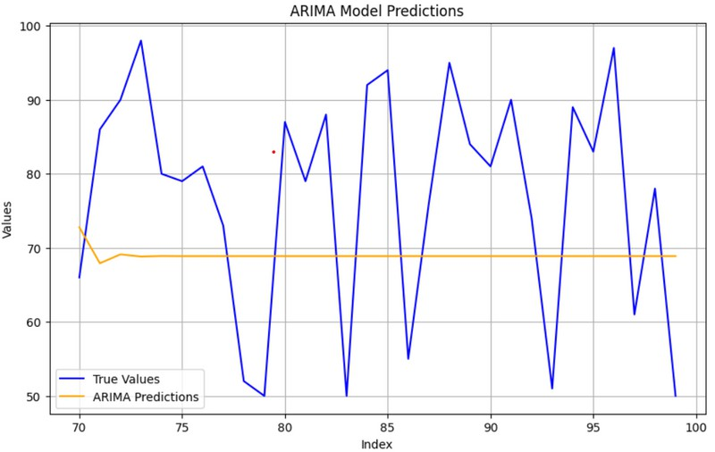
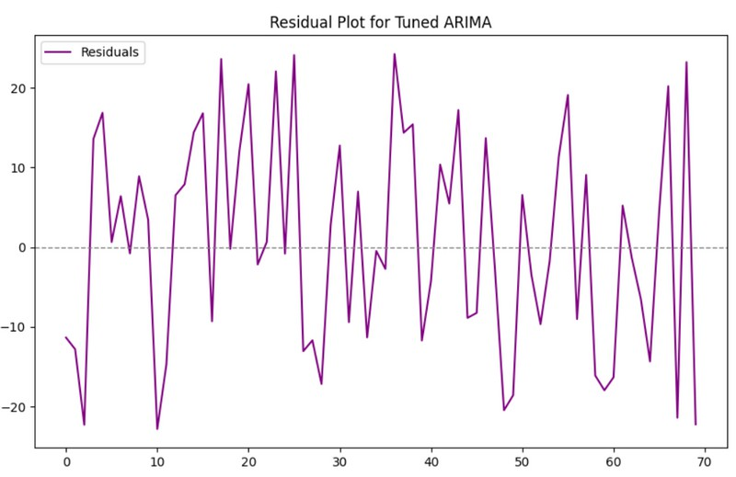
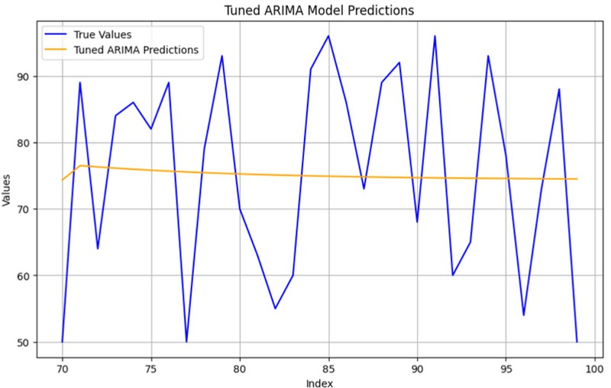
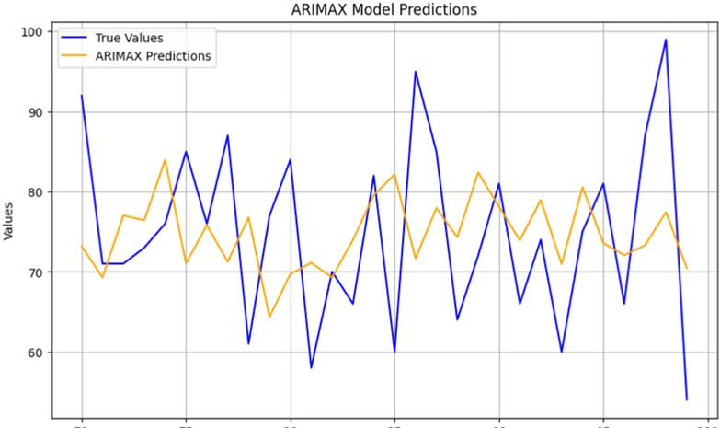
ARIMA & ARIMAX

Slide 10
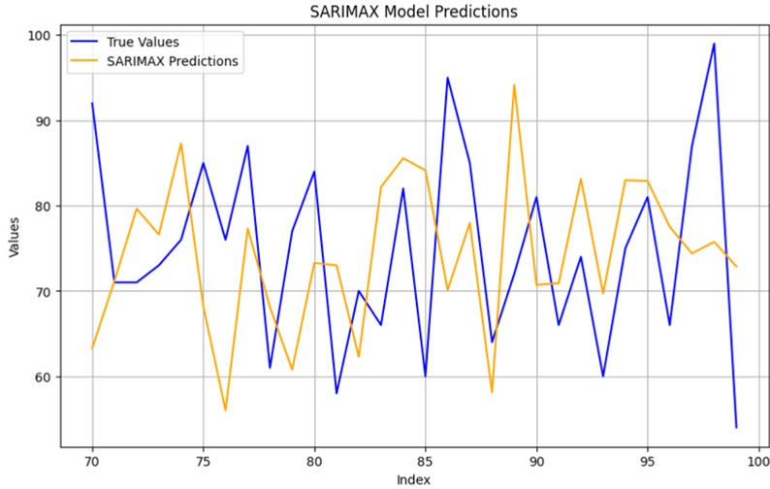
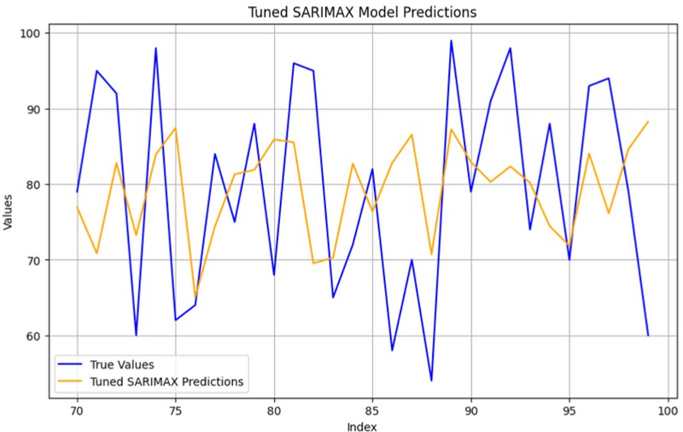
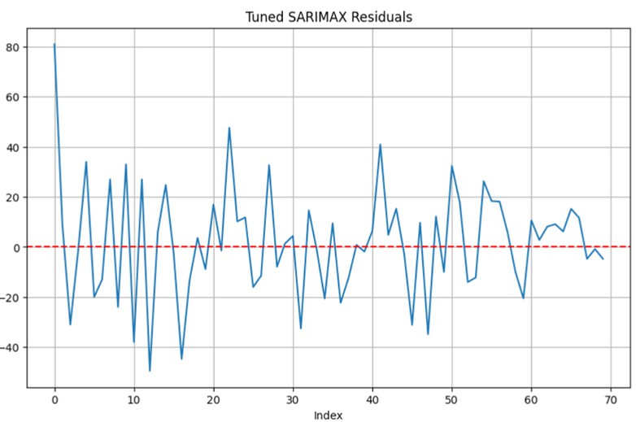
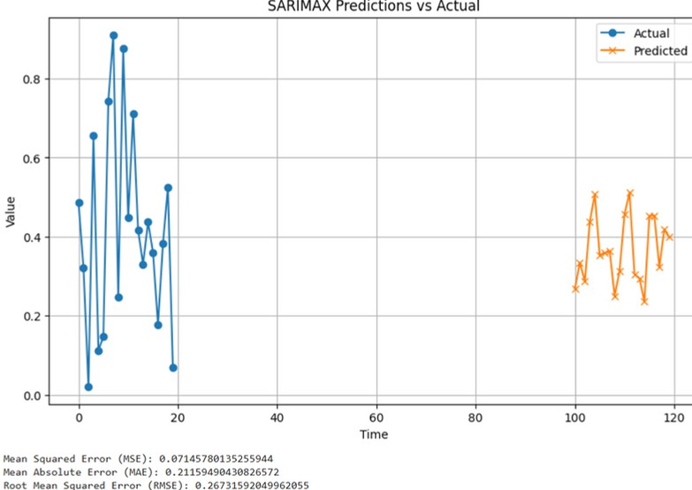
SARIMAX

Slide 11

MODEL EVALUATION
Evaluation Metrics After Hyperparameter Tuning
 | Model MAE RMSE | MSE | MAPE
0 | AR 13.682303 15.842102 | 250.972190 | 17.900313
1 | MA 13.755215 15.892283 | 252.564645 | 17.995794
2 ARIMA | 13.066995 | 14.803777 | 219.151801 | 18.274050
3 SARIMA | 11.257081 | 14.560693 | 212.013768 | 15.357851
4 ARIMAX | 12.967085 | 14.759570 | 217.844918 | 17.913413
5 SARIMAX | 15.053653 | 18.301928 | 334.960584 | 21.807880

Slide 12

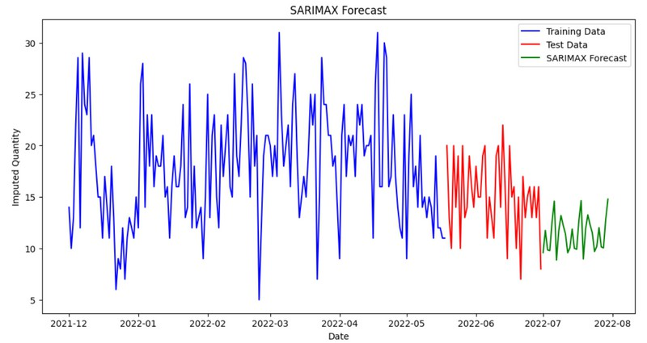
FUTURE FORECAST

Slide 13

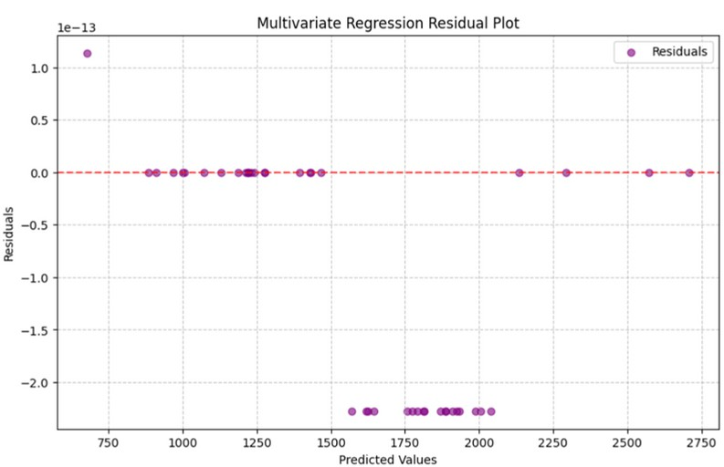
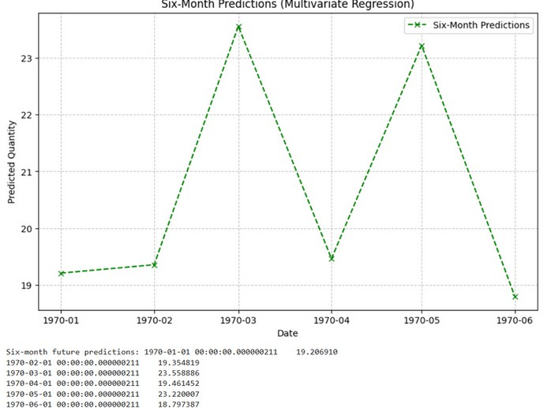
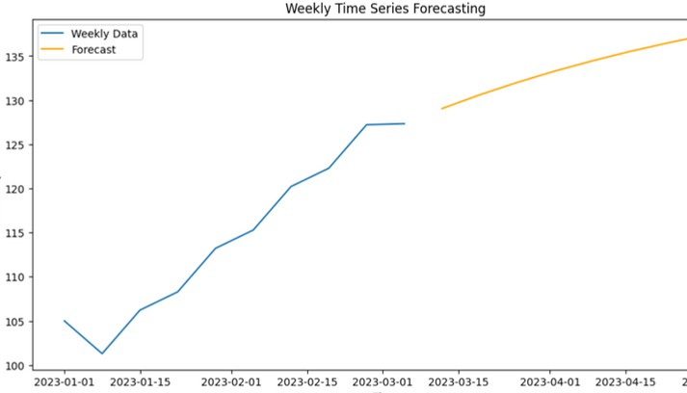
MULTIVARIAT & WEEKLY FORECAST

Slide 14




CONCLUSION
Time series analysis helped us understand the patterns and trends in the data, providing valuable insights for future forecasting.
By using models like SARIMAX, we were able to account for seasonality, trends, and external factors, improving the accuracy of our predictions.
Forecasting plays a critical role in decision-making, as it helps anticipate future values and prepare for changes in demand or behavior.
This analysis can be applied to optimize strategies, resource allocation, and planning, ensuring more informed and effective business decisions.

Slide 15


THANK YOU

