Slide 1
AI-Driven Demand Prediction for Smarter Retail
Nitin Manohar Mishra

Slide 2
INTRODUCTION TO THE PROJECT
In the ever-evolving retail environment, anticipating demand is crucial for success. Traditional forecasting methods often fall short in identifying the intricate patterns shaped by online interactions and seasonal fluctuations.
This project leverages AI-driven time series analysis and multivariate regression to predict product demand. By integrating historical sales data with online activity metrics such as clicks and impressions, it aims to help businesses optimize inventory planning, refine marketing strategies, and enhance customer experiences.

Slide 3
PROBLEM STATEMENT
In the dynamic landscape of e-commerce, accurate demand forecasting is critical for success. Retail businesses often struggle with managing inventory, optimizing marketing strategies, and meeting customer demands due to unpredictable sales patterns and external influences.
This project focuses on developing an AI-driven demand forecasting model leveraging historical sales data and key external metrics (e.g., Google clicks, Facebook impressions).
The goal is to improve inventory management, enhance marketing efficiency, and support data-driven decision-making to meet customer expectations effectively.

Slide 4
OBJECTIVES
TARGETED CAMPAIGN PLANNING
INSIGHTFUL BUSINESS DECISIONS
OPTIMIZED INVENTORY CONTROL
SMARTER INSIGHTS
Leverage demand patterns to craft impactful marketing strategies during peak periods.
Drive confident and informed decision-making through data-backed predictions and analysis.
Utilize AI models to accurately forecast demand trends using past sales and digital engagement data.
Use AI models to accurately forecast demand trends using past sales and digital engagement data.

Slide 5
METHODOLOGY
01
02
03
04
DATA PRE PROCESSING
DATASET MERGING
Clean and prepare the data for analysis by handling missing values and transforming features.
Combine multiple datasets into a single comprehensive dataset for further analysis.
DATA ANALYSIS AND VISUALIZATION
TIME SERIES ANALYSIS
You can describe the topic of the section here
Apply statistical methods to understand patterns in time-dependent data and make predictions.

Slide 6
DATA SOURCES AND OVERVIEW
Data Description | The dataset includes historical sales data (target: Quantity) and external factors like Clicks and Impressions from Google Analytics and social media.
Data Structure | Quantity (sales data) is the Target Variable, while Clicks and Impressions are Exogenous Variables influencing product demand.
Data Quality | Challenges included handling missing values and data cleaning.

Slide 7
Introduction
Mercury is the closest planet to the Sun and the smallest one in the entire Solar System. This planet’s name has nothing to do with the liquid metal, since Mercury was named after the Roman messenger god. Despite being closer to the Sun than Venus, its temperatures aren’t as terribly hot as that planet’s. Its surface is quite similar to that of Earth's Moon, which means there are a lot of craters and plains
Speaking of craters, many of them were named after artists or authors who made significant contributions to their respective fields. Mercury takes a little more than 58 days to complete its rotation, so try to imagine how long days must be there! Since the temperatures are so extreme, albeit not as extreme as on Venus, and the solar radiation is so high, Mercury has been deemed to be non-habitable for humans

Slide 8
01
DATA PRE PROCESSING

Slide 9
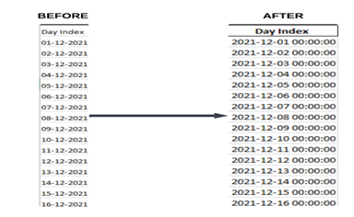
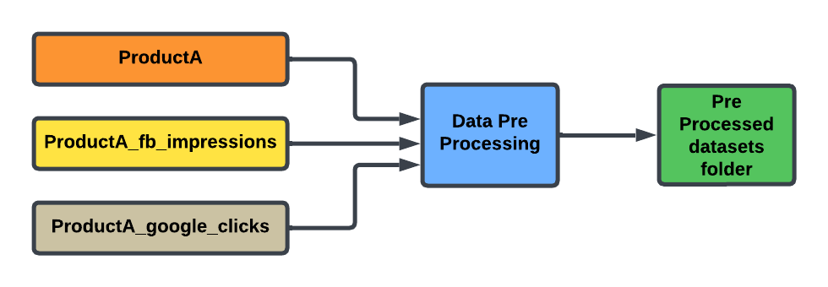
DATA PRE PROCESSING
STEP 1: Convert the 'Day Index' column to a proper datetime format
Converting the 'Day Index' column to a proper datetime format ensures consistency, accuracy, and compatibility with date-based operations. It allows for easier analysis, time-based aggregations, and smooth data merging or filtering, while preventing errors or mismatches due to incorrect date formats
STEP 2: Remove duplicate rows There were no duplicate rows in the dataset, so this step was not necessary.
STEP 3: Fill any missing values using forward fill
There were no missing values in the dataset, so this step was not needed.
FINAL STEP: Output Data
Cleaned datasets are saved into the pre_processed_datasets folder, ready for merging.

Slide 10
02
DATA SET MERGING

Slide 11
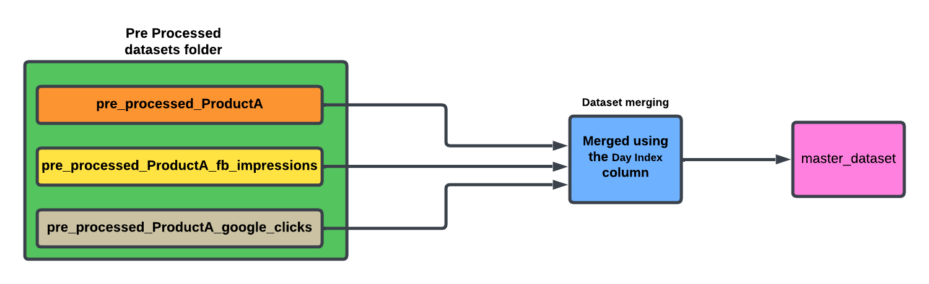
DATASET MERGING
The process involves loading preprocessed datasets from the pre_processed_datasets folder, merging them based on the common column Day Index, and saving the final merged dataset to the master_dataset folder.

Slide 12
03
EXPLORATORY DATA ANALYSIS

Slide 13
EXPLORATORY DATA ANALYSIS
This code is important in understanding the Master Dataset, turning raw data into actionable insights. Trends, correlations, and the most important metrics to decide on are unveiled from it.
Purpose of the Code is as follows :
Data Cleaning: Handling missing values and infinities to ensure calculations and visualizations are accurate and dependable.
Visualizations: Plotting and charting of relationships, growth patterns, and trends in an understandable format.
Feature Engineering: Adds columns to a dataset to capture more hidden insights, which supports time-series modeling, regression, and forecasting, and reveals seasonality.
Key Takeaways: The code allows analyzing and visualizing performance metrics, tracking trends over time, and identifying factors impacting sales. This step is pivotal in the process of making data actionable and supports more effective demand prediction and business planning.

Slide 14

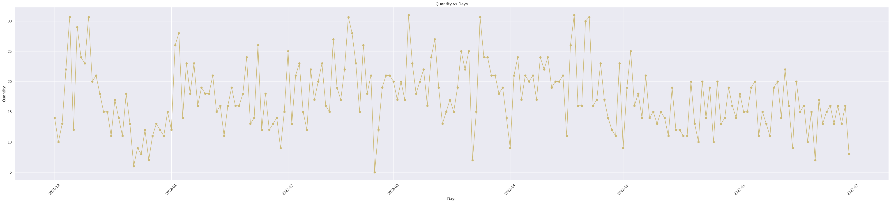
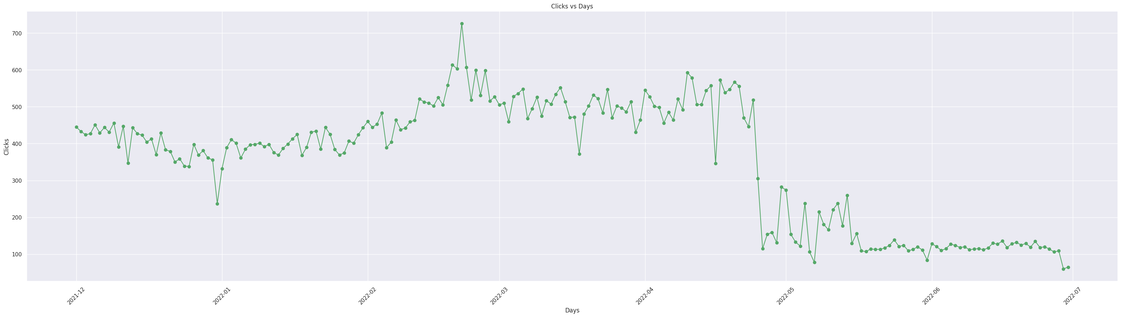
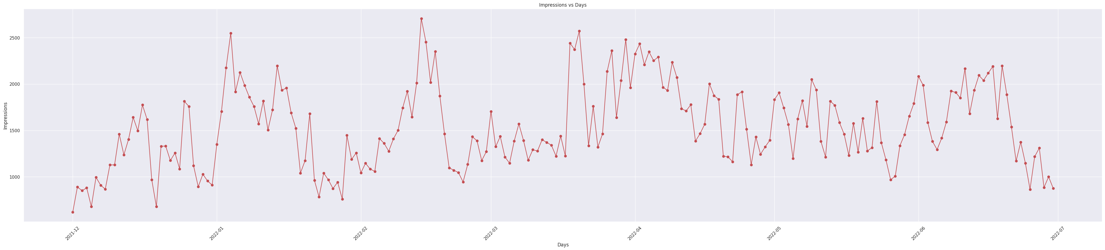

Slide 15
04
TIME SERIES ANALYSIS

Slide 16
TIME SERIES ANALYSIS
1. Auto Regressive: Predicts future values based on a linear combination of its past values. Captures temporal dependencies in the dataset, focusing on lagged relationships.
2. Moving Average: Models the error terms (residuals) from past predictions rather than the actual values. Useful for smoothing short-term fluctuations and identifying trends.
3. ARIMA(Autoregressive Integrated Moving Average):Combines AR and MA techniques, adding a differencing step to handle non-stationary data. Ideal for datasets with trends but no significant seasonality.
4. SARIMA (Seasonal ARIMA): Extends ARIMA by incorporating seasonal components to address repeating patterns over fixed intervals. Suitable for data with clear seasonal variations, such as monthly or quarterly sales.
5. ARIMAX (ARIMA with Exogenous Variables):Enhances ARIMA by including external predictors (e.g., clicks, impressions) to improve accuracy. Allows the model to account for external factors influencing the target variable.
6. SARIMAX (Seasonal ARIMA with Exogenous Variables):Combines the seasonal capabilities of SARIMA with the flexibility of external inputs.
Provides a holistic approach for forecasting when external variables and seasonality are critical.

Slide 17
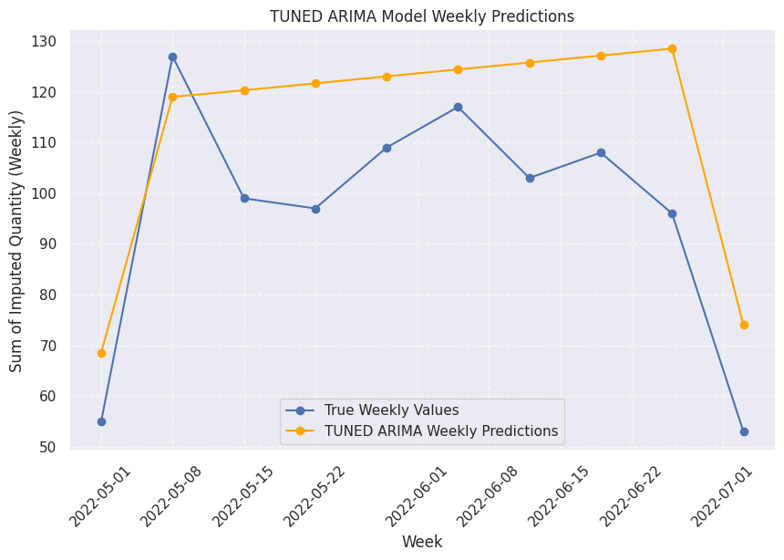
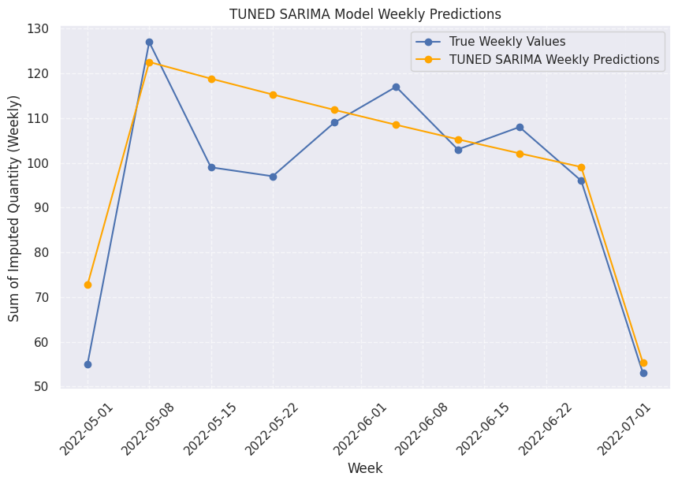
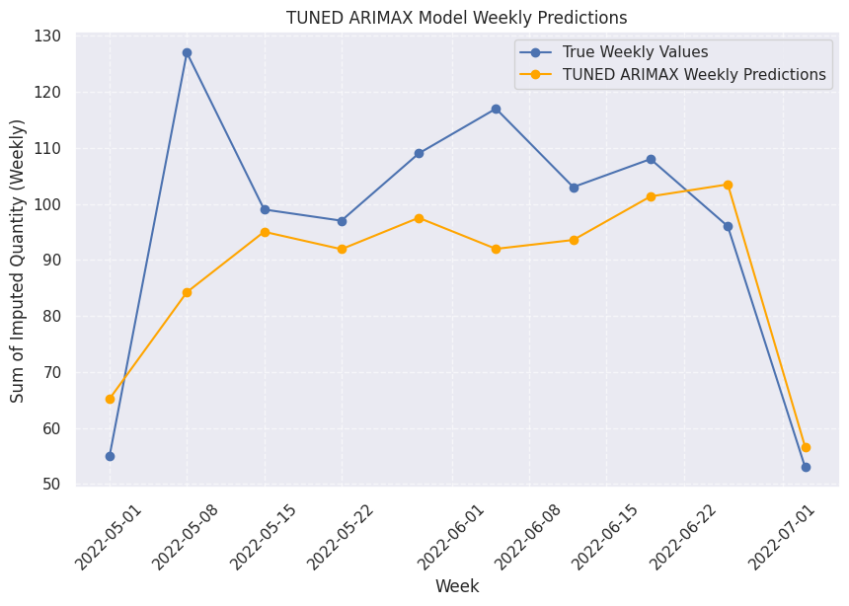
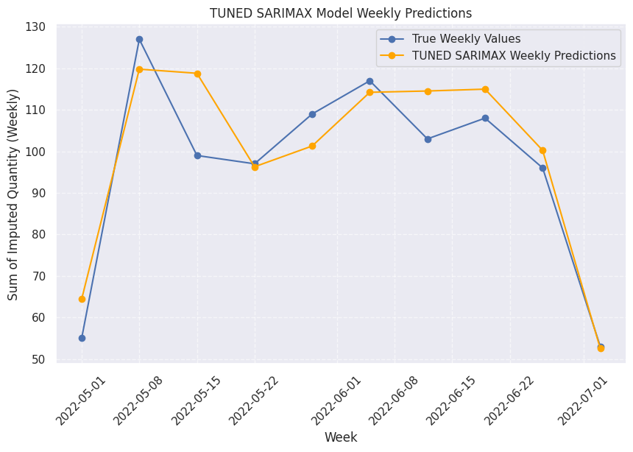

Slide 18
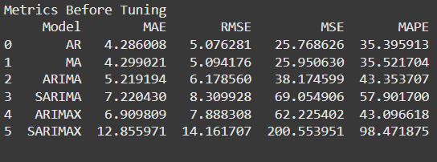
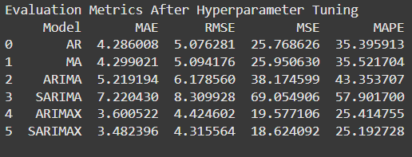
EVALUATION METRICES

Slide 19
INSIGHTS AND CONCLUSION
After evaluating all the models, the SARIMAX model emerged as the most suitable choice for this project:
Seasonality Capture: It effectively captures seasonality, essential for predicting recurring demand patterns.
Incorporation of Exogenous Variables: It integrates key external factors like Clicks and Impressions, which influence the target variable (Quantity).
Superior Accuracy: Compared to simpler models (AR, MA), SARIMAX consistently showed higher accuracy and a more comprehensive data understanding.
Conclusion: SARIMAX meets the project’s forecasting needs, making it the recommended approach for reliable time series analysis and demand prediction.

Slide 20
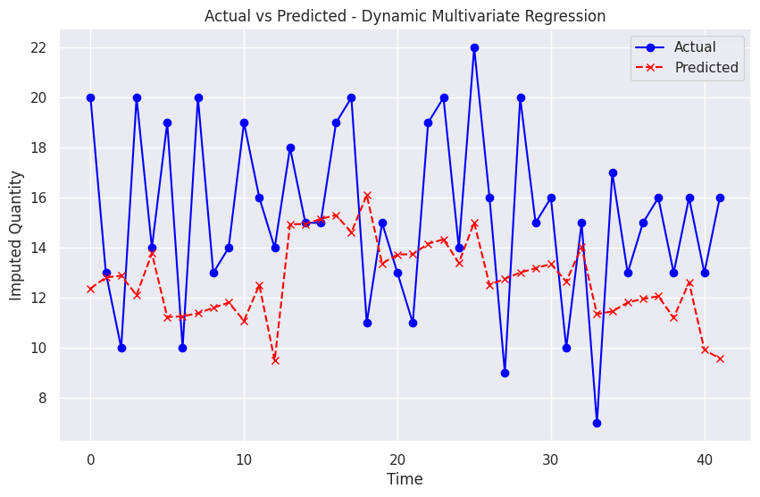
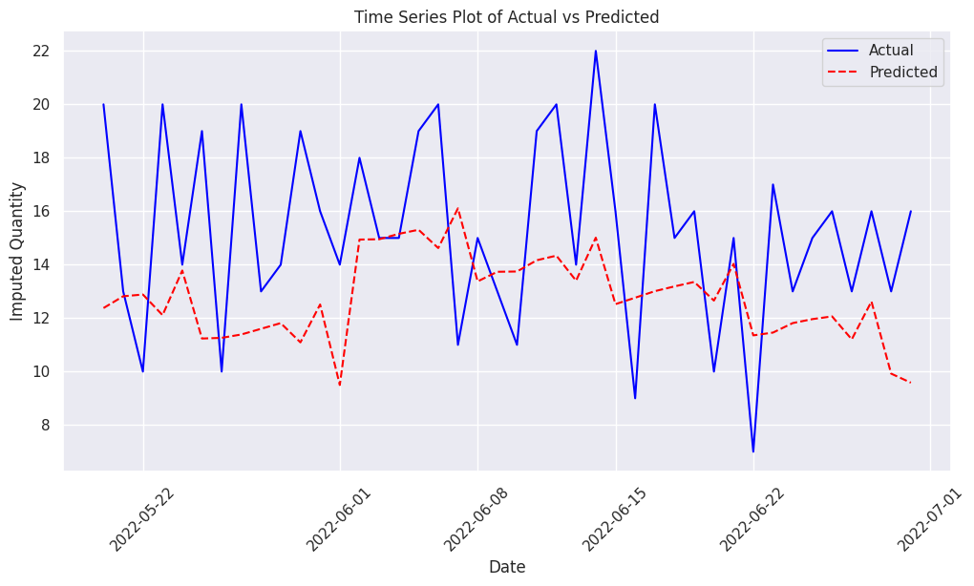
Final Step: Splitting Data and Running Multivariate Regression with Visualization
Hyperparameter Tuning: The multivariate regression model's hyperparameters were fine-tuned using GridSearchCV to optimize parameters such as fit_intercept and copy_X. After testing multiple configurations, the best model was identified with parameters {'copy_X': True, 'fit_intercept': True}. The evaluation metrics showed an RMSE of 30.13 and an R-squared value of 0.17.
Nate Silver
The multivariate regression model was used to predict the daily values based on the parameters that were tuned. Key Insight: The model captures the day-to-day fluctuations but fails to capture extreme spikes, and thus the predicted value differs slightly from the actual value.
Residuals were obtained by subtracting the predicted values from actual values and plotted to measure the accuracy of the model. The findings revealed minimal systematic errors and no large biases, thereby showing robustness of the model.

Slide 21
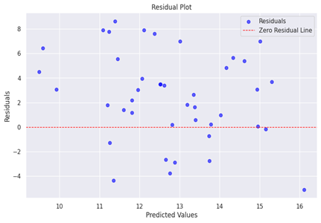
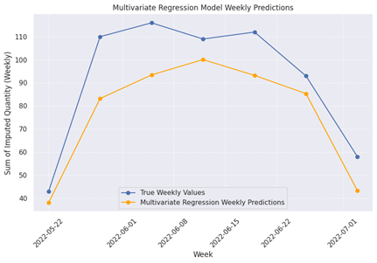
Final Step (Continued)
The residuals plot was used to check for randomness between actual and predicted values.
Key Insight: Residuals show minor biases, but no significant outliers, suggesting that the model largely captures patterns.
The model was used to generate predictions for the next six months based on simulated future values of exogenous variables (Clicks and Impressions).
Key Insight: The model forecasts a significant increase in the predicted quantity during the initial months, followed by a stabilization.

Slide 22
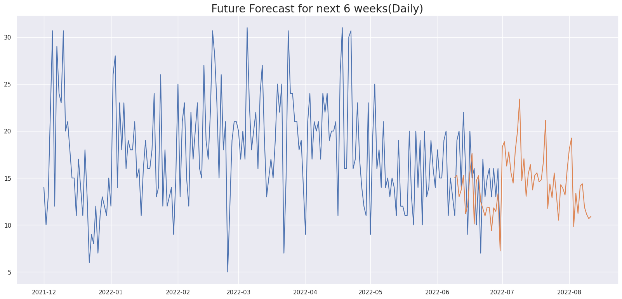
FORECASTING(SARIMAX MODEL)

Slide 23
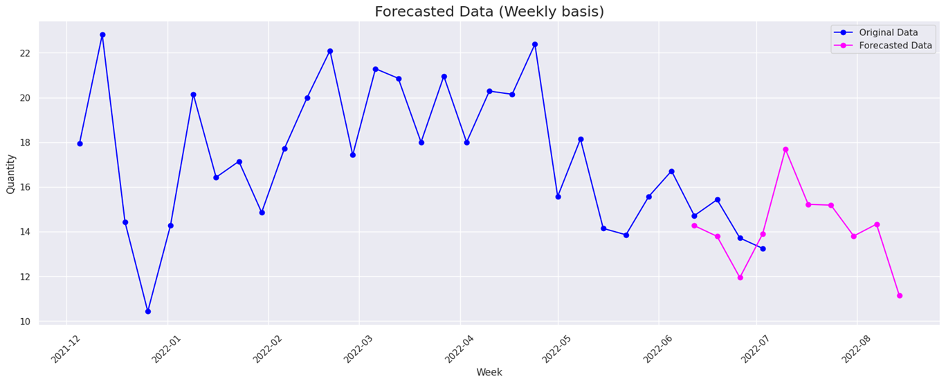
FORECASTING(SARIMAX MODEL)

Slide 24

Thanks!
Do you have any questions?

