Slide 1
AI-Based Insider Threat Detection & Behavioral Risk Analysis System
Flask + Machine Learning + SQLite Security Operations Dashboard
PROJECT PRESENTATION
End-to-end workflow: employee behavior → ML prediction → risk assessment → security dashboard
1

Slide 2
1. Problem Statement
The Problem
Why Automation?
Project Goal
Insider threats can arise from abnormal employee behavior such as unusual logins, removable-media activity, file copying, email activity and web usage.
Manual monitoring is difficult when many behavioral events must be considered together. A machine-learning system can provide consistent first-level risk assessment.
Build a web-based security tool that predicts threat status and combines ML output with behavioral risk to highlight employees needing attention.
Identify potentially abnormal employee behavior.
Generate NORMAL / THREAT predictions using Random Forest.
Calculate ML risk and behavioral risk separately.
Produce an overall risk level and analyst-facing action.
Support both individual analysis and bulk CSV analysis.
2

Slide 3
2. Objectives & Key Features
Secure Access
Employee Management
ML Prediction
Login-protected Flask application for security analysts.
Create, view and manage employee behavioral profiles.
Random Forest classifies behavior as NORMAL or THREAT.
Risk Assessment
Bulk CSV Analysis
Reporting
ML risk + behavioral score → overall security risk.
Upload multiple employee records and analyze them together.
Store and review prediction history, risk levels and model results.
3

Slide 4
3. End-to-End System Architecture
Employee Data
Preprocessing
Random Forest
Risk Engine
Flask Dashboard
CSV / web form
behavioral features
validation + feature
preparation
ML prediction +
probability
ML risk + behavioral
score + overall risk
alerts, reports,
bulk results
SQLite / SQLAlchemy Database
Users • Employees • Predictions • Risk Indicators
4

Slide 5
4. Behavioral Data & Machine Learning
Behavioral Features
Random Forest Output
Login / logoff activity
Night and weekend login ratios
PC switching frequency
USB connect / disconnect activity
File-copy activity
Email and external-email activity
Website and domain activity
Personality-related features (O, C, E, A, N)
The trained Random Forest produces:
• predicted class: NORMAL or THREAT
• threat probability
• normal probability
Risk Interpretation
ML probability is converted into ML risk. Behavioral indicators contribute an independent score. These are combined to produce LOW, MEDIUM, HIGH or CRITICAL overall risk.
5

Slide 6
5. Risk Assessment Logic
ML PREDICTION
THREAT PROBABILITY
BEHAVIORAL SCORE
OVERALL RISK
NORMAL / THREAT
e.g. 31.8%
0–100
LOW → CRITICAL
Important Design Decision
ML prediction and overall risk are intentionally separate. An employee may be classified as NORMAL by the classifier but still receive a HIGH/CRITICAL overall risk when behavioral indicators are severe. This lets the system distinguish classifier output from broader security risk assessment.
6

Slide 7
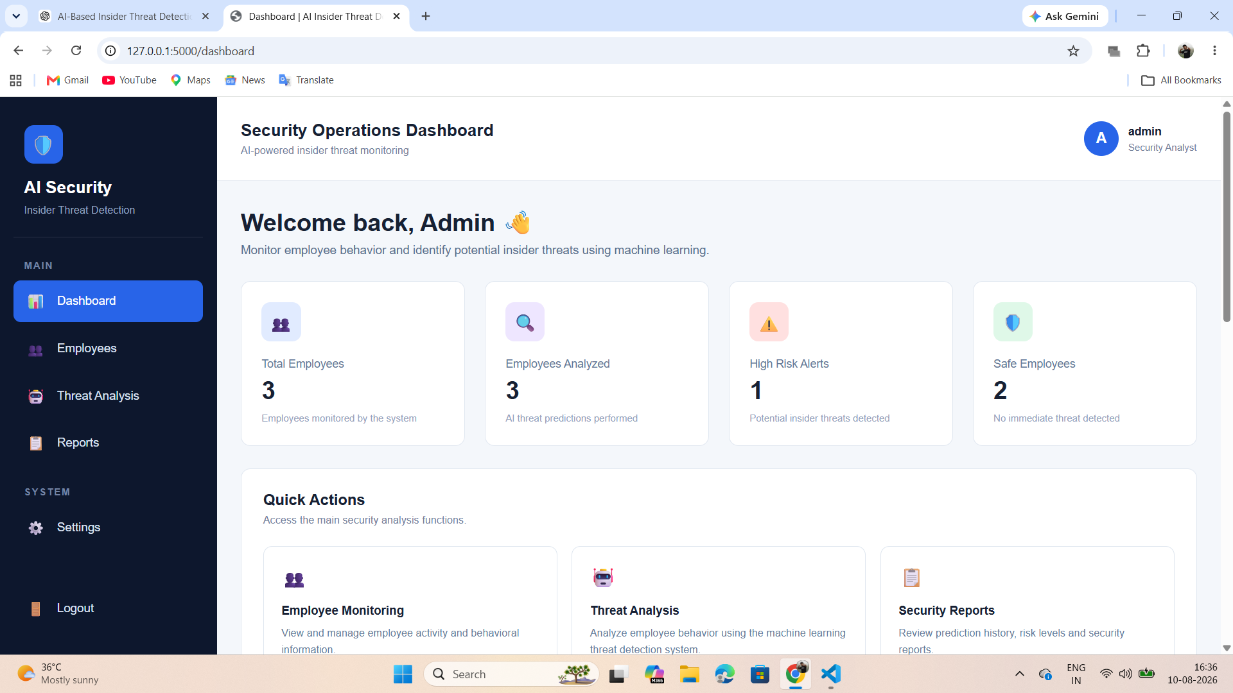
6. Web Application — Security Operations Dashboard
Central view for monitoring employees and security risk.
7

Slide 8
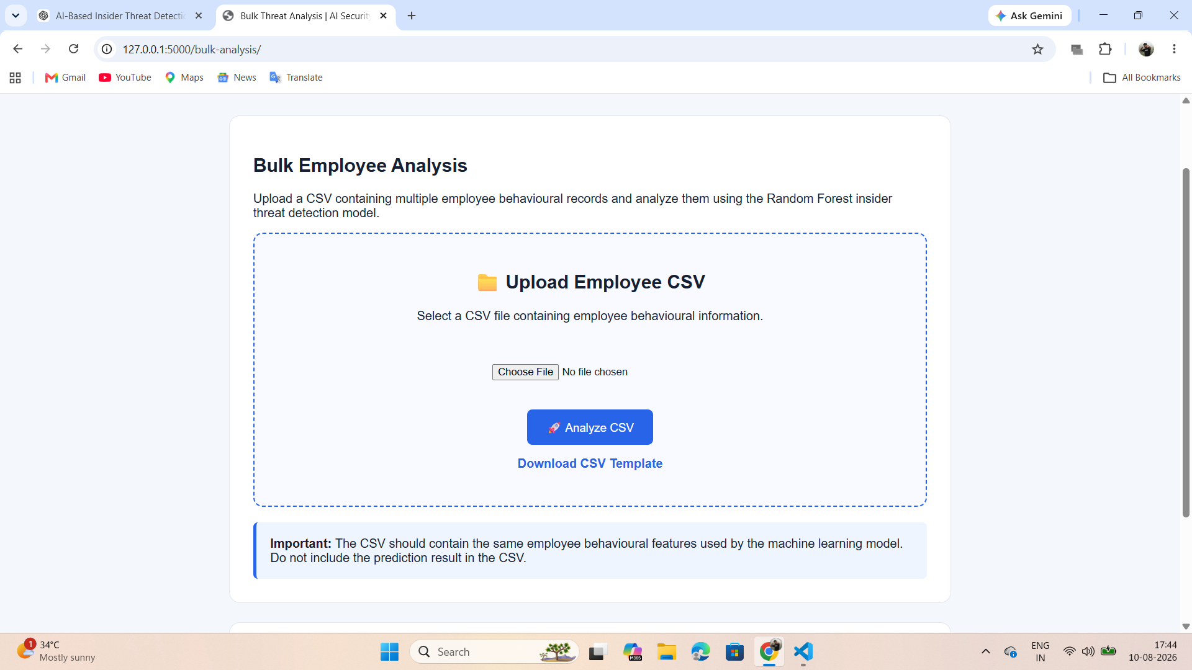
7. Bulk CSV Analysis — Input
CSV Upload
Multiple employee behavioral records can be submitted in one operation.
Validation
The application expects the behavioral features used by the ML model.
Output
Each row receives an individual prediction and risk assessment.
8

Slide 9
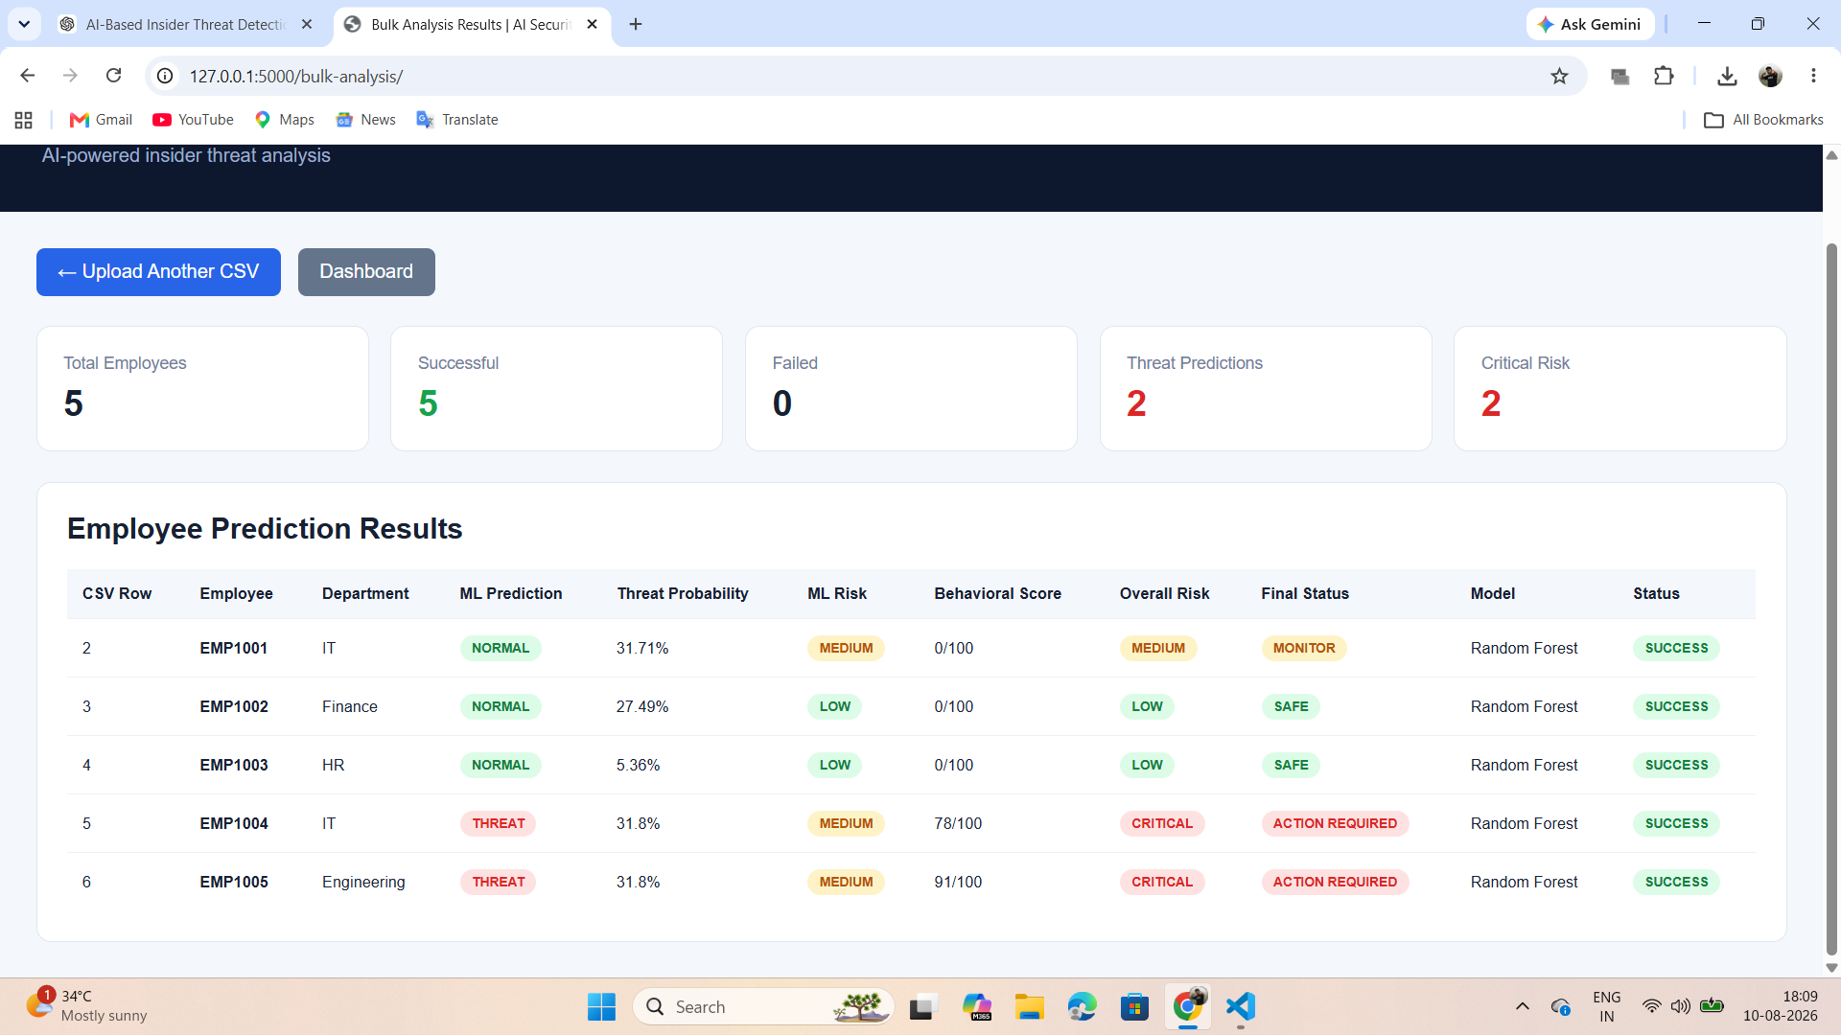
8. Bulk CSV Analysis — Results
Five employee records processed successfully in the demonstrated test.
9

Slide 10
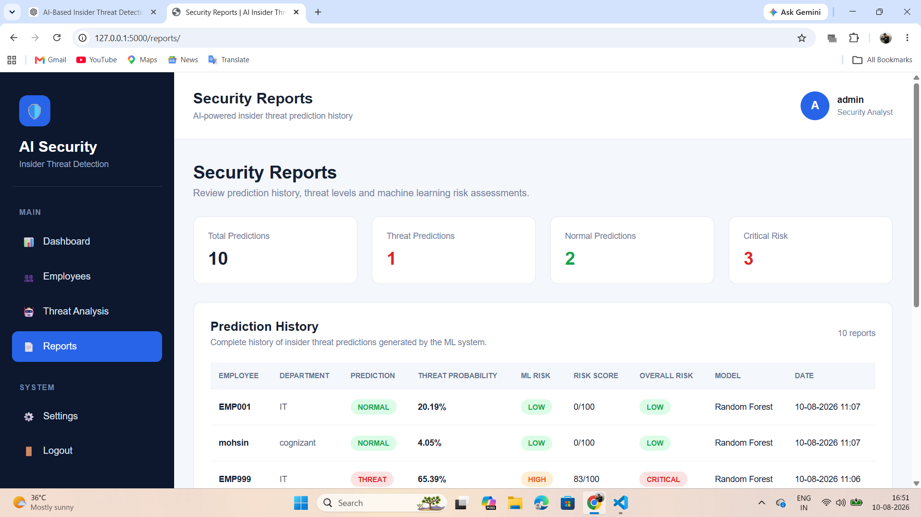
9. Reports & Prediction History
History
Predictions are stored and displayed chronologically.
Risk Visibility
Threat probability, ML risk, risk score and overall risk are visible together.
Traceability
Model name and timestamp support review of past analyses.
10

Slide 11
10. Technology Stack & Data Storage
Frontend
Backend
HTML5 • CSS3 • Jinja templates
Python • Flask • Blueprints
ML
Database
Scikit-learn • Random Forest
SQLite • SQLAlchemy
Security
Data
Flask-Login • protected routes
CSV upload • employee behavioral features
Core Database Entities
Users • Employees • Predictions • Risk Indicators
11

Slide 12
11. Demonstrated Results
Bulk Test
Threat Detection
Critical Risk
5 employee records processed successfully.
The demonstrated batch identified 2 threat predictions.
2 employees received CRITICAL overall risk in the demonstrated batch.
Dashboard provides a security-operations overview.
Reports maintain prediction history for review.
Bulk CSV analysis scales the workflow from one employee to multiple employees.
The final risk view combines model output with behavioral assessment.
The system is ready for demonstration and project submission.
12

Slide 13
12. Conclusion
Developed an end-to-end AI-based insider threat monitoring web application.
Integrated machine learning prediction with behavioral risk assessment.
Implemented secure analyst access, employee management, reports and bulk CSV analysis.
Created a dashboard-oriented interface for practical security monitoring.
The system provides a foundation for future enhancements such as live event streaming, alert notifications and additional ML models.
THANK YOU
AI-Based Insider Threat Detection & Behavioral Risk Analysis System
13

