Slide 1

MedAssist AI
Medical Symptom Analysis & Disease Prediction System
“Smarter Healthcare. Better Decisions.”
MILESTONE 1 — PROGRESS REVIEW
Infosys Springboard Internship • Developed by Mr. Swastik Sukla • July 31, 2026
Notes:
Introduce the project: MedAssist AI, an AI-powered medical symptom analysis and disease prediction platform, built as part of the Infosys Springboard internship. Mention that this review covers Milestone 1 (Weeks 1-2): project setup, architecture, and the core UI.

Slide 2





Project Overview & Milestone 1 Status
OBJECTIVE
MILESTONE 1
COMPLETE
MedAssist AI is an AI-powered platform that helps patients and healthcare providers analyze symptoms, predict possible diseases, assess health risk, and receive preliminary care recommendations — all through one connected system.
Healthcare workflows & project scope defined
System architecture & database schema designed
UI wireframes built for Patient & Provider portals
BUILT FOR
Patients
Healthcare Providers
Frontend & backend environments set up
Authentication & role-based access (RBAC) implemented
Clinics & Hospitals
Telemedicine Platforms
Symptom collection workflow built
Notes:
Explain the objective in your own words. Then walk through the Milestone 1 checklist on the right — all the Week 1-2 deliverables from the project plan (architecture, schema, wireframes, environment setup, auth/RBAC, symptom workflow) are complete.

Slide 3




Tech Stack & Database Design
Frontend IMPLEMENTED
DATABASE STRUCTURE
React.js · Vite · JavaScript (ES6) · CSS3 · React Router DOM · React Icons
Table | Purpose
Users | Stores registration and login information
Patients | Stores patient details
Symptoms | Stores symptoms and medical history
Predictions | Stores AI disease prediction results
Backend PLANNED
Python · FastAPI
Database
SQLite · SQLAlchemy -FastAPI
AI / ML MILESTONE 2
Scikit-learn · XGBoost · TensorFlow
Backend, database and AI/ML integration begin in Milestone 2.
Notes:
Walk through the stack: React.js + Vite on the frontend is built and working. Backend (FastAPI), the database (PostgreSQL/MongoDB) and the AI/ML libraries are planned for the next milestones. Then explain the four core tables — Users, Patients, Symptoms, Predictions — that will back the app.

Slide 4
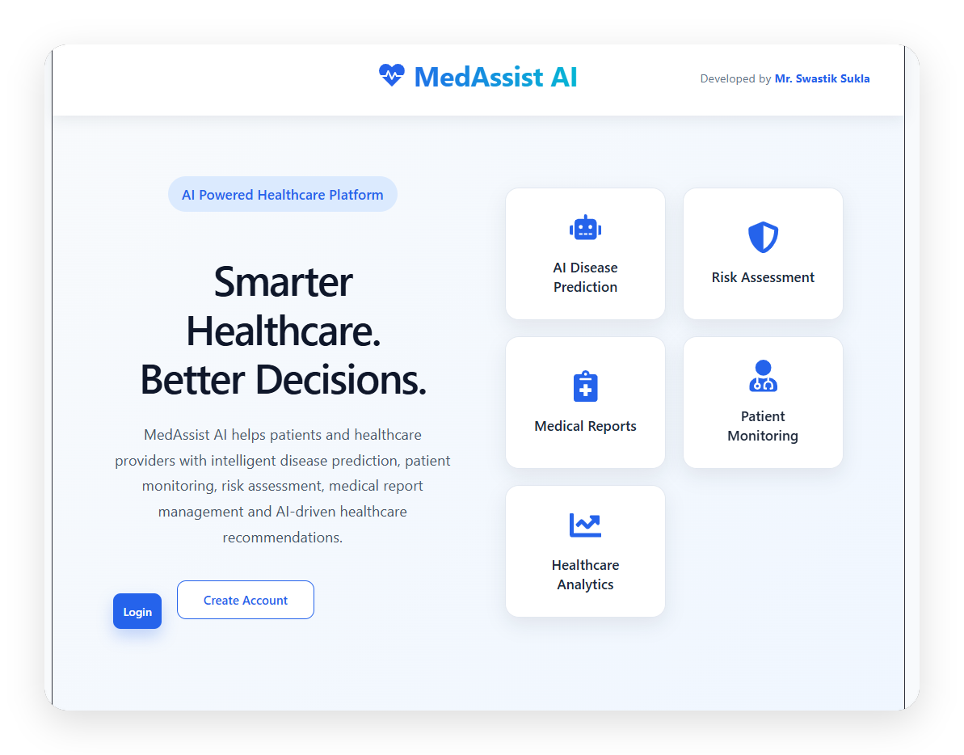
SCREEN WALKTHROUGH · 01 OF 03
Homepage
The landing page that introduces MedAssist AI.
Introduces MedAssist AI as an AI-powered healthcare platform
Highlights 5 core capabilities — prediction, risk, reports, monitoring, analytics
Login and Create Account route users into role-based portals
Notes:
Show the homepage — the first screen a visitor sees. It explains what MedAssist AI does and links to Login / Create Account before anyone signs in.

Slide 5
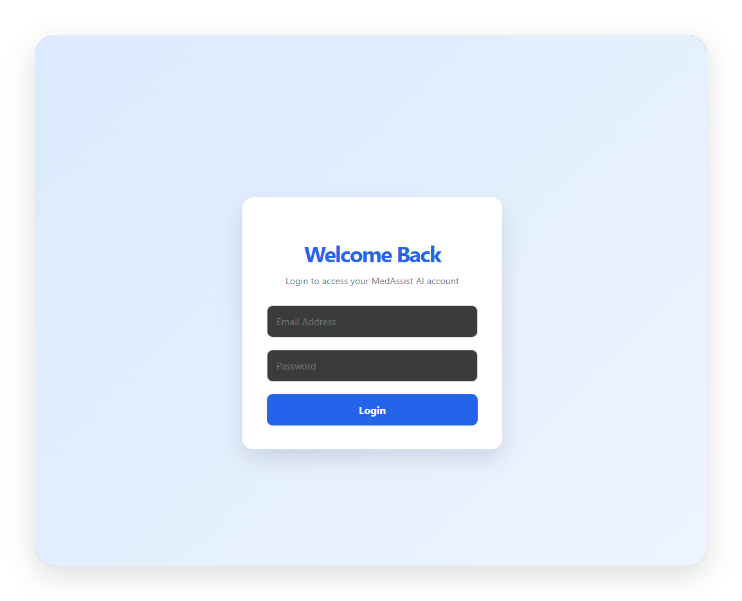
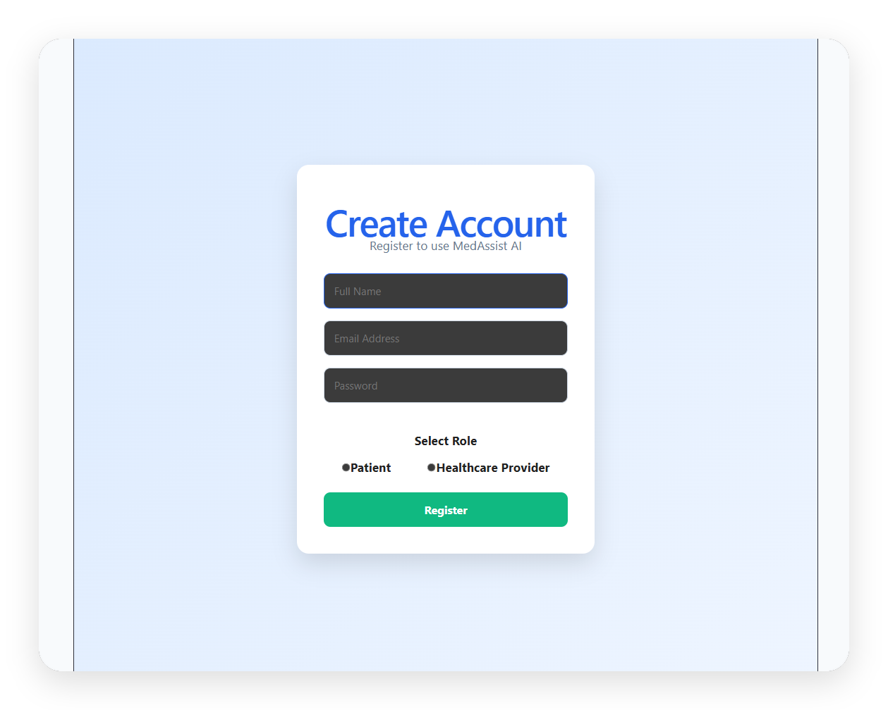
SCREEN WALKTHROUGH · 02 OF 03
Authentication
Secure sign-in and role-based registration — the gateway into the Patient and Healthcare Provider portals.
Login
Register
Notes:
Walk through login and registration. Registration captures the user's role — Patient or Healthcare Provider — which drives the role-based access control (RBAC) built in Milestone 1.

Slide 6
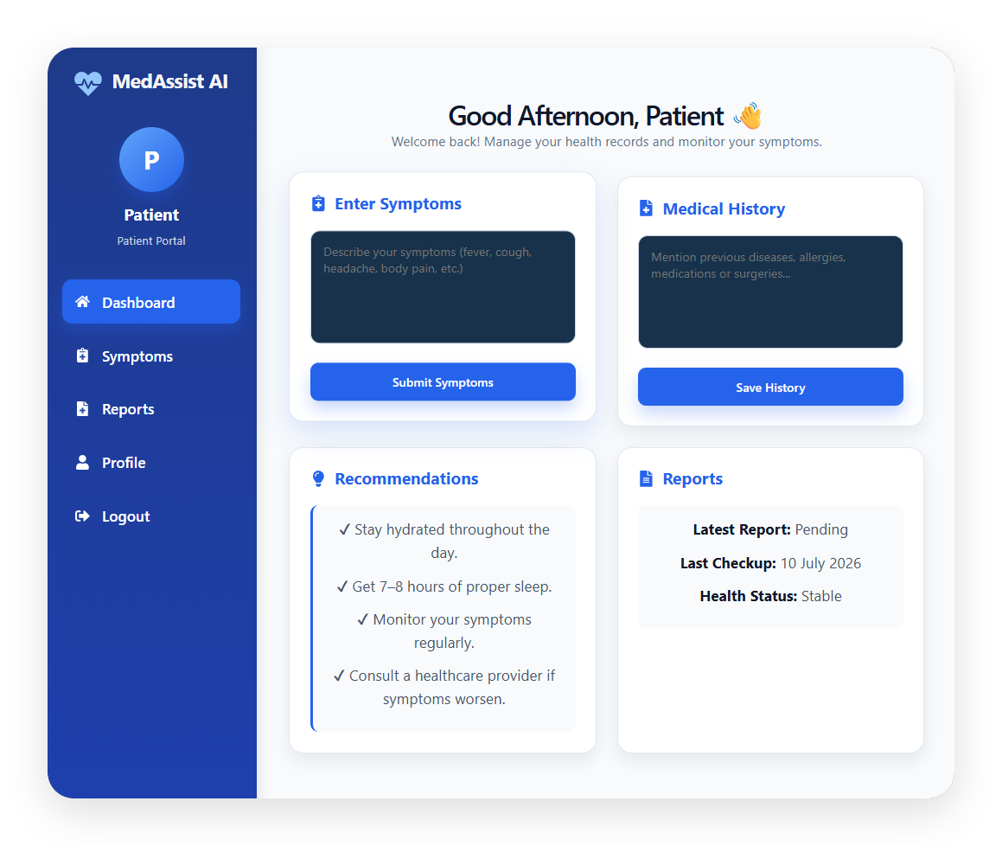
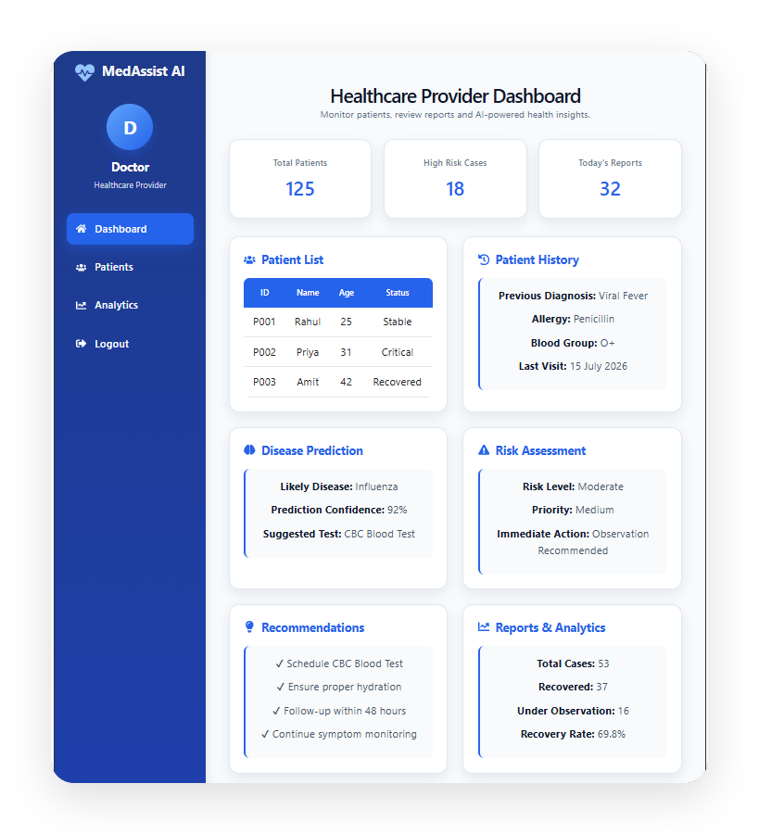
SCREEN WALKTHROUGH · 03 OF 03
Dashboards
Role-based views for patients and healthcare providers.
NEXT — MILESTONE 2
Train and integrate the disease-prediction and risk-scoring models behind these screens.
Patient Portal
Healthcare Provider Portal
Symptoms, medical history, recommendations & reports
Patient list, history, disease prediction & risk assessment
Notes:
Show the two role-based dashboards. Be upfront that the disease-prediction and risk panels currently display sample data — the UI is complete, and wiring in the real ML models is the focus of Milestone 2, starting next.

