Slide 1







MedAssist AI
Milestone 2 – AI-Based Disease Prediction & Healthcare Management System
MILESTONE 2 — PROGRESS REVIEW
WHAT WE BUILT
Symptom-Based
Prediction
Medical History
Management
Patient Profile
Management
Prediction
History
Reports &
Recommendations
Database
Integration
Infosys Springboard Internship • Developed by Mr. Swastik Sukla • August 2026
Notes:
Introduce Milestone 2: building on the Milestone 1 foundation, this phase delivers real AI-based disease prediction, medical history and profile management, prediction history, reports, and full database integration.

Slide 2
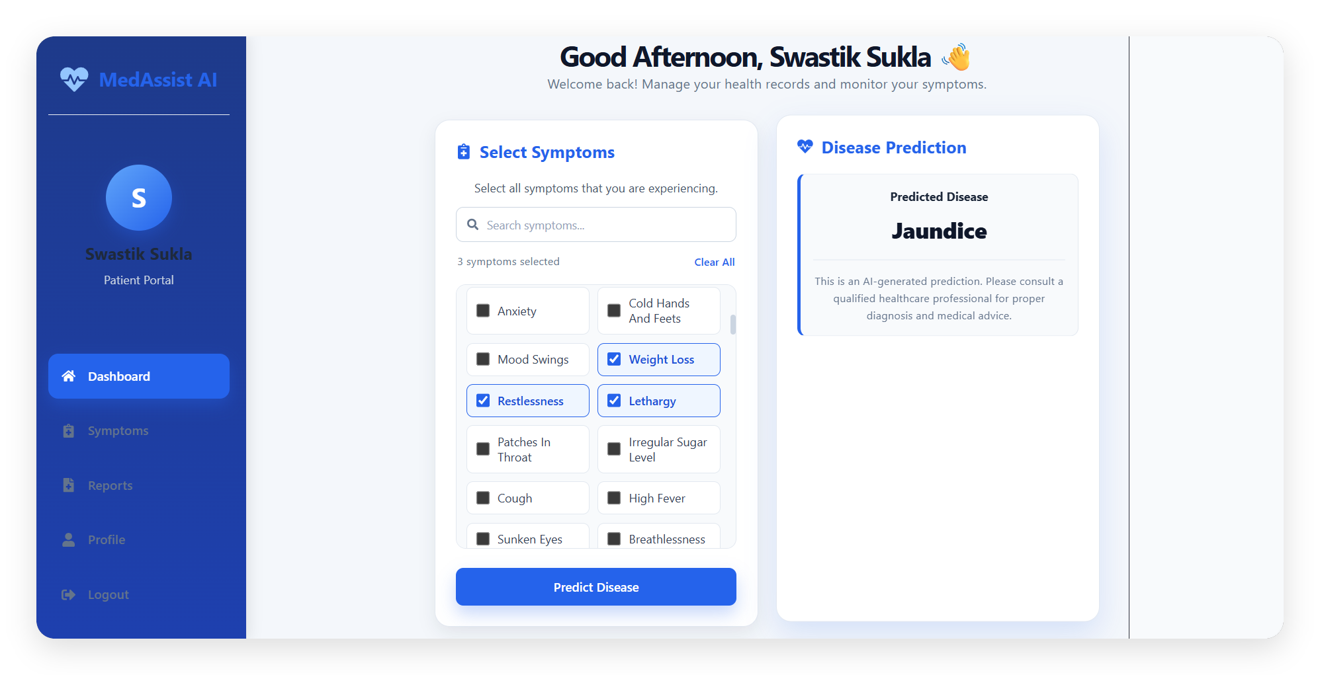
SCREEN 01 · PATIENT EXPERIENCE
Patient Dashboard
Also includes Medical History, Recommendations, Prediction History and Reports — shown on the following slides.
Search & Select Symptoms
Search or check symptoms from the list
AI Prediction Result
Displays the predicted disease instantly
Navigation
Dashboard, Symptoms, Reports, Profile
Predict Disease
Sends symptoms to the AI model
MedAssist AI | Milestone 2
2 / 06
Notes:
This is the patient's home screen. Walk through the sidebar navigation, the symptom search/selection panel, the Predict Disease button, and the AI prediction result panel. Mention the dashboard also holds medical history, recommendations, prediction history and reports, shown next.

Slide 3




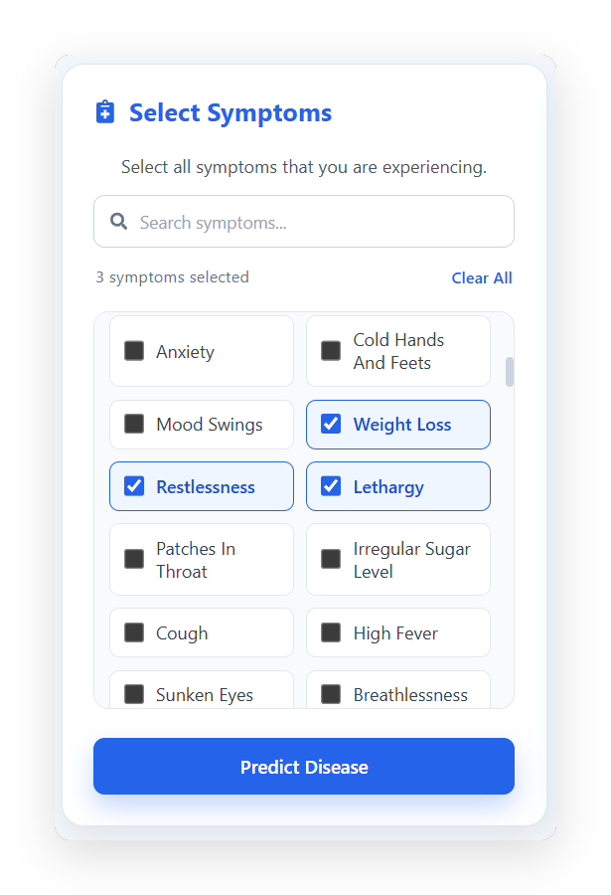
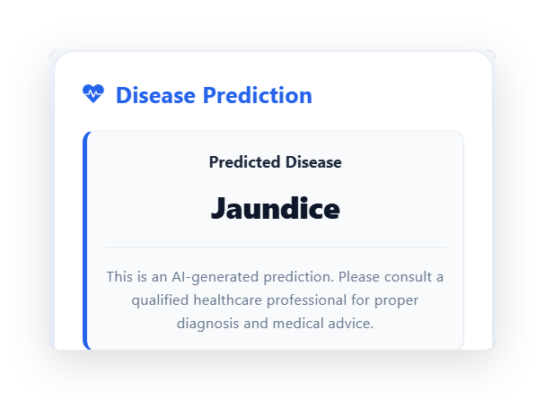
SCREEN 02 · AI PREDICTION WORKFLOW
Disease Prediction & Results
Select
Symptoms
Send Data to
Backend
AI / ML
Prediction
Display Predicted
Disease
Store in
History
Step-by-step: symptoms flow from the patient to the AI engine and back as a stored result.
Symptom Selection
Disease Prediction Result
MedAssist AI | Milestone 2
3 / 06
Notes:
Walk through the workflow: the patient selects symptoms, they're sent to the backend, the AI/ML model processes them, the predicted disease is displayed, and the result is stored in prediction history. Screenshots show the actual symptom selection and the live result — Jaundice, in this example. We're not claiming a specific algorithm or accuracy figure since none is exposed in the UI yet.

Slide 4
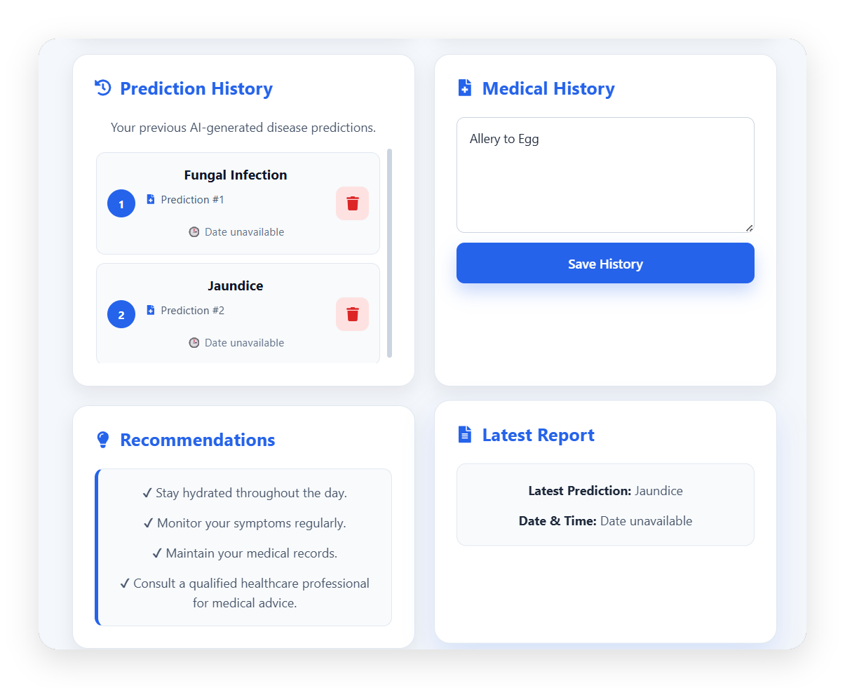

SCREEN 03 · PATIENT RECORDS
Reports & Prediction History
Prediction History
Every past AI prediction is listed, each with its own delete control.
Latest Report
The most recent prediction is summarized for quick reference.
Medical History
Patient-entered allergies and conditions, saved for the record.
Recommendations
General self-care guidance shown alongside each result.
Prediction History · Latest Report
MedAssist AI | Milestone 2
4 / 06
Notes:
The patient can look back at every previous AI prediction, each with a delete control to manage their own history, plus a latest-report summary, saved medical history, and general recommendations — all in one place.

Slide 5
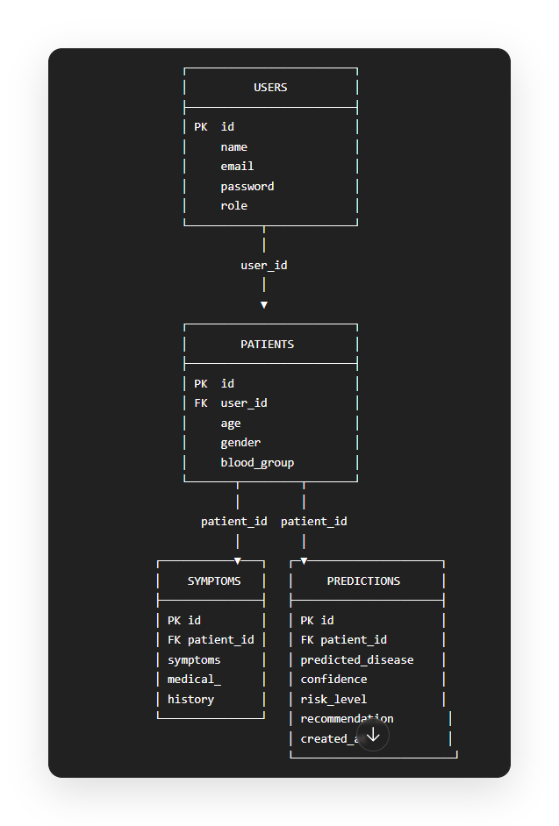


SCREEN 04 · DATA ARCHITECTURE
Database Integration
USERS
Registration & login details — name, email, password, role.
PATIENTS
Patient profile info — age, gender, blood group — linked to a user account.
SYMPTOMS
Submitted symptoms and medical history per patient.
PREDICTIONS
AI results — predicted disease, confidence, risk level, recommendation & timestamp.
All four tables are relationally linked through user_id and patient_id.
Database Tables (ERD)
MedAssist AI | Milestone 2
5 / 06
Notes:
This is the actual entity-relationship diagram for Milestone 2. Users links to Patients, and Patients links to both Symptoms and Predictions — giving each patient their own symptom and prediction records, all relationally connected.

Slide 6

MILESTONE 2 SUMMARY
Achievements & System Workflow
How a patient's symptoms become a stored, reviewable prediction.
Patient
Login
Patient
Dashboard
Enter
Symptoms
AI
Prediction
Prediction
Result
Save to
Database
History &
Reports
COMPLETED COMPONENTS
Frontend Dashboard
Backend API Integration
Disease Prediction
Database Integration
Medical History
Patient Profile
Prediction History
Reports
Milestone 2 successfully integrates the frontend, backend, AI prediction system, and database into a functional healthcare management workflow.
MedAssist AI | Milestone 2
6 / 06
Notes:
Close with the end-to-end flow: login, dashboard, enter symptoms, AI prediction, result, saved to the database, and available in history and reports. All eight components listed are complete and working together. End with the summary line.

