Slide 1







MedAssist AI
Milestone 3 – Recommendations, Reports & Healthcare Analytics
MILESTONE 3 — PROGRESS REVIEW
WHAT WE BUILT
Recommendation
Engine
Treatment
Suggestions
Advisory
Features
Prediction
Reports
Analytics
Dashboard
Health Trend
Visualizations
Infosys Springboard Internship • Developed by Mr. Swastik Sukla • August 2026
Notes:
Milestone 3 builds on Milestone 2 by turning raw predictions into actionable output: a recommendation engine, treatment suggestions, advisory guidance, downloadable reports, and an analytics dashboard with health trends.

Slide 2
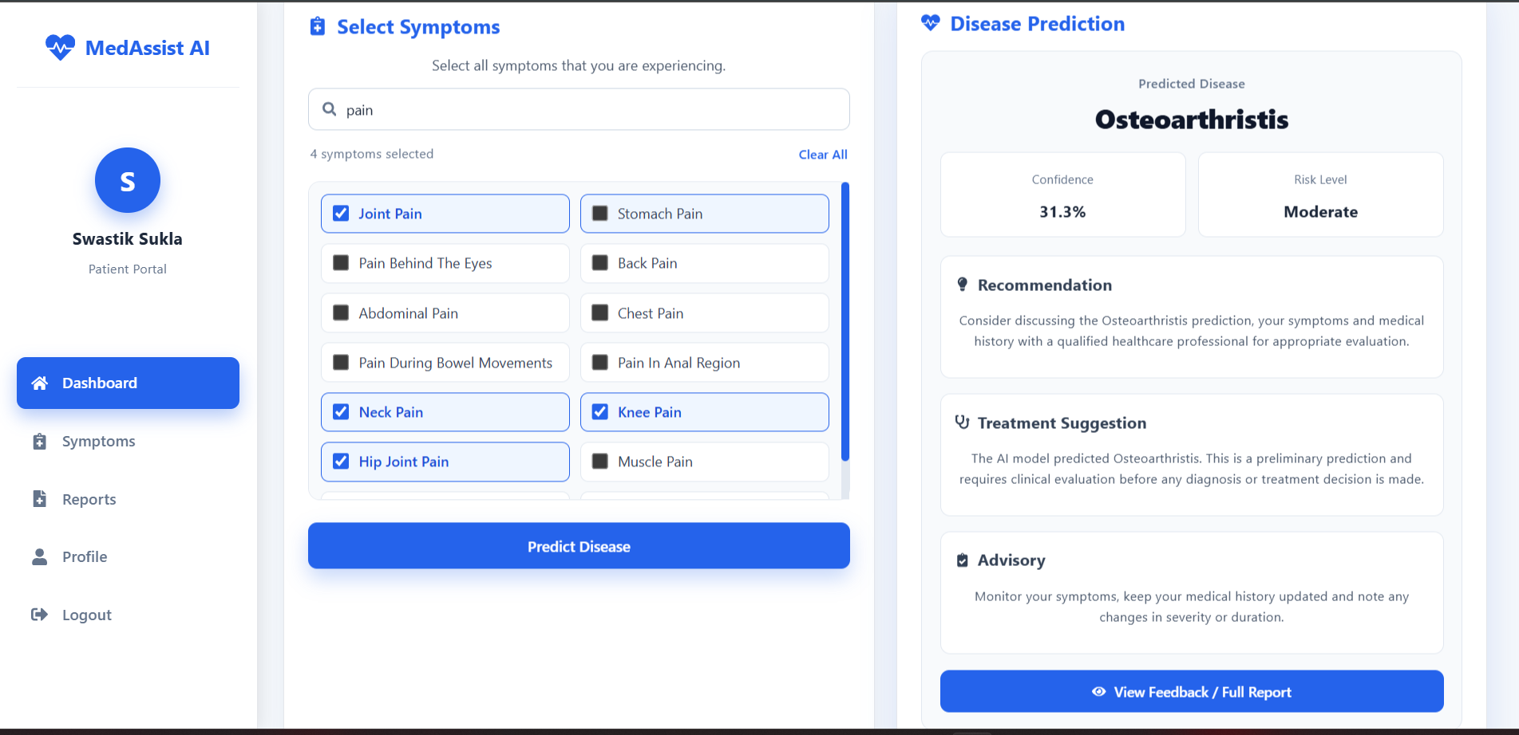
SCREEN 01 · PATIENT EXPERIENCE
Recommendation & Treatment Engine
Prediction results now include Confidence %, Risk Level, a Recommendation, a Treatment Suggestion, and an Advisory.
MedAssist AI | Milestone 3
2 / 06
Notes:
The prediction panel is now much richer than Milestone 2 — alongside the predicted disease it shows confidence and risk level, plus three new sections: a recommendation, a treatment suggestion, and an advisory. A 'View Feedback / Full Report' button leads into the generated report.

Slide 3
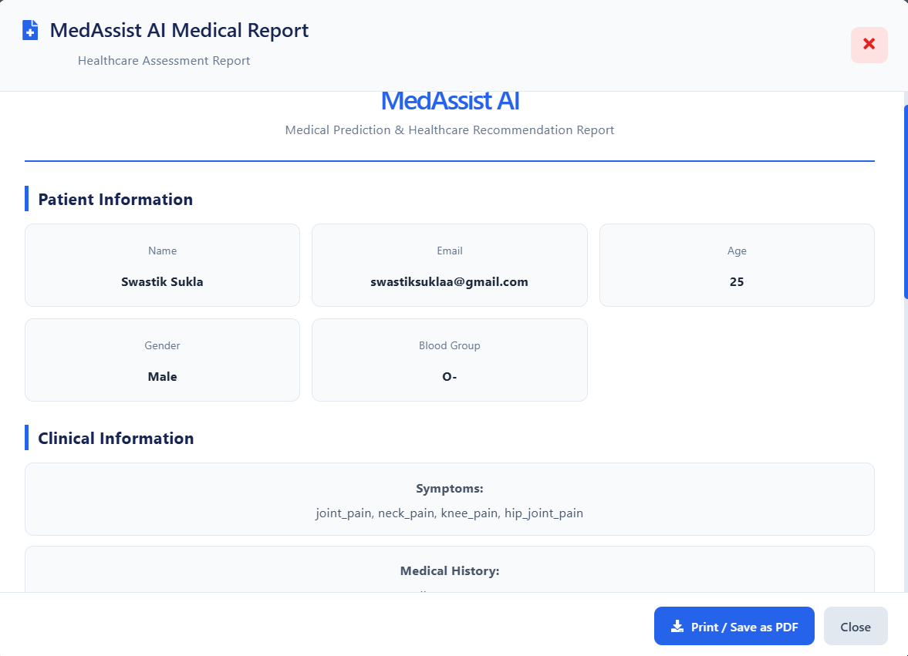
SCREEN 02 · GENERATED DOCUMENT
Disease Prediction Report
A downloadable Medical Report is generated from the prediction — patient info, symptoms, and medical history, printable or savable as PDF.
MedAssist AI | Milestone 3
3 / 06
Notes:
The system generates a formal Medical Report from each prediction: patient information, clinical information (symptoms, medical history), with Print / Save as PDF built in.

Slide 4
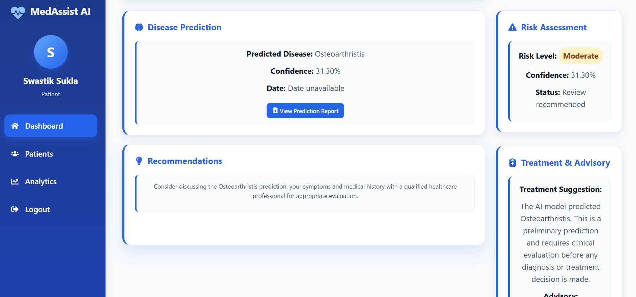
SCREEN 03 · PROVIDER EXPERIENCE
Risk Assessment & Treatment Advisory
The provider dashboard mirrors the same prediction, with risk level, recommendations, and treatment & advisory guidance.
MedAssist AI | Milestone 3
4 / 06
Notes:
On the provider side, the dashboard now surfaces the same Disease Prediction and Risk Assessment as the patient view, plus Recommendations and a Treatment & Advisory panel — giving the provider the full clinical picture at a glance.

Slide 5
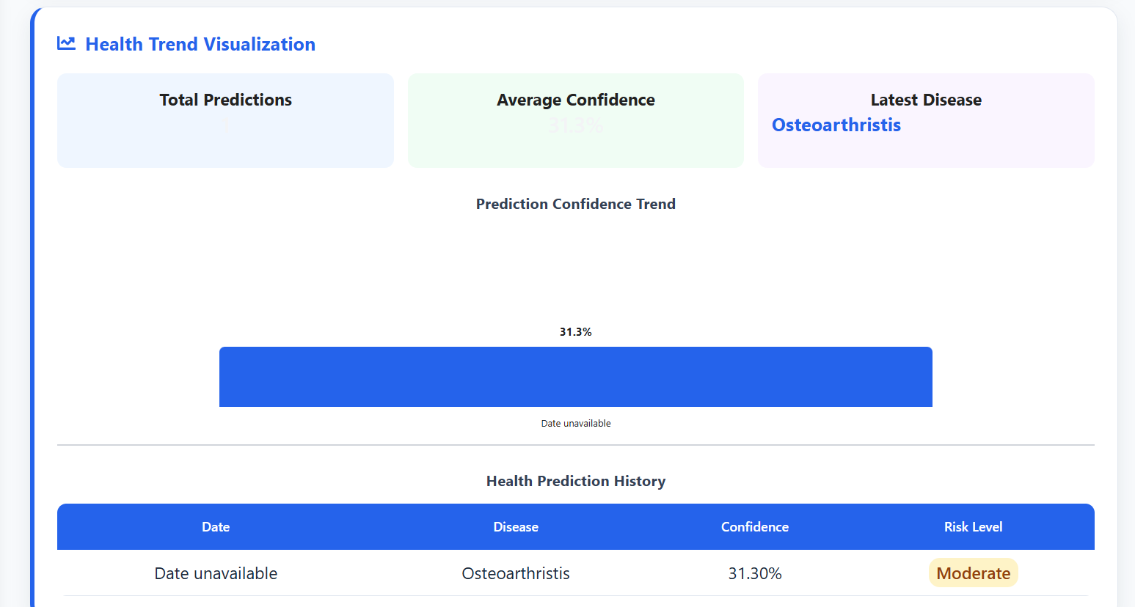
SCREEN 04 · HEALTHCARE ANALYTICS
Analytics Dashboard & Health Trends
Total Predictions, Average Confidence, and Latest Disease are tracked, with a Prediction Confidence Trend chart and a full Health Prediction History table.
MedAssist AI | Milestone 3
5 / 06
Notes:
The new Health Trend Visualization brings the patient's prediction history together: summary stats, a confidence trend chart, and a history table with date, disease, confidence and risk level.

Slide 6
MILESTONE 3 SUMMARY
Milestone 3 Achievements
From a raw prediction to a full clinical picture — recommendations, reports, and trends.
Healthcare Recommendation Engine
Treatment Suggestions
Advisory Features
Disease Prediction Reports
Healthcare Analytics Dashboard
Health Trend Visualizations
Milestone 3 successfully adds recommendations, treatment guidance, downloadable reports, and analytics on top of the Milestone 2 prediction system.
MedAssist AI | Milestone 3
6 / 06
Notes:
Close by naming all six Milestone 3 deliverables and the summary line: recommendations, treatment suggestions, advisory features, prediction reports, the analytics dashboard, and health trend visualizations are all complete.

