Slide 1








MedAssist AI
Milestone 4 – Production Deployment & Cloud Architecture
MILESTONE 4 — PROGRESS REVIEW
WHAT WE BUILT
Recommendation
Engine
Prediction
Reports
Analytics
Dashboard
Health Trend
Visualizations
Dockerized
Backend
Cloud
Hosting
Live Production
Demo
Infosys Springboard Internship • Developed by Mr. Swastik Sukla • August 2026
Notes:
Milestone 4 takes everything from Milestone 3 and puts it live on the internet. Same recommendation engine, reports, and analytics as before — the new part this time is getting it all running on real cloud infrastructure that anyone can access.

Slide 2
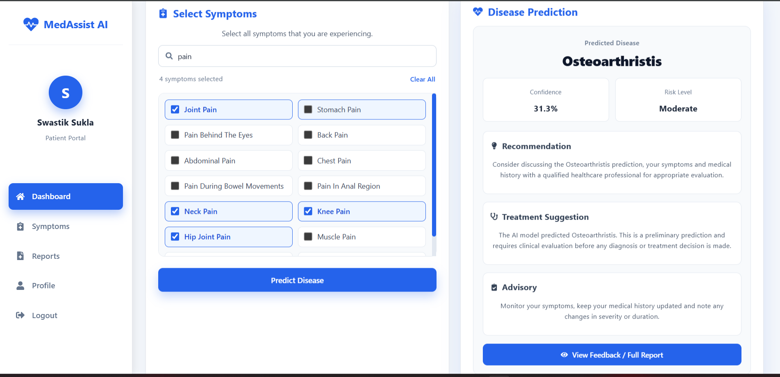
SCREEN 01 · PATIENT EXPERIENCE
Recommendation & Treatment Engine
Prediction results include Confidence %, Risk Level, a Recommendation, a Treatment Suggestion, and an Advisory.
MedAssist AI | Milestone 4
2 / 06
Notes:
Same recommendation engine from Milestone 3: predicted disease, confidence, risk level, plus a recommendation, treatment suggestion, and advisory.

Slide 3
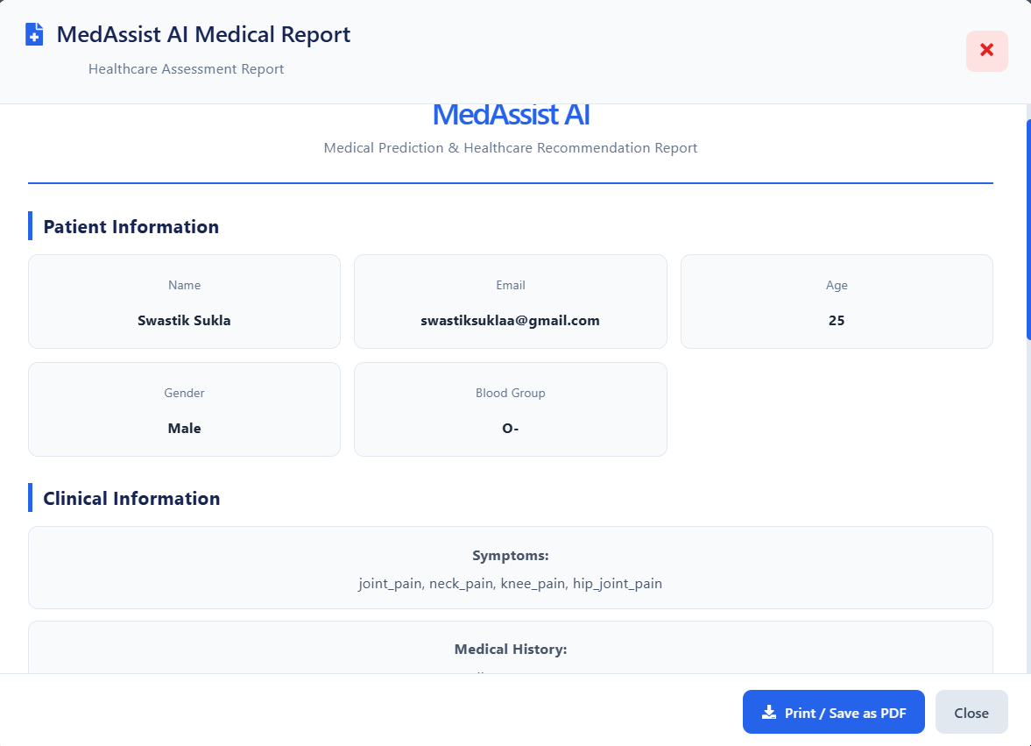
SCREEN 02 · GENERATED DOCUMENT
Disease Prediction Report
A downloadable Medical Report is generated from the prediction, printable or savable as PDF.
MedAssist AI | Milestone 4
3 / 06
Notes:
Same report feature from Milestone 3: patient info, symptoms, and medical history, with Print / Save as PDF.

Slide 4
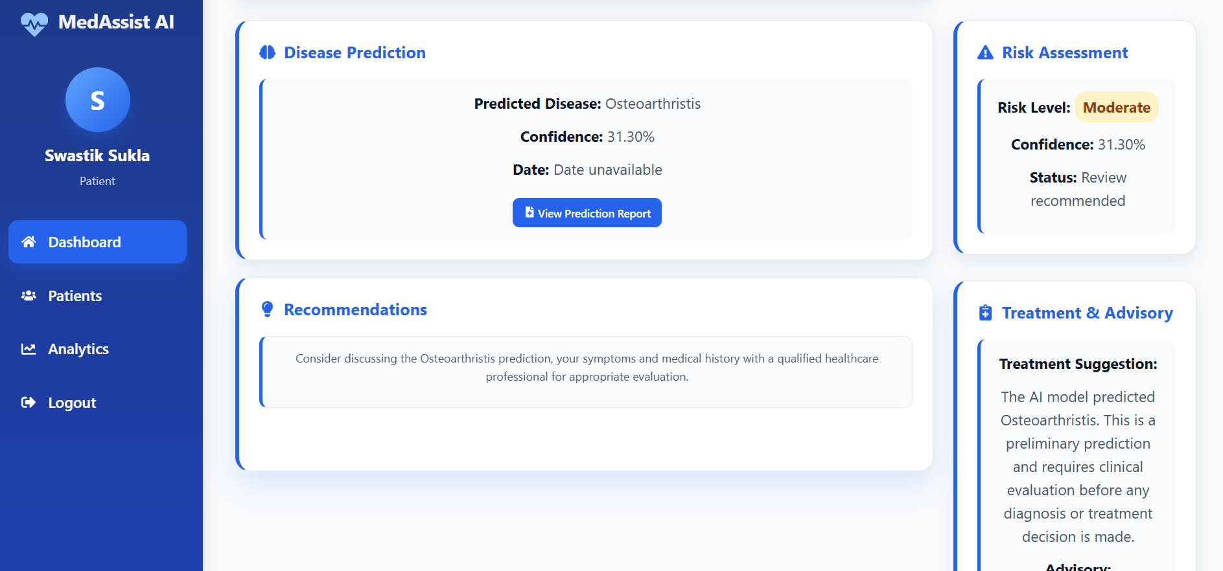
SCREEN 03 · PROVIDER EXPERIENCE
Risk Assessment & Treatment Advisory
The provider dashboard mirrors the same prediction, with risk level, recommendations, and treatment & advisory guidance.
MedAssist AI | Milestone 4
4 / 06
Notes:
Same provider view from Milestone 3: the doctor sees the same prediction, risk level, recommendation, and treatment advisory as the patient.

Slide 5
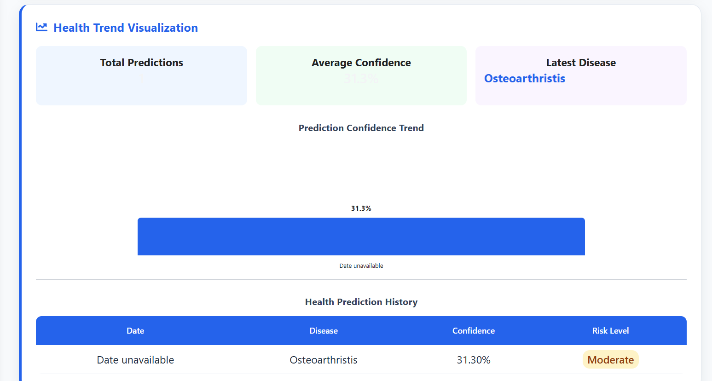
SCREEN 04 · HEALTHCARE ANALYTICS
Analytics Dashboard & Health Trends
Total Predictions, Average Confidence, and Latest Disease are tracked, with a confidence trend chart and full history table.
MedAssist AI | Milestone 4
5 / 06
Notes:
Same analytics dashboard from Milestone 3: summary stats, confidence trend chart, and prediction history table.

Slide 6




SCREEN 05 · INFRASTRUCTURE
Production Cloud Deployment & Architecture
Browser
Vercel
AWS EC2
Patient / Doctor
Frontend + Reverse Proxy
Docker: FastAPI + ML Model
Containerization — Backend runs in Docker, so it behaves the same everywhere.
FastAPI on Python 3.11, with scikit-learn models packaged in the container.
Cloud Infrastructure — An always-on AWS server hosts the backend.
AWS EC2 instance running 24/7, with 2GB swap memory configured for stability.
Frontend Delivery — The website loads fast, anywhere in the world.
Hosted on Vercel with automatic CI/CD linked to the GitHub main branch.
Proxy Routing — No browser security errors between frontend and backend.
vercel.json reverse-proxy (/api/* → EC2 public IP) eliminates CORS and HTTPS/HTTP mixed-content blocking.
LIVE DEMO
Frontend: med-assist-ai-delta.vercel.app
API Docs: 3.110.188.253/docs
MedAssist AI | Milestone 4
6 / 06
Notes:
This slide is about how the app runs in the real world, not just on a laptop. The backend is packaged in Docker so it behaves the same everywhere, and it runs on an AWS EC2 server that stays on 24/7, with 2GB of swap memory added for stability. The frontend is hosted on Vercel, which auto-deploys every time we push to GitHub main. And there's a proxy in vercel.json that quietly forwards API calls to the EC2 server, so the browser never throws CORS or mixed-content errors. At the bottom are the live links — the app and the API docs are both online right now.

