Slide 1

MEDASSIST AI PROJECT
MILESTONE 2
Week 3 & 4 — Disease Prediction & Risk Assessment
MedAssist AI — Disease Prediction & Risk Assessment System
Prepared by Devamithra A | Infosys Springboard Internship 7.0

Slide 2






Milestone Overview
Six core deliverables completed across weeks 3 & 4
Model Training
Risk Scoring Engine
Trained disease prediction models on prepared healthcare datasets.
Built a scoring engine to quantify overall patient health risk.
Model Evaluation
Severity Analysis
Evaluated model performance and prediction accuracy.
Implemented workflows to analyze and classify severity levels.
Probability Reports
Health Risk Reports
Generated disease probability reports for each patient case.
Generated comprehensive health risk reports for review.
MILESTONE 2 | WEEK 3 & 4
2

Slide 3




Model Training & Evaluation Pipeline
From prepared data to a validated prediction model
1
2
3
4
5
→
→
→
→
Data Preparation
Model Training
Validation
Accuracy Evaluation
Model Selection
Clean, split, and structure the healthcare datasets.
Train prediction models on symptom & risk-factor data.
Validate against held-out data for generalization.
Measure precision, recall, and overall accuracy.
Select the best-performing model for deployment.
MILESTONE 2 | WEEK 3 & 4
3

Slide 4
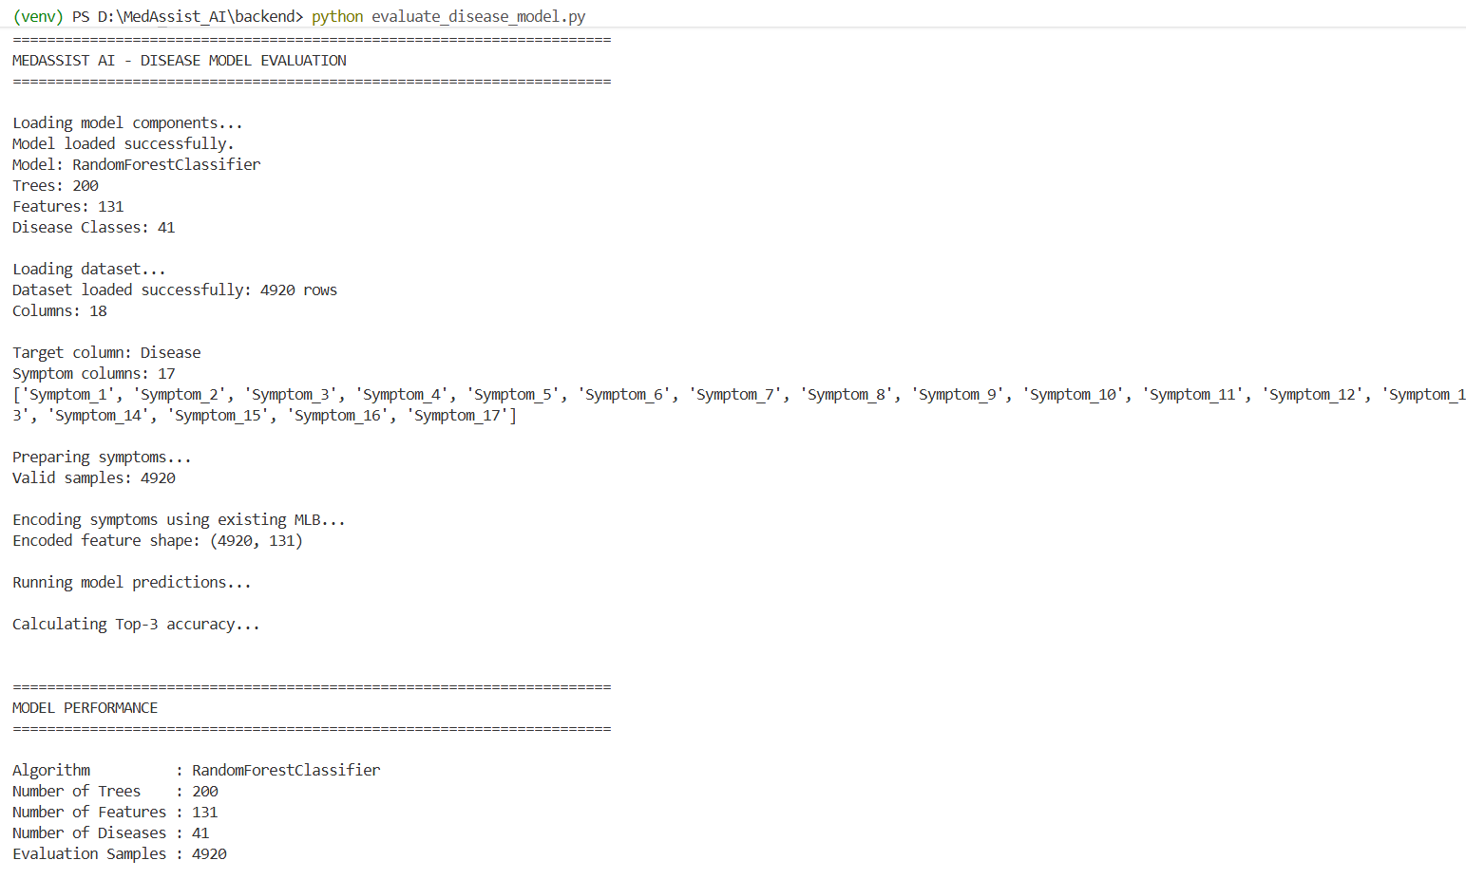
Model Prediction
MILESTONE 2 | WEEK 3 & 4
8

Slide 5

Disease Probability Reports
Model output translated into ranked, readable probability scores
Prediction Summary
Sample Prediction Output
Ranked list of likely conditions with probability scores.
Illustrative format — values shown are examples only
Condition A
78%
Confidence Score
Model confidence level attached to each prediction.
Condition B
54%
Condition C
33%
Recommended Action
Suggested next step based on top prediction.
Condition D
17%
MILESTONE 2 | WEEK 3 & 4
4

Slide 6
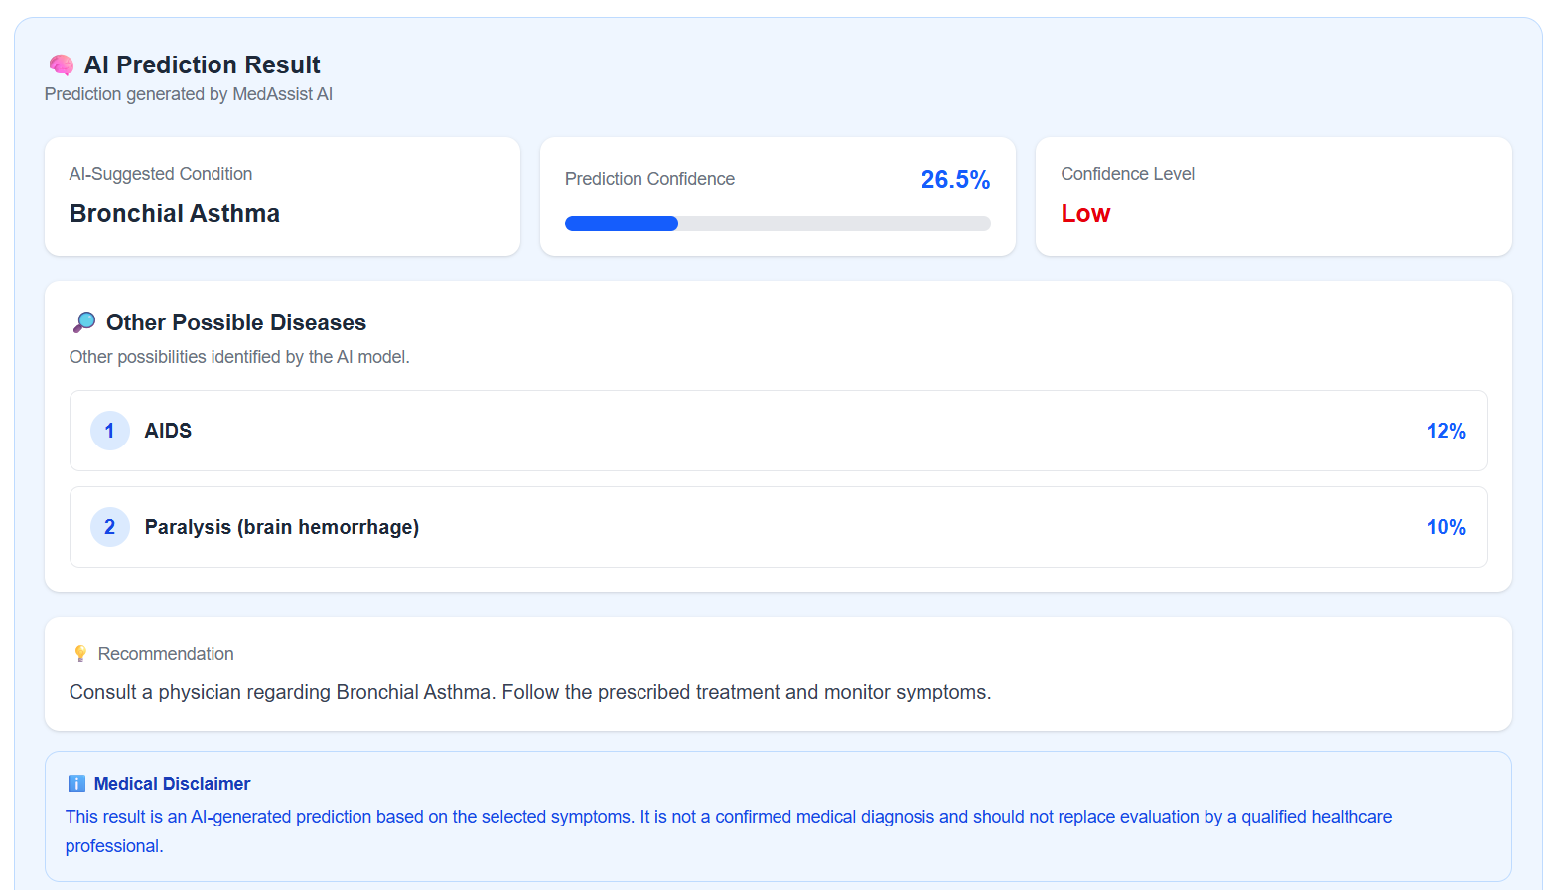
Prediction Result
MILESTONE 2 | WEEK 3 & 4
4

Slide 7
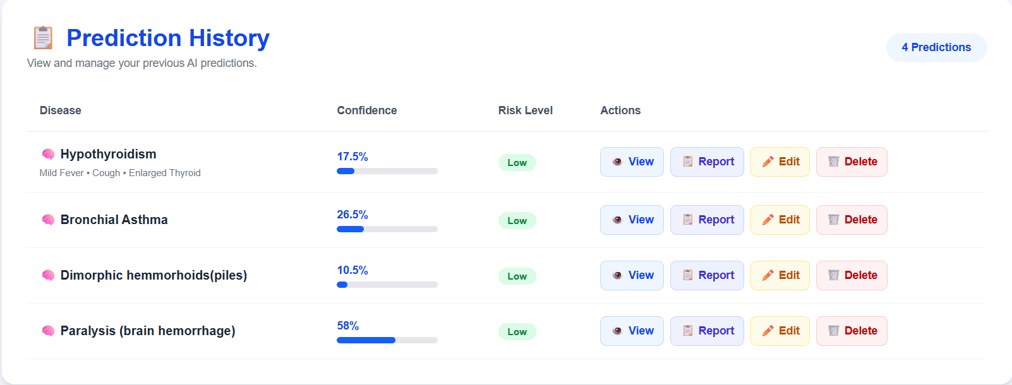
Prediction History
MILESTONE 2 | WEEK 3 & 4
4

Slide 8
Risk Scoring Engine
Quantifying patient health risk into clear, actionable tiers
Low Risk
Moderate Risk
High Risk
Minimal indicators present. Routine monitoring recommended.
Some risk factors detected. Follow-up assessment advised.
Significant risk indicators. Immediate clinical review suggested.
MILESTONE 2 | WEEK 3 & 4
5

Slide 9
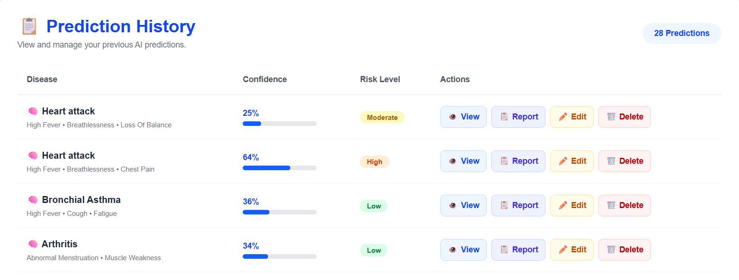
Risk Scoring Engine Result
MILESTONE 2 | WEEK 3 & 4
4

Slide 10

Severity Analysis Workflow
From raw symptom input to a flagged severity level
1
2
3
4
→
→
→
Symptom Severity Input
Weighted Scoring
Severity Classification
Escalation Flag
Patient-reported intensity captured alongside symptoms.
Symptoms weighted by clinical significance and combined.
Combined score mapped to a severity level.
High-severity cases flagged for priority review.
MILESTONE 2 | WEEK 3 & 4
6

Slide 11

Health Risk Reports
Consolidated output combining prediction, risk, and severity
Patient Health Risk Report
Patient Summary
Profile, demographics, and reported symptoms.
Prediction & Risk Score
Top disease predictions with overall risk score.
Severity Level
Classified severity with escalation status.
Recommendations
Suggested next steps and follow-up actions.
MILESTONE 2 | WEEK 3 & 4
7

Slide 12
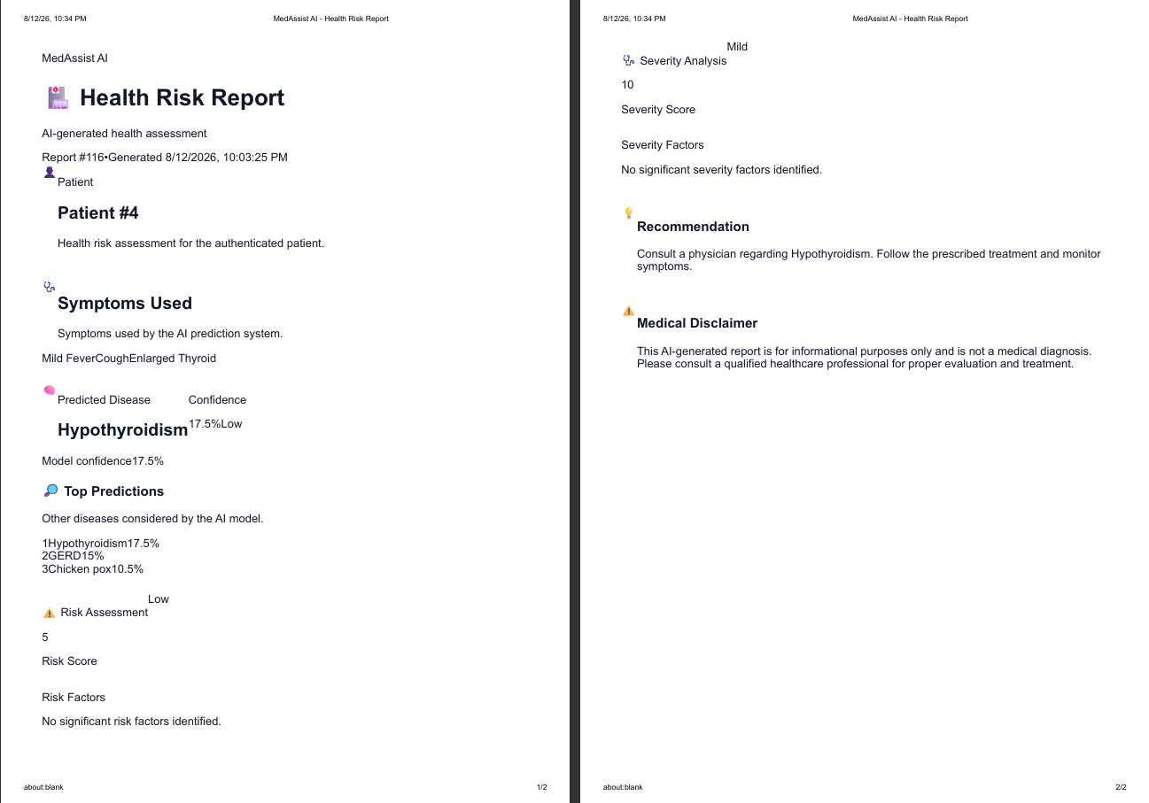
Health Risk Reports
MILESTONE 2 | WEEK 3 & 4
7

Slide 13



Milestone Outcomes
What this milestone establishes for the project
Disease Prediction & Risk Assessment
AI-Powered Analytics Workflows
Implemented working systems for disease prediction and patient risk assessment.
Built healthcare analytics workflows driven by AI predictions.
ML in Healthcare
Real-Time Insights
Practical understanding of machine learning applications in healthcare.
Generated real-time disease prediction insights for faster decisions.
MILESTONE 2 | WEEK 3 & 4
8

Slide 14
Milestone 2 Complete
Disease prediction and risk assessment systems are live in MedAssist AI
Next: Milestone 3 — Integration, Testing & Deployment
Thank You

