Slide 1

WEEK 7 & 8
MedAssist AI
Milestone 4 — Testing, Deployment & Documentation
Transforming MedAssist AI into a tested, optimized and live healthcare platform.
Testing & Validation
Cloud Deployment
Documentation
Infosys Internship 7.0

Slide 2






MILESTONE 4 OVERVIEW
From build to live platform
Goal: transform MedAssist AI into a tested, optimized and live healthcare platform.
Validate AI Performance
Test Healthcare Workflows
Test prediction accuracy and confidence scores
End-to-end patient and doctor journeys
Optimize Dashboards
Deploy to the Cloud
Improve responsiveness and usability
Ship frontend, backend and database live
Prepare Documentation
Demonstrate the Platform
Capture architecture, results and outcomes
Present the complete MedAssist AI system
MedAssist AI · Milestone 4
2

Slide 3
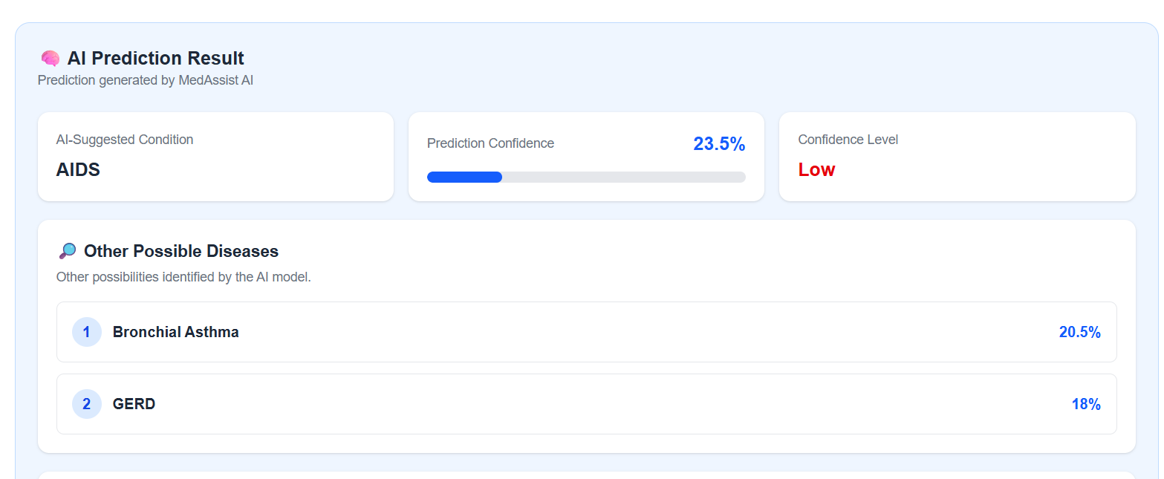

AI MODEL TESTING & VALIDATION
Validating the prediction engine
The AI prediction system was tested to ensure reliable disease predictions.
TESTING ACTIVITIES
Tested the AI model with different symptom combinations
Verified predicted diseases and confidence scores
Checked prediction results against expected outcomes
Tested risk and severity classification
Verified recommendation generation
Tested different patient inputs and edge cases
Screenshot — AI prediction results
VALIDATION FOCUS
Accuracy
Reliability
Consistency
Usability
Outcome: improved confidence in the AI-based health prediction system.
MedAssist AI · Milestone 4
3

Slide 4
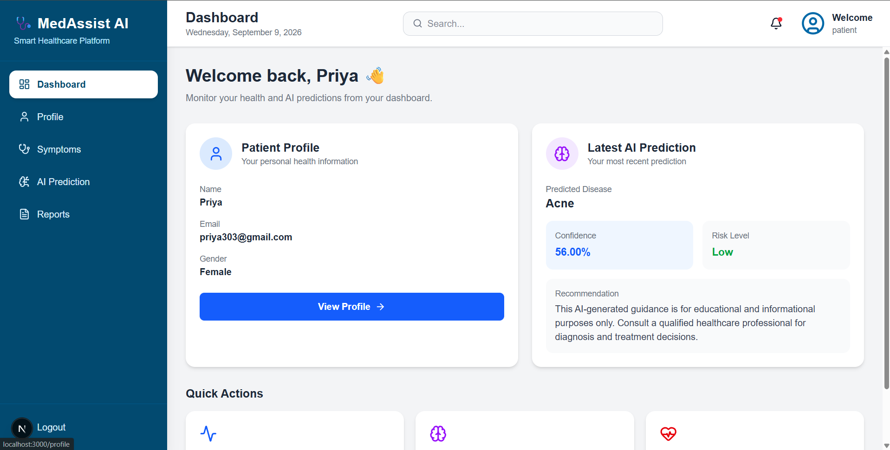


HEALTHCARE WORKFLOW TESTING
End-to-end workflows, verified
The complete patient and doctor workflows were tested across the platform.
Patient Workflow
Register → Login → Profile → Symptoms → AI Prediction → Reports
Doctor Workflow
Login → Dashboard → Assigned Patients → Patient Details → AI Predictions → Reports → Analytics
Screenshot — patient / doctor dashboard
TESTING INCLUDED
Authentication & authorization
Prediction history & health reports
Patient profile management
Doctor dashboard & analytics
Symptom recording
Role-based access
AI prediction workflow
MedAssist AI · Milestone 4
4

Slide 5
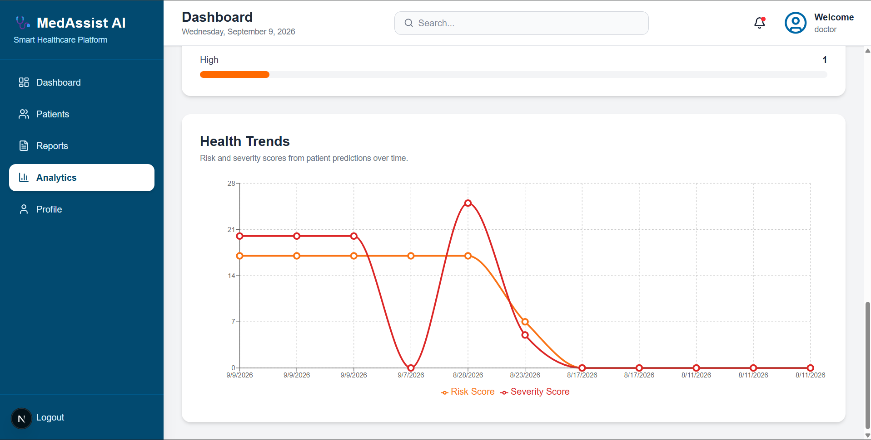
DASHBOARD & PLATFORM OPTIMIZATION
Built for a smoother experience
The platform was optimized to provide a smoother user experience.
OPTIMIZATION AREAS
Improved dashboard loading
Improved navigation between modules
Reduced unnecessary API requests
Designed clear health information cards
Improved frontend responsiveness
Improved visualization of analytics and health trends
Added loading and error handling
Handled patients with no previous predictions
Screenshot — optimized dashboard
RESULT
Better user experience
Responsive dashboards
Clear healthcare information
Smooth navigation
MedAssist AI · Milestone 4
5

Slide 6


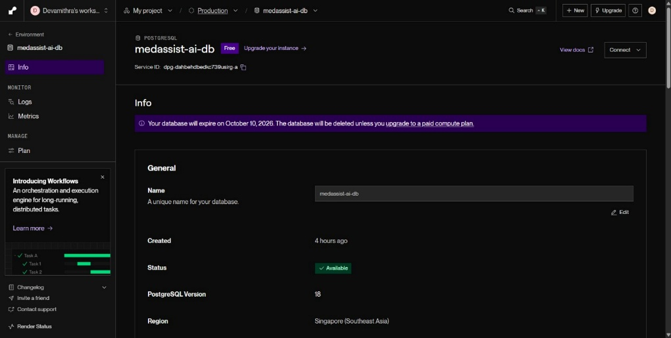
CLOUD DEPLOYMENT
MedAssist AI, live on the web
The platform was deployed using modern cloud environments.
Frontend
Backend API
Database
Vercel
Render (FastAPI)
PostgreSQL on Render
DEPLOYMENT ACTIVITIES
Connected frontend with production backend API
Connected PostgreSQL database
Screenshot — live deployed platform
Configured environment variables
Tested authentication on production
Configured CORS
Verified live API communication
Deployed FastAPI backend
Database Deployment using Render.
MedAssist AI · Milestone 4
6

Slide 7
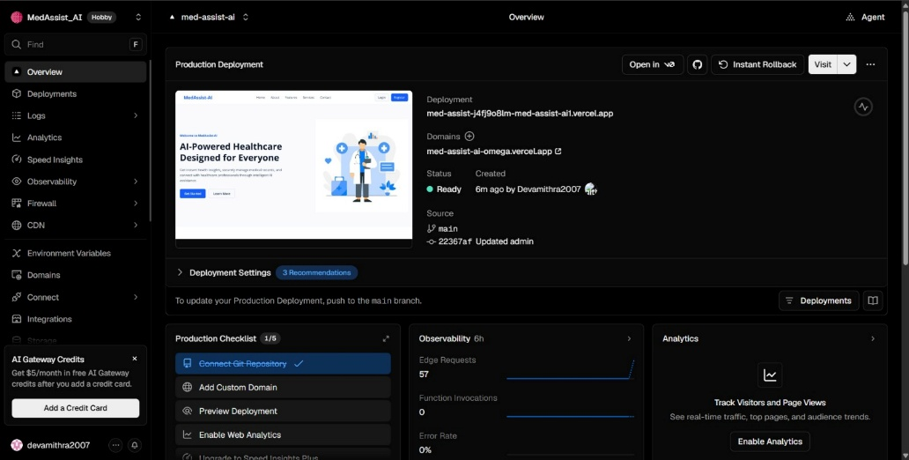
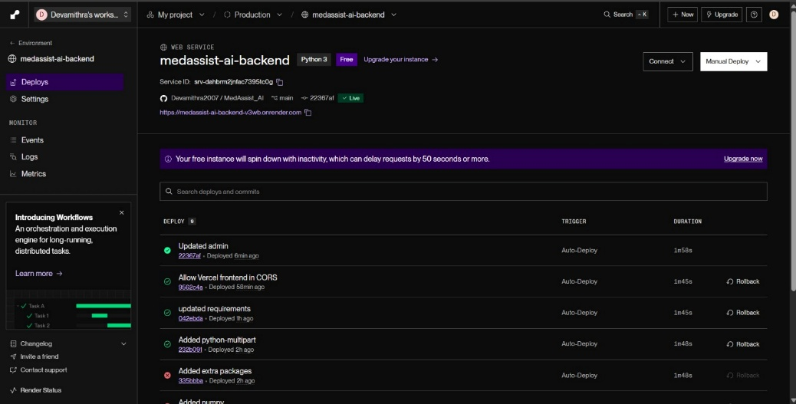
CLOUD DEPLOYMENT
DEPLOYMENT ACTIVITIES
Frontend Deployment using vercel
Backend Deployment using Render
Result: MedAssist AI is available as a live web platform.
MedAssist AI · Milestone 4
6

Slide 8
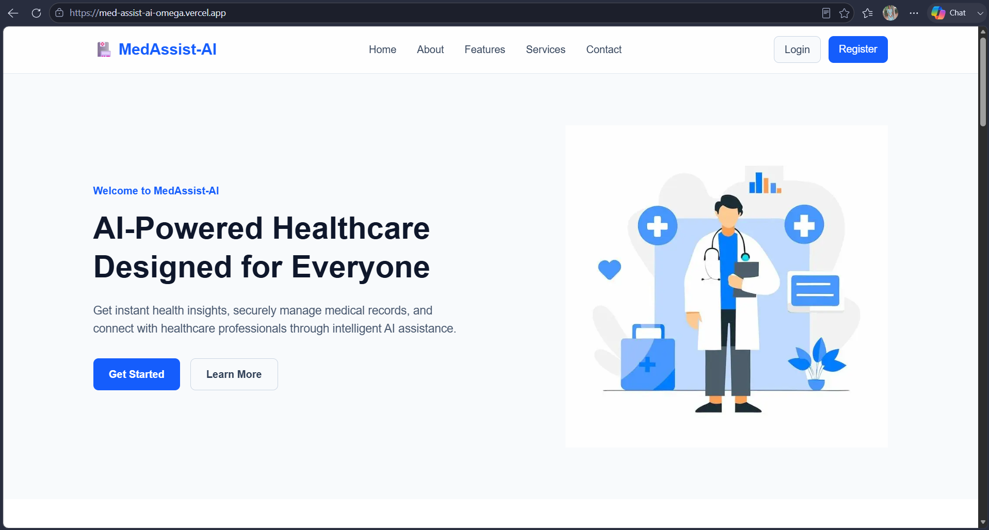

DOCUMENTATION & FINAL PRESENTATION
Telling the complete story
Final documentation was prepared to explain the complete MedAssist AI system.
Documentation Includes
Final Presentation
• Project introduction & objectives
• Explain project objectives
• System architecture
• Demonstrate major features
• Technologies used
• Database design
• Show AI prediction workflow
• AI prediction workflow
• Explain deployment architecture
Screenshots of the platform
• Patient & doctor modules
• Present project outcomes
• Testing & validation
• Deployment process
• Results & outcomes
• Future enhancements
MedAssist AI · Milestone 4
7

Slide 9

FINAL OUTCOME & DEMONSTRATION
MedAssist AI — Final Outcome
Key outcomes delivered across Milestone 4.
AI-based disease prediction system validated
Healthcare workflows tested end-to-end
Patient and doctor dashboards optimized
Responsive and user-friendly interface
PostgreSQL database integrated
Backend deployed on cloud
Frontend deployed on Vercel
Complete platform available for live demonstration
Project documentation and presentation completed
MedAssist AI · Milestone 4
8

