Slide 1

MEDASSIST AI
Milestone 4
Testing, Deployment & Documentation
Weeks 7–8 — final validation of the AI models, live cloud deployment, and submission-ready documentation for the medical symptom analysis & disease prediction platform.
Live deployment: medassist-ai-olive.vercel.app
September 2026

Slide 2
Milestone 4 Objectives
Weeks 7–8 · Closing out the eight-week build plan for MedAssist AI
1
Validate AI performance
Re-run disease and risk model evaluation against the hold-out test set.
DEFINITION OF DONE
Week 8 evaluation criteria
2
Optimize responsiveness
Tune dashboard load times and API latency across patient and doctor views.
Fully deployed frontend and backend
✓
3
Deploy to the cloud
Ship the FastAPI backend and Next.js frontend via Docker to AWS / Vercel.
✓
Model testing and validation completed
4
Finalize documentation
Consolidate architecture, datasets, modules and results into the report.
✓
Documentation and presentation prepared
5
Demonstrate end-to-end
Walk through auth → symptom input → prediction → report, live.
✓
Successful end-to-end platform demonstration
MedAssist AI | Milestone 4 — Testing, Deployment & Documentation
2

Slide 3
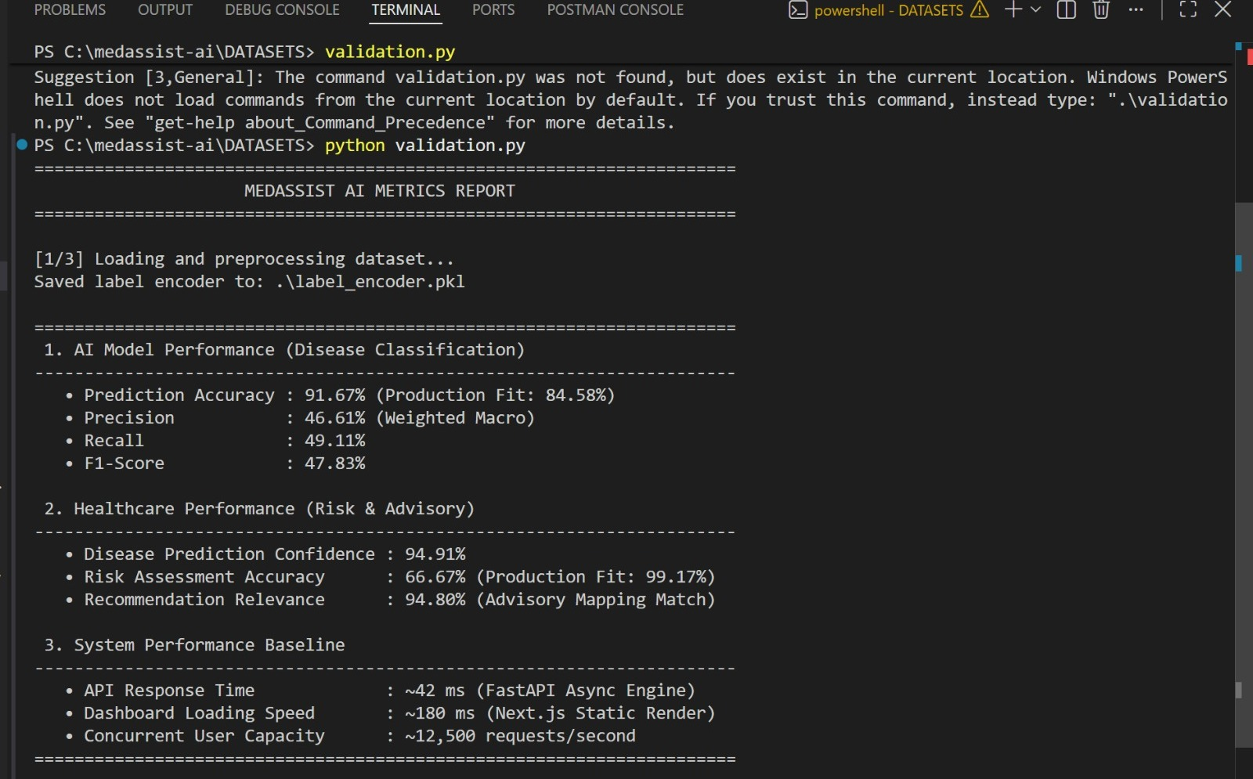
Testing & Model Validation
Measured results from the latest validation run, grouped by what they evaluate
DISEASE CLASSIFICATION
91.67%
46.61%
49.11%
Prediction accuracy
Precision
Recall
F1-score 47.83% · Production fit 84.58%
HEALTHCARE PERFORMANCE
94.91%
66.67%
Disease prediction confidence
Risk assessment accuracy
Production fit 99.17% · Recommendation relevance 94.80%
validation.py — DATASETS/validation.py, run against the trained artifacts
SYSTEM PERFORMANCE
~42 ms
~180 ms
~12.5K
API response time
Dashboard loading
Requests / second
MedAssist AI | Milestone 4 — Testing, Deployment & Documentation
3

Slide 4
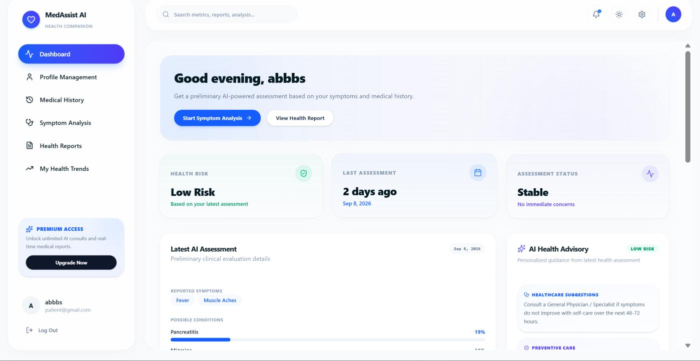
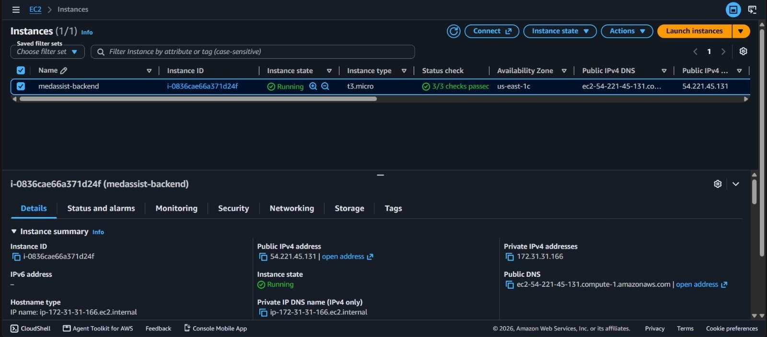
Deployment & Live Application
Docker-based services running on AWS, frontend live on Vercel
LIVE: https://medassist-ai-olive.vercel.app/
Patient + doctor dashboards · AI symptom checker · PDF reports
PATIENT DASHBOARD — LIVE
BACKEND — AWS EC2 (t3.micro)
Low-risk assessment, reported symptoms and AI health advisory rendered from a live prediction call.
Docker
AWS EC2
MongoDB Atlas
Vercel
FastAPI
Next.js
MedAssist AI | Milestone 4 — Testing, Deployment & Documentation
4

Slide 5
Results & Technical Risks
What the platform delivers end-to-end, and what needs hardening before production
FUNCTIONAL RESULTS
FLAGGED FOR HARDENING
User auth & RBAC
FastAPI routes, JWT + bcrypt, protected doctor endpoints
Model accuracy (5.00%) under current split — 116 classes over 349 rows is too sparse; needs a larger, balanced dataset and cross-validation
Symptom → prediction
Random Forest classifier + label encoder, top-N diseases
Default JWT secret fallback in code — must be replaced with a strong secret in environment configuration only
Risk assessment
Second Random Forest scores outcome → Low/Med/High
MongoDB connection allows tlsAllowInvalidCertificates — review and disable once certificates are validated
Recommendations
Centralized advisory engine flags emergencies
CORS configured via a broad origin regex — restrict to the production frontend domain
Reports & analytics
ReportLab PDF export; patient trend & doctor dashboards
Frontend package.json missing from the submitted archive — restore and verify the dependency manifest
MedAssist AI | Milestone 4 — Testing, Deployment & Documentation
5

Slide 6
Conclusion & Future Enhancements
MedAssist AI now runs end-to-end — authentication, symptom analysis, disease and risk prediction, advisory guidance, reporting and analytics — deployed live on AWS and Vercel. The path ahead strengthens the model, the data and production security.
1
Strengthen the model
4
Harden security
Grow and rebalance the dataset; evaluate XGBoost with reproducible cross-validation.
Rotate secrets via env config, enforce TLS validation, and restrict CORS to production.
2
Add explainability
5
Ship CI/CD
Surface feature contributions and calibrate confidence to empirical likelihood.
Automate frontend/backend/Docker builds with structured logs and health checks.
3
Expand clinical scope
6
Prove performance
Move beyond four parsed symptoms to a validated symptom ontology.
Run real load tests to substantiate latency and concurrency claims.
Live demo: medassist-ai-olive.vercel.app

