Slide 1
ScreenSense:Kids’ Screentime Visualization
Done By : Devarasi Bhavani
Duration : 8 Weeks

Slide 2
Project Overview
This project analyzes kids' screentime data to identify patterns based on age, gender, location, device usage, and weekday/weekend behavior. The dataset is cleaned, processed, and visualized using charts, comparisons, and heatmaps. The goal is to uncover meaningful insights that help parents, teachers, and policymakers understand digital habits and promote healthier screen-time routines.

Slide 3
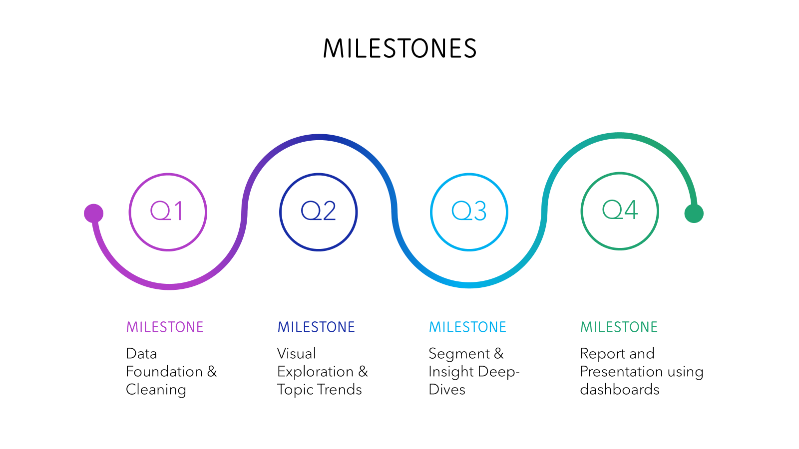
Contents of this template

Slide 4
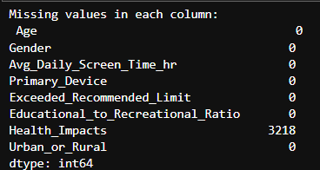
Week 1: Project Initialization & Dataset Setup
What to do:
Define analysis goals & workflow
Import dataset into Jupyter Notebook
Understand schema: columns, data types, size
Detect missing values & anomalies
Record initial assumptions, data quality issues
Output:
Dataset loaded and reviewed
Initial data quality notes
Found missing Values

Slide 5
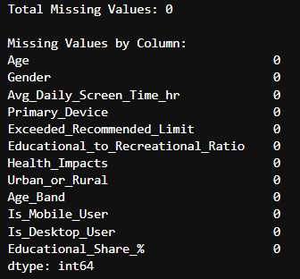
Week 2: Preprocessing & Feature Engineering
Tasks Performed:
Handle missing values
Standardize inconsistent categories (device names, gender labels, etc.)
Create new features:
Age bands
Device usage shares
Activity ratios
Saved the preprocessed dataset
Deliverables:
Cleaned Dataset
Preprocessing Summary
Feature Dictionary

Slide 6
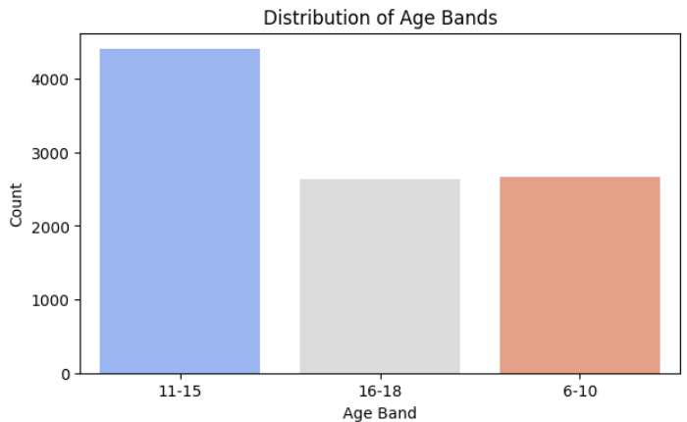
Week 3: Univariate & Bivariate Analysis
Key Visuals:
Histograms (Daily Screen Time Distribution)
Bar charts (Age Bands, Device Usage, Gender)
Boxplots (Screen Time by Gender, Location Type)
Line charts (Time progression if applicable)
Insights :
11-15 is the most screen time using age band
Smarphone is most used device

Slide 7
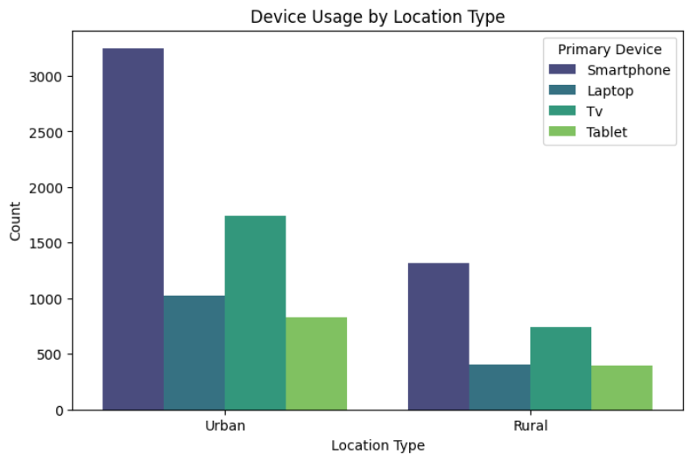
Week 4: Device/Activity & Weekday/Weekend Analysis
Things Analyzed:
Device mix across age, gender, urban/rural
Activity category share (education vs entertainment)
Weekday vs weekend patterns
Time-based usage differences
Insights:
On weekends the screentime is higher
Males use more screentime compared to females

Slide 8

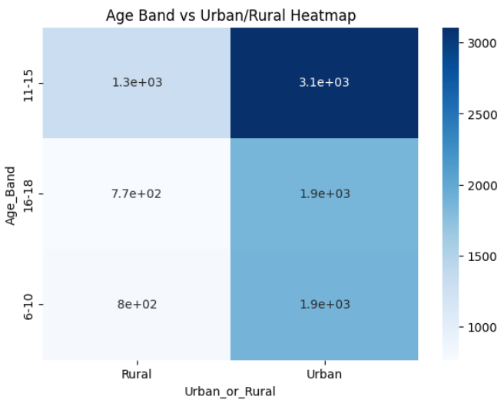
Week 5: Cohort & Segment Analysis
Advanced Analysis:
Identify top user cohorts
Age band × device type combos
Heatmaps for demographic vs activity
Stacked charts for usage clusters
Insights:
11-15 segment uses screens the most
Urban kids are more contributing to the most screentime.

Slide 9
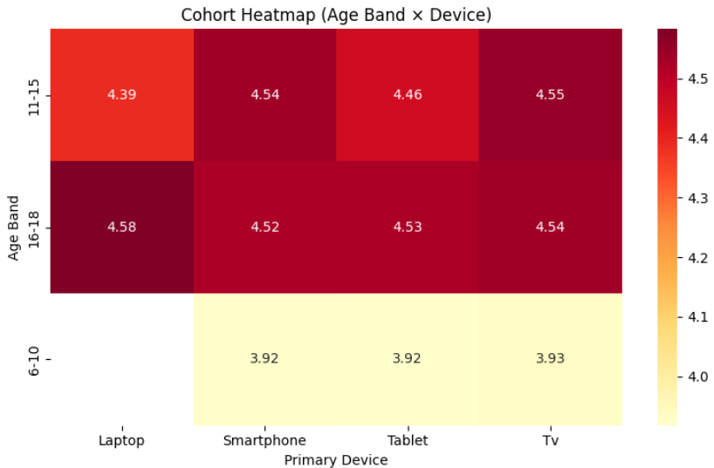
Week 6: Habit/Seasonal Pattern Analysis
Things Analysed:
We don’t have dates/timestamps
Gender-based behavioural patterns
Device preference patterns
Activity split (Educational vs Recreational)
Ratio differences between groups
Insights: 16-18 ageband mostly used laptops Tv is the most used among 6-10

Slide 10
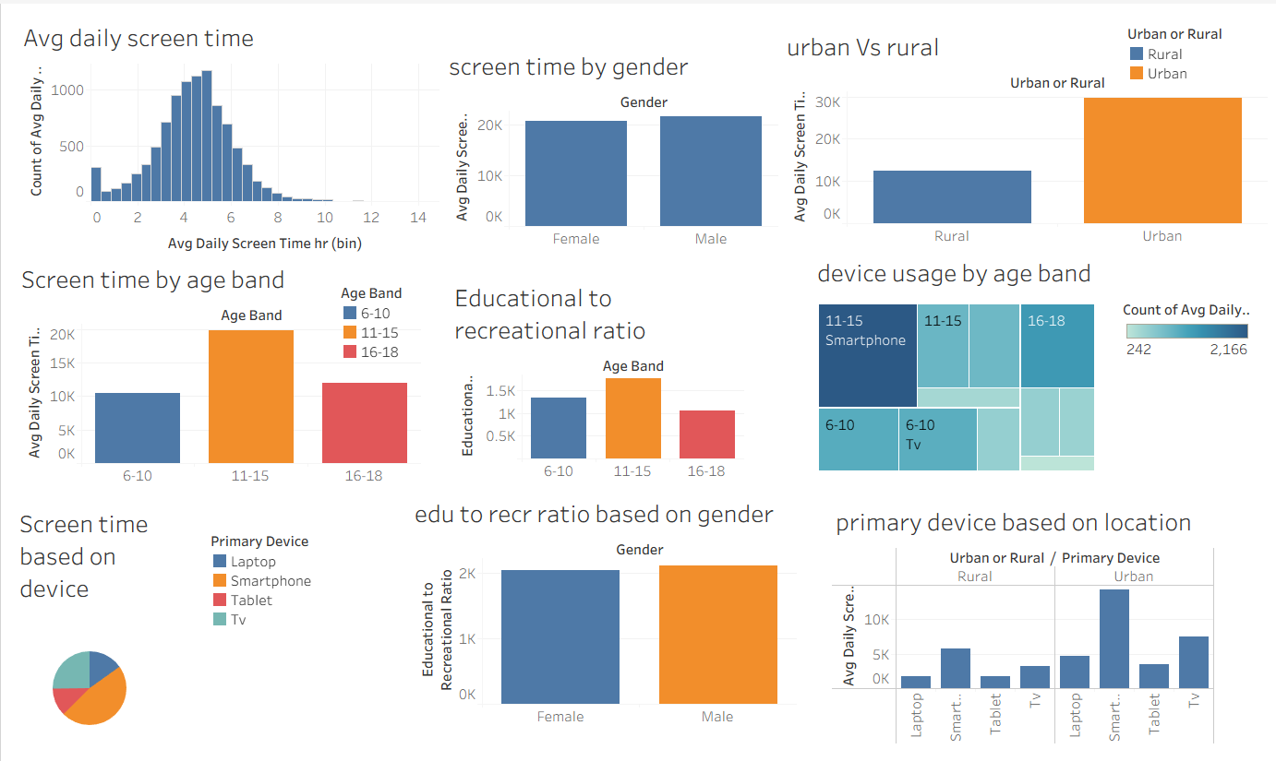
Week 7: Visual Report or Dashboard Preparation

Slide 11
Week 8: Documentation and Final Presentation
Key Insights :
1. Avg Daily Screen Time:
Most kids spend 3–6 hours daily on screens.
Very few are at the extremes.
Overall usage follows a normal distribution, meaning screen habits are consistent across the group.
2. Screen Time by Gender:
Male and Female children have almost the same screen time.
Gender does not significantly influence daily usage.
3. Urban vs Rural:
Urban kids use screens much more compared to rural kids.
Higher access to devices and internet may be driving this increase.

Slide 12
4. Screen Time by Age Band:
11–15 age group shows the highest screen time, peaking above both younger and older groups.
6–10 have the lowest screen time.
Teens (16–18) still use screens heavily but less than early teens.
5.Educational vs Recreational Ratio (Age Band)
11–15 age group has the best balance, with a slightly higher educational ratio.
16–18 group has a lower educational ratio, indicating more recreational usage.
Younger kids (6–10) show moderate educational engagement.
6. Device Usage by Age Band:
Smartphones dominate across all age groups.
Teens (11–15 and 16–18) use smartphones the most.
Younger kids (6–10) rely more on TV than older children.
Laptop and tablet usage is less common overall.
7. Primary Device Based on Location:
Urban kids heavily prefer smartphones.
Rural areas show lower usage overall and more balanced device distribution.
Laptops and tablets are more commonly seen in urban setups.

Slide 13


