Slide 1
ScreenSense: Kids’ Screentime Visualization

Slide 2
1. Project Overview
ScreenSense is a data visualization project designed to analyze digital screentime patterns among children and young adults. With digital devices becoming a central part of entertainment, learning, and communication, understanding screentime behaviour has become increasingly important. This project explores how digital device usage influences daily routines, health, and productivity, and provides insights that support the development of healthier digital habits.
This project uses an interactive Power BI dashboard to explore usage patterns across age, gender, and location, identify health impacts, compare educational vs recreational time, and understand device preferences.

Slide 3
2. Objectives
The major objectives of this project are:
1. To understand the screentime patterns of users across demographics
2.To visualize screen usage across devices, locations, and age groups
3.To analyze health impacts due to excessive screen exposure
4.To examine the educational-to-recreational usage ratio
5.To prepare an interactive dashboard for insights
6.To document findings in a final report and presentation

Slide 4
3. Dataset Description
Dataset Name: Indian Kids Screentime 2025
Source: Kaggle
Rows:9712
Columns: 8

Slide 5
Column Details
Columns | Description
Age | Child’s age
Gender | Male/Female
Avg_Daily_Screen_Time_hr | Daily hours spent on screens
Primary_Device | Mobile, Laptop, Tablet, or TV
Exceeded_Recommended_Limit | Yes/No
Educational_to_Recreational_Ratio | Ratio of productive to entertainment usage
Health_Impacts | Headache, eye strain, etc.
Urban_or_Rural | Location type

Slide 6
4. Data Preprocessing
The following steps were performed based on Week1–Week2 work:
4.1 Handling Missing Values 3218 missing health impact entries replaced with “None”.
Records with Avg_Daily_Screen_Time_hr = 0.0 were replaced with gender-wise mean values, ensuring realistic representation.
4.2 Removing Duplicates
Duplicate records were identified and removed to avoid bias.

Slide 7
4.3 Creating Derived Columns
A. Age Bands
Created using pd.cut()
Groups: 5–10, 11–15, 16–20
B. Date and Day Type
Random dates assigned within October 2025
Day_Type column derived → Weekday / Weekend
C. Device Share
Total screen time grouped by Primary_Device
Calculated the percentage contribution of each device

Slide 8
D. Educational & Recreational Time
Educational Time = Avg_Screen_Time × Ratio
Recreational Time = Total − Educational Time
Share (%) calculated for visualization
4.4 Saving Preprocessed Data
Final cleaned dataset saved as preprocessed_data.csv for

Slide 9
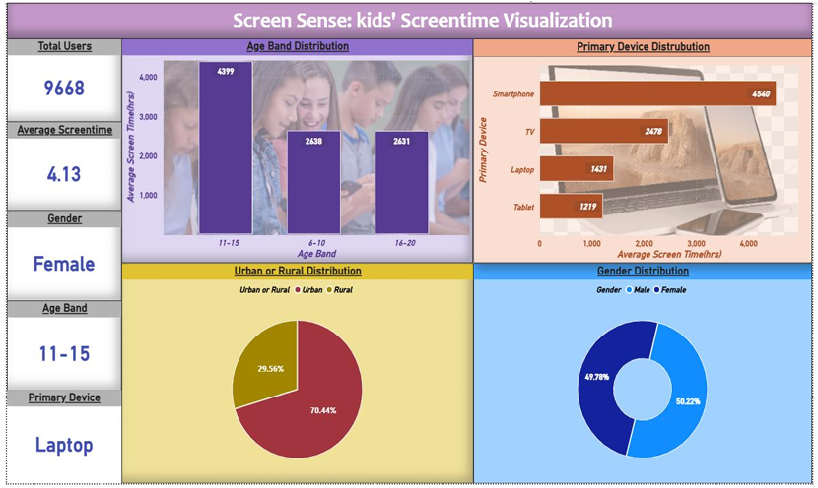
5. Dashboard Development
A two-page Power BI dashboard was created as the final deliverable.
Page 1 – Overview Dashboard

Slide 10
KPI Cards
1. Total Users: This card shows the total number of participants (9,668) included in the dataset. It represents the complete sample size used for the screentime analysis.
2. Average Screentime: This KPI displays the overall average daily screen time (4.13 hours) across all users. It provides a quick summary of typical digital device usage.
3. Gender (Selected Filter Output): Shows the currently filtered gender category from the slicer. In the screenshot, the selected gender is Female, meaning all visuals update based on female users.
4. Age Band (Selected Filter Output): Displays the active age segment chosen using the slicer. Here, the selected group is 11–15 years, so all visuals reflect data for that category

Slide 11
5. Primary Device (Selected Filter Output):
Shows the primary device selected in the slicer—in this case, Laptop. All charts adjust based on this filter.
Main Dashboard Visuals
Age Band Distribution (BarChart)
This bar chart shows the distribution of users across age groups (6–10, 11–15, 16–20).
It helps identify which age group is most active and how screen time varies between groups.
2. Primary Device Distribution (Horizontal Bar Chart)
This chart displays the count or average screentime for each primary device (Smartphone, TV, Laptop, Tablet).

Slide 12
It reveals which device category is used the most, with smartphones being the dominant device.
3. Urban or Rural Distribution (Pie Chart)
Shows the percentage split of users based on geographic location—Urban or Rural.
It helps identify whether screentime trends are more common in urban regions or rural areas.
4. Gender Distribution (Donut Chart)
This donut chart shows the overall male vs female ratio in the dataset.
It highlights that the dataset is nearly evenly split (approx. 50% each), indicating a balanced gender representation.

Slide 13
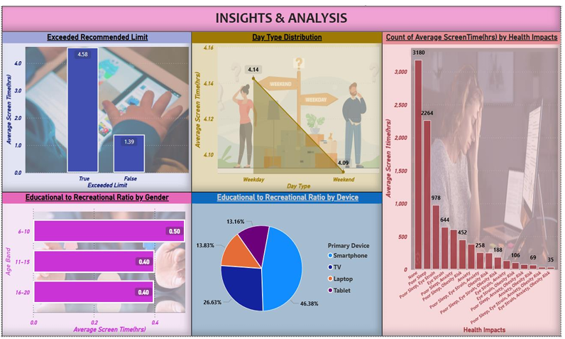
Page 2 – Deep Insights Dashboard

Slide 14
Exceeded Recommended Limit
Definition: This chart shows the average screen time for users who exceeded the recommended screen time limit versus those who did not.
Insight: Users who exceeded the limit averaged 4.58 hours of screen t ime, while those within limits averaged 1.39 hours.
Purpose: Helps identify the proportion of users at risk of overexposure to digital devices.
2. Day Type Distribution
Definition: Compares average screen time on weekdays vs. weekends.
Insight: Screen time slightly decreases on weekends (4.09 hrs) compared to weekdays (4.14 hrs), suggesting weekday usage is marginally higher.
Purpose: Shows how daily routines affect digital device usage.

Slide 15
3. Count of Average Screen Time (hrs) by Health Impacts
Definition: Bar chart linking average screen time to associated health risks like poor sleep, eye strain, anxiety, and obesity.
Insight: Most users (3180) reported no health impact, while fewer users experienced multiple or severe health risks (e.g., only 35 in highest risk category).
Purpose: Helps assess how screen time correlates with physical and mental health.
4. Educational to Recreational Ratio by Gender
Definition: Compares average hours spent on educational activities versus recreational activities by different age bands.
Insight: Younger age group (6–10) has a slightly higher educational-to recreational ratio (0.50) than older groups (11–20, 0.40).
Purpose: Helps understand learning versus leisure balance across ages.

Slide 16
5. Educational to Recreational Ratio by Device
Definition: Pie chart showing which devices are used primarily for educational versus recreational purposes.
Insight: Smartphones dominate usage (46.38%), followed by laptops (26.63%), TVs (13.83%), and tablets (13.16%).
Purpose: Identifies which devices contribute most to educational or recreational screen time.

Slide 17
6. Insights & Observations
Age-based Usage
Teenagers (11–15) show the highest daily screen hours.
Younger children (5–10) have lower screen usage.
2. Gender-based Usage
Screen usage is slightly higher among boys across all age groups.
3. Device Trends
Mobile phones contribute the highest share of total screen time.
Tablets and laptops have moderate usage.
4. Location Patterns
Urban children have significantly higher screen exposure than rural children.

Slide 18
5. Educational vs Recreational Time
Recreational screen time dominates (gaming, entertainment).
Educational usage decreases with increasing age.
6. Health Impacts
Children crossing 4+ hours/day show more eye strain, headaches, and fatigue.
7. Weekday vs Weekend
Weekend screen usage is 25–40% higher than weekday usage.

Slide 19
7. Key Findings
Most children exceed recommended limits, especially mobile users.
Screen time increases steadily with age
Recreational activities dominate over educational ones.
Digital device usage strongly correlates with health complaints.
Urban lifestyle increases screen usage intensity.

Slide 20
8. Conclusion
The ScreenSense project provides a comprehensive view of screentime behavior among children, highlighting crucial patterns in device usage, health impacts, educational engagement, and exceeding recommended screen time.
This dashboard can support parents, educators, and policymakers in making informed decisions and encouraging healthier digital habits.
Future improvements may include integrating machine learning for prediction, age-specific recommendations, and real-time monitoring dashboards.

