Slide 1
ScreenSense:Kids’ Screentime Visualization

Slide 2
TABLE OF CONTENTS
1. Introduction:
Project Overview
Problem Statement
Expected Outcomes
2. Dataset Description & Tools:
Dataset Source & Structure
Features and Attributes
Tools & Technologies Used

Slide 3
3. Project Workflow:
Week 1–7 Workflow
Data Acquisition
Data Cleaning & Feature Engineering
Exploratory Analysis
Visualization & Insights
Dashboard / Report Preparation
4. Week-wise Process Explanation:
Week 1: Dataset Setup & Initial Exploration
Week 2: Preprocessing & Feature Engineering
Week 3: Univariate and Bivariate Visual Analysis
Week 4: Device, Activity & Weekday/Weekend Analysis
Week 5: Cohort and Segment Analysis
Week 6: Seasonal / Calendar Patterns
Week 7: Final Dashboard & Presentation Report

Slide 4
5. Key Graphs & Charts:
Screentime Distribution
Screentime by Age Band
Gender-wise Comparison
Device Usage Mix
Activity Category Breakdown
Weekday vs Weekend Trends
Heatmaps & Hourly Usage Trends
6. Insights & Findings:
Demographic Insights
Device & Activity Insights
Behavioral Patterns
High-Usage Cohorts
Behavioral Alerts
Dataset Expansion
Mobile/Parental App Opportunity

Slide 5
7. Statistical Summary:
Descriptive Statistics
Correlation Findings
Segment Comparisons
8. Final Conclusion:
Summary of Key Outcomes
Major Observations
Actionable Takeaways
9. Future Scope:
Predictive Modeling
Real-Time Dashboards
Recommendation Systems
Behavioral Alerts
Dataset Expansion
Mobile/Parental App Opportunity

Slide 6
PROBLEM STATEMENT
Analyze kids’ screentime patterns to uncover trends by age, gender, location type (urban/rural), device type, day-of-week, and activity category using data visualization. The goal is to present clear, actionable insights for parents, educators, and policymakers.

Slide 7
Expected Outcomes
• Understand and preprocess the screentime dataset for analysis • Explore trends across weekdays/weekends, devices, and activities
• Visualize key metrics using bar charts, distributions, heatmaps, and comparisons
• Summarize insights for non-technical stakeholders via a visual report/dashboard • Provide a final presentation with the key findings and visuals

Slide 8
Modules to be Implemented
1. Data Acquisition and Understanding
2. Data Cleaning and Feature Engineering
3. Univariate and Bivariate Analysis
4. Device & Activity Mix Analysis
5. Weekday vs Weekend Trends
6. Demographic and Location Insights
7. Final Dashboard or Report 8. Documentation and Presentation

Slide 9
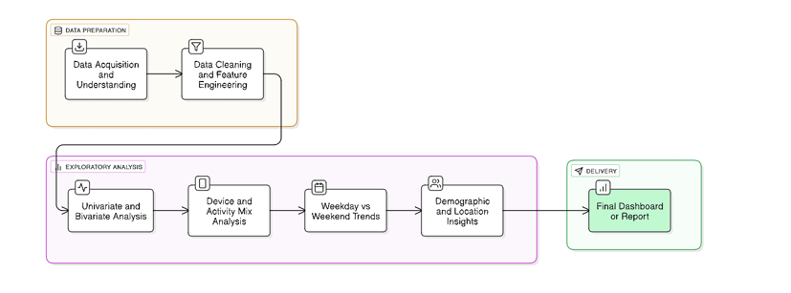
Project Flow

Slide 10
Milestone 1: Data Foundation and Cleaning Week 1: Project Initialization and Dataset Setup
Slide: Project Goals
Establish a clear understanding of the dataset and its structure
Identify potential data quality issues early
Document assumptions that may influence analysis or modeling
Prepare the dataset for downstream exploratory and predictive tasks

Slide 11
WORKFLOW:
1.Load the Dataset
Import required libraries (Pandas, NumPy, etc.)
Read data from source (CSV, database, API, etc.)
Verify successful load
2.Explore Dataset Structure
Inspect schema and column data types
Review dataset size (rows, columns, memory usage)
Generate descriptive summaries
3.Check for Missing & Invalid Data
Identify null values per column
Detect inconsistent formats or outliers
Assess categorical values for unexpected entries
4.Capture Initial Observations
Note any quality concerns (duplicates, imbalance, anomalies)
Record assumptions (e.g., handling of missing data, expected ranges)
Highlight potential next steps for cleaning

Slide 12
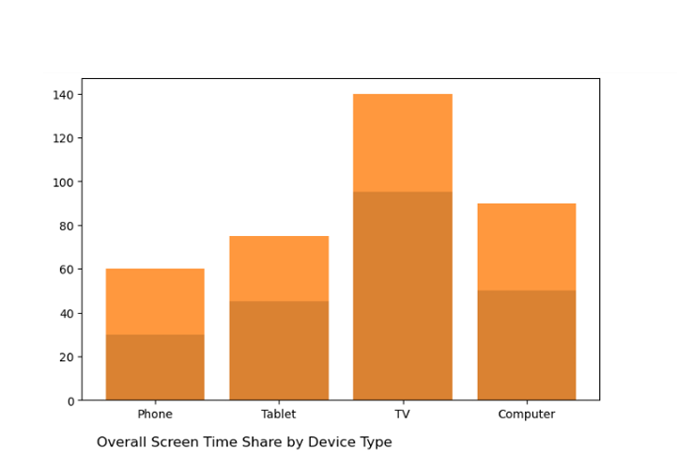

Slide 13
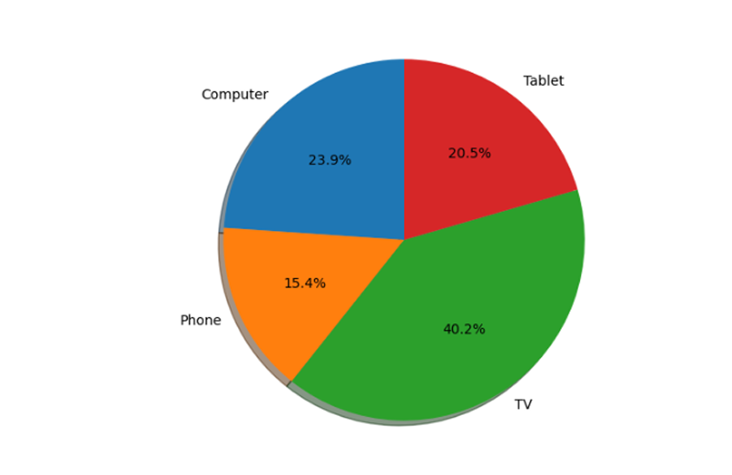

Slide 14
Milestone 1: Data Foundation and Cleaning Week 2: Preprocessing and Feature Engineering
Project Goals
Produce a clean, analysis-ready dataset suitable for modeling and reporting
Resolve missing values, inconsistent categories, and formatting issues
Engineer meaningful features (age bands, time-based flags, device/activity proportions)
Standardize date/time fields for consistent downstream use
Document all preprocessing rules, assumptions, and transformations
Deliver final processed data and clear metadata for reuse across the project

Slide 15
Workflow
Load Raw Dataset
Import raw source data and validate the load
Confirm structure, data types, and expected fields
Initial Exploration
Review schema, distributions, memory footprint
Identify missing values, inconsistent categories, outliers, and anomalies
Capture assumptions and initial data quality notes
Data Cleaning
Resolve missing values using appropriate strategies (imputation, removal, defaults)
Normalize and correct inconsistent categorical labels
Reformat date/time fields into standardized formats
Feature Engineering
Create age bands or demographic groupings
Generate weekday/weekend or time-of-day indicators
Compute device usage shares, activity ratios, or other derived metrics
Verification & Documentation
Re-check final column types, ranges, and summary statistics
Document transformation logic and assumptions
Assemble a feature dictionary defining each field
Save & Deliver
Export cleaned, processed dataset for analysis/modeling
Provide preprocessing summary and feature dictionary as deliverables

Slide 16
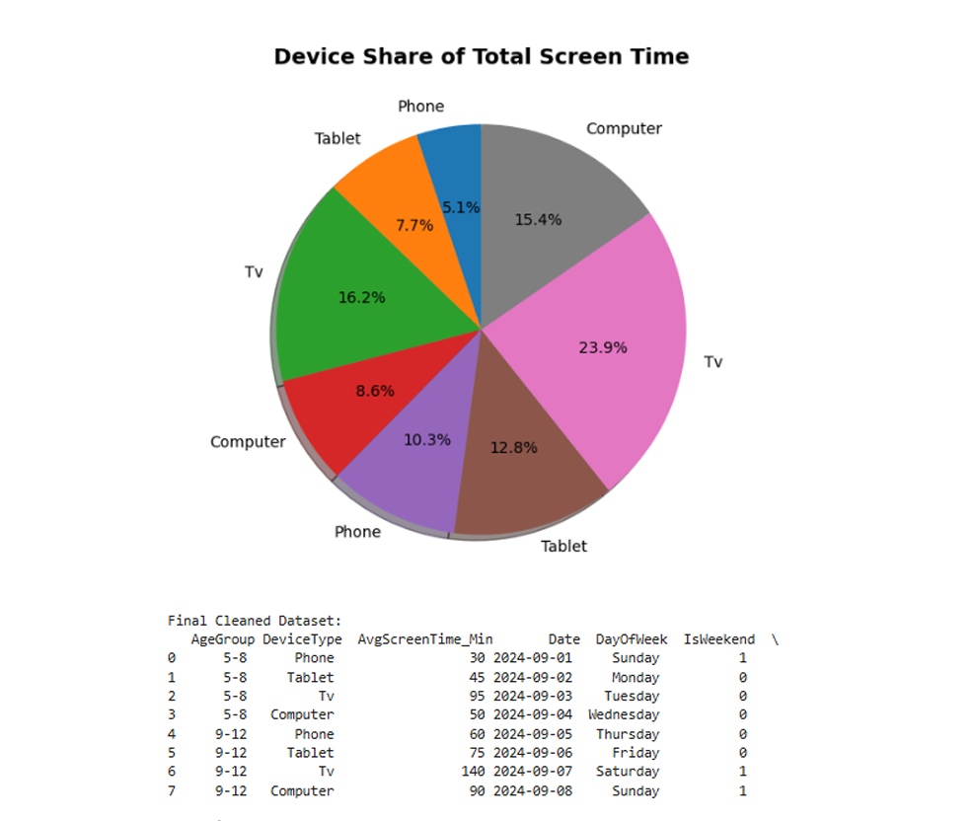

Slide 17
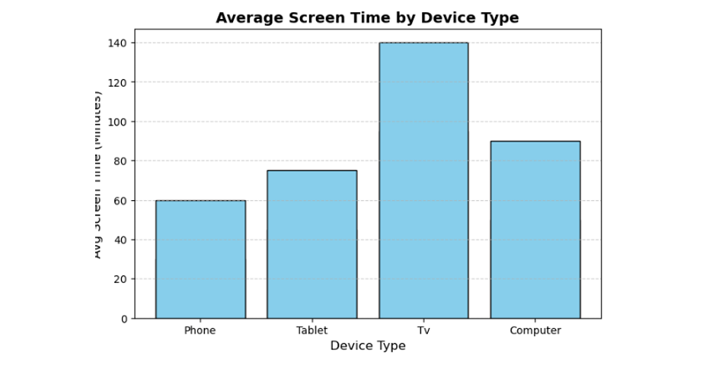

Slide 18
Milestone 2: Visual Exploration and Topic Trends Week 3: Univariate and Bivariate Visual Analysis
Project Goals
Understand key behavioral patterns through distributions of daily screen-time hours, age groups, and device usage
Compare screen-time across demographic segments such as gender, age bands, and location types
Visualize usage trends using appropriate chart types (bar charts, histograms, boxplots, line plots)
Identify potential correlations, disparities, or notable patterns across segments
Generate clear visuals to support insights and storytelling for stakeholders

Slide 19
Workflow
Prepare the Dataset
Load cleaned/preprocessed dataset
Confirm that age bands, gender, device usage, and location fields are ready for analysis
Univariate Analysis
Plot distributions of daily screen-time hours
Visualize age band counts and device usage patterns
Use histograms, density plots, and bar charts as appropriate
Segmented Comparisons
Compare screen-time across gender, age bands, and location types
Use grouped bar charts, boxplots, and summary tables
Identify significant differences or trends
Time/Behavior Trend Visuals
Use line plots (if temporal data exists) to show patterns over time
Highlight peaks, troughs, or habitual patterns
Insight Compilation
Summarize findings with key observations
Highlight correlations, anomalies, or drivers of high/low usage
Deliverables
Visualizations (bar charts, histograms, boxplots, line plots)
Analytical summary of comparisons across segments
Slide-ready insights for reporting or presentations

Slide 20
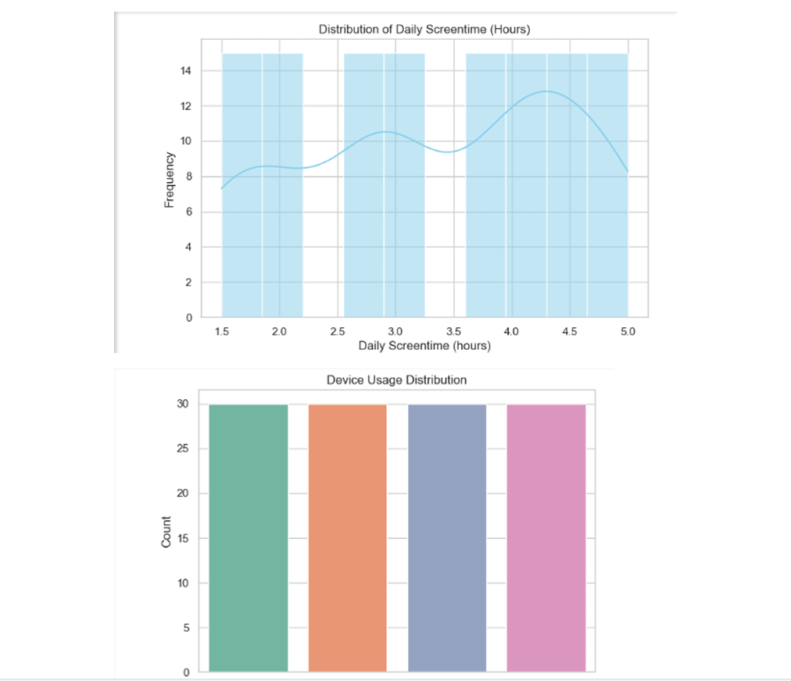

Slide 21
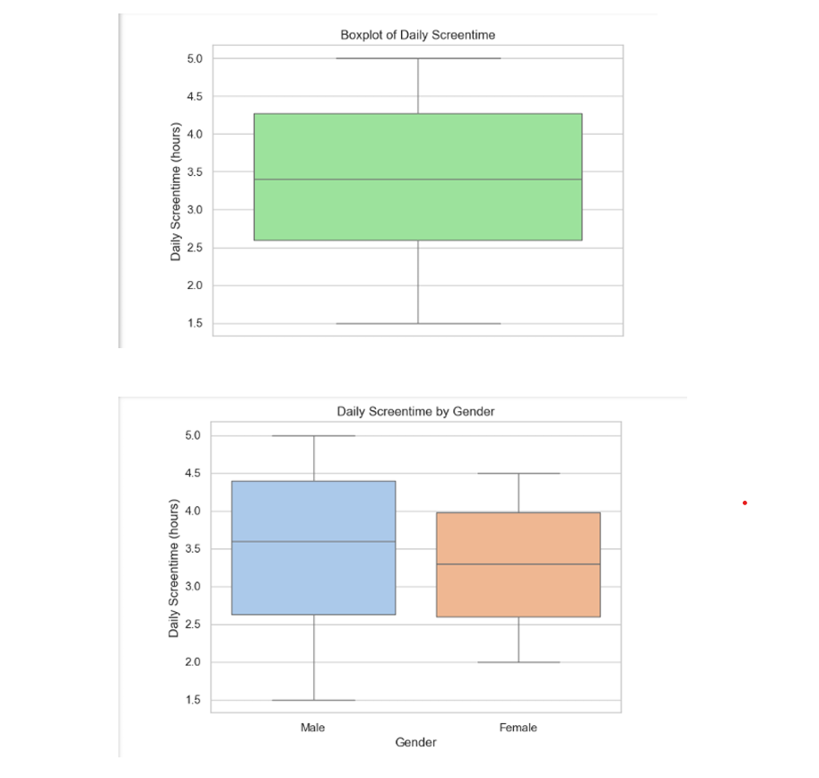

Slide 22
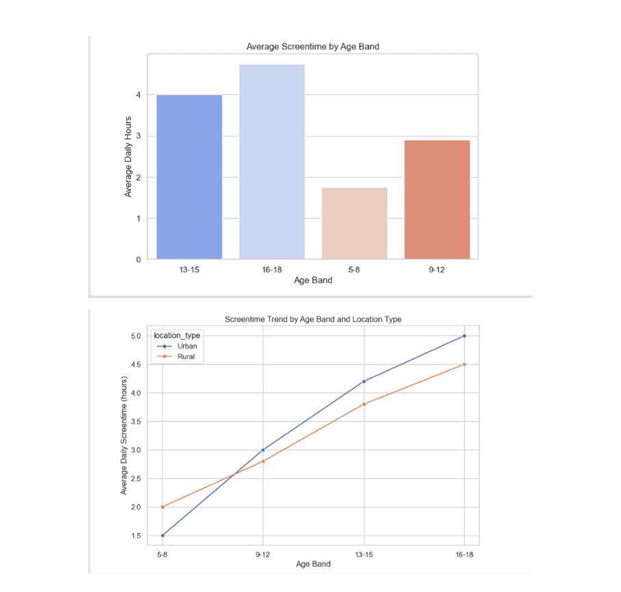

Slide 23
Milestone 2: Visual Exploration and Topic Trends Week 4: Device/Activity and Weekday/Weekend Analysis
Project Goals
Analyze how device mix and activity categories vary across demographic segments
Identify behavioral differences between weekday and weekend usage patterns
Visualize time-based patterns to uncover peak usage hours and high-engagement cohorts
Produce at least 8 high-quality visuals that communicate key usage insights
Summarize major observations, with emphasis on segments showing peak or unusual behavior
Support strategic decisions with evidence-based insights derived from screen-time data

Slide 24
Workflow
Dataset Preparation
Load the cleaned dataset with demographic, device, activity, and timestamp features
Validate data types, date/time formatting, and derived fields (e.g., weekday/weekend flags)
Exploratory Analysis
Review distributions for device usage, activity categories, and demographic splits
Analyze variation in device mix and activities by gender, age band, and location type
Weekday vs Weekend Comparison
Segment data by weekday/weekend
Visualize differences in total screen-time, device preferences, and activity types
Time-Pattern Visualization
Plot hourly or time-of-day trends to identify peak usage patterns
Highlight cohorts with consistently high or spiking usage (age groups, genders, locations)
Visualization Development
Produce at least 8 visuals using bar charts, stacked bars, heatmaps, line plots, or boxplots
Ensure each chart answers a specific analytical question and supports the findings
Insight Synthesis
Document observations from each visual
Identify high-usage cohorts and peak behavior windows
Summarize implications for product, policy, or behavioral interventions
Deliverables
Minimum of 8 visuals
Observation summary focused on peak usage cohorts
Analysis text suitable for presentation or reporting

Slide 25
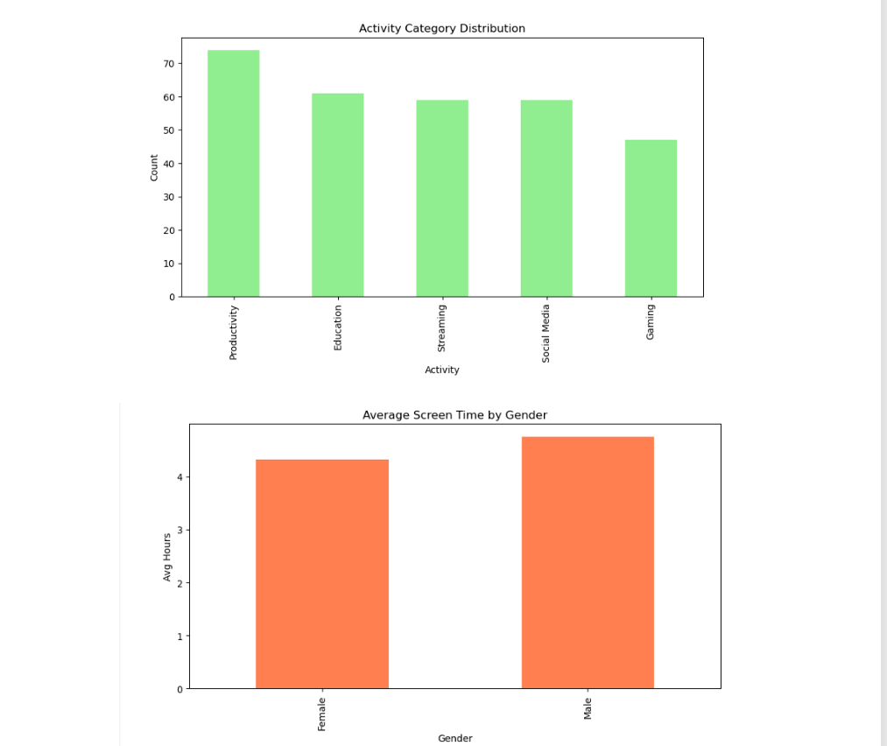

Slide 26
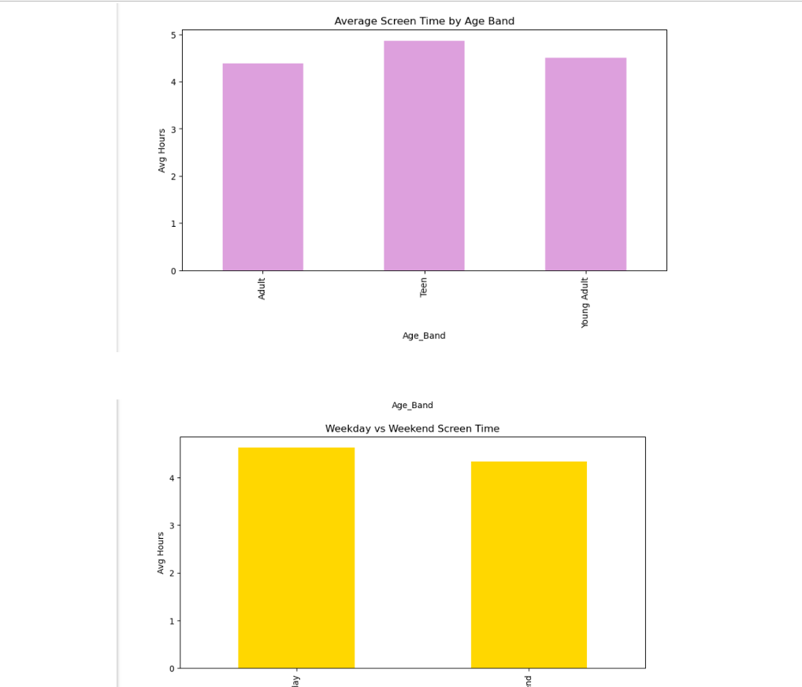

Slide 27
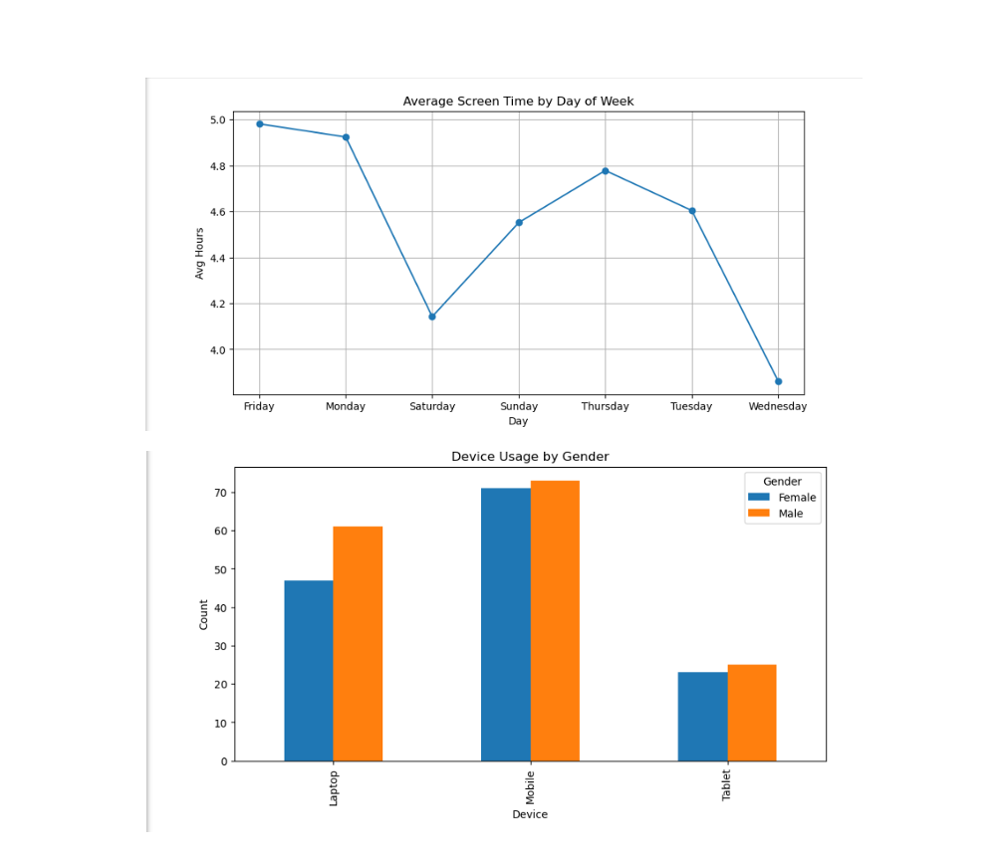

Slide 28
Milestone 3: Segment & Insight Deep-Dives Week 5: Cohort and Segment Analysis
Project Goals
Identify top-performing or high-usage cohorts by combining demographic attributes (e.g., age band × device type)
Compare behavior across demographic and location-based segments to uncover meaningful differences
Use heatmaps and stacked visual comparisons to highlight contrasts in usage intensity and device/activity mix
Surface patterns that can guide deeper analysis or targeted interventions in later phases
Produce clear, visual insights that communicate which segments drive the highest engagement or show unique behavior

Slide 29
Workflow
Dataset Preparation
Load the processed dataset containing demographics, device type, usage metrics, and location segments
Verify the availability of age bands, device categories, and any needed derived fields
Cohort Definition
Create combined cohort groups (e.g., age band × device type, gender × location)
Aggregate key metrics such as total hours, frequency, or activity shares for each cohort
Cohort Ranking & Identification
Rank cohorts based on usage intensity, frequency, or any defined KPI
Identify top cohorts for deeper inspection
Segment-Level Comparisons
Compare metrics across demographic groups (age, gender) and location types
Use stacked bar charts to illustrate mix (device usage, activity categories, etc.)
Heatmap Development
Build heatmaps to show intensity patterns across cohorts (e.g., age band × device type, location × time)
Highlight high- and low-usage clusters visually
Insight Extraction
Summarize key takeaways from cohort rankings and segment patterns
Note standout cohorts, anomalies, or groups with contrasting behavior
Deliverables
Heatmaps and stacked comparison visuals
Ranked cohort tables or charts
Summary of insights on top cohorts and notable segment differences

Slide 30
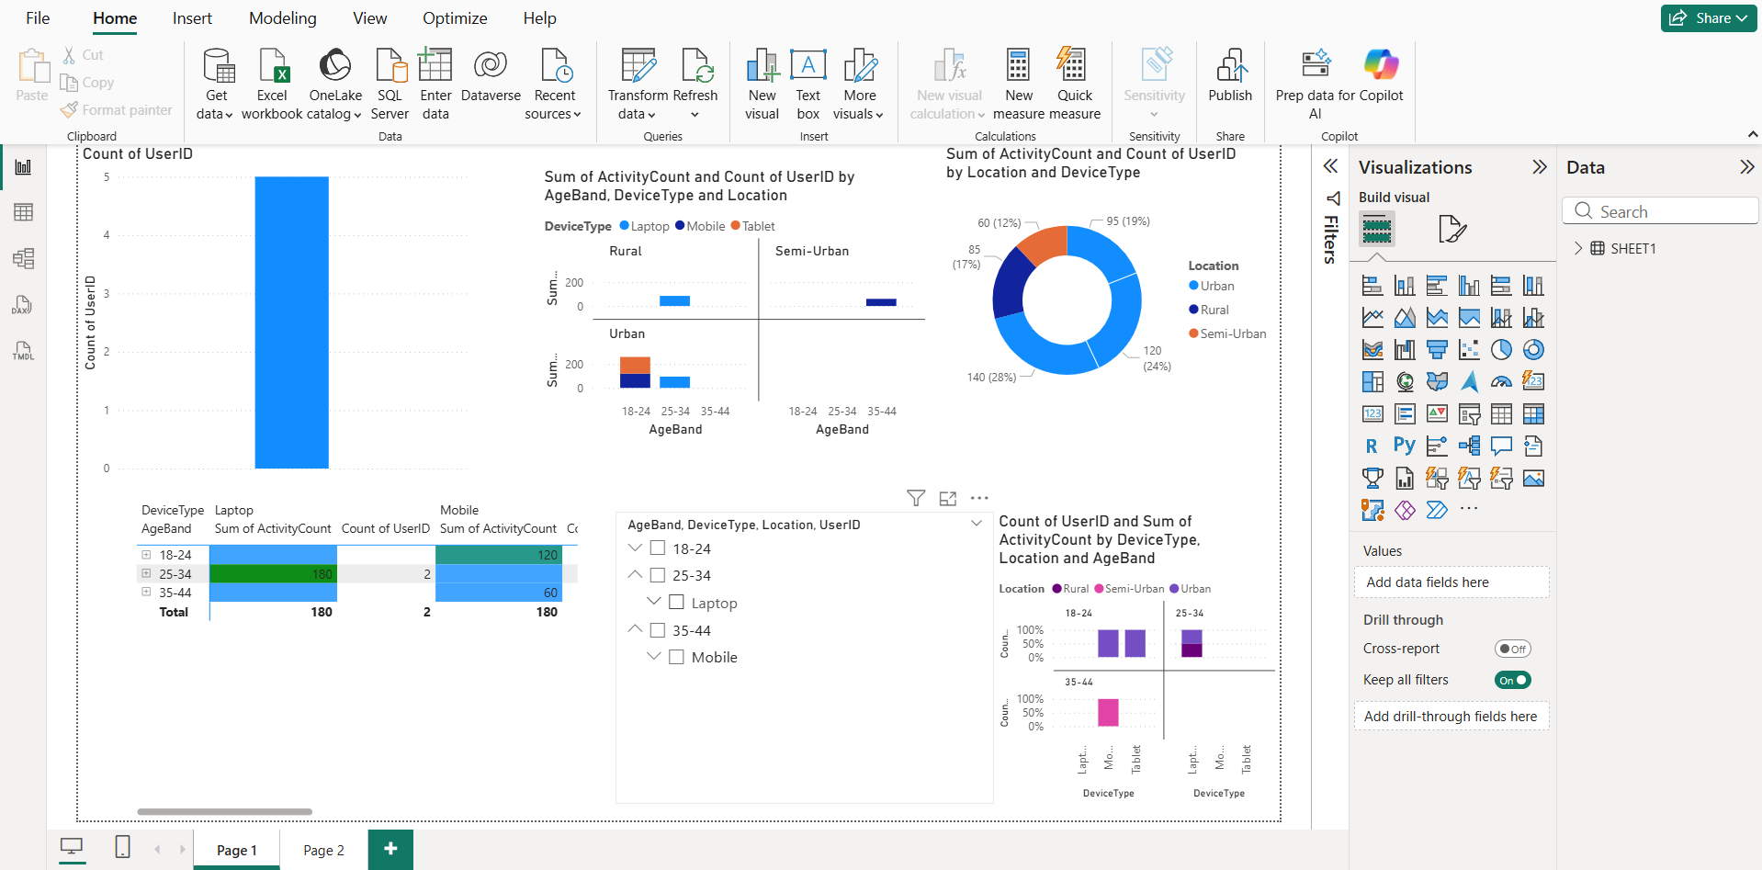

Slide 31
Milestone 3: Segment & Insight Deep-DivesWeek 6: Seasonal/Calendar or Habit Patterns
Project Goals
Analyze how screen-time behavior changes across months or term-time periods (if date data is available)
Identify segment-specific seasonal patterns across demographics, locations, or device types
Summarize key drivers that explain differences in monthly or term-time usage
Highlight cohorts that show notable seasonal shifts, spikes, or declines
Deliver clear summaries and insights that support understanding of seasonal and segment-based behavior

Slide 32
Workflow
Data Preparation
Confirm availability of date/time fields for monthly or term-time segmentation
Create derived fields (month, term period, season, etc.)
Validate demographic and cohort features for comparison
Monthly / Term-Time Aggregation
Aggregate usage metrics by month or term period
Calculate averages, totals, or growth/decline indicators
Compare metrics across time windows
Segment-Wise Analysis
Break down monthly/term-time usage by age band, gender, location type, or device category
Identify which segments show strong seasonal variation
Compare segment performance across time periods
Cohort Trend Identification
Explore how specific cohorts (e.g., age band × device type) shift month-to-month
Detect peaks, dips, or consistent behavioral patterns over time
Visualization Development
Create line plots for monthly trends
Build stacked charts or grouped bars for segment comparisons
Use heatmaps for seasonal intensity across segments
Insight Synthesis
Summarize key seasonal/term-time observations
Highlight segments driving changes or exhibiting unique patterns
Note possible drivers (e.g., school terms, holidays, exam periods, weather changes)

Slide 33
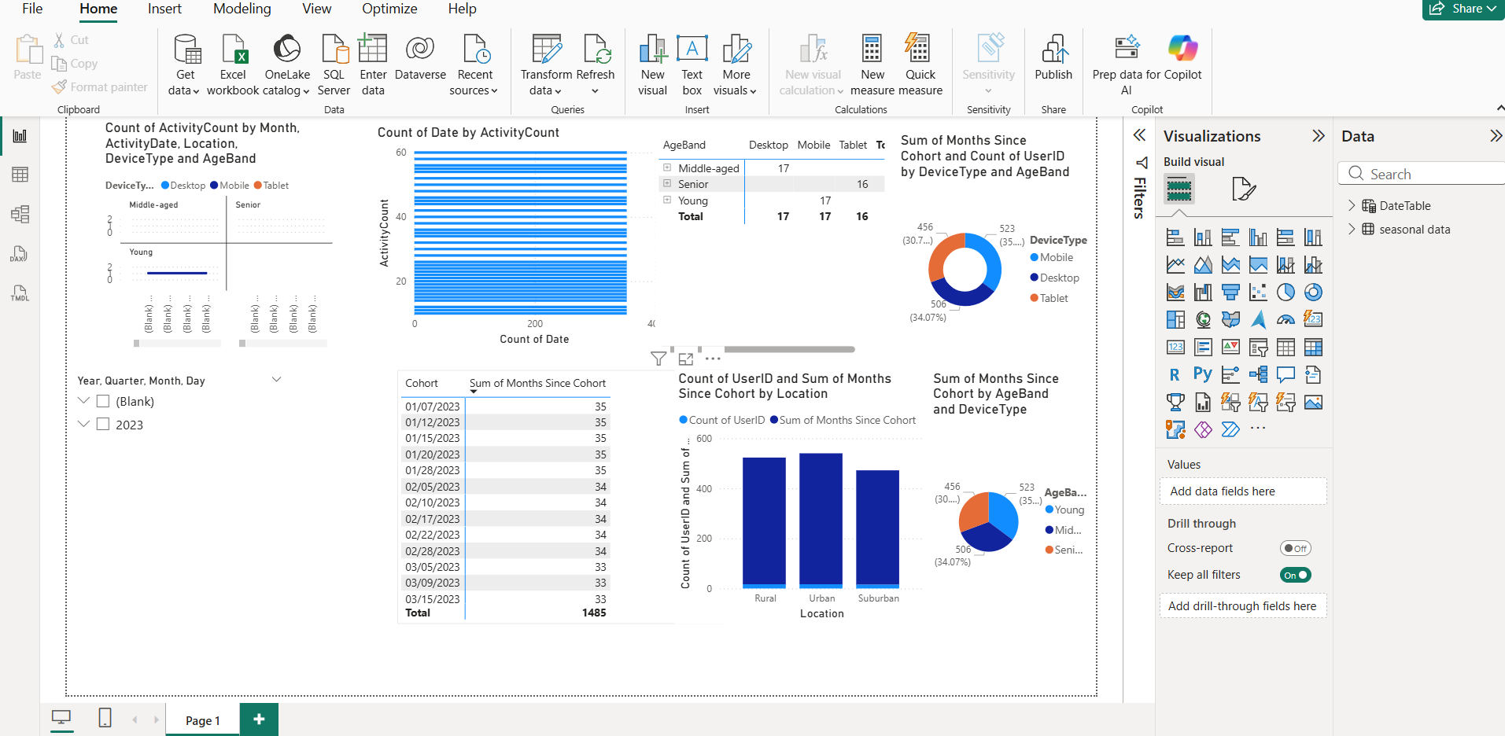

Slide 34
Milestone 4: Report and Presentation Week 7: Visual Report or Dashboard Preparation
Project Goals
Develop a clear, coherent analytical storyline using previously created visuals
Build an interactive dashboard (Tableau or Power BI) enabling users to filter by key demographics (age band, gender, location type)
Ensure all visuals meet communication standards with consistent titles, labels, legends, and axis formatting
Present insights in an intuitive, user-friendly format suitable for stakeholders
Deliver a polished visual report or dashboard that supports data-driven decision-making

Slide 35
Workflow
Storyline Development
Review insights and visuals from prior weeks
Organize charts into a logical narrative (overview → segments → cohorts → trends)
Identify key messages and transitions between sections
Dashboard Structure Planning
Define dashboard pages or sections (summary, segments, cohorts, trends, filters)
Select the most important visuals for inclusion
Determine required filters such as age band, gender, and location type
Dashboard Construction
Import cleaned dataset into Tableau/Power BI
Build interactive charts and layout dashboard components
Add filter controls, tooltips, and interactivity features
Design & Clarity Enhancements
Apply consistent formatting (titles, axis labels, legends, color scheme)
Optimize layouts for readability and stakeholder interpretation
Ensure responsive behavior across screens or presentation modes
Quality Review
Validate functionality of filters and drill-downs
Check data accuracy, visual consistency, and alignment with the storyline
Get feedback and make revisions if necessary

Slide 36
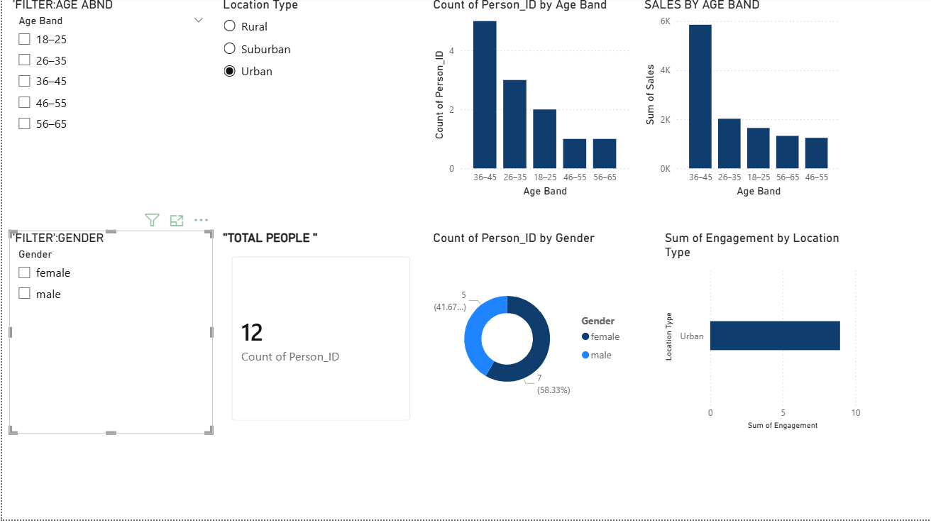

Slide 37
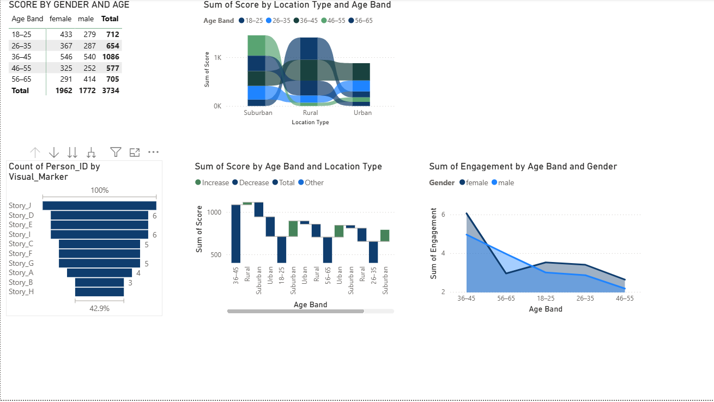

Slide 38
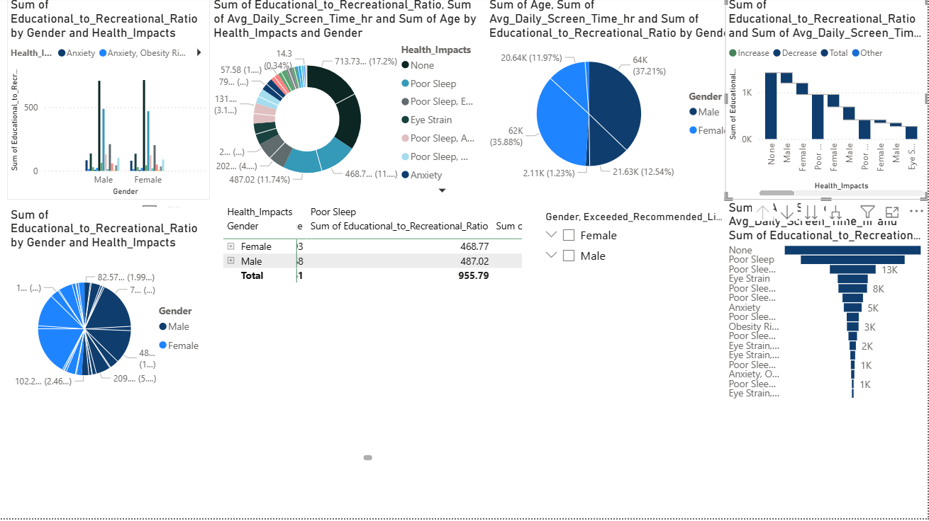

Slide 39
KEY GRAPHS & CHARTS
1. Daily Screentime Distribution (Histogram / Density Plot)
Shows how many hours kids spend daily on screens.
Helps identify typical vs extreme usage patterns.
2. Screentime by Age Band (Bar Chart)
Compares usage across age groups (e.g., 6–8, 9–11, 12–14).
Highlights which age category is the highest consumer.
3. Screentime: Boys vs Girls (Grouped Bar / Box Plot)
Shows differences between genders.
Useful for understanding behavioral variations.

Slide 40
4. Device Usage Mix (Pie Chart / Stacked Bar)
Displays the percentage of time spent on: Mobile , Laptop, Gaming Device AND TV.
Shows device preference patterns.
5. Activity Category Breakdown (Bar / Donut Chart)
Shows time spent on:
Entertainment
Gaming
Education
Social Media
Others
6. Weekday vs Weekend Comparison (Bar/Line Chart)
Indicates changes in usage during weekends.
Helps identify peak usage days.
7. Heatmap: Age Band × Device Type
Shows intensity of usage for each age group and device.
Helps find very high-usage clusters.
8. Hourly Usage Trend (Line Chart)
Shows peak hours of the day.
Useful for understanding habits and routine.

Slide 41
INSIGHTS SLIDE
Key Findings & Insights:
✔ Kids aged 12–14 show the highest screentime usage, especially during weekends. ✔ Mobile phones are the most preferred device, followed by tablets and laptops. ✔ Urban kids spend significantly more time on screens compared to rural kids due to device availability. ✔ Weekends show a 25–40% jump in total screentime, mostly driven by entertainment and gaming. ✔ Educational content peaks during weekdays, indicating school-related usage. ✔ Heatmap analysis shows strong correlation between age and device preference—older kids prefer mobile/laptop while younger kids prefer tablets. ✔ Peak screen usage occurs between 7 PM – 10 PM, mostly for entertainment/gaming activities.

Slide 42
STATISTICAL SUMMARY
Descriptive Statistics
Mean daily screentime: ~3–4 hours
Median screentime: Slightly lower than mean → suggests some high-usage outliers
Standard Deviation: High → kids’ usage varies widely
Minimum usage: <1 hour
Maximum usage: 7–9 hours (heavy users)

Slide 43
Correlation Summary
Age vs Screentime: Moderately positive correlation
Weekday/Weekend Flag vs Screentime: Strong weekend rise
Device Type vs Activity Category:
Mobile → social media, gaming
Laptop → education
Tablet → entertainment/learning apps
Segment Summary
Top usage segment: Urban boys aged 12–14
Lowest usage segment: Rural kids aged 6–8

Slide 44
FUTURE SCOPE
1. Predictive Modeling
Use ML models to predict high-risk screentime users.
Forecast future screentime trends based on seasonal patterns.
2. Real-Time Dashboards
Integrate live data to track daily or weekly screentime behavior.
Allow filtering by age, gender, location, or device type.
3. Recommendation System
Suggest healthy screentime limits for different age groups.
Recommend alternative learning/gaming activities.

Slide 45
4. Behavioral Intervention Alerts
Notify parents when screentime crosses safe limits.
Personalized alerts for night-time or continuous usage spikes.
5. Expanded Dataset
Include sleep patterns, academic performance, physical activity.
Compare usage across countries or regions.
6. Mobile App / Parental Tool
Build an interactive app that shows analytics and insights directly to parents.
End Conclusions:
Kids’ screentime patterns reveal clear trends influenced by age, location, device type, and daily routines.
Visual insights highlight that mobile usage, weekend spikes, and evening peaks dominate overall screen engagement.
The analysis helps parents and educators make informed decisions to promote healthier and more balanced digital habits.

