Slide 1

Indian Kids’ Screen Time Analysis
A Data Analytics Project Using Python & Power BI
Presented By:
K. Lakshmi Reddy.

Slide 2
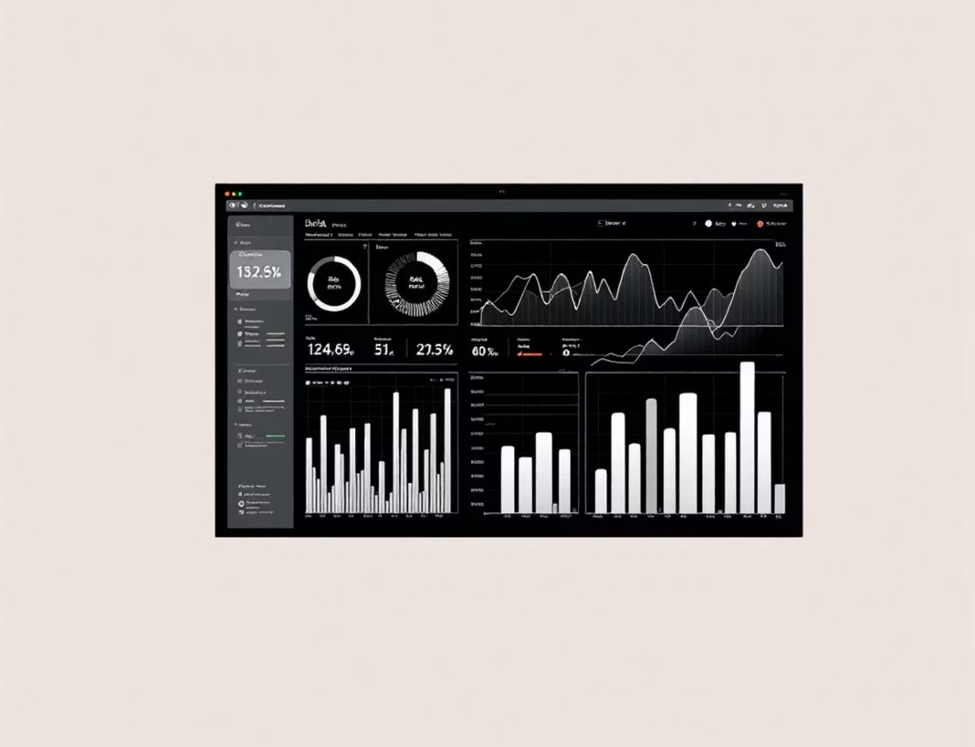

Project Overview: Understanding Digital Habits
Objective
To comprehensively analyse the screen-time habits of Indian children , segmenting by age groups, device types, and demographics. The ultimate goal is to build an interactive Power BI dashboard that reveals actionable insights into these patterns.
What This Project Covers
Data Cleaning & Feature Engineering (Python): Ensuring data quality and creating new, insightful features.
Visual Exploration: Conducting univariate and bivariate analyses to uncover initial trends.
Cohort & Segment Analysis: Deep diving into specific user groups based on shared characteristics. Seasonal/Habit Patterns: Identifying how screen time varies by day of the week or specific periods. Interactive Power BI Dashboard: Developing a three-page, dynamic report for easy exploration of insights.

Slide 3
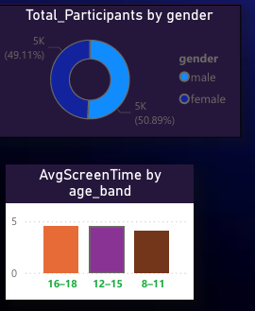
Dataset Description: The Foundation of Our Analysis
Dataset Columns (Key Features)
age, gender, urban_or_rural: Fundamental demographic and geographic identifiers.
primary_device, avg_daily_screen_time_hr: Capturing the main device used and average daily screen exposure in hours.
exceeded_recommended_limit: A binary indicator highlighting whether the child's screen time is above health guidelines.
educational_to_recreational_ratio: Quantifying the balance between learning and entertainment on screens.
screen_level, age_band, age_group: Derived features for granular segmentation and analysis.
Source: Indian Kids Screen Time Dataset (Cleaned using Python)

Slide 4
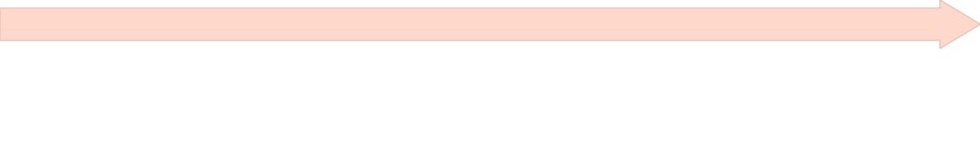


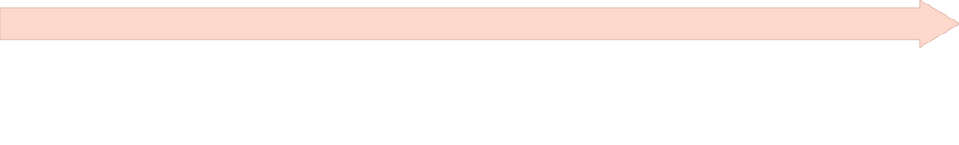
Methodology: End-to-End Analytics Pipeline
Step 2: Exploratory Data Analysis (EDA)
Utilised histograms, bar charts, and boxplots to understand data distributions. Performed cross-demographic comparisons to identify initial patterns and relationships.
Step 1: Data Preparation (Python)
Cleaned column names, handled missing values, and created new categorical columns such as 'age_band', 'screen_level', and 'age_group'. Normalized categories and meticulously checked data types for consistency.
Step 3: Cohort & Segment Analysis
Conducted in-depth analysis across age, device, and location. Employed heatmaps and stacked bar charts to visualise complex interactions and identify high-impact segments.
Step 4: Dashboard Development
Designed and developed a three-page interactive report in Power BI. Included dynamic filters for age, device, gender, and location to facilitate user-driven exploration.

Slide 5
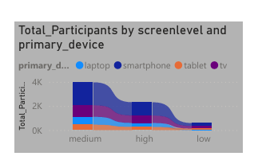
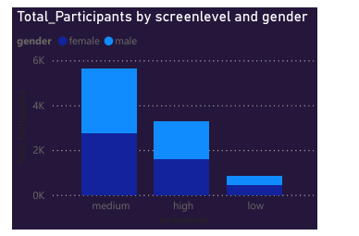
Key Visual Insights: Uncovering Usage Patterns
Univariate/Bivariate Findings
Screen Time Distribution: The overall screen time distribution exhibits a right-skew, indicating that a majority of children spend less time, with a long tail of higher usage.
Age and Usage: Teenagers (13–18 years) consistently demonstrate the highest screen usage among all age groups.
Dominant Device: Mobile phones emerge as the most prevalent and dominant device for screen-time consumption.
Comparisons
Gender Variance: Girls show a slightly lower variation in screen time compared to boys, suggesting more consistent usage patterns.
Urban vs. Rural: Children residing in urban areas spend significantly more time on screens than their rural counterparts.

Slide 6

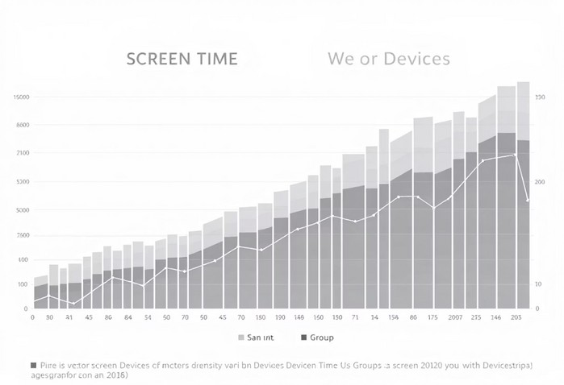
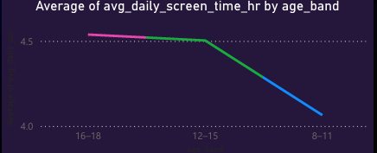
Cohort Insights: Deep Dive into User Segments
1
2
3
Top Screen-Time Cohorts
Urban Teens using Smartphones Rural Teens using Smartphones Urban Pre-Teens using Laptops
Heatmap Findings
Strong screen-time intensity for older age groups
Urban smartphone users show the highest cluster
Segment-Level Trends
Device usage differs heavily by location
Laptop users exhibit higher educational ratios

Slide 7
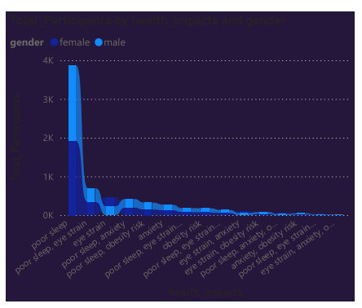
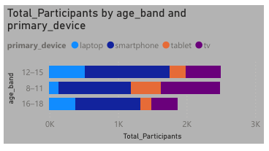
Habit & Seasonal Patterns: Understanding Usage Dynamics
Educational vs. Recreational Ratio
Teenagers: Show the lowest educational ratio, indicating a higher proportion of recreational screen time.
Young Children: Exhibit a more balanced ratio, suggesting a healthier mix of educational and recreational content.
Overall Pattern
A clear trend emerges: screen time increases significantly with age, and this tendency is markedly amplified during weekends. This suggests that discretionary time heavily influences screen usage habits.

Slide 8
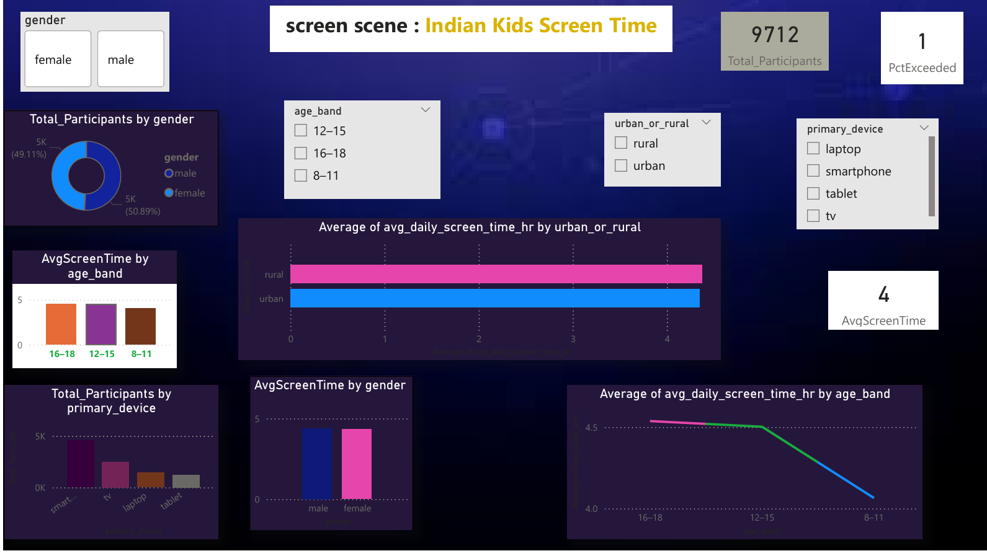
Power BI Dashboard Overview: Page 1 - Key Performance Indicators
Page 1: Overview & KPIs
Key Performance Indicators (KPIs)
Avg Daily Screen Time: The average hours children spend on screens daily.
% of Kids Exceeding Recommended Limit: The proportion of children whose screen time surpasses health guidelines.
Avg Educational Ratio: The average balance between educational and recreational screen usage.
Visuals
Screen Time Distribution: A histogram illustrating the frequency of different screen time durations.
Screen Time by Age Band: A bar chart breaking down usage across various age groups.
Screen Time by Gender & Location: Visualisations comparing usage patterns based on gender and whether children are in urban or rural areas.
Purpose
This page provides a high-level, immediate snapshot of screen-time severity and demographic variations, allowing for quick assessment of key trends.

Slide 9
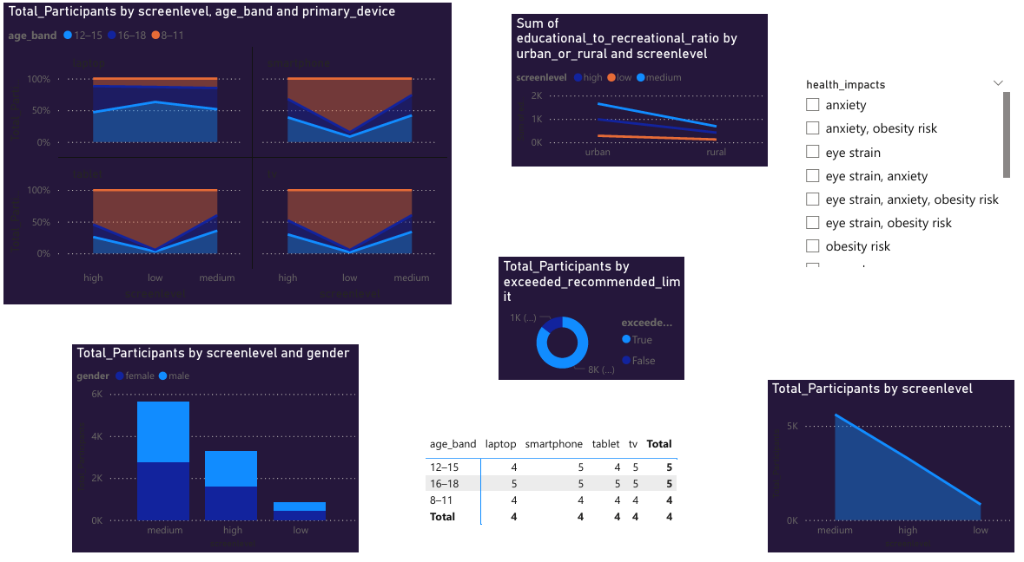
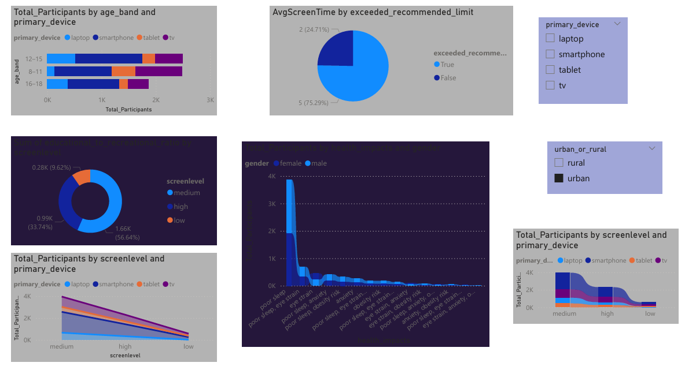
Power BI Dashboard: Pages 2 & 3 - Deep Dive into Patterns
Page 2: Device & Activity Patterns
Device Usage by Location: A stacked bar chart showing which devices are popular in urban versus rural settings.
Top Cohorts Heatmap: Visualising high-impact segments based on age, device, and location. Educational vs. Recreational Ratio Comparison: A visual breakdown of screen content type. Interactive Device Selector: Allows users to filter data by specific devices to explore usage nuances.
Page 3: Habit Patterns & Deep Insights
Weekday vs. Weekend Line Chart: Illustrates the variance in screen time between weekdays and weekends.
Age-Band Habit Heatmap: A detailed heatmap showing how habits change across different age groups.
High-Risk Cohort Identification: Highlights specific groups that are most susceptible to excessive screen time.
Dynamic Filters: Comprehensive filters for age, gender, device, and location to enable granular analysis.

Slide 10
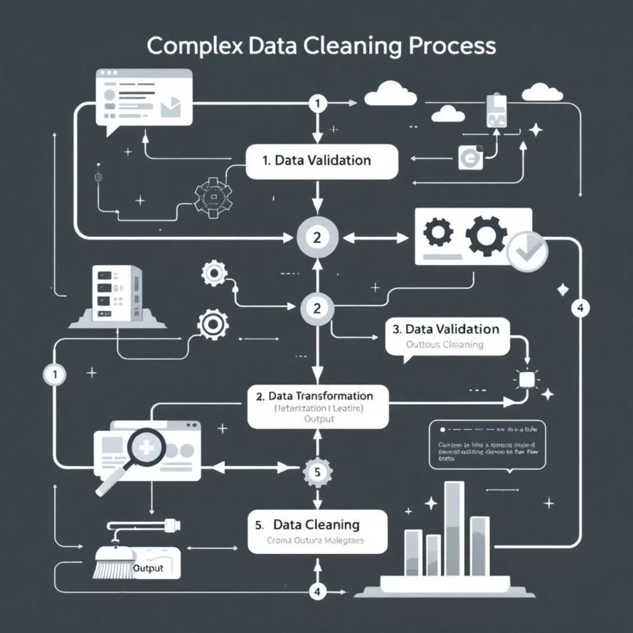

Challenges & Conclusion: Key Learnings and Impact
Challenges Faced
Data Cleaning & Standardisation: Overcoming inconsistencies and standardising diverse categorical data was a significant hurdle.
Visual Selection: Choosing the most appropriate and impactful visuals to effectively tell the story embedded in the data.
Dashboard Design: Creating an attractive, intuitive, and interactive dashboard that is both functional and aesthetically pleasing.
Cohort Identification: Defining and identifying meaningful cohort segments that provided actionable insights.
Conclusion
High-Risk Groups: Teenagers and urban populations exhibit the highest risk patterns for excessive screen time.
Device Dominance: Smartphones remain the primary driver of screen consumption across all segments.
Weekend Amplification: Weekend usage dramatically increases screen time, indicating a need for targeted interventions during leisure periods.
Empowering Stakeholders: The interactive dashboard serves as a vital tool, enabling stakeholders to proactively explore screen- time risks and patterns across various segments, supporting informed decision-making.

