Slide 1
ScreenSense: Kids’ Screentime Analysis
Presented By: Kshiti Gambhir Mentor: Sirisha Arangi

Slide 2
Project Overview
Aim: Analyze kids’ screentime patterns to uncover trends by age, gender, location type (urban/rural), device type, day-of-week, and activity category using data visualization. The goal is to present clear, actionable insights for parents, educators, and policymakers.
Dataset size: 9712 entries, 8 key attributes
Focus Variables:
'Age', 'Gender', 'Avg_Daily_Screen_Time_hr', 'Primary_Device', 'Exceeded_Recommended_Limit', 'Educational_to_Recreational_Ratio', 'Health_Impacts', 'Urban_or_Rural'

Slide 3
Milestone 1 – Data Cleaning & Preparation
Handled missing values using median imputation
Standardized categorical labels (e.g., Male/male → Male)
Removed duplicates & dropped unrealistic outliers (> 15 hrs/day)
Ensured consistent formatting (Date, text casing)
Output :
Dataset size: 9712 rows, 8 columns
Missing values detected in Age and Avg_Daily_Screen_Time_hr
Minor categorical inconsistencies like “male” and “Male” or “urban” and “Urban”
No date/time fields present

Slide 4
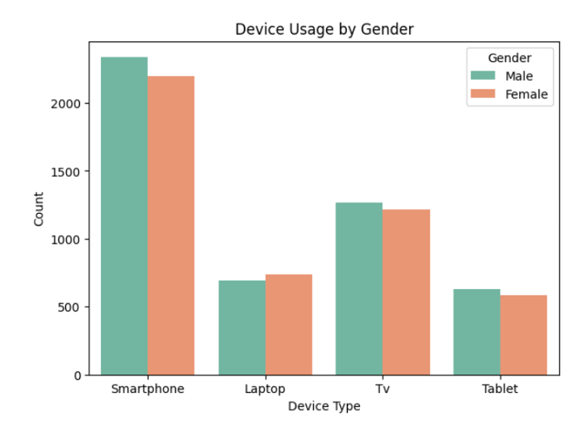
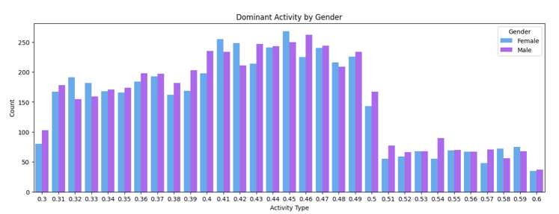
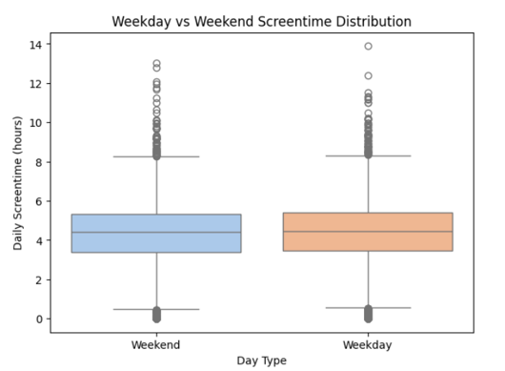
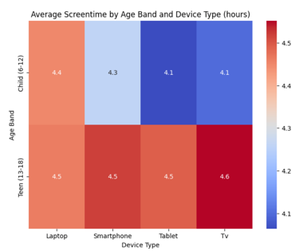
Milestone 2 – Exploratory Visual Analysis
Univariate visuals and Bivariate visuals created:

Slide 5
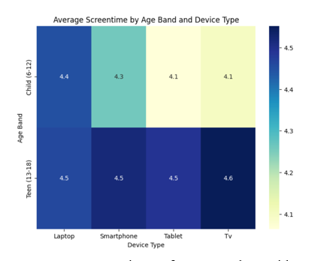
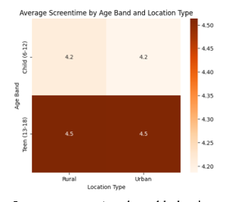
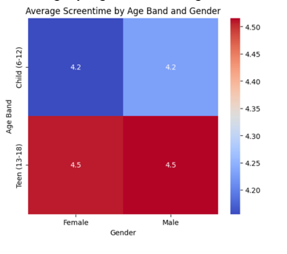
Created device usage comparison charts by gender
Compared daily screen-time distribution by age bands
Generated recreational vs educational ratio distributions
Observations:
Smartphone top device across both genders
Teens show highest average screen-time
Gender differences minimal, especially below age 12
Outcome: Core engagement pattern identified → teens highest exposure group.

Slide 6
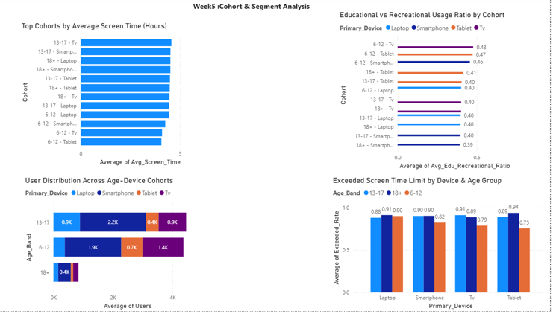
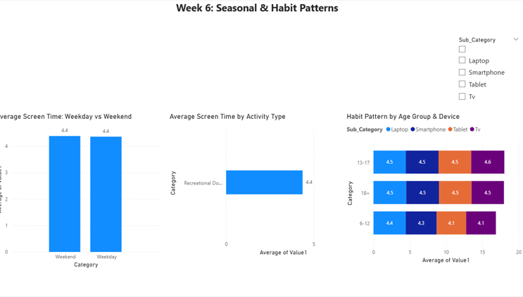
Milestone 3 – Segment Insights
Top screentime group:
Urban Kids & Teens (13–17 yrs)
Dominant device:
Smartphone
Dominant activity category:
Recreational, significantly higher than learning
Notable health impacts:
Poor Sleep, Eye Strain, Anxiety leading categories

Slide 7
Key Findings
Metric | Finding
Average Screentime | 4.37 hrs/day
Highest Screentime Group | Urban Teens
Top Device | Smartphone
Top Activity | Recreation
Health Impact | Poor sleep & eye strain dominate

Slide 8
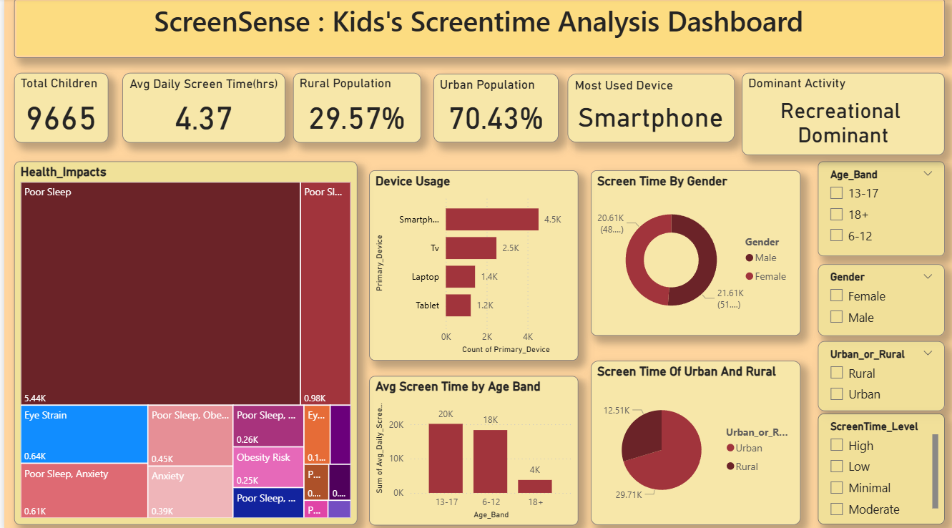

Slide 9
Impact & Conclusion
Provides visibility into early screen dependency
Supports digital well-being decisions for children
Helps parents monitor device exposure
Enables educators to adjust digital learning load
Highlights need for balanced recreation & education

